Slide 1
Statistics and Experimental Design Introduction and Key Terms

Slide 2
Today
Review Syllabus
Answer questions that you have about video lectures
Exercises and group work (e.g., Let’s Make a Deal)

Slide 3
Learning goals
What you will learn:
How to calculate statistical procedures
By Hand
Using computer software
The statistical theory behind these procedures
How to analyze, interpret and report scientific data
To be an informed consumer of statistical claims

Slide 4
Syllabus
Attendance: Super important
Stats is not intuitive for many/most folks
Readings
Clarify links between this class and the rest of the Psych curriculum
We want you to read the results section!

Slide 5
Prepping for a typical day
Watch video lectures
Most videos less than 10 minutes
Most days 30 minutes or less
Slides
The ones I use to build the video lectures
Checks
To keep you honest
To help you recognize if you have questions

Slide 6
Assessments
Weekly problem sets
Shorter but more frequent than the old days
Exams
Four exams
Shorter but more frequent than the old days
Less onerous prep
Allow us to do them in class
But still thinking this through
Lower stakes (esp. Exam #1)
Final
data analysis project

Slide 7
Syllabus overview
Come to EVERY class
One Quiz and Two Cumulative Exams Four Exams
Homework Weekly Problem Sets
Labs
Final project Final data analysis project
Buy a calculator (phones are ok)
Practice, come to office hours, visit TA, ASK QUESTIONS!

Slide 8
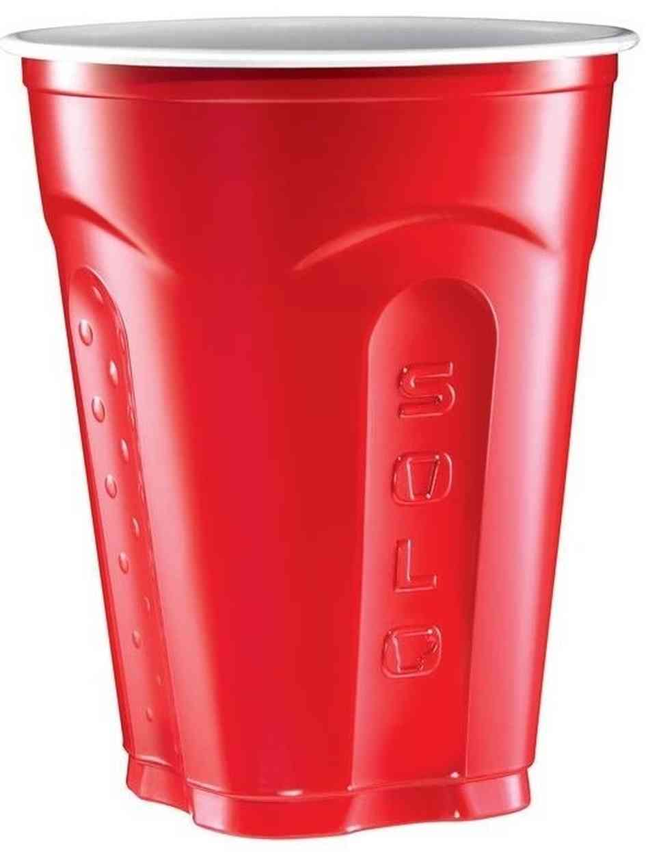
Monty Hall Problem: Let’s Make a Deal! Why do we need stats anyway?

Slide 9
Monty Hall Problem: Let’s Make a Deal! Why do we need stats anyway?
1
2
3

Slide 10
The Game
I hide a piece of candy under one of the cups
You pick one of the cups.
I’ll turn over one of the remaining cups (it will not have the piece of candy).
Then comes the moment of truth: I’ll offer you the opportunity to
STAY with your original choice
SWITCH your choice for the other cup.
If the candy is under the cup you end up with, you can have it. If the cup you chose is empty, you lose.
Big Question: Should you STAY with your original choice or should you SWITCH for the other cup?

Slide 11
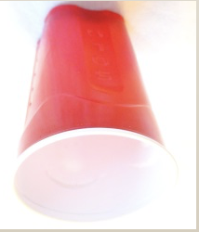
Stay or Switch? View #1: there are 2 possible outcomes
You Pick
Win if STAY
I Show you
OR
Lose if STAY
I Show you

Slide 12
View #2: there are 3 possible outcomes
You Pick
(Or I could show this one)
Win if STAY
I Show you
OR
Lose if
STAY
I Show you
OR
Lose if STAY
I Show you

Slide 13
Data collection – Table by Table
 | STAY | SWITCH
WIN
LOSE
Notes:
Have them do it table-by-table in class.
So which assumption do the data favor?

Slide 14
View 1
 | STAY | SWITCH
WIN | .50 | .50
LOSE | .50 | .50
View 2
 | STAY | SWITCH
WIN | .33 | .66
LOSE | .66 | .33
Notes:
So which assumption do the data favor?

Slide 15
Monty Hall Simulator
Simulator
Notes:
https://www.mathwarehouse.com/monty-hall-simulation-online/

Slide 16
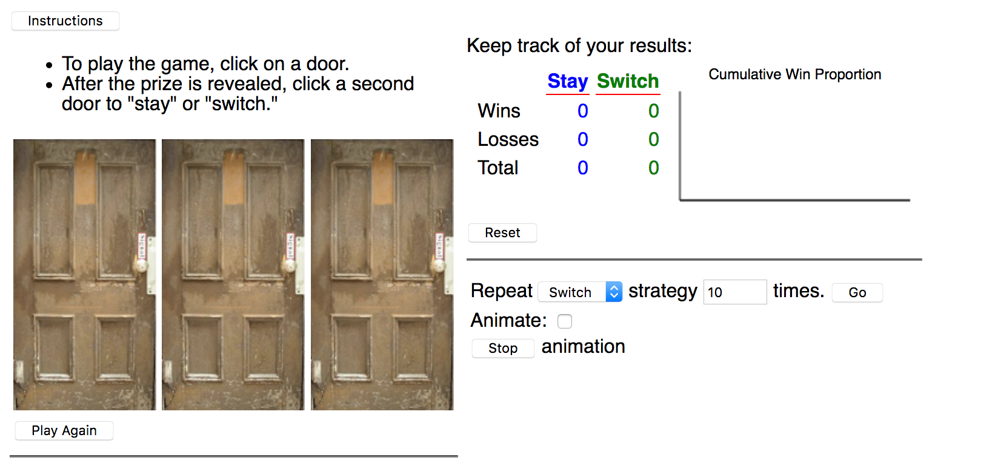
Monty Hall Simulator
Simulator
Notes:
http://www.rossmanchance.com/applets/2021/montyhall/Monty.html

Slide 17
View 1
 | STAY | SWITCH
WIN | .50 | .50
LOSE | .50 | .50
View 2
 | STAY | SWITCH
WIN | .33 | .66
LOSE | .66 | .33
Notes:
So which assumption do the data favor?

Slide 18
TRUTH
 | STAY | SWITCH
WIN | .33 | .66
LOSE | .66 | .33
Notes:
So which assumption do the data favor?

Slide 19
Intro / Key Terms
Questions about the video lectures
Notes:
Can I have a volunteer to explain who FantasyFootball works

Slide 20
Sampling error
What is sampling error?
How does it fit within the practice of statistics?

Slide 21
Sampling error: hours of sleep
With other folks at your table:
Say hello
Say your name
Say: Hello <insert name>. Nice to meet you!
Find the average number of hours of sleep for your table
Population = this class
Sample = your group

Slide 22
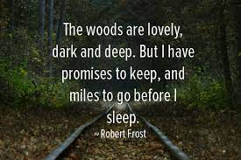
Sampling error: Miles to go before I sleep
With other folks at your table:
Say hello
Say your name
Say: Hello <insert name>. Nice to meet you!
Find the average distance home from Amherst for your table (use the google maps)
Population = this class
Sample = your group

Slide 23
Two different kinds of statistics:
1. Descriptive Statistics - numerical and graphical methods for analyzing patterns within a data set; used to summarize information contained within a data set and present it to an audience.
2. Inferential Statistics - the use of sample information (i.e., descriptive statistics) to make estimates, decisions, predictions and/or other generalizations about the population from which they were drawn.

Slide 24
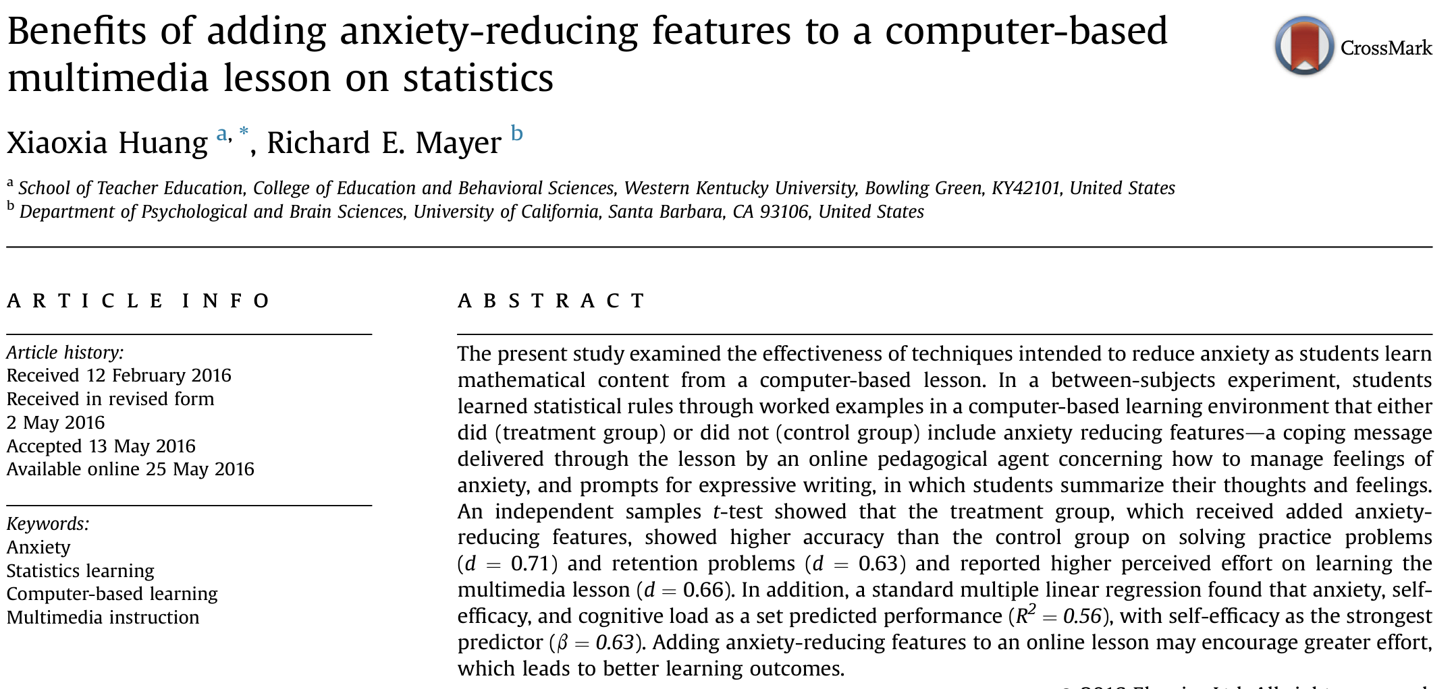
Real world Example:

Slide 25
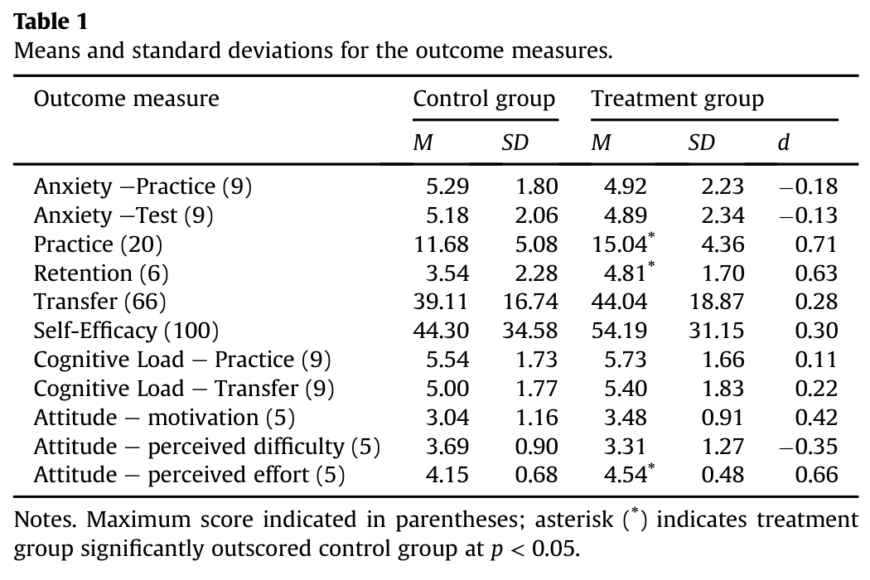
Real world Example:

Slide 26
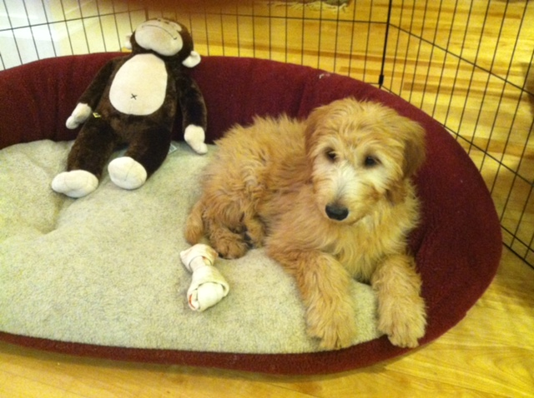
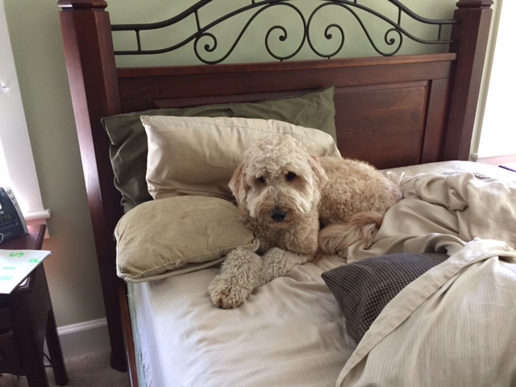
Design an experiment: Does pet ownership reduce stress?

Slide 27
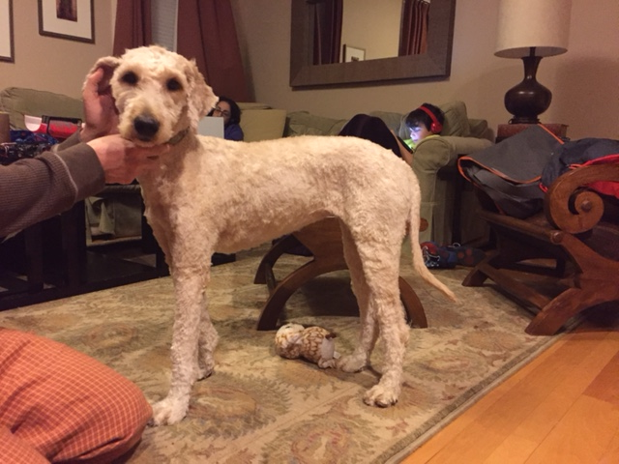
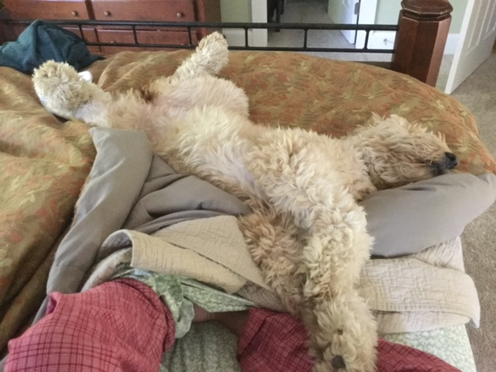
Design an experiment: Does pet ownership reduce stress?

Slide 28
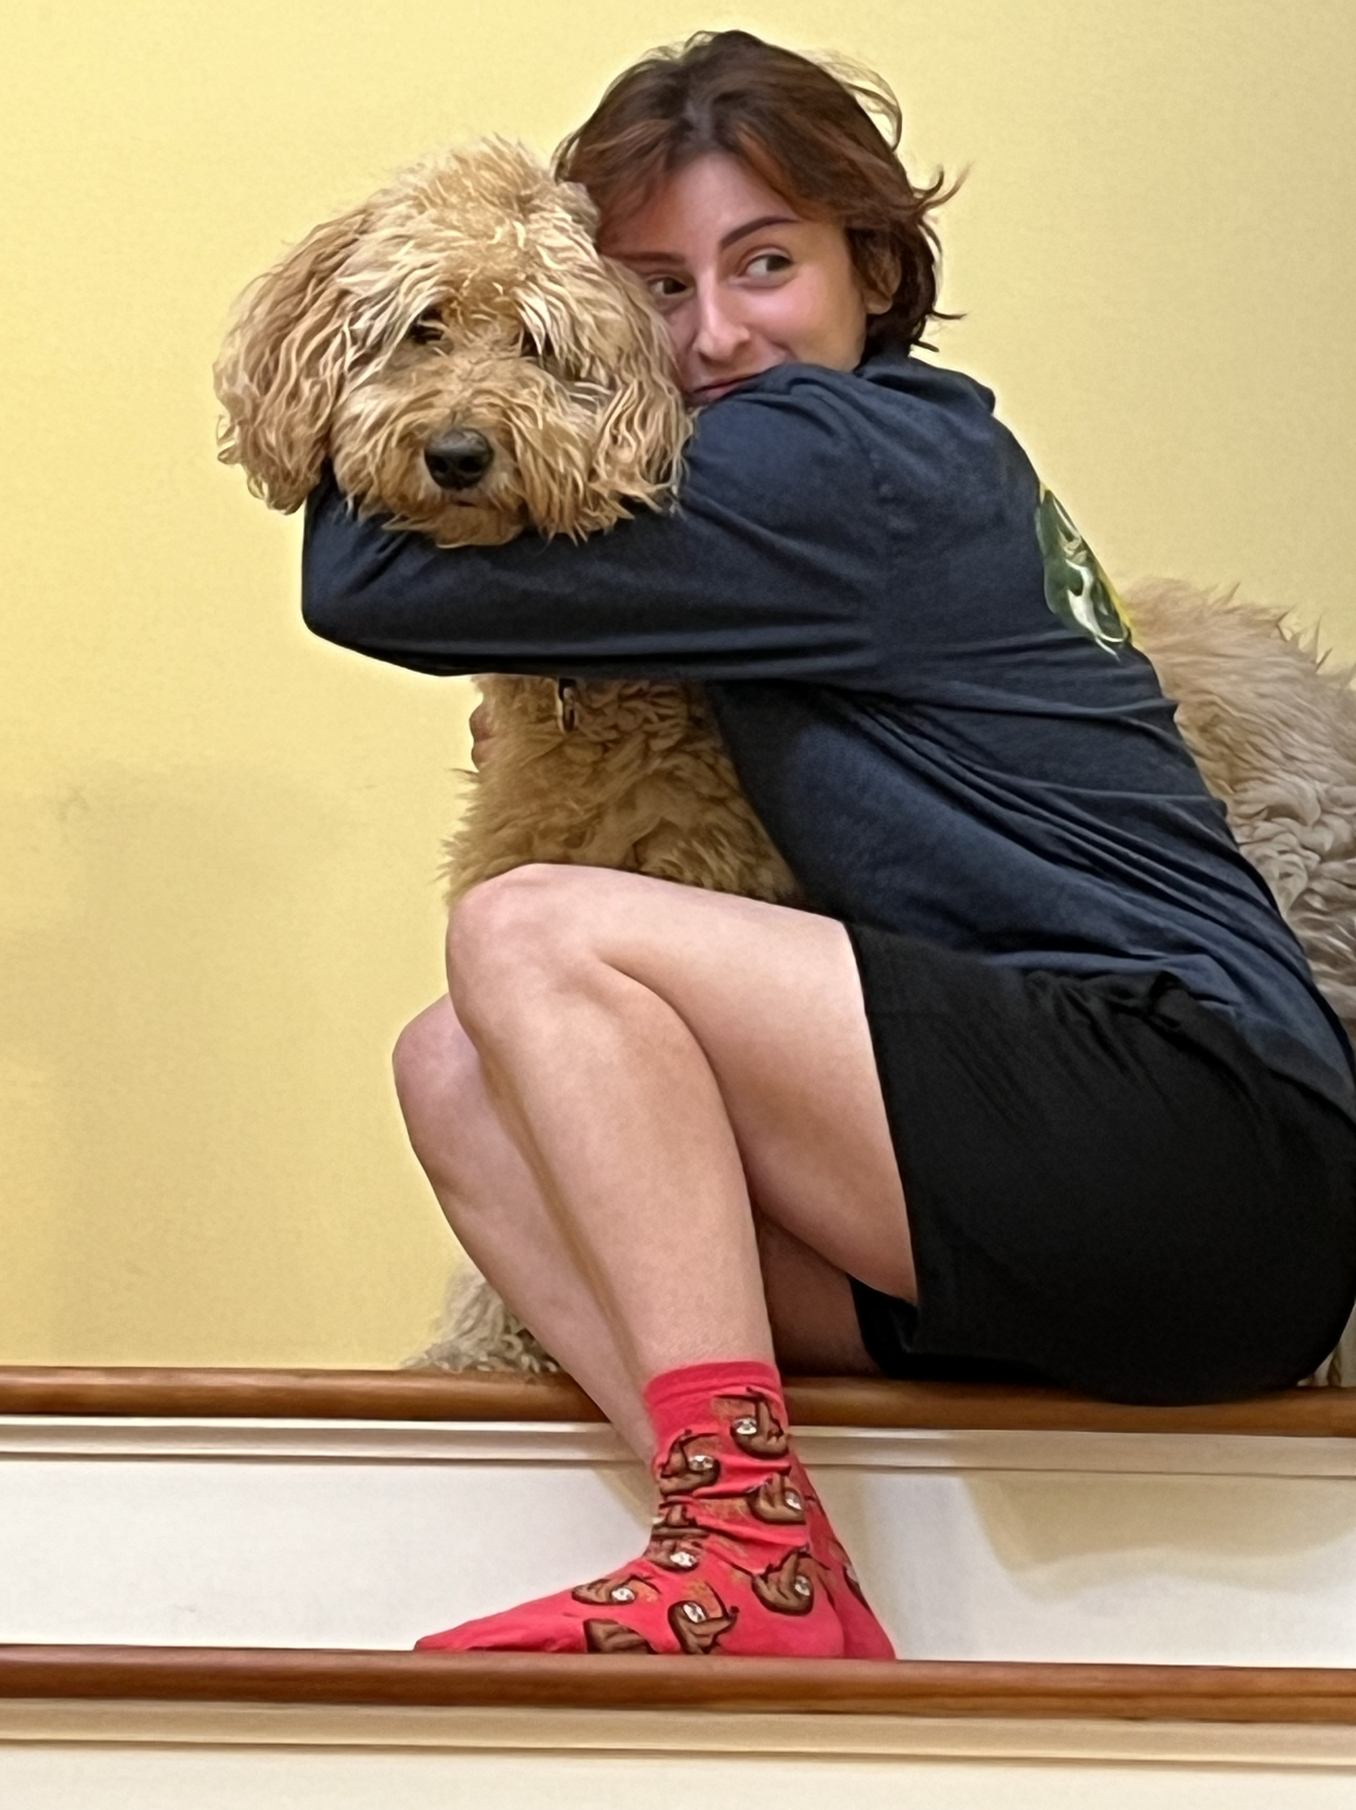
Design a study: Does pet ownership reduce stress?
Questions:
Is your study observational or experimental?
What is/are your independent variable(s)?
What is/are your dependent variable(s)?
What was the operational definition for each IV/DV?
What are some potential confounding variables?

Slide 29
Crash course in notation
N (or n) = number of subjects in the population (or sample)
X = scores for a particular variable
Y = scores for another variable
Example:
N = 23, n=6
hours of sleep = X
Anxiety about course = Y
X | Y
8 | 1
5 | 3
0 | 1
6 | 2
9 | 1
7 | 4

Slide 30
Crash course in notation
∑ (called sigma) = summation (“sum of the scores”)
Simple Example:
∑ X = 8+5+0+6+9+7
∑ X = 35
X | Y
8 | 1
5 | 3
0 | 1
6 | 2
9 | 1
7 | 4

Slide 31
Crash course in notation
∑ (called sigma) = summation (“sum of the scores”)
Little more complicated:
∑ (X-1)² = 49+16+1+26+64+36
=191
X | (X-1)²
8 | (8-1)² | =49
5 | (5-1)² | =16
0 | (0-1)² | =1
6 | (6-1)² | =25
9 | (9-1)² | =64
7 | (7-1)² | =36

Slide 32
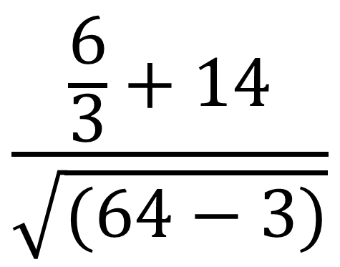
“Please excuse my dear Aunt sally” -- PEMDAS
Order of computation:
Parentheses (X-1)
Exponents X²$or \sqrt{X}$
Multiply or Divide
Add or Subtract

Slide 33
Order of Operations practice
${\left(3+2\right)}^{2}−7=$
${\left(6\right)}^{2}−2\left(5+1+3\right)=$
${\left(4∗2\right)}^{2}−{\left(2∗2\right)}^{2}=$
$\sum{x−4};for x=1 to 10$
$\sum{{\left(2x\right)}^{2}−\sum{2x^{2}}};for x=1 to 5$
$\sum{x^{2}−\frac{{\sum{x}}^{2}}{n}};for x=1 to 5$

Slide 34
Order of Operations practice
18
$18$
$48$
11
110
$10$
${\left(3+2\right)}^{2}−7=$
${\left(6\right)}^{2}−2\left(5+1+3\right)=$
${\left(4∗2\right)}^{2}−{\left(2∗2\right)}^{2}=$
$\sum{x−4};for x=1 to 10=$
$\sum{{\left(2x\right)}^{2}−\sum{2x^{2}}};for x=1 to 5$ =
$\sum{x^{2}−\frac{{\sum{x}}^{2}}{n}};for x=1 to 5$ =

