Slide 1
Descriptive Statistics
Psyc 122 – Statistics and Experimental Design

Slide 2
Today
Qualtrics Survey
Answer questions about the video lectures/check
Exercises
Mean, Median, Mode
What are they good for?
Means by group

Slide 3
You will be taking a survey
Do independently
Be honest
Be QUIET!
Not everyone will be working on exactly the same task so try to be focused on your own task.
When I say begin:
Enter password:
Think carefully during the ‘thinking’ period.
Answer the final questions
You will have the option of excluding your data from the the final dataset at the end if you wish.
122rules

Slide 4
Descriptive Statistics
Questions about the video lectures

Slide 5
Finding the Mean, Median, and Mode
Go to Amazon.com or any commercial site of your choosing.
Key point: the site must include customer reviews, so you could choose a recipe on a cooking site if you choose.
Find the Mean, median, and mode of the customer reviews for your ranking.
Note: the mean will likely already be there, but I want you to calculate the mean
Share via Product Ratings google sheet:
Product
Screen shot of your ‘data’
Mean, Median, and Mode

Slide 6
Downloading a dataset
Go to the course schedule page
Find the In Class Files column/label
Click the link that says GHR.sav
Probably have to download first
Fire up SPSS
Then Open the data file.
Notes:
Can I have a volunteer to explain who FantasyFootball works

Slide 7
Finding Mean, Median, Mode
SPSS will do this kind of thing for you
Let me show you…Happiness!!!!
Mean, Median, Mode
Analyze → Descriptive Statistics → Frequencies
Click Statistics
Select Mean, Median, and Mode

Slide 8
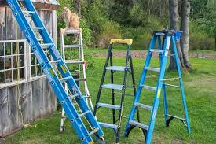
Finding MCTs with SPSS
Now, let’s you try it.
Go to the course web page.
Download the dataset called: Ladder.sav
These are the data we collected earlier today
I feverishly put into an SPSS file while you fiddled around with Amazon.
Find the MCTs for the class’ happiness data.

Slide 9
Wait, you look unhappy…
Wait…WHAT?!?!?
Ok…sorry. I gotta calm down.
You’re saying: wasn’t the point of the demo to figure out if the thinking exercise affected happiness ratings?
Yeah, yeah, I guess it was.
So, we should probably find the happiness ratings for each group separately. If only we could…

Slide 10
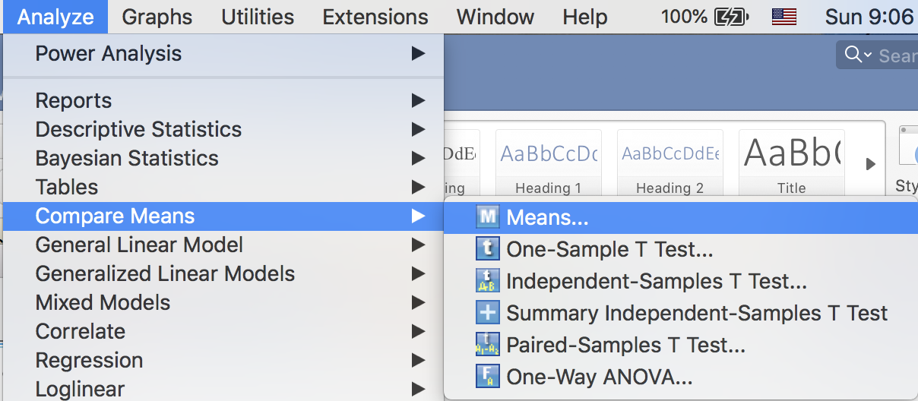
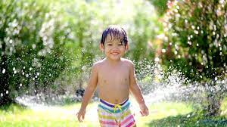
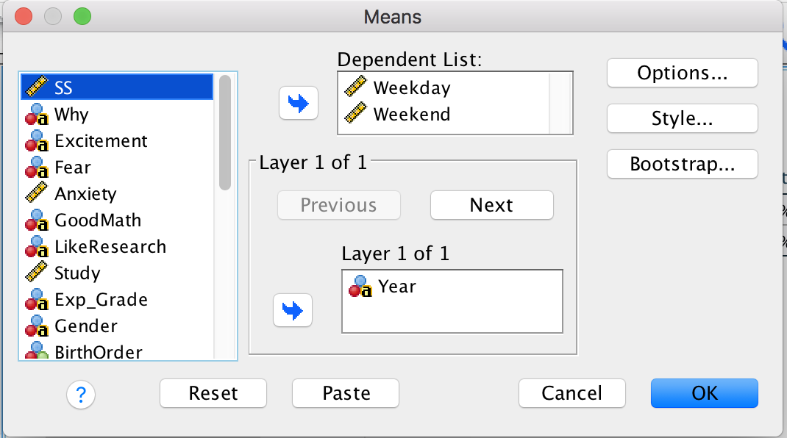
We CAN!!!!
What if you want to compare the means for different groups?
Analyze → Compare Means→ Means
Slide your DV(s) into the Dependent List box.
Slide your IV(s) into the Layer box.

