Slide 1
Variability
Psyc 122 – Statistics and Experimental Design

Slide 2
Today
Why do we care about variability?
Answer questions about variability
Practice some calculations.
By hand and using SPSS

Slide 3
Variability
Questions about the video lectures
Notes:
Can I have a volunteer to explain who FantasyFootball works

Slide 4
Definition of Variability
Variability: a quantitative measure of how much scores vary in a distribution. Describes the degree to which scores spread out or cluster together.
Examples:
What are some examples of high and low variability behaviors in your peer group?
Notes:
Getting a 1600 on the SAT….not a rare event at Amherst…a rare event on many other campuses.

Slide 5
Why do we care about variability?
Rare Event Approach
Experimenter makes a hypothesis about the frequency distribution of a given population.
Collects a sample of data from that population
Decides how likely it is that the sample came from the hypothesized distribution

Slide 6
Why does variability matter for the Rare event Approach?
Because variability is important for determining the magnitude of the effect
Hours of sleep vs. miles from home
SAT vs. ACT
Waiting for a train/friend

Slide 7
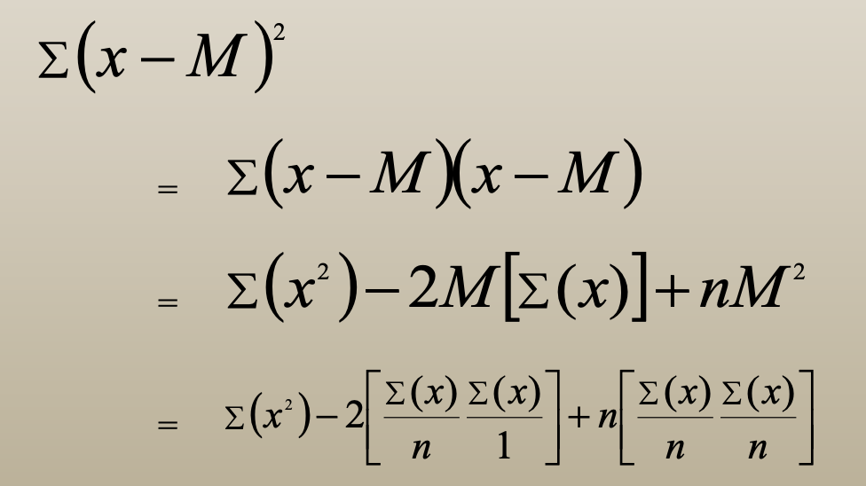
Is the shortcut formula equal to the standard formula?

Slide 8
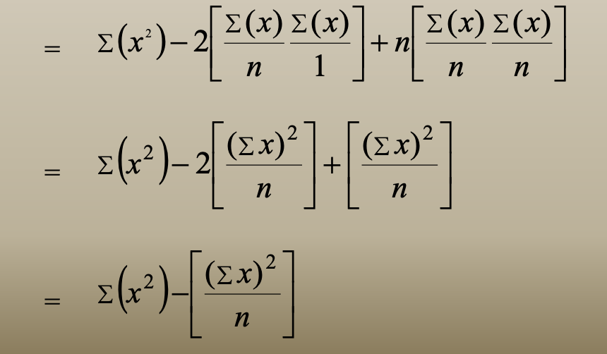
Is the shortcut formula equal to the standard formula?

Slide 9
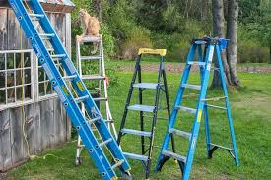
Calculations by Hand
Open the ladder data set
Calculate the standard deviation for your assigned condition (e.g., gratitude; humor; daily routine).

Slide 10
Choosing the best product
Let’s choose a product category.
Then each group will choose a product from within that category.
Find the mean for your product (given).
Calculate the standard deviation.
Then, we’ll try to figure out which product we should buy on the basis of the data.

Slide 11
Finding Standard Deviation
SPSS will do this kind of thing for you
Let me show you…Sleep!!!!
Mean, Median, Mode, SD, Variance
Analyze → Descriptive Statistics → Frequencies
Click Statistics
Select Standard Deviation (and anything else you would like)
Greater variability for WeekEnd or WeekDay?

Slide 12
Your Turn
Use SPSS to find the variance and standard deviation for the ladder data; separately for each condition.
Then, use SPSS to find the variance and standard deviation for the WHR data.
Which data set demonstrated greater variability?
Why do you think this pattern was observed?

Slide 13
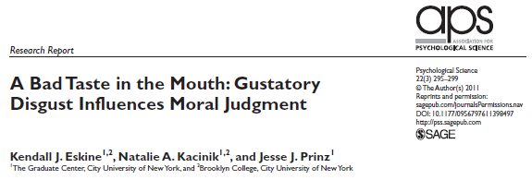

Slide 14
Research on Moral Judgements
Evidence of association between physical disgust and moral disgust
Clean scent →
Recalling own immoral actions →
Fart spray →
Brain regions activated
more charity and reciprocity
greater need for physical cleansing
harsher moral judgments
Similar for disgust and moral judgements

Slide 15
Eskine et al.,’s (2011) study
What was the goal of their study?
How did they manipulate physical disgust?
What was their dependent variable?
What were their two independent variables?

Slide 16
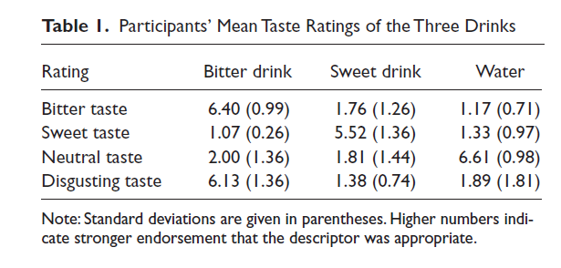
Results: Taste Ratings

Slide 17
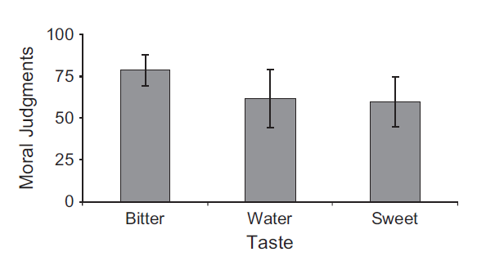
Primary Results

Slide 18
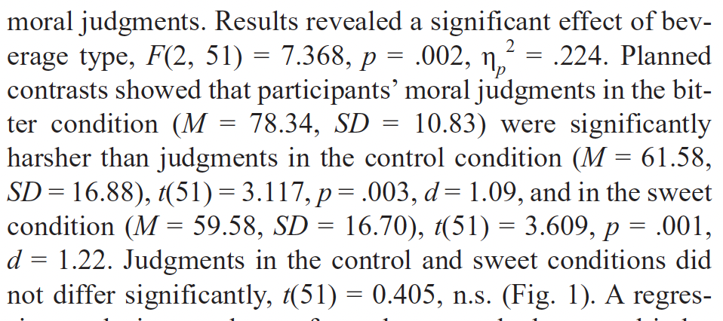
Primary Results

Slide 19
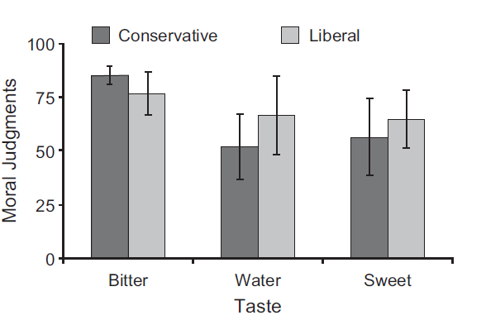
Primary Results

Slide 20
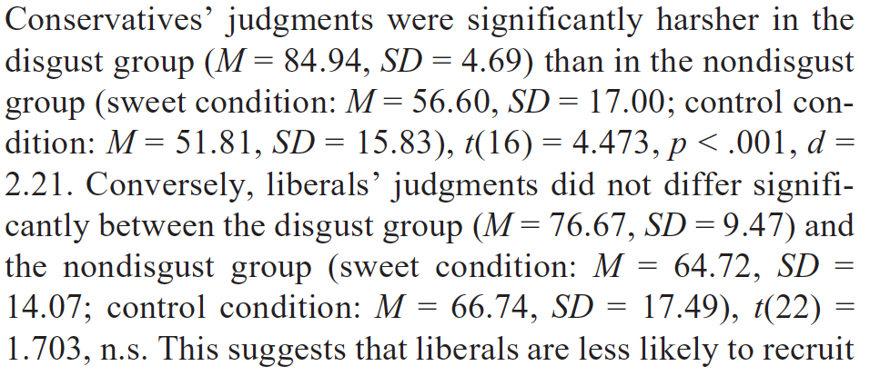
Primary Results

