Slide 1
Z-sc0res and Probability
Psyc 122 – Statistics and Experimental Design

Slide 2
Z-Scores
Questions about the video lectures
What are z-scores?
What does standardized mean?
What do they tell us?
Do y’all have questions?
How do Z-scores relate to the rare event approach?
Fun with Z-score calculations1!

Slide 3
Re-cap: what z-scores can do
Tell us the distance of a score from the mean in SD units
Compare scores from different distributions
Standardize an entire distribution
Use to transform scores into a distribution with a specific M and SD
Tell us the probability of obtaining certain scores (more to come on this!)

Slide 4
Using Z-scores to assess relative Standing
Choose a country…any country.
Calculate the z-score for that country
1st step: figure out the mean and SD for the data.
Use the z-score to calculate the percentile rank for your country.
Compare the percentile rank that you calculated with the actual percentile rank.
Hint: Use the rank by the number of countries in the dataset.
Notes:
Take a few minutes to strategize and then we’ll discuss

Slide 5
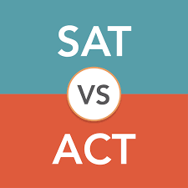
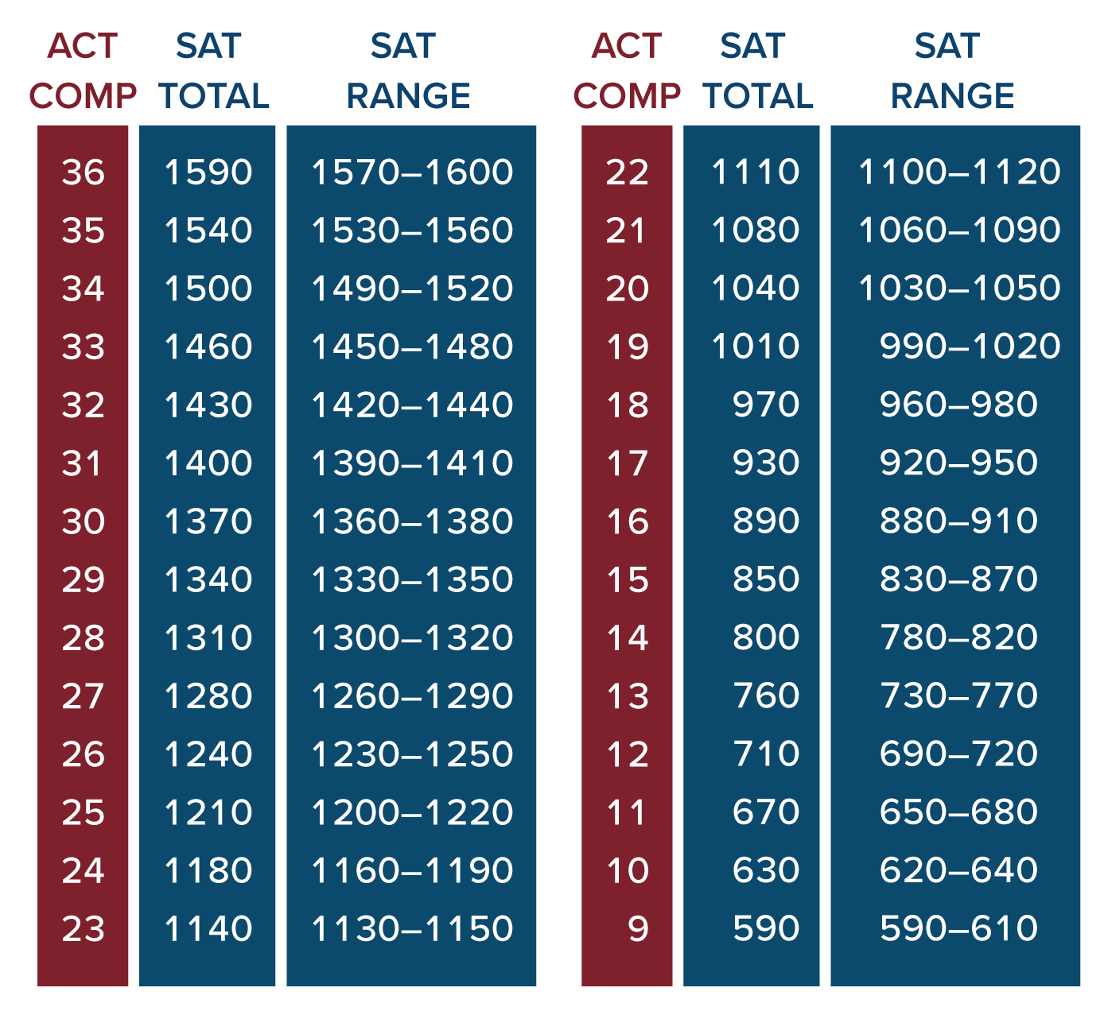
Z-scores as Standard Scores
Notes:
Take a few minutes to strategize and then we’ll discuss

Slide 6
Z-scores as Standard Scores
Let’s check their math.
Everyone grab a marker.
Head to a whiteboard and clearly write:
Your name.
Your best SAT or ACT score.
No cheating. Your ACTUAL SAT or ACT score.
Go!
Notes:
Take a few minutes to strategize and then we’ll discuss

Slide 7
Z-scores as Standard Scores
But for realz…
Standard scores are valuable.
Many factors influence data in World Happiness Dataset:
Economy
Corruption
Freedom
How can we decide which are most/least important?
Have to standardize/put factors on a common number line.
Notes:
Take a few minutes to strategize and then we’ll discuss

Slide 8
Z-scores as Standard Scores
Let’s look at a real example.
Fill out the Vals google form.
What is the best predictor of Vals satisfaction?
Let’s fiddle around some with the data.
Notes:
Take a few minutes to strategize and then we’ll discuss

Slide 9
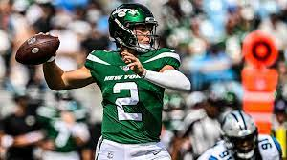
Z-scores as Standard Scores
Who was the most valuable player in FF last year?
What was the most valuable position?
But, who was the most valuable player relative to their position?

Slide 10
Z-scores as Standard Scores
Who was the most valuable player in FF last year?
What was the most valuable position?
But, who was the most valuable player relative to their position?

Slide 11
Z-scores as Standard Scores
Position | Player | Points | Mean | SD
QB | Mahomes | 428.4 | 201.0 | 103.4
RB | Jacobs | 275.3 | 128.2 | 62.6
WR | Jefferson | 240.7 | 100.0 | 46.7
TE | Kelce | 206.3 | 81.6 | 33.8
DST | Cheaters | 186.0 | 117.1 | 25.5
K | Tucker | 164.0 | 128.4 | 23.0

Slide 12
Z-scores as Standard Scores
Position | Player | Points | Mean | SD | Z-score
QB | Mahomes | 428.4 | 201.0 | 103.4 | 2.20
RB | Jacobs | 275.3 | 128.2 | 62.6 | 2.35
WR | Jefferson | 240.7 | 100.0 | 46.7 | 3.01
TE | Kelce | 206.3 | 81.6 | 33.8 | 3.69
DST | Cheaters | 186.0 | 117.1 | 25.5 | 2.70
K | Tucker | 164.0 | 128.4 | 23.0 | 1.55

Slide 13
Looking ahead to inferential statistics
The Original Whole Population
T
R
E
A
T
M
E
N
T
Is the treated sample noticeably different from the population?
Sample
Treated Sample

Slide 14
The effect of growth hormones
Adult Rats
μ = 400g
σ = 20g
H
O
R
M
O
N
E
Is the treated sample noticeably different from the population?
Sample of Adult Rats
Treated Sample of Rats

Slide 15
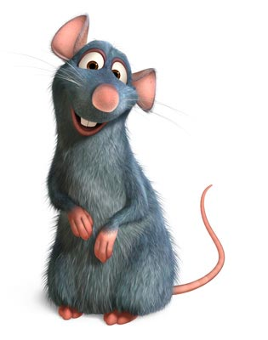
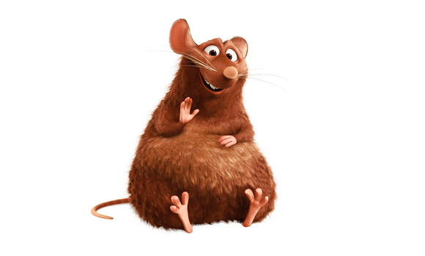
Treated rat: 418g
μ = 400g
σ = 20g
Would we expect to get a rat this heavy from the population of Adult rats?
Treated rat: 450g
Would we expect to get a rat this heavy from the population of Adult rats?

Slide 16
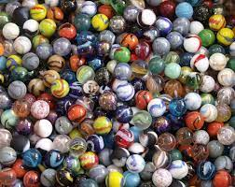
Using Z-scores to draw inferences
Each table has a bag o’ marbles that contains an equal number of light and dark marbles.
Take turns pulling one marble out of the bag.
Record whether your marble is light or dark; then return the marble to the bag and Shake It UP!
Continue the process until you have drawn a total of 12 marbles.
Notes:
Take a few minutes to strategize and then we’ll discuss

Slide 17
Using Z-scores to draw inferences
Then calculate a z-score to determine the probability that you would get X light/dark marbles out of 12.
Here is some helpful information:
The mean of the population: $μ$= 6.
The standard deviation of the population $σ$ = 1.73.
And of course:
$$z=\frac{X− μ}{σ}$$
Notes:
Take a few minutes to strategize and then we’ll discuss

Slide 18
Using Z-scores to draw inferences
Notes:
Take a few minutes to strategize and then we’ll discuss

Slide 19
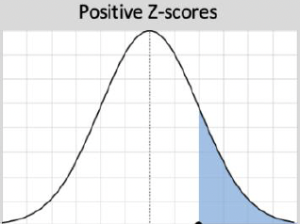
Using Z-scores to draw inferences
Light | Dark | Z-score | Probability
0/12 | 12/0 | 3.46 | 0.0003
1/11 | 11/1 | 2.89 | 0.0019
2/10 | 10/2 | 2.31 | 0.0104
3/9 | 9/3 | 1.73 | 0.0418
4/8 | 8/4 | 1.15 | 0.1251
5/7 | 7/7 | 0.58 | 0.2810
6 | 6 | 0.00 | 0.5000
Notes:
Take a few minutes to strategize and then we’ll discuss

