Slide 1
Central limit theorem
Asps. Very Dangerous. You go first.

Slide 2
CLT
Questions about the video lectures

Slide 3
Please define the three types of distributions that we have spoken about thus far?
Population distribution:
Sample distribution:
Sampling Distribution:

Slide 4
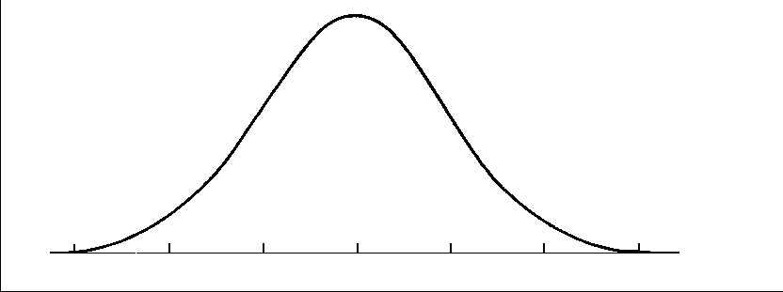
Three types of distributions: don’t mix them up!
Population distribution: scores of all individuals in a population
Sample distribution: scores of individuals in a single sample
Sampling Distribution: means of samples randomly selected from a population

Slide 5
What makes for a good estimator?
Unbiased
Mean of the sampling distribution will be equal to µ
We don’t want to over/underestimate µ
Low variability
Ensures the estimate will be as close as possible to µ
Estimate will be as reliable as possible.

Slide 6
Let’s Make our own sampling distribution
Arrange yourselves (I’ll help) into groups of 5 peoples.
Choose a Table Name.
Enter the number of siblings for each person in your group onto the google sheet that I shared with you (class files website).
Calculate the mean for every possible sample of n=3.
Calculate the mean and the standard deviation for your set of 10 sample means.
(you can use SPSS if you want)

Slide 7
Let’s Make our own sampling distribution
What is the relationship between the population mean and the average of the means?
What is the relationship between the population standard deviation and the standard deviation of the sample distribution…a/k/a…the standard devation of the sample means…a/k/a…the standard error?
Is this what the CLT predicts?

Slide 8
CLT in Action: # of Heads: 2 flips

Slide 9
CLT in Action: # of Heads – 3 flips

Slide 10
CLT in Action: # of Heads – 5 flips

Slide 11
CLT in Action: # of Heads – 10 flips

Slide 12
CLT in Action: # of Heads – 20 flips

Slide 13
CLT in Action: # of Heads – 30 flips

Slide 14
CLT in Action: # of Heads – 50 flips

Slide 15
CLT in Action: # of Heads – 100 flips

Slide 16
CLT in Action: # of Heads – 500 flips

Slide 17
Looking ahead to inferential statistics
Adult Rats
μ = 400g
σ = 20g
H
O
R
M
O
N
E
Is the treated sample noticeably different from the population?
Sample of Adult Rats
n= 25
Treated Sample of Rats
n= 25

Slide 18
Looking ahead to inferential statistics
Distribution of sample means for untreated adult rats:
μ =400, $σ=20$
Central Limit Theorem Tells us:
Expected sample mean = 400g
$standard error of mean σM= \frac{σx}{\sqrt{n}}$ = $\frac{20}{\sqrt{25}}$ = 4
What is the middle 95% of sample means?
$X=\text{μ}+z \left(SE\right)$
$X=\text{400}+1.96 \left(4\right)$ = 407.8
$X=\text{400}+−1.96 \left(4\right)$ = 392.2
There is a 95% chance that the sample mean weight should be between 392.2 and 407.8

Slide 19
Is my sample representative of the population?
Open the World Happiness Data file.
Choose a subset of 8 countries.
Any 8 you choose for any reason.
Figure out the probability of obtaining a sample at least as extreme as yours.
What will you need to do that?

Slide 20
Is my sample representative of the population?
You will need the mean from your sample.
You will need µ (i.e., the mean of the population).
You will need $σ$ (i.e., the standard deviation of the population.
And….you will need this formula:
And you’ll also need the z-table, once you calculate Z.
When you are done, enter the relevant information into the Google Sheet.
P(z ≤ [M-μ] / [σ/√n])

