Slide 1
Confidence Intervals
And the day came when the risk it took to remain tight inside the bud was more painful than the risk it took to blossom. -Anais Nin, writer (1903-1977)

Slide 2
Musical Statistical Chairs Everything you remember, but much less fun!!! And no prizes….
Everybody stand UP!!! And move to the edge of the room.
I need a volunteer.
Find a seat – ANY SEAT – and sit in it.
I need a second volunteer.
Find a seat – ANY SEAT – as long as no one is already sitting at that table.
Don’t be afraid of your freedom!!!

Slide 3
CI Questions

Slide 4
Key Questions
What is a CI?
Why do we need Cis? Why can’t we just figure out what μ is and be done with it?
What is the central tradeoff of Cis (e.g., the width vs. confidence tradeoff)?
How do we know that there is a 90% chance that M is within 2 standard errors of μ (Hint: think social distancing in the COVIDs era)?
What does this beautifully colored figure represent about the 90% CI?

Slide 5
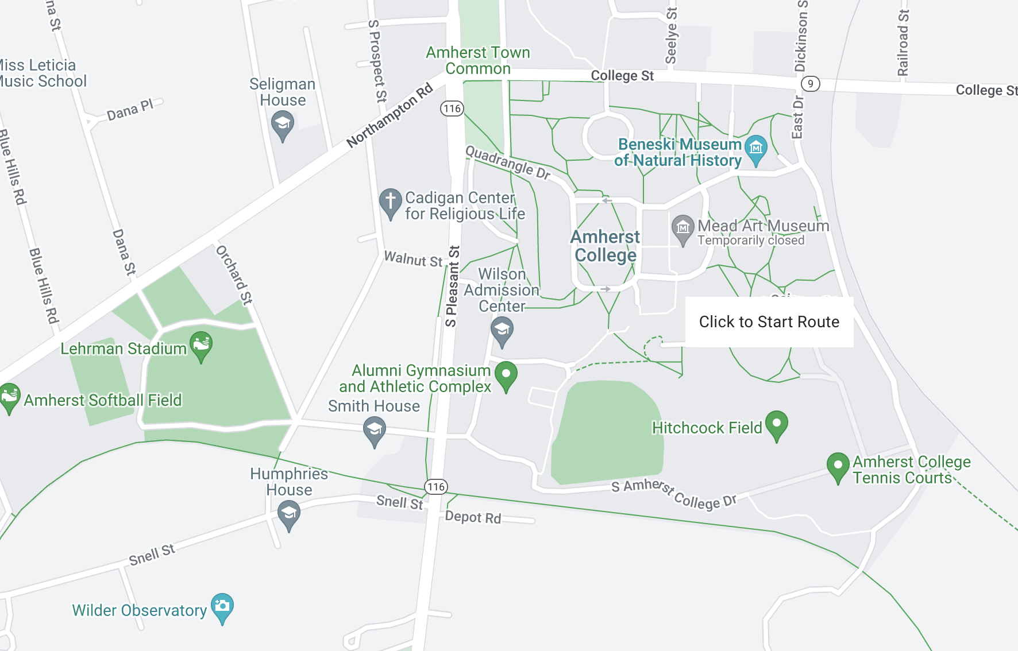
Mapmyride.com
New GAME!!!! I need a volunteer.
Pick a location on campus…any location.
Pick a second location…any location that isn’t the first location.
How far is Location1 from Location2?
Well, how far is Location2 from Location1?
That is how/why CIs work…

Slide 6
Key Questions
What is a CI?
Why do we need Cis? Why can’t we just figure out what μ is and be done with it?
What is the central tradeoff of Cis (e.g., the width vs. confidence tradeoff)?
How do we know that there is a 90% chance that M is within 2 standard errors of μ (Hint: think social distancing in the COVIDs era)?
What does this beautifully colored figure represent about the 90% CI?

Slide 7
90% CI
Sample | Confidence Interval 1 2 3 4 5 6 7 8 9 10
1
2
3 | _____________________
4
5
6
7
8
9
10 | _____________________
μ = 5

Slide 9
Shoes, Shoes, Shoes
Go to this Google form and answer the question
Be honest (or at the very least consistent)!
No shoe-shaming!!!! This is a safe space for shoe aficionados (like me) and shoe-eschewers!

Slide 10
Shoes, Shoes, Shoes
Collect a sample of n=5 data points.
Open SPSS
Create an SPSS data set for your data:
File → New → Data

Slide 11
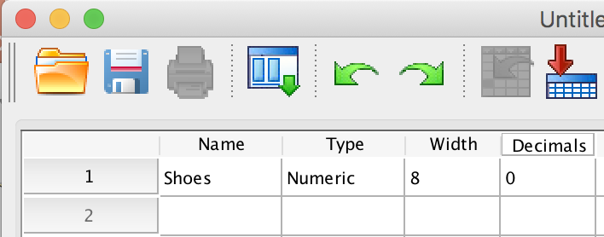
Shoes, Shoes, Shoes
Click the Variable View button at the bottom of the page in the center
Enter a variable name in the first row (e.g., Shoes).
Set the value in the Decimals box to 0.
Then click the Data View button.

Slide 12
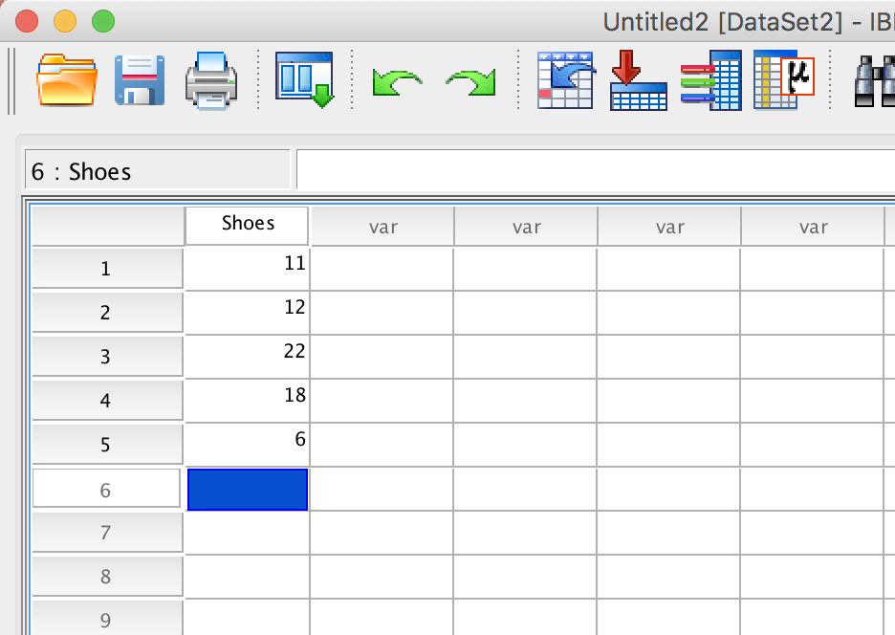
Shoes, Shoes, Shoes: Mean and SD
Enter the data that you collected in the first five spaces of the Shoes column.
Now we are ready to calculate the Mean and SD for your sample of data!

Slide 13
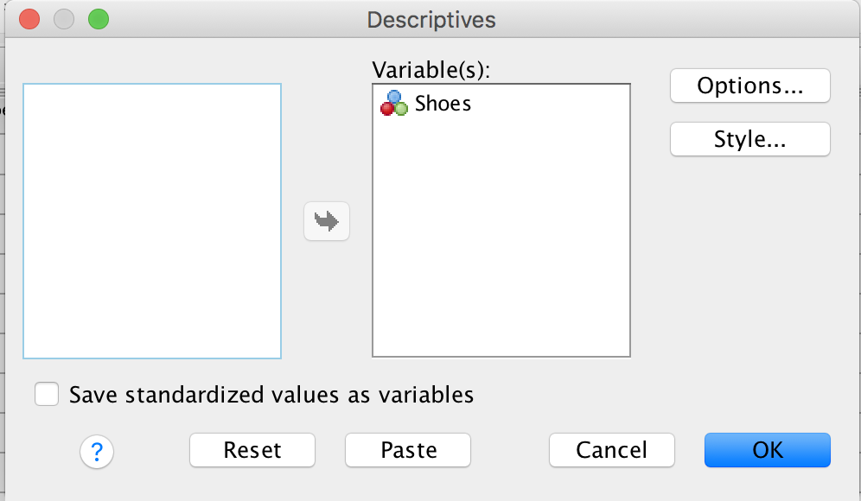
Shoes, Shoes, Shoes: Mean and SD
Find the Mean and SD for your dataset.
Click Analyze → Descriptive Statistics → Descriptives
Slide Shoes into the Variables box using the cute little arrow.
Then click OK.

Slide 14
Shoes, Shoes, Shoes: Mean and SD

Slide 15
Shoes, Shoes, Shoes: CI by hand
Calculate a 90% CI by hand:
Use the mean and SD you derived from SPSS

Slide 16
Shoes, Shoes, Shoes: CI in SPSS
Click Analyze → Compare Means → One-Sample T-test

Slide 17
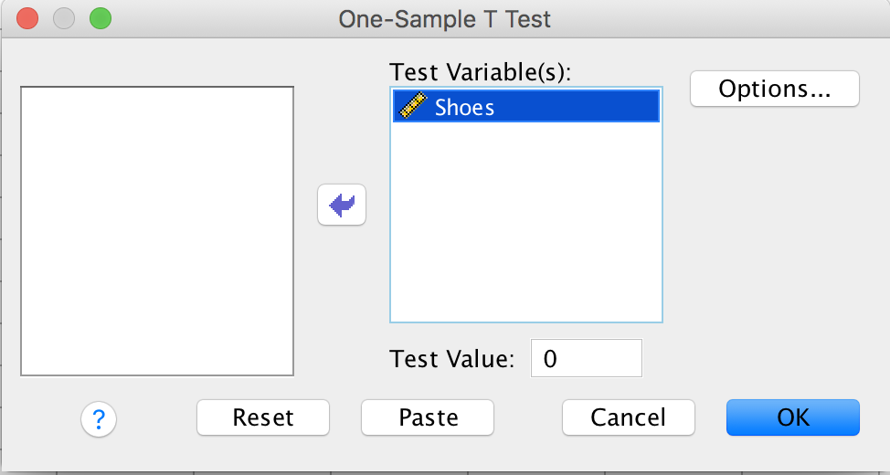
Shoes, Shoes, Shoes: CI in SPSS
Slide Shoes into the Test Variable(s) box by clicking the little arrow.
Then click Options.

Slide 18
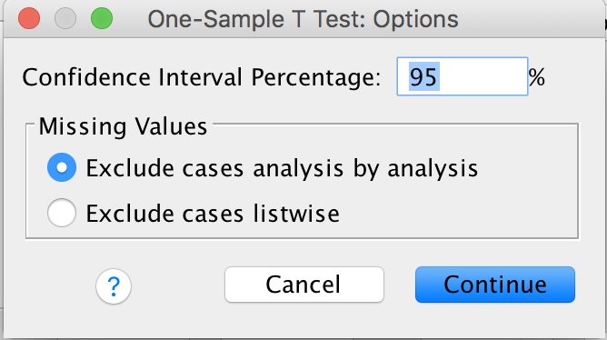
Shoes, Shoes, Shoes: CI in SPSS
Note that you can adjust the confidence coefficient. 95 is the default, but we want the 90% CI, so change 95 to 90.
Click Continue.
Click OK.

Slide 19
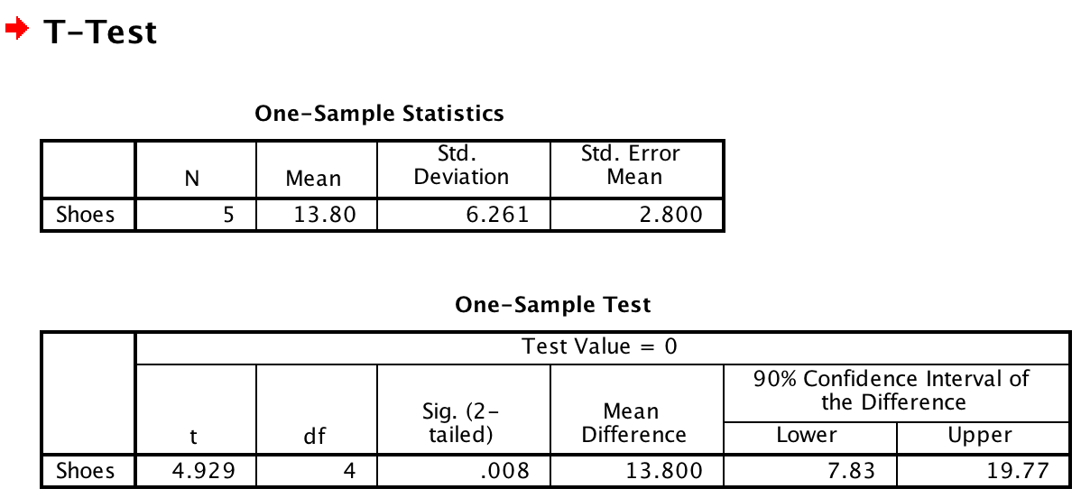
Shoes, Shoes, Shoes: CI in SPSS
Once you have calculated your CI, please enter your data into this google sheet.

Slide 20
90% CI
Sample | Confidence Interval 1 2 3 4 5 6 7 8 9 10
1
2
3 | _____________________
4
5
6
7
8
9
10 | _____________________
μ = 5

Slide 21
More Key Questions
What in the world is alpha?
Why do we split alpha in half?
When can we use z to calculate a CI?
What is meant by the term degrees of freedom?
Notes:
What is a measure of reliability? It tells us how willing we are to make a mistake (that is calculate a CI that does not include

Slide 22
Using Cis to draw an inference
Use SPSS to find the 90% CI for Happiness in the World Happiness Report data.
On the basis of your calculation, which countries are:
Unusually Happy 😀
Unusually Unhappy 😢

Slide 23
Confidence Intervals and Polling
Margin of error: defines the 95% CI
October 27 2016: Washington Post:
Clinton 47%, Trump 45%, margin of error = +/- 3.0
We are 95% sure that between 44% and 50% of voters will vote for Hillary.
Trump: we are 95% sure that between 42% and 48% of voters will vote for Donald.

Slide 24
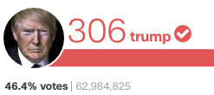
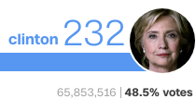
Confidence Intervals and Polling
Trump: 42% - 48% Clinton: 44% - 50%

