Slide 1
Building on the logic of hypothesis testing: T-tests

Slide 2
One-sample t-tests
Questions about the video lectures

Slide 3
One-tailed vs. Two-Tailed tests
Last class, we looked at the abstracts of some Psychological Science articles to determine what the null and alternative hypotheses might be.
Let’s revisit that question today to think through the difference between one-tailed and two-tailed hypothesis tests.
Please identify both types of hypotheses for your paper and think about what which type of test would be preferred.

Slide 4
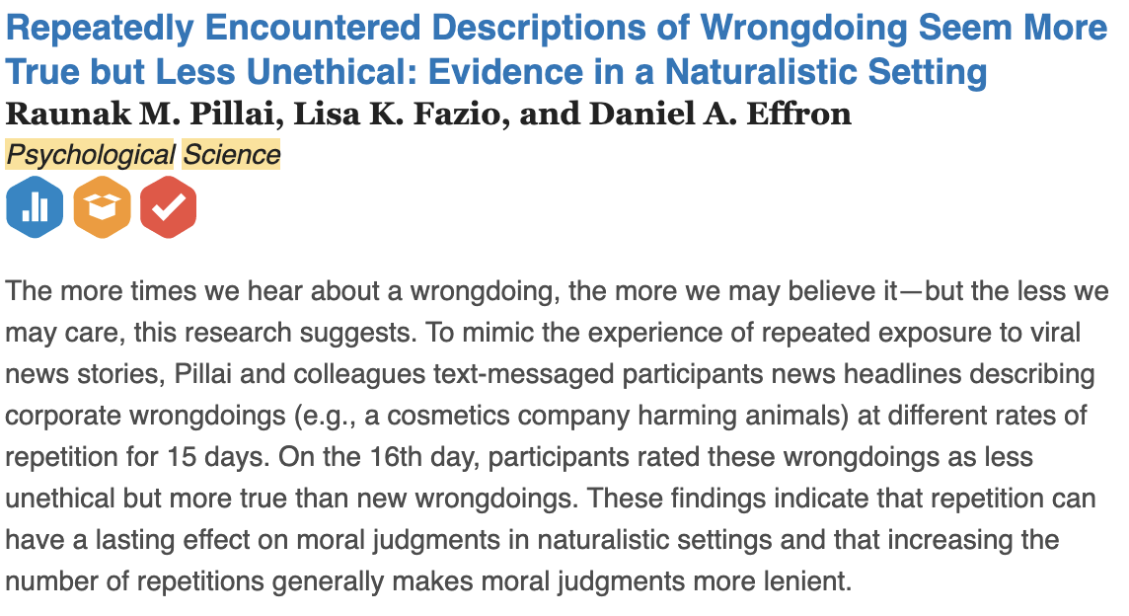
What are the null and alternative hypotheses?
Table I

Slide 5
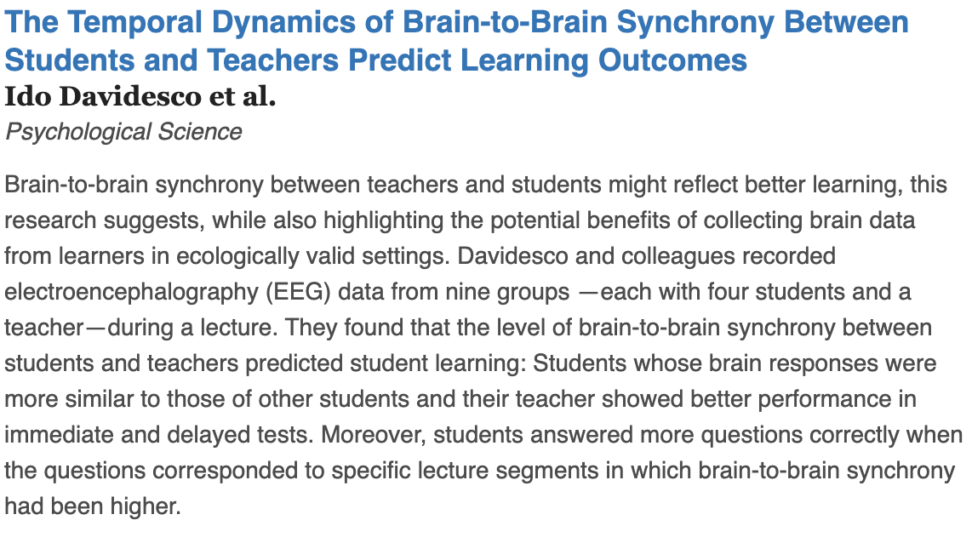
What are the null and alternative hypotheses?
Table II

Slide 6
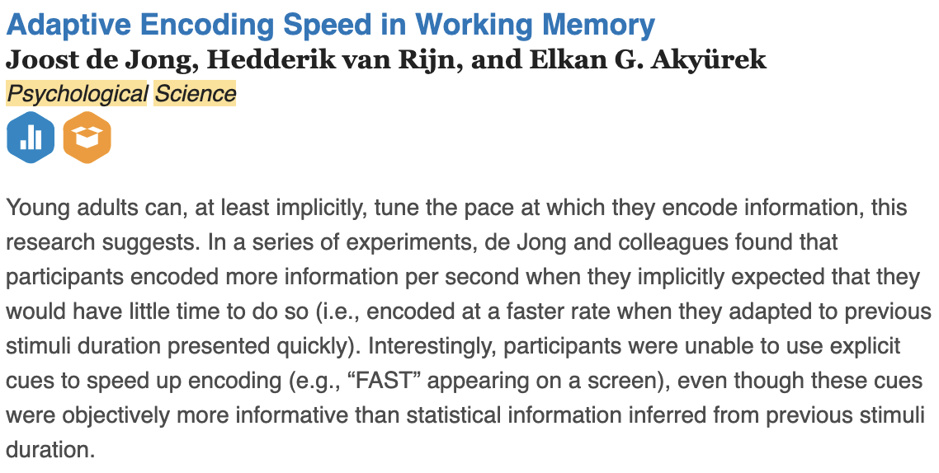
What are the null and alternative hypotheses?
Table III

Slide 7
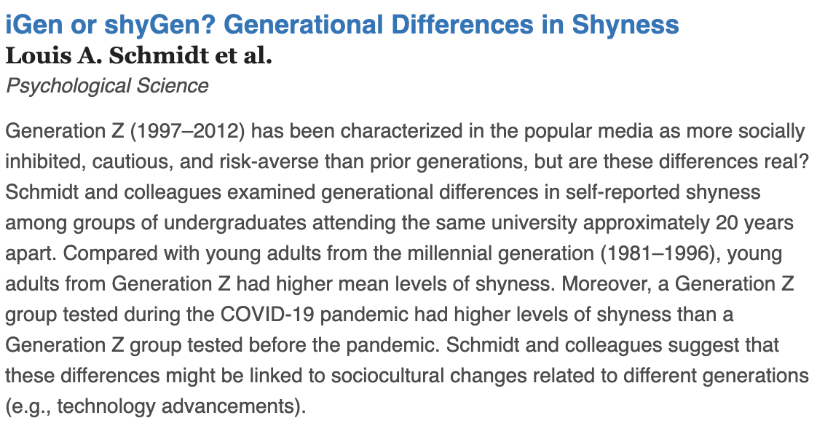
What are the null and alternative hypotheses?
Table IV

Slide 8
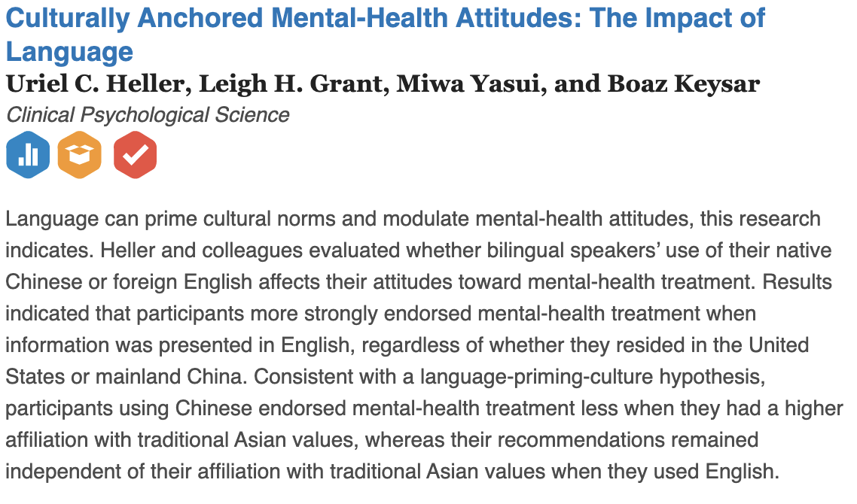
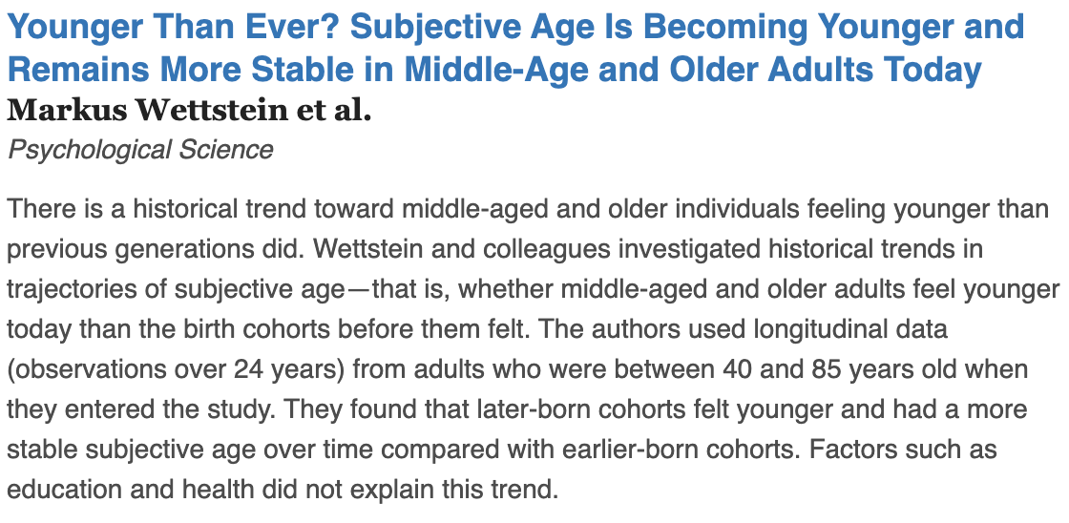
What are the null and alternative hypotheses?
Table V

Slide 9
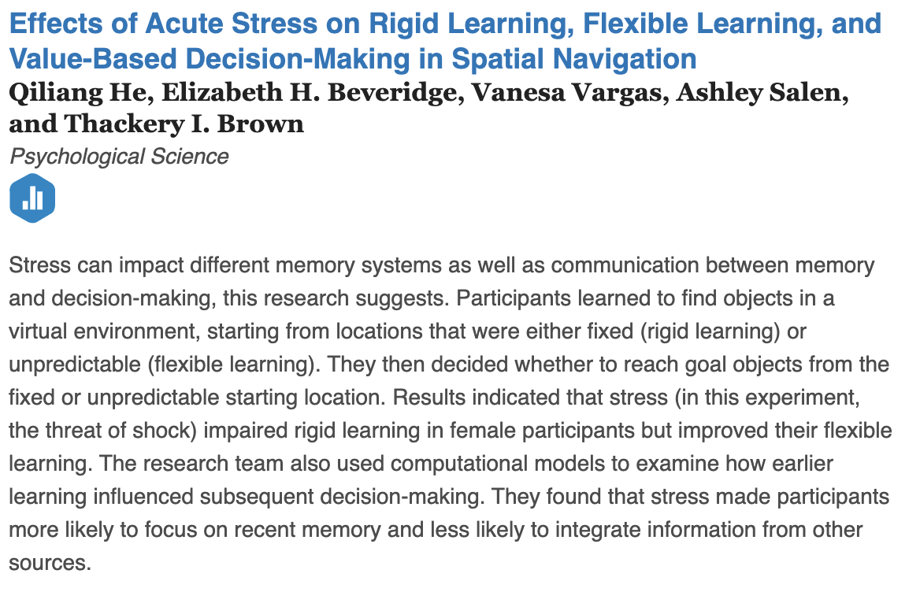
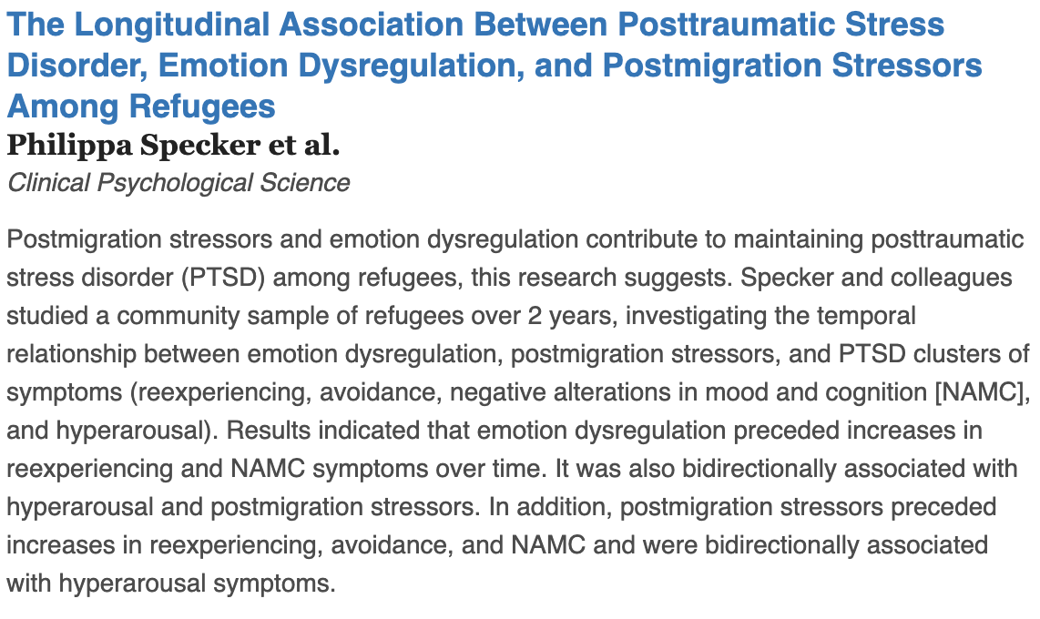
What are the null and alternative hypotheses?
Table VI

Slide 10
Effect size- Cohen’s D
Effect size – a statistical procedure for determining the magnitude of an experimental manipulation.
d_{m} = the difference between the sample mean and the expected value of µ
Cohen’s d | Evaluation
0 < d < .2 | Small
.2 < d < .8 | Medium
d > .8 | Large
Effect size for the ‘Big Lou’ question:
mean difference: 3338 vs. 3500 = 162

Slide 11
Statistical significance isn’t everything
PS#4 Q 3:
A researcher examines the relationship between delinquent behaviors and poor verbal abilities in teenagers. They administer a verbal IQ test to a sample of 81 incarcerated juvenile delinquents, you find that the sample mean verbal IQ is 103. The verbal IQ test is known to have a μ = 107 and a σ = 15 in the general population of teenagers.

Slide 12
Statistical significance isn’t everything
$$t=\frac{M−μ}{s/{\sqrt{n}}}=\frac{103−107}{{15}/{\sqrt{25}}}=\frac{−4}{3}=−1.33;p−value≈ .20$$
$$t=\frac{M−μ}{s/{\sqrt{n}}}=\frac{103−107}{{15}/{\sqrt{100}}}=\frac{−4}{1.5}=−2.67;p−value≈ .01$$
Same difference between the means, but a much smaller p-value when n is large.

Slide 13
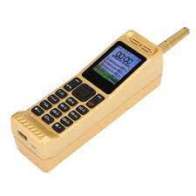
Your turn – It’s the THING!
Everyone pull out your phone….I’m serious. Let’s pick a THING. It could be the number of photos, the number of people/entities we follow or the number of apps; number of songs on a randomly selected play list. Just something on your phone.
Conduct a one-tailed hypothesis test (α = .01) to determine if your THING is significantly different from the THINGS of the other people in this room.

Slide 14
Your turn – It’s the THING!
Conduct a one-tailed hypothesis test (α = .01) to determine if your THING is significantly different from the THINGS of the other people in this room.
For this exercise, your value is µ, and the rest of the class data should be used to calculate M and the sd.
Enter your data on the google form and I’ll calculate M and the sd for you. Because I’m a swell guy.

Slide 15
It’s the THING!
Mean =. ; s =. ; n =
Step 1: One-tailed test or two-tailed test?
Step 2: Ho: μ
Step 3: Ha: μ
Step 4: α = .01
Step 5: t_{crit (α=.01, df = ; )} =
Step 6:
Step 7:
Step 8:

Slide 16
It’s the THING! In SPSS
Let’s see if TD is an outlier.
Analyze → Compare Means →One Sample T-Test

Slide 17
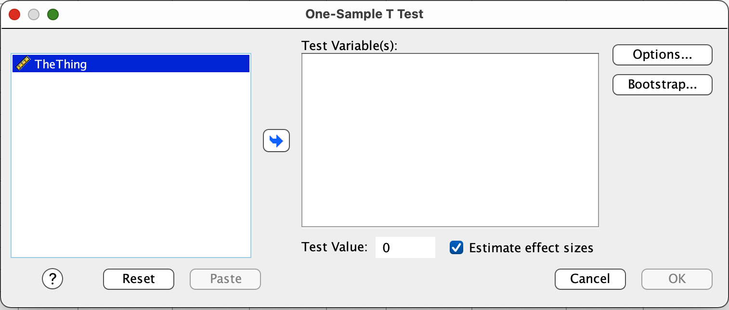
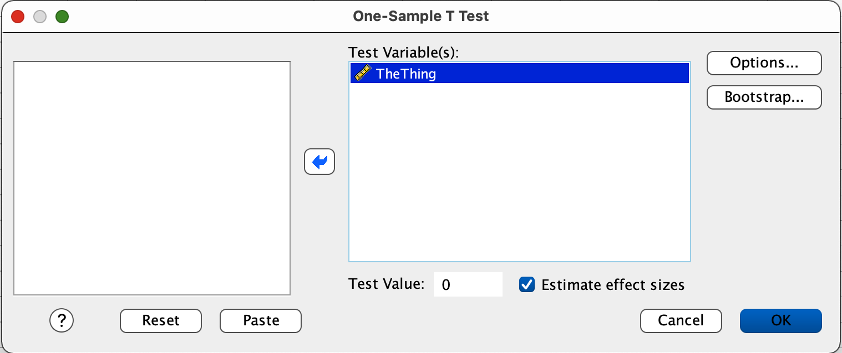
It’s the THING! In SPSS
Select TheThing as the variable of interest from the box on the left.
Then click the arrow in the middle of the page to slide TheThing into the Test Variables box.

Slide 18
It’s the THING! In SPSS
Set the value in the Test Value box equal to YourValue for TheThing (which is functioning as µ in this example).
Click OK

Slide 19
It’s the THING! In SPSS
 | N | Mean | Std. Deviation | Std. Error Mean
Moral | 91 | 56.9120879 | 19.06409532 | 1.99846020
BTW: the heart was Abby’s suggestion

Slide 20
Pick a country…any country! In SPSS
Choose a country and see if it is an outlier in terms of happiness using SPSS.
Analyze → Compare Means →One Sample T-Test

Slide 21
Jaswal and Neely (2006)

Slide 22
Sleepy Time and The Darkness
Did y’all get better sleep than me over break. Go to the Google form and enter the number of nights that you got a decent night’s sleep over the Spring Break period. Then, we will see whether y’all got a better sleep bonus than me over break.
I was sick for the first part of break, and then I traveled across three time zones to visit with a group of friends who I have known since I was in 4th grade. So, none of those things add up to very good sleep.

