Slide 1
Independent samples t-tests

Slide 2

Questions???

Slide 3
Hypnosis and eye witness testimony
People who witness a crime may recall the details of the crime differently when under hypnosis. Participants are asked to watch a video of a robbery and half are randomly assigned to a hypnosis condition. These subjects are hypnotized and then asked 30 questions about the robbery. The other participants answer the same questions without being hypnotized. α = .05
 | Hypnosis | No Hypnosis
Mean correct responses | 23 | 20
Number of participants | 17 | 15
Estimated Variance | 9.0 | 7.5
1) Conduct a two samples t-test
2) Calculate and interpret Cohen’s D
3) Calculate and interpret the 95% CI (if you have time)

Slide 4
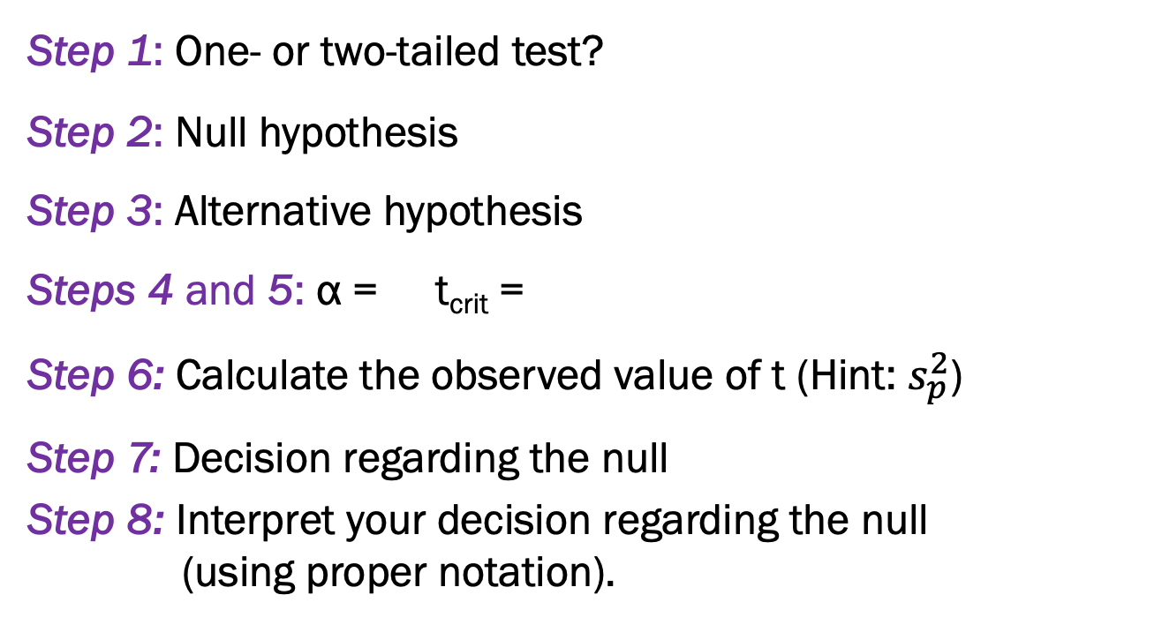
 | Hypnosis | No Hypnosis
Mean number of questions correct | 23 | 20
Number of participants | 17 | 15
Estimated Variance | 9.0 | 7.5
Step 1: One- or two-tailed test?
Step 2: Null hypothesis
Step 3: Alternative hypothesis
Steps 4 and 5: α = t_{crit} =
Step 6: Calculate the observed value of t (Hint: $s_{p}^{2}$)
Step 7: Decision regarding the null
Step 8: Interpret your decision regarding the null
(using proper notation).

Slide 5
Reporting results of an independent t-test
Individuals under hypnosis answered significantly more questions correctly (M = 23.00, SD = 3.00) than those not under hypnosis (M = 20.00, SD = 2.74), t (30) = 2.93, p < .05. The 95% confidence interval for the difference is 0.91 to 5.09. The Cohen’s D effect size is 1.04, suggesting a large effect.

Slide 6
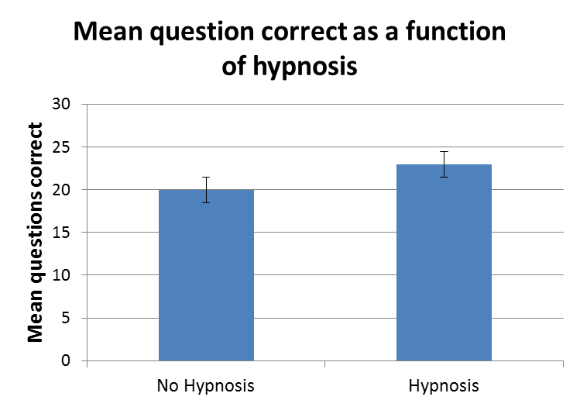
Reporting results of an independent t-test
Individuals under hypnosis answered significantly more questions correctly (M = 23.00, SD = 3.00) than those not under hypnosis (M = 20.00, SD = 2.74), t (30) = 2.93, p < .05. The 95% confidence interval for the difference is 0.91 to 5.09. The Cohen’s D effect size is 1.04, suggesting a large effect.

Slide 7
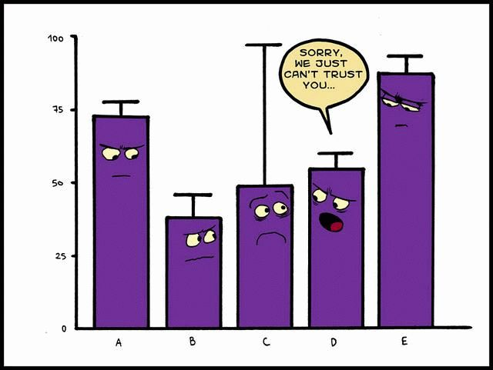

Slide 8
Let’s practice Using SPSS
New DATA FILE!!!!! PizzaPizza.sav
Let’s use SPSS to see if our earlier calculations hold.
Questions:
  What is the null hypothesis?
  What is the alternative hypothesis?
  Should we reject or FTR the null?
  What is your interpretation?

Slide 9
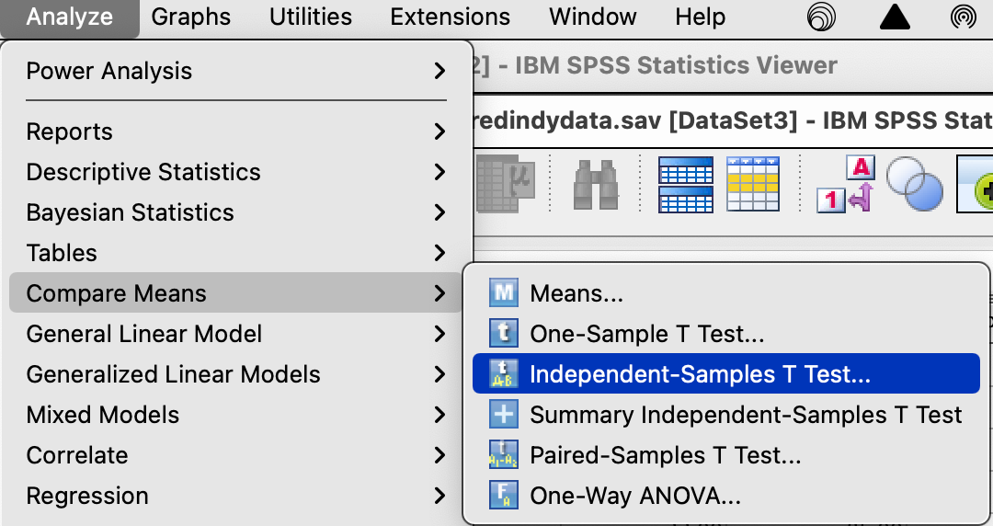
Pizza…Pizza
Analyze → Compare Means →Independent Samples T-Test

Slide 10
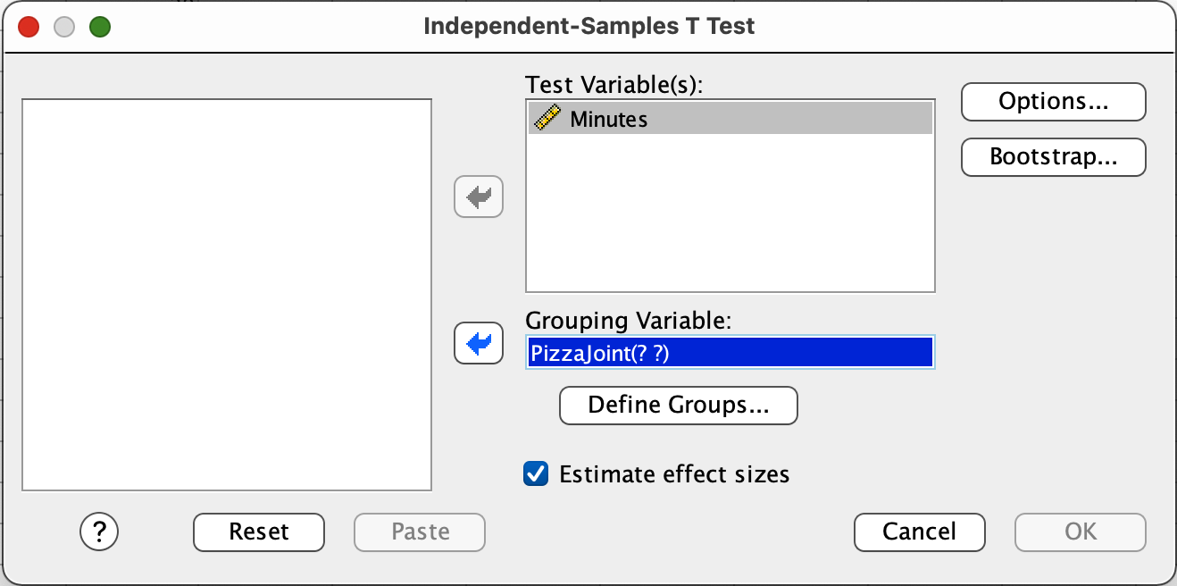
Pizza….Pizza
Slide the DV into the Test Variables box.
Slide the IV into the Group Variable box.
Then click Define Groups…

Slide 11
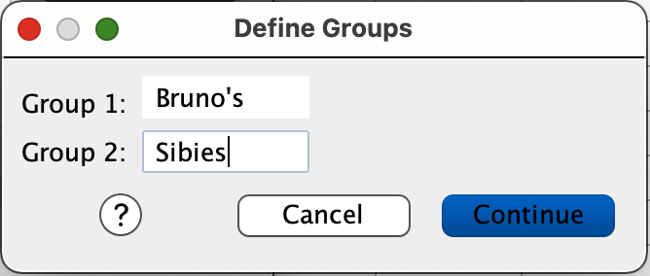
Pizza….Pizza
Enter the labels of your groups in the appropriate boxes.
  Capitalization and punctuation matter
  SPSS is not intelligent.
Click Continue.
Click OK.

Slide 12
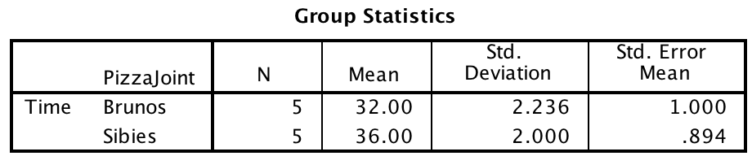
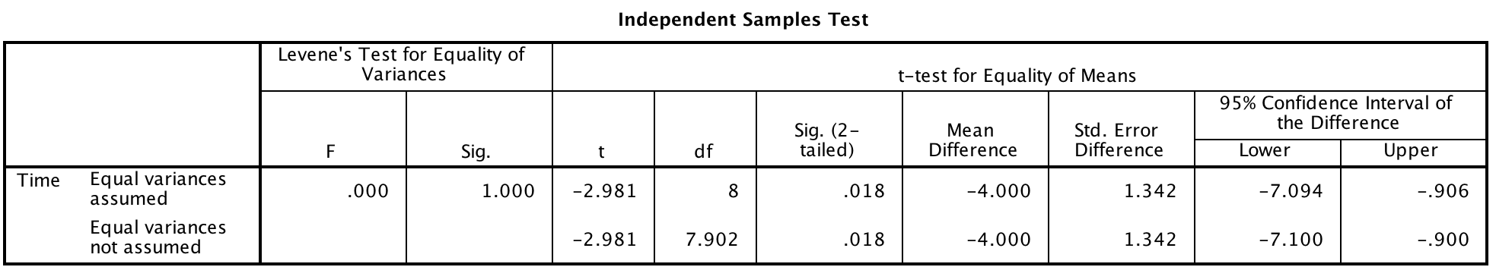
SPSS output – Pizza Delivery

Slide 13
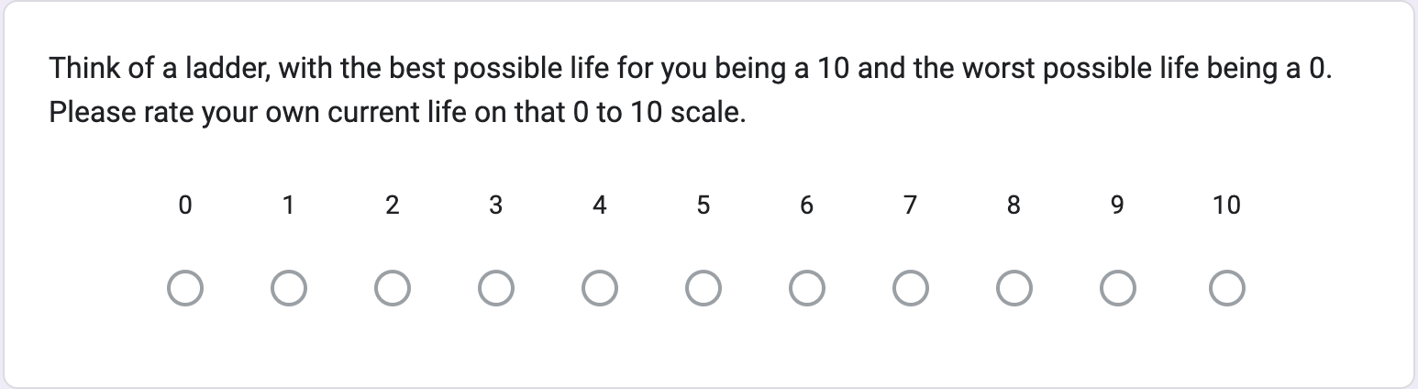
Let’s practice Using SPSS
old DATA FILE!!!!! Ladder.sav
Earlier in the semester, we did a demo in which I asked you to reflect on either
  Humorous experiences
  Gratitude
  Daily routine (control)
Then I asked you to rate your life satisfaction using the ladder scale.

Slide 14
Let’s practice Using SPSS
old DATA FILE!!!!! Ladder.sav
Earlier in the semester, we were fools. All we could do was calculate MCTs and measures of variability. We are so beyond that now.

Slide 15
Let’s practice Using SPSS
old DATA FILE!!!!! Ladder.sav
Let’s conduct an independent samples t-test to see if there are differences between the control group (daily routine) and one of the experimental groups – either Humor or Gratitude.
  Randomly assign by table

Slide 16
Let’s practice Using SPSS
old DATA FILE!!!!! Ladder.sav
  What is the null hypothesis?
  What is the alternative hypothesis?
  Should we reject or FTR the null?
  What is your interpretation?

Slide 17
What two factors that enhance learning were the subject of this study?
What were the subjects asked to learn?
How many learning/test phases were there?
    Learning
    Re-learning
    Test (1 day; 6 months)
Notes:
1. Sleep; spaced practice
2. French / Swahili vocabulary
3. Learning; learning phase, followed by practiced with feedback until first correct response to all 16 items; # correct in 1st run was recorded
Re-learning; same as learning except all items were repeated (even correct); again # correct in 1st run was recorded
Test: No feedback

Slide 18
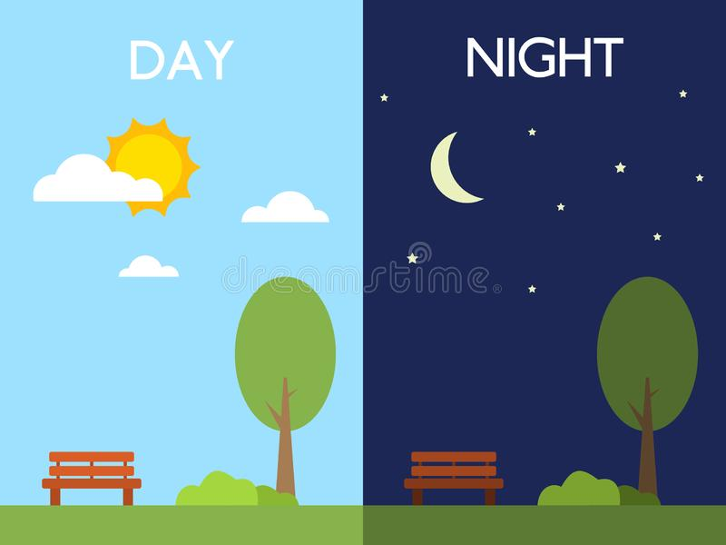
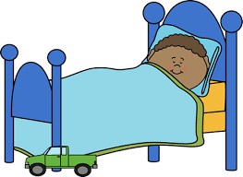
Mazza, et al. (2016)
What were the groups in the study?
 | Learning | Activity | ReLearn | Test
Wake |  |  |  | 1 day 6 months
Sleep |  |  |  | 1 day 6 months
Control
Notes:
Time saving during relearning and retention
One group slept in between the initial practice and the relearning(9pm and 9am)), the other group did not (9am and 9pm, a control group only learned one time and then just did a recall (so no relearning; but they slept! 9pm and 9am)- no relearning
IV was sleep and opportunity to relearn
DV: retention- operational def was number of trials took to relearn
Before they analyzed their primary variables, they did a bunch of preliminary analyses, comparing groups on sleep quality, sleepiness, memory ability- on these comparisons they found no significant difference between the groups- why were those important comparisons to make and why is it good there were no significant differences?

Slide 19
Mazza, et al. (2016)
Group differences in sleep quality, memory (etc.)?
 | Learning | Activity | ReLearn | Test
Wake |  |  |  | 1 day 6 months
Sleep |  |  |  | 1 day 6 months
Control
Notes:
Before they analyzed their primary variables, they did a bunch of preliminary analyses, comparing groups on sleep quality, sleepiness, memory ability- on these comparisons they found no significant difference between the groups- why were those important comparisons to make and why is it good there were no significant differences?

Slide 20
Mazza, et al. (2016)
* symbol for significant difference

Slide 21
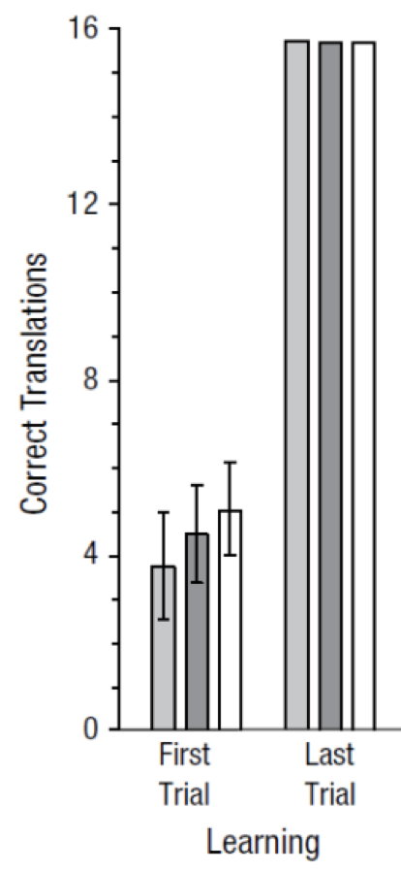
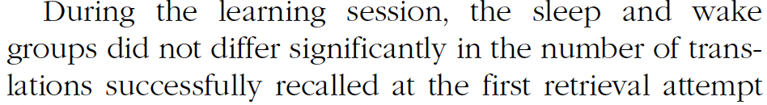
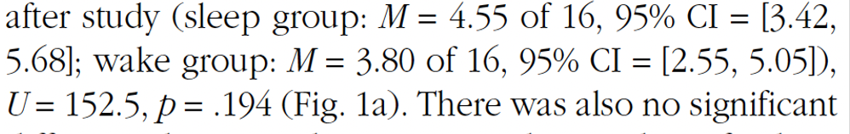

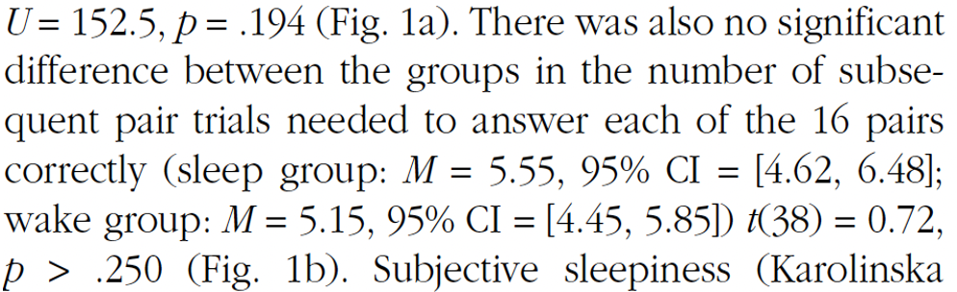
Mazza, et al. (2016)

Slide 22

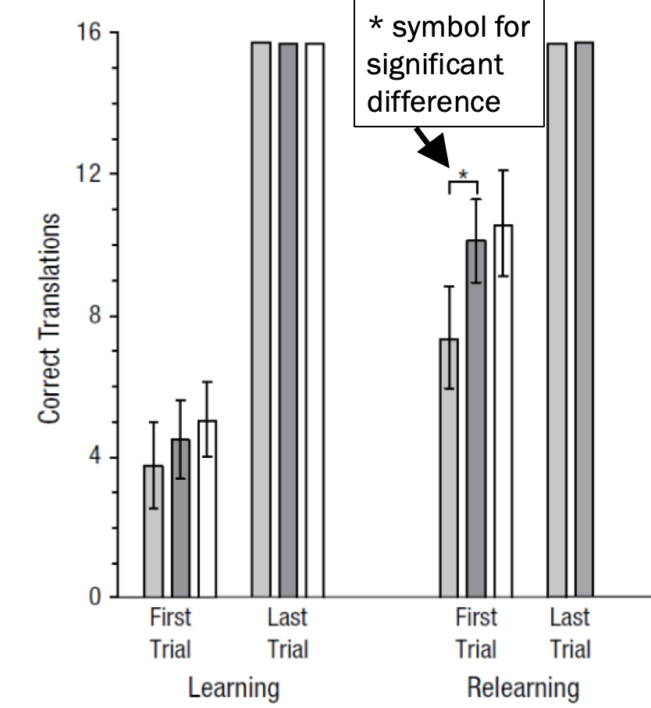
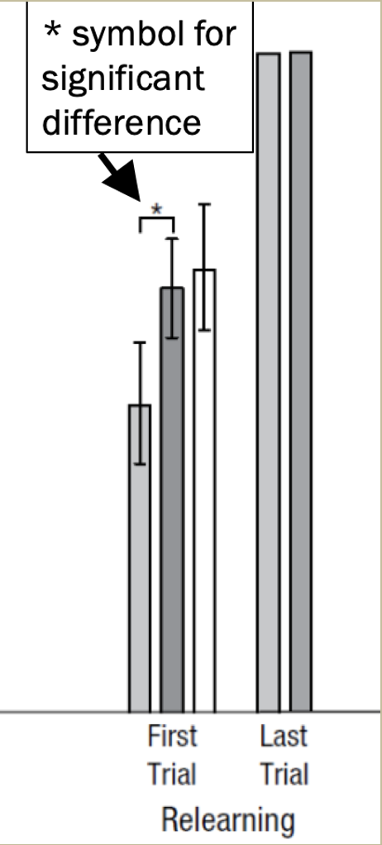
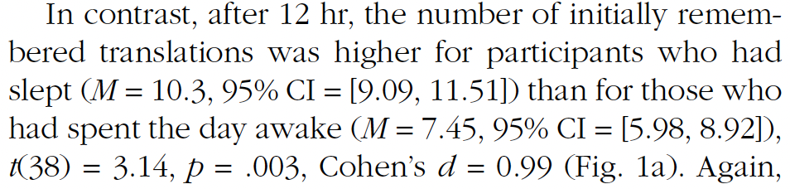
Mazza, et al. (2016)

Slide 23
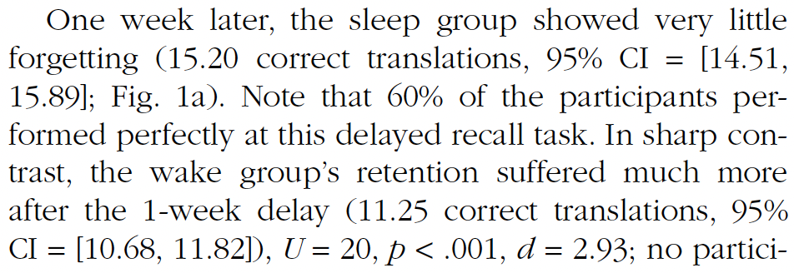
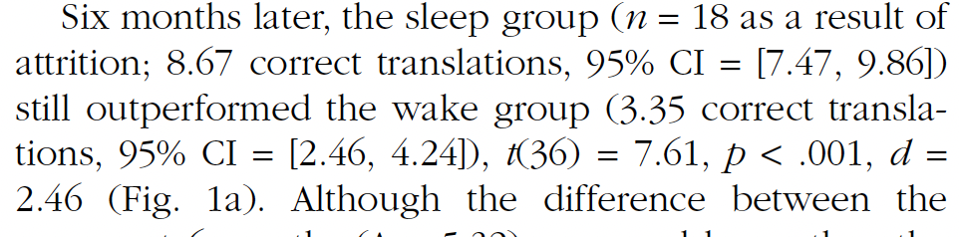
Mazza, et al. (2016)

Slide 24
Mazza, et al. (2016)
What do results suggest you should do as you approach studying for our next exam?

Slide 25
Watching Sherlock
Tammy believes that watching Sherlock makes life worth living. I like the show, but I’m not sure I would go that far. We approach this disagreement the same way we approach all forms of marital discord: we collect some data. We asked a group of Sherlock Fans and a group of Sherlock haters to write their life satisfaction on a scale from 1-20, with higher scores indicating greater happiness. The data appear below.
Conduct a two-tailed hypothesis test with α = .01 to determine whether these data provide enough evidence to conclude that being a Sherlock fan influences life satisfaction. Your answer should include a statement of the null and alternative hypotheses, the critical value for your test statistic, the observed value of your test statistic, your decision regarding the null, an interpretation of the results, and a correct report of your test statistic.
 | Raw Data |  |  |  |  |  |  |  |  | Mean | Variance
Haters | 8 | 9 | 5 | 9 | 10 | 10 | 9 | 12 |  | 9 | 4
Fans | 9 | 11 | 14 | 13 | 10 | 14 | 17 | 16 | 13 | 13 | 7

Slide 26
Participants were randomly assigned to sit in a room with a citrus cleaner scent (clean scent) or in a room with no scent (control). Participants were then provided with a biscuit to eat. Number of times the participant removed crumbs from table was coded to measure cleaning behavior, alpha was set to .05.

Slide 27
Results:
Clean Scent: M = 3.54 times Control: M = 1.09 times
t (20) = 2.37, p = .02
Answer the following:
  What were the IV and DV?
  Provide an interpretation of the results
  Assuming equal sample sizes, how many subjects were in each group? (OK if you get stuck on this one)

Slide 29
Participants were children with and without a diagnosis of ADHD. Children and their teacher were both asked to rate the child’s social acceptance on a 1 to 4 scale, higher suggests more accepted by peers.

Slide 30
Child’s perception of their social acceptance:
ADHD: M = 2.75 (SD = .67) Control: M = 2.88 (SD = .77)
t(76) = .61, p > .05, d = .18
Results for teacher’s rating of the child’s social acceptance:
ADHD: M = 2.12 (SD = .67) Control: M =3.75 (SD = .35)
t(76) = 12.01, p < .05, d = 2.92
Answer the following:
  What was the IV and what were the two DVs?
  Interpret the results for child perception and teacher rating
  Interpret the magnitude of the group differences (HINT: think about effect size)

