Slide 1
Building on the logic of hypothesis testing: T-tests

Slide 2
Limitations of hypothesis testing using z-scores
Our sample must be large (> 30) in order for the Central Limit Theorem to ‘kick in’.
σ must be known.
This is a more serious limitation because it is almost impossible to know σ in the real world.

Slide 3
What do we do if σ is unknown?
Just like we did with confidence intervals:
Use s as an estimate of σ
Use t as our test statistic instead of z
The basic steps for conducting t-tests
Determine the value for t_{crit} Calculate t_{obs} Compare t_{obs} with t_{crit}

Slide 4
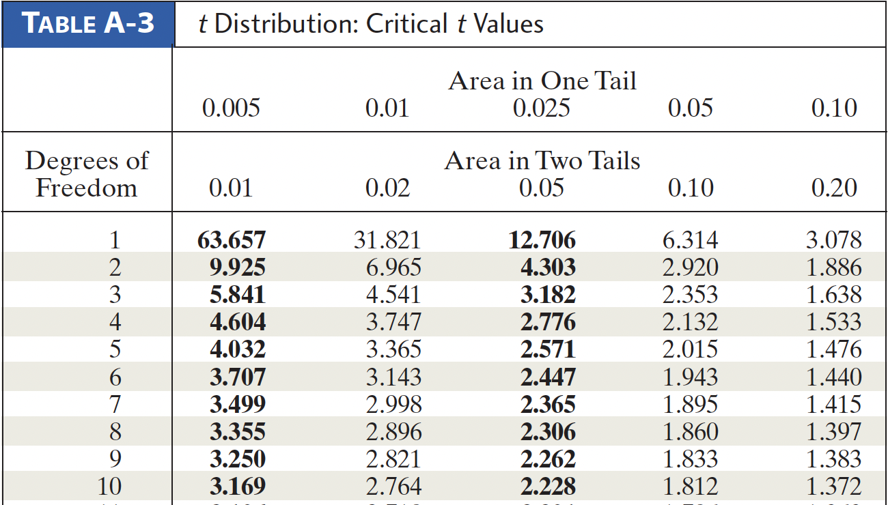
Step 1: Determining t_{crit}
t_{crit} depends on the degrees of freedom; df = n-1
If α = .05, and n = 10: t_{(α=.05; 9)} = 2.262
*If specific df is not listed; look up t values for df in between and then use the larger t value

Slide 5
Step 2: Calculating t_{obs}
The only difference is that s replaces σ
NOTE: is an estimate of SE
Step 3: compare t_{obs} with t_{crit}
Exactly the same as before.

Slide 6
Proper Statistical Notation
“Old school style”
t (df) = t-observed, p < alpha OR p > alpha
t (24) = 2.625, p < .05
Code for: “With degrees of freedom of 24, our t-observed value was 2.625 and the probability of getting this value or one more extreme if the null were true is less than a 5% chance.”
“New APA style”
t (24) = 2.625, p = .025
(exact p can only be calculated using a computer)

Slide 7
Two-tailed vs. One-tailed tests
Two-tailed: observing a sample mean in either the upper or lower tail of the sampling distribution would be theoretically meaningful
Ho: μ = some value
Ha: μ ≠ some value
Rejection region split between two tails: α/2 in upper tail, α/2 in lower tail.

Slide 8
Two-tailed vs. One-tailed tests
One-tailed: observing a sample mean in only one of the two tails of the sampling distribution would be theoretically meaningful
Ho: μ ≥ some value OR μ ≤ some value
Ha: μ < some value OR μ > some value
Rejection region located entirely in one tail; EITHER α in upper tail OR α in lower tail.

Slide 9
What’s a one-tailed test?
Take a minute to think about a statistical question for which it would make sense to conduct it as a one-tailed test. It can be a practical question or a ‘research’ question or even a ‘fun’ question.
Last class, we asked questions about whether alcohol consumption differed from normal during 2020 due to the pandemic.
What would be the null and alternative hypotheses if this was conducted as a two-tailed test?
What would be the null and alternative hypotheses if this was conducted as a one-tailed test?

Slide 10
Comparing the results of one- and two-tailed t-tests
Do in class???
You lost a lot of money at the track and were forced to become the personal statistician of notorious underworld crime boss “Big Lou”. Big Lou wants to know if his son “Moderately-Sized Lou” is stealing from his gambling operation. Before Lou Jr. took over the operation, it used to gross $3500 per night (µ). Big Lou tells you, “I don’t care if he is grossing more than $3500, I only care if he’s grossing less. Got it?!”

Slide 11
Comparing the results of one- and two-tailed t-tests
Do in class???
At this point, you could give Big Lou a lecture regarding the theoretical considerations that guide the choice between one- and two-tailed tests, but I would not be so bold... You sample the gross earnings of the casino over the next 25 nights. The average of the sample is $3338; s = 450. Is “Moderately-Sized Lou” going to sleep with the fishes? α = .05?

Slide 12
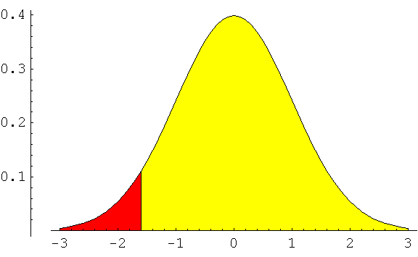
Do in class???
$3,500
Lou Jr.
gets whacked
Lou Jr. is ok!

Slide 13
Comparing the results of one- and two-tailed t-tests
Do in class???
Gross $3500 per night (µ)
Sample 25 nights, M =$3338; s = 450.
Step 1: Big Lou has asked us to conduct a one-tailed test with the entire rejection region in the lower tail. Thus, our null and alternative hypotheses will be as follows:
Step 2: Ho: μ ≥ 3500
Step 3: Ha: μ < 3500
Step 4: α = .05
Step 5: tcrit (α=.05, df = 24; 1-tailed) = -1.711.
Step 6: t_{obs}
Negative value!

Slide 14
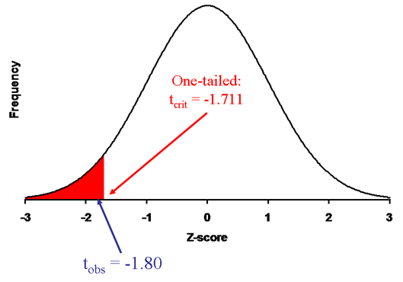
Comparing the results of one- and two-tailed t-tests
Do in class???
Gross $3500 per night (µ)
Sample 25 nights, M =$3338; s = 450.
Step 7: Our observed t falls in the rejection region. Therefore, we would reject the null:
t (24) = -1.8, p <.05
Step 8: Interpret the results

Slide 15
Big Bad Lou as a Two-Tailed Test
Do in class???
Although it would be unwise for you to challenge Big Lou’s decision to run a one-tailed test, the same is not true for Mrs. Lou. She loves her baby boy and wisely asks you to conduct a two-tailed test, just to see what would happen. After all, wouldn’t Lou Jr. deserve a big raise if receipts from the gambling operation increased rather than decreased?
Bear in mind that, just like with selecting a value for α, the time to make a decision regarding whether to run a one- or two-sampled test is BEFORE you have seen the data.

Slide 16
Following mama Lou’s request
Do in class???
Step 1: Because we have decided to conduct a two-tailed test, our statistical hypotheses would be as follows:
Step 2: Ho: μ = 3500
Step 3: Ha: μ ≠ 3500
Step 4: α = .05
Step 5: t_{crit(α=.05, df = 24, 2-tailed)} = ± 2.064.
Step 6: The observed value of our test statistic does not change: t_{obs} = -1.8

Slide 17
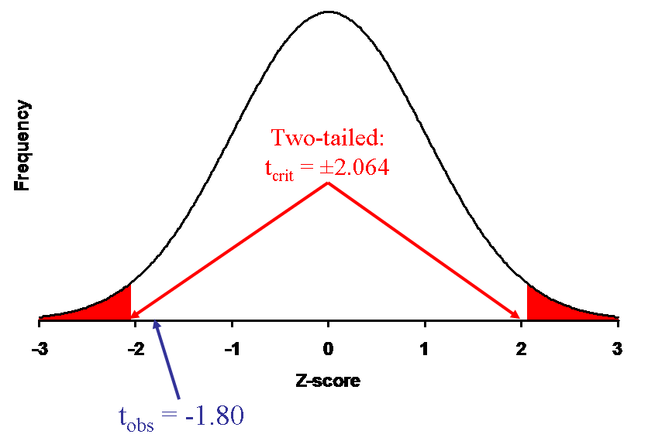
Following mama Lou’s request
Do in class???
Step 7: Our observed t DOES NOT fall in the rejection region. Therefore, we would fail to reject the null: t (24) = -1.8, p > .05
Ethics: Be judicious.
Choose before you see your data!
Step 8: Interpret results

Slide 18
My opinion on one-tailed tests….
ONE-TAILED TESTS ARE INAPPROPRIATE UNLESS YOU HAVE AN EXTREMELY GOOD REASON FOR USING THEM BEFORE YOU RUN YOUR EXPERIMENT.
I HAVE NEVER SEEN A STRONG ARGUMENT FOR WHY ONE WAS APPROPRIATE.
EVER!!!!

Slide 19
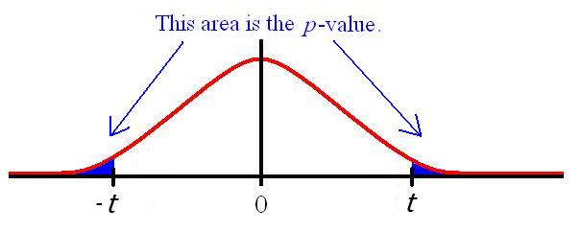
Ways to reject the null
Critical value:
│t_{obs}│> │t_{crit}│ OR │z_{obs}│> │z_{crit}│
P-value:
p-value < alpha

Slide 20
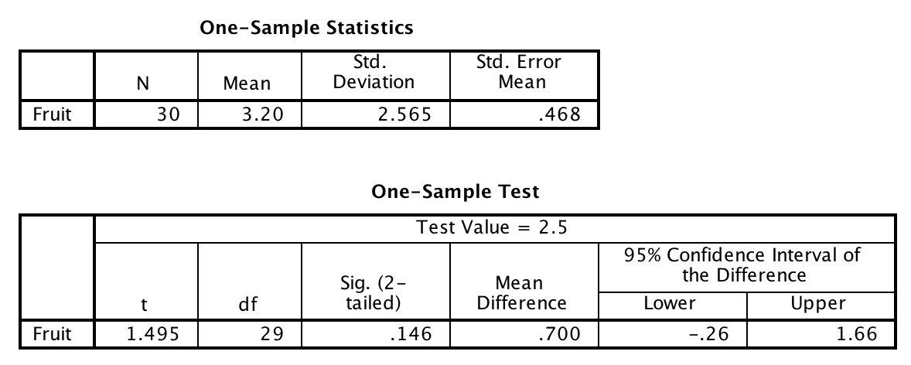
One-Sample T-test: SPSS Output

Slide 21
One-Sample T-test: SPSS Output

Slide 22
Reporting the results of a t-test
Amherst College students consumed an average of 3.2 pieces of fruit per day (s = 2.57). These data did not provide enough evidence to conclude that Amherst College students differed from the national average in terms of fruit consumption: t (29) = 1.495, p = .15.
Mean
SD
Df
t_{obs}
p-value

Slide 23
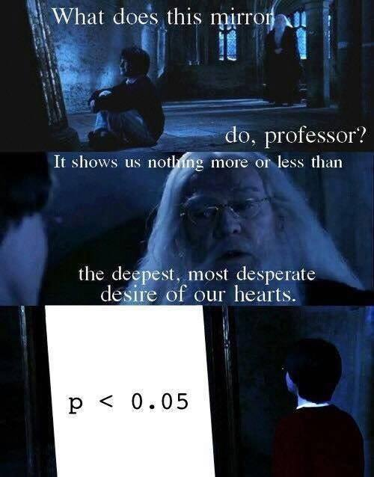

Slide 26
Important points about the p-value method
The p-value method and the critical value method will always produce the same decision regarding the null.
The p-value method gives us more information than the critical value method, in that it tells us where our sample mean fell in the sampling distribution
What if p = .06? (a marginally significant result)
A lower p-value does not imply a ‘bigger effect’ even though – all things being equal – a lower p-value implies a larger difference between M and µ₀.
What is the easiest way to obtain a smaller p-value in an experiment?

Slide 27
Getting a smaller p-value through the magic of Math!!
$$t=\frac{M−μ}{s/{\sqrt{n}}}=\frac{103−107}{{15}/{\sqrt{25}}}=\frac{−4}{3}=−1.33;p−value≈ .20$$
$$t=\frac{M−μ}{s/{\sqrt{n}}}=\frac{103−107}{{15}/{\sqrt{100}}}=\frac{−4}{1.5}=−2.67;p−value≈ .01$$
Same difference between the means, but a much smaller p-value when n is large.

Slide 28
Effect size- Cohen’s D
Effect size – a statistical procedure for determining the magnitude of an experimental manipulation.
d_{m} = the difference between the sample mean and the expected value of µ
Cohen’s d | Evaluation
0 < d < .2 | Small
.2 < d < .8 | Medium
d > .8 | Large
Effect size for the ‘Big Lou’ question:
mean difference: 3338 vs. 3500 = 162

Slide 29
Statistical significance isn’t everything
A large school district decides to implement a new drug awareness program for high school students. They select 1,000 students from the district to participate. Prior data suggested that the average high school student in this district has 4.2 alcoholic drinks per month, σ =2. The district administers the new program and finds that afterwards the average is now 4 drinks per month. Should they adopt the new intervention program?

Slide 30
Statistical significance isn’t everything
Mean = 4 drink per month; n = 1000
Ho:μ = 4.2 drinks
Ha:μ ≠ 4.2 drinks
= .05
Z_{obs}
.0008 x 2 = .0016 < alpha (.05): therefore reject the null.
Decision: the intervention significantly reduced drinking behavior.
Problem???

