Slide 1
Paired t-tests
Why can’t we all just reduce variation due to chance!!

Slide 2
Paired T-tests
Questions about the video lectures

Slide 3
Paired T-tests
Complete the Things have Changed google form.

Slide 4
Sherlock Part Deux
Jake and Abby have their own argument about the benefits of watching Sherlock. Abby thinks that watching a single episode is powerful enough to affect life satisfaction scores; Jake is not convinced. Usually, they solve their disagreements with violence, but we convince them to collect some data instead. They gather 8 of their friends and have them rate their life satisfaction right before and right after watching an episode of Sherlock (‘The Lying Detective’ Series 4, Episode 2).
 |  |  |  |  |  |  |  |  |  | Mean | Variance
 | Ruby | Anna | Pooja | Gimin | Chris | Jack | Steve | Scott
After | 14 | 14 | 20 | 14 | 16 | 10 | 16 | 16 |  | 15 | 8
Before | 10 | 16 | 12 | 12 | 6 | 10 | 12 | 10 |  | 11 | 8
Conduct a hypothesis test to determine whether these data provide enough evidence to conclude that watching an episode of Sherlock influences life satisfaction (­­­­­­­­α = .05). Your answer should include a statement of the null and alternative hypotheses, the critical value for your test statistic, the observed value of your test statistic, your decision regarding the null, an interpretation of the results, and a correct report of the test statistic.

Slide 5
 |  |  |  |  |  |  |  |  |  | Mean | Variance
 | Ruby | Anna | Pooja | Gimin | Chris | Jack | Steve | Scott
After | 14 | 14 | 20 | 14 | 16 | 10 | 16 | 16 |  | 15 | 8
Before | 10 | 16 | 12 | 12 | 6 | 10 | 12 | 10 |  | 11 | 8
Step 1: One- or two-tailed test?
Step 2: Null hypothesis
Step 3: Alternative hypothesis
Steps 4 and 5: α = t_{crit} =
Step 6: Calculate the observed value of t.
Step 7: Decision regarding the null
Step 8: Interpret your decision regarding the null
(using proper notation).

Slide 6
Paired vs. Independent T-tests
Talk amongst yourselves:
What is the main difference between paired t-tests and independent t-tests?
What affect does this have on the variability in our data? Why?
How do you predict that will affect the outcome of statistical analyses? In other words, - all other things being equal - will the probability of rejecting the null hypothesis increase, decrease or stay the same?

Slide 7
Paired vs. Independent T-tests
Let’s look at some examples from the video lectures:
Factory safety data
Ice cream and exams
Sherlock

Slide 8
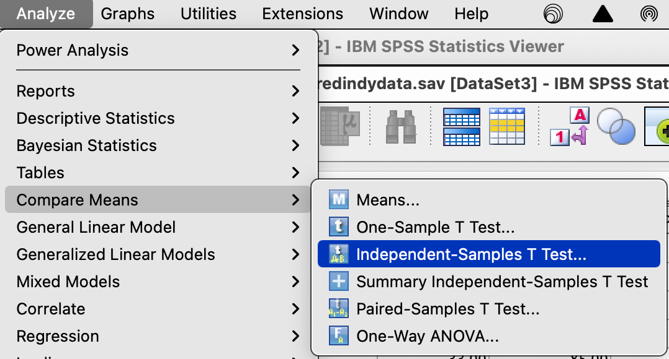
Factory Safety: Indy t-test
Analyze → Compare Means →Independent Samples T-Test

Slide 9
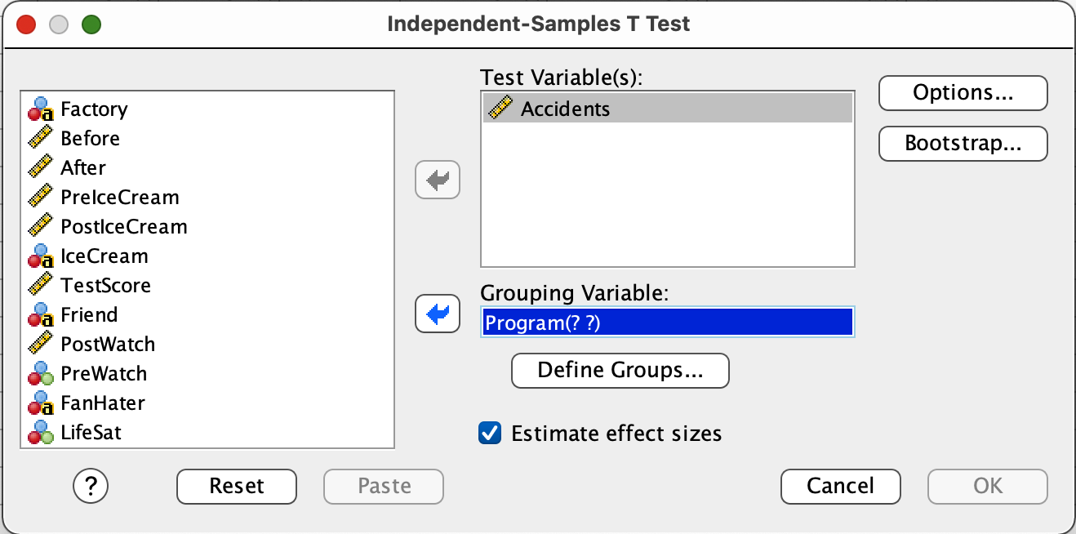
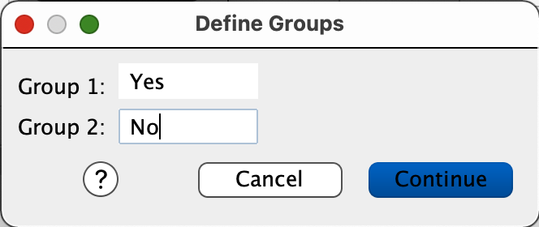
Factory Safety: Indy t-test
Slide the DV into the Test Variables box.
Slide the IV into the Group Variable box.
Then click Define Groups…
Enter the labels of your groups in the appropriate boxes.
Click Continue.
Click OK.

Slide 10
Factory Safety: Indy t-test

Slide 11
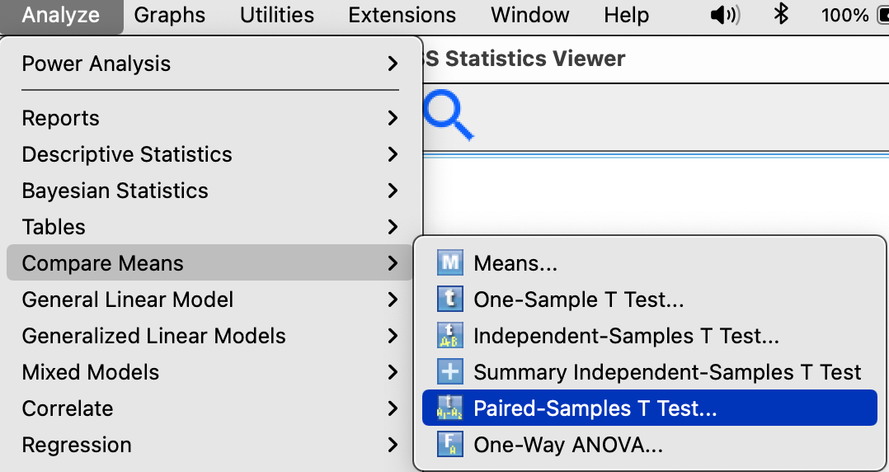
Factory Safety: Paired t-test
Analyze → Compare Means →Paired Samples T-Test

Slide 12
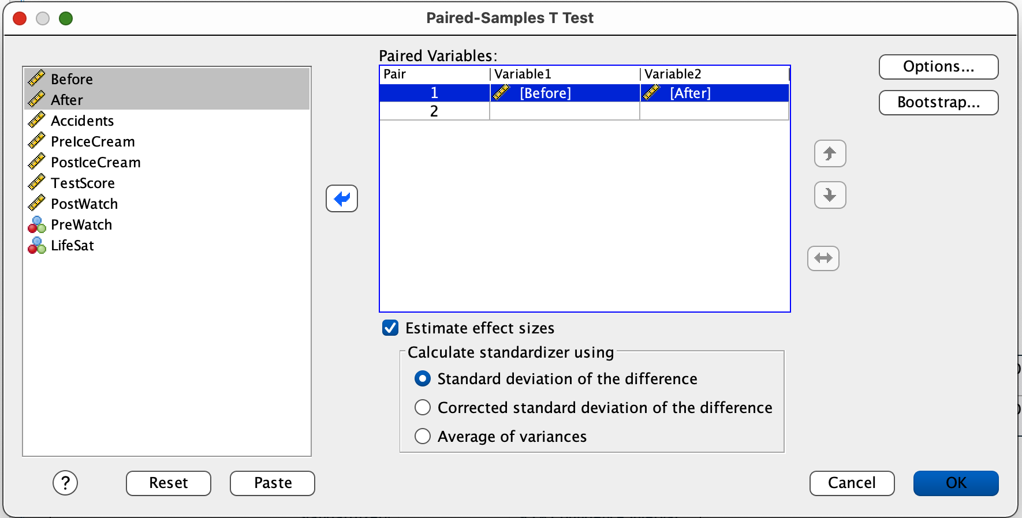
Factory Safety: Paired t-test
Slide the the variables you are comparing into the Paired Variables box.
Then click OK.

Slide 13
Factory Safety: Paired t-test

Slide 14
Paired vs. Independent T-tests
You try it with one of the other data sets:
Factory safety data
Ice cream and exams
Sherlock

Slide 15
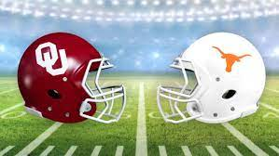
Bastos, et al. (2021)
What is Zoe thinking?
Notes:
Zoe eats ornamental grass at John Wells’ house and throws it up almost immediately?
Can she have any complex thoughts?

Slide 16
Bastos, et al. (2021)
What was their main research question?
Why is there doubt that non-human species (e.g., dogs) can experience jealousy?
What were the major concerns about previous research?
How did they design the experiment?
What were the IVs / DVs / experimental groups?
What was the purpose of the confirmation trial?
What analyses did they run and what did those analyses show?
What conclusions did they draw regarding the capacity of dogs to experience jealousy?
Notes:
Zoe flips if she feels she is not part of the pack. So keeping close to the pack is safe, etc.
Because it is thought to require theory of mind, which many believe is specifically human.
What is theory of mind?

Slide 17
Bastos, et al. (2021)
Why might jealousy be an evolutionary beneficial adaptation?
Why is there doubt that non-human species (e.g., dogs) can experience jealousy?
Notes:
Zoe flips if she feels she is not part of the pack. So keeping close to the pack is safe, etc.
Because it is thought to require theory of mind, which many believe is specifically human.
What is theory of mind?

Slide 18
Bastos, et al. (2021)
What did previous research find?
Dogs react differently when owners interact with a rival than a non-rival
Looking at owner
Whining
Getting in between
Also brain activation

Slide 19
Bastos, et al. (2021)
Why did Batsos, et al. remain unconvinced?
Mere presence of the rival?
Behavior of the owner could have elicited “jealous” actions by dog
Notes:
Lots of alternatives: fear, territoriality, for example.

Slide 20
Bastos, et al. (2021)
What were Batsos, et al. looking for?
Jealous behavior should emerge when its owner interacts with a rival but not with an inanimate object.
Jealous behavior should emerge when a dog’s relationship with the owner is threatened the interaction of a rival rather than its mere presence.
Imagined interactions should also elicit the response; direct observance is not necessary.
What was the purpose of the confirmation trial?
Notes:
Zoe flips if she feels she is not part of the pack.

Slide 21
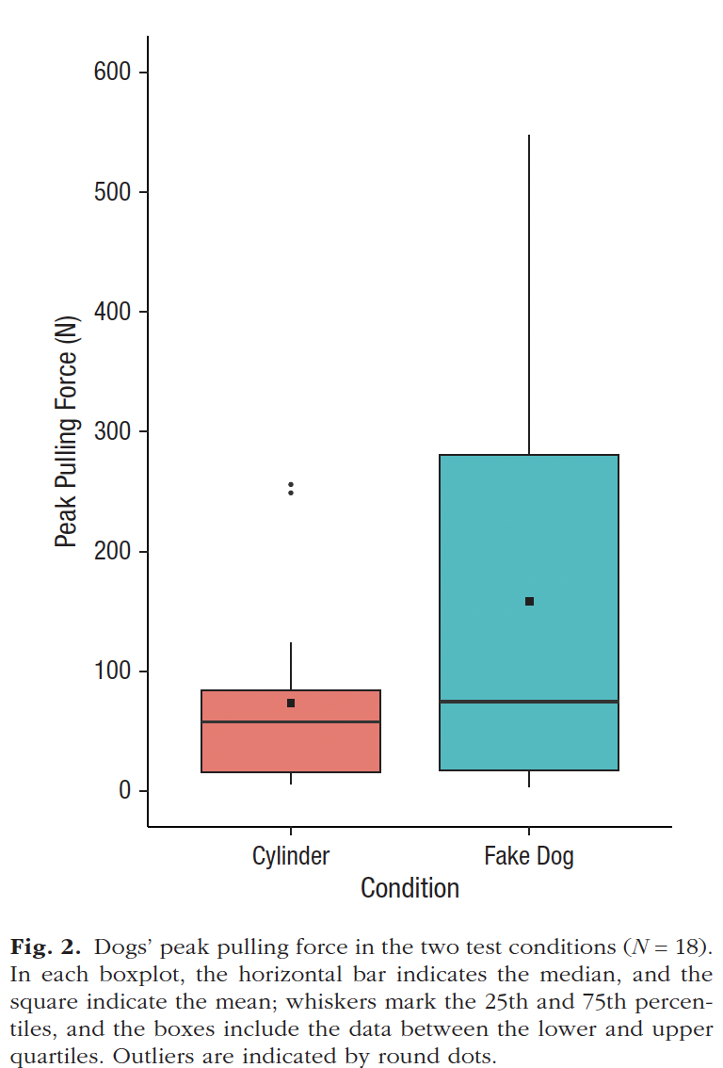
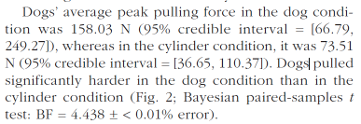
Bastos, et al. (2021)
Results
What do the confidence intervals on page 651 mean?
Is there anything concerning about the confidence intervals vis a vis the conclusions that Batsos et al. draw about the differences between their conditions?
Notes:
Zoe flips if she feels she is not part of the pack.

Slide 22
Batsos, et al. (2021)
Conclusions
Dogs are complex animals who have meaningful social interactions with their owners
Dogs displayed jealous, not just envy (because they didn’t strain with non-living object)
Dogs pulled just as hard when they could see the stuffed dog as when they could not
They were imagining the interaction
Notes:
Zoe flips if she feels she is not part of the pack.

