Slide 1
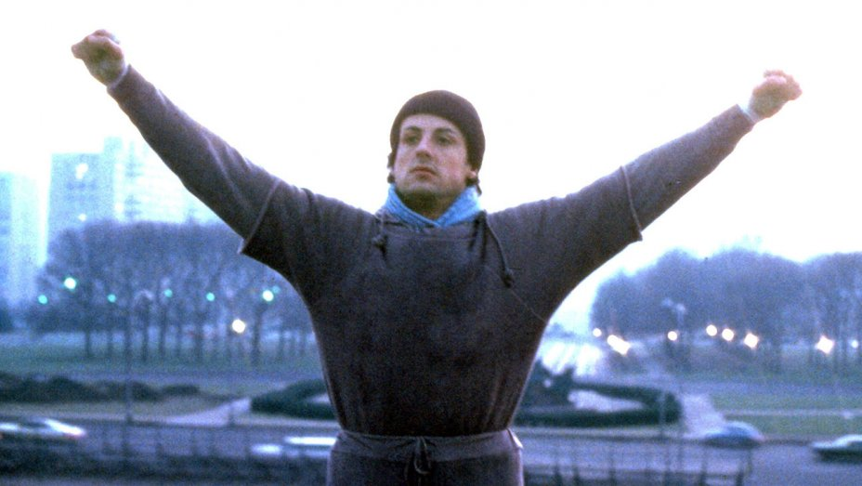
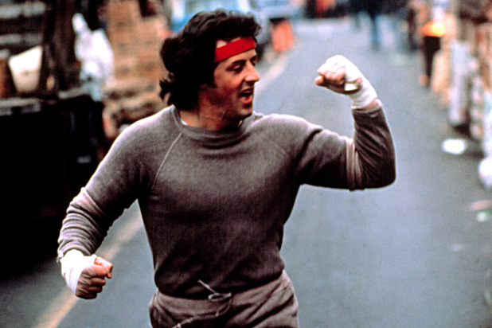
Exam 1 is coming up! You need to train!
Stay up on your skills:
Do the practice problems from the book
Do my practice problems
Review the lecture slides
Make your formula sheet
Can make word doc: copy formulas from the slides
I can check it over if you want
Figure out what you don’t understand
Come see me!!!

Slide 2
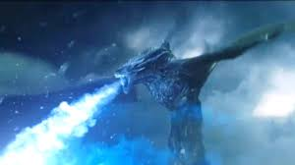
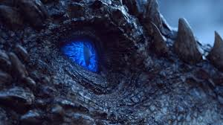
Exam 1 is coming up! You need to train!
Stay up on your skills:
Do the practice problems from the book
Do my practice problems
Review the lecture slides
Make your formula sheet
Can make word doc: copy formulas from the slides
I can check it over if you want
Figure out what you don’t understand
Come see me!!!

Slide 3
Paired t-tests
Why can’t we all just reduce variation due to chance!!

Slide 4
Paired T-tests
Questions about the video lectures

Slide 5
Paired T-tests
Show them stuff in SPSS
And explain differences between paired and independent when doing so. Use the SPSS data sat on Factory safety programs

Slide 6
Types of Two-Sample Tests
Independent test – two conditions are comprised of different elements or subjects
Example: comparing children and adults on a task
Paired test – two conditions are comprised of the same elements or subjects; same observation is measured under different testing conditions.
Example: pre-post observations of the same subjects
Notes:
Yoga pre and post-stress

Slide 7
Sherlock Part Deux
Jake and Abby have their own argument about the benefits of watching Sherlock. Abby thinks that watching a single episode is powerful enough to affect life satisfaction scores; Jake is not convinced. Usually, they solve their disagreements with violence, but we convince them to collect some data instead. They gather 8 of their friends and have them rate their life satisfaction right before and right after watching an episode of Sherlock (‘The Lying Detective’ Series 4, Episode 2).
 |  |  |  |  |  |  |  |  |  | Mean | Variance
 | Ruby | Anna | Pooja | Gimin | Chris | Jack | Steve | Scott
After | 14 | 14 | 20 | 14 | 16 | 10 | 16 | 16 |  | 15 | 8
Before | 10 | 16 | 12 | 12 | 6 | 10 | 12 | 10 |  | 11 | 8
Conduct a hypothesis test to determine whether these data provide enough evidence to conclude that watching an episode of Sherlock influences life satisfaction (­­­­­­­­α = .05). Your answer should include a statement of the null and alternative hypotheses, the critical value for your test statistic, the observed value of your test statistic, your decision regarding the null, an interpretation of the results, and a correct report of the test statistic.

Slide 8
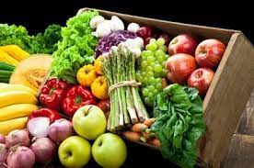
Fruits and Vegetables
If we want to do a paired test, can we compare fruits with vegetables with one another?
Why not?
Instead, let’s ask the following question: are fruits and vegetables a better source of __________ or ___________ <fill in the two blanks with nutrients of your choosing>?

Slide 9
Bastos, et al. (2021)
What is Zoe thinking?
Notes:
Zoe eats ornamental grass at John Wells’ house and throws it up almost immediately?
Can she have any complex thoughts?

Slide 10
Bastos, et al. (2021)
What was their main research question?
Why is there doubt that non-human species (e.g., dogs) can experience jealousy?
What were the major concerns about previous research?
How did they design the experiment?
What were the IVs / DVs / experimental groups?
What was the purpose of the confirmation trial?
What analyses did they run and what did those analyses show?
What conclusions did they draw regarding the capacity of dogs to experience jealousy?
Notes:
Zoe flips if she feels she is not part of the pack. So keeping close to the pack is safe, etc.
Because it is thought to require theory of mind, which many believe is specifically human.
What is theory of mind?

Slide 11
Bastos, et al. (2021)
Why might jealousy be an evolutionary beneficial adaptation?
Why is there doubt that non-human species (e.g., dogs) can experience jealousy?
Notes:
Zoe flips if she feels she is not part of the pack. So keeping close to the pack is safe, etc.
Because it is thought to require theory of mind, which many believe is specifically human.
What is theory of mind?

Slide 12
Bastos, et al. (2021)
What did previous research find?
Dogs react differently when owners interact with a rival than a non-rival
Looking at owner
Whining
Getting in between
Also brain activation

Slide 13
Bastos, et al. (2021)
Why did Batsos, et al. remain unconvinced?
Mere presence of the rival?
Behavior of the owner could have elicited “jealous” actions by dog
Notes:
Lots of alternatives: fear, territoriality, for example.

Slide 14
Bastos, et al. (2021)
What were Batsos, et al. looking for?
Jealous behavior should emerge when its owner interacts with a rival but not with an inanimate object.
Jealous behavior should emerge when a dog’s relationship with the owner is threatened the interaction of a rival rather than its mere presence.
Imagined interactions should also elicit the response; direct observance is not necessary.
What was the purpose of the confirmation trial?
Notes:
Zoe flips if she feels she is not part of the pack.

Slide 15
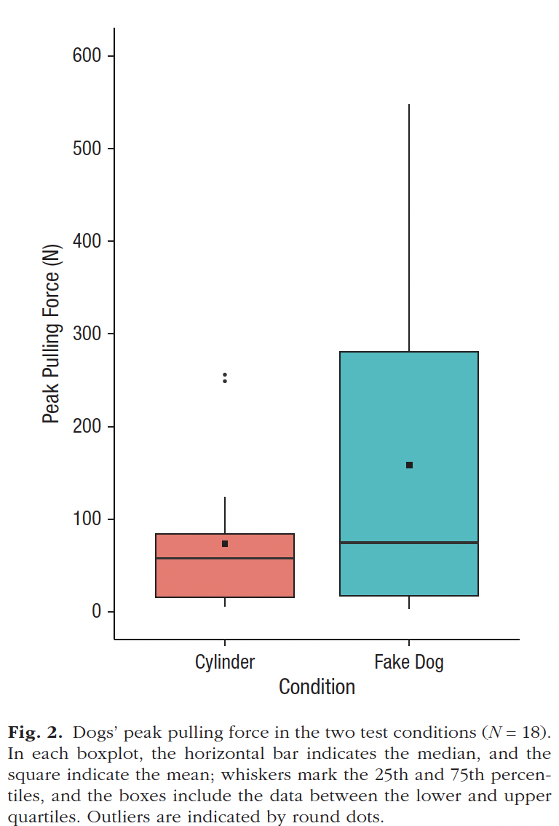
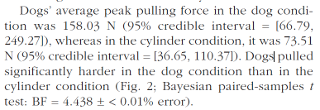
Bastos, et al. (2021)
Results
What do the confidence intervals on page 651 mean?
Is there anything concerning about the confidence intervals vis a vis the conclusions that Batsos et al. draw about the differences between their conditions?
Notes:
Zoe flips if she feels she is not part of the pack.

Slide 16
Batsos, et al. (2021)
Conclusions
Dogs are complex animals who have meaningful social interactions with their owners
Dogs displayed jealous, not just envy (because they didn’t strain with non-living object)
Dogs pulled just as hard when they could see the stuffed dog as when they could not
They were imagining the interaction
Notes:
Zoe flips if she feels she is not part of the pack.

