Slide 1
MidSemester Evaluations
Five-Minute overview at the start of class.
More and fewer hand calculation problems
More and less time for questions
More conceptual questions
Group work
SPSS – where does it fit in?

Slide 2
One-Way ANOVA
Part I

Slide 3
One-Way Anova: The Rundown
T-test was fabulous, but limited to experiments with two or fewer groups
ANOVA is the next step: we use it when we have
One IV
Three or more groups
ANOVA = ANalysis Of VAriance.
Partition the variance into three groups
Total Variability
Variability due to treatment/IV (between)
Variability due to CHANCE (within)
Test Statistic is F
It’s a ratio of Treatment variability divided by chance variability.

Slide 4
One-Way Anova: The Rundown II
What is old?
Hypothesis testing
Null and alternative hypotheses
Observed and critical values
Rejection region; alpha
What is new?
SS formulas
Mean Square / df
F statistic / table
Tukey (next time)
Eta-squared (next time)

Slide 5
Questions about the Video Lectures

Slide 6
Sources of variability
The scores in the data set as a whole are relatively spread apart or relatively bunched together.
The scores in the a treatment are relatively close to one another or relatively spread apart.
The means are relatively similar to the Grand Mean or are relatively dissimilar from the Grand Mean
Which of the above refers to:
Total Variability?
Between treatments?
Withing treatments / error?

Slide 7
Sources of variability
Generate an example of an experiment with an IV that has three levels. Then describe in words what it would mean if each of the following increased/decreased
Which of the above refers to:
Total Variability?
Between treatments?
Withing treatments / error?

Slide 8
How would this graph change if…
Total variability increased/decreased?
Between treatments variability increased/decreased?
Within subjects variability increased/decreased?

Slide 9
SS Treatment lower
Means are closer together
LESS likely to reject the null
SS Treatment higher
Means are further apart
MORE likely to reject the null

Slide 10
SS Error higher
Tails are longer/thicker
LESS likely to reject the null
SS Error lower
Tails are shorter/thinner
MORE likely to reject the null

Slide 11
ANOVA – Total Variability
M₁
M₂
M₃
M_{G}

Slide 12
ANOVA – Treatment Variability
M₁
M₂
M₃
M_{G}

Slide 13
ANOVA – Error Variability
M₁
M₂
M₃
M_{G}

Slide 14
ANOVA: Total = Treatment + Error
Total
Total
Treatment
Error
Error
Treatment
M₁
M₂
M₃
M_{G}

Slide 15
Mood and memory
Does mood effects memory. The subjects in an experiment recalled a list of words after listening to either happy music, sad music, or neutral music. There were 12 subjects in each condition. The data appear in the table below.
What is the IV? What is the DV?
How many factor(s) are in the experiment?
How many levels does the factor have?
What is the null hypothesis for this experiment?
What is the alternative hypothesis for the experiment?
Identify a source of treatment variability?
Identify one source of chance variability.
What is critical value for F?
Interpret the data if Tukey’s HSD = 1.2.
Positive | Neutral | Negative
8.4 | 6.2 | 7.5

Slide 16
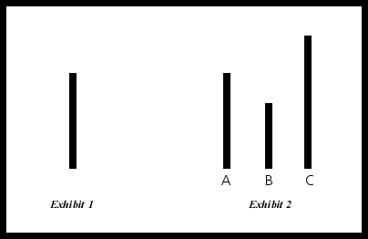
Group Size and Conformity
You are interested in the classic conformity studies conducted by Ashe. You want to replicate findings that group size matters. You randomly assign participants to one of three conditions: 3 person, 4 person, or 5 person groups. You then conduct the classic Ashe experiment and measure the number of times the participant conforms over 25 trials. Does your study suggest that group size affects the likelihood of conformity? Alpha =.05

Slide 17
Formula Sheet: One-Way ANOVA
Step 1: One- vs. Two-tailed Test
Step 2: Determine Ho and Ha
Step 3: Critical value for alpha
Step 4: Calculate
SST; SSB; SSE
MSB; MSE
F ratio
Step 5: Decision regarding the null
Step 6: Tukey test (if necessary)
Step 7: Interpret the the results
$${SS}_{Total}= \sum{x^{2}−\frac{G^{2}}{N}}$$
$${SS}_{bt}= \sum{\left({T^{2}}/n\right)−\frac{G^{2}}{N}}$$
$${SS}_{error}= \sum{\left[\sum{x^{2}}−\frac{T^{2}}{n}\right]}$$
$${df}_{total}=N−1$$
$${df}_{bt}=a−1$$
$${df}_{error} =N−a$$
$${MS}_{bt}=\frac{{SS}_{bt}}{{df}_{bt}}$$
$${MS}_{error}=\frac{{SS}_{error}}{{df}_{error}}$$
$$F=\frac{{MS}_{bt}}{{MS}_{error}}$$
$$Tukey^{′}s HSD=q\sqrt{{{MS}_{error}}/n}$$

Slide 18
Group Size and Conformity
You are interested in the classic conformity studies conducted by Ashe. You want to replicate findings that group size matters. You randomly assign participants to one of three conditions: 3 person, 4 person, or 5 person groups. You then conduct the classic Ashe experiment and measure the number of times the participant conforms over 25 trials. Does your study suggest that group size affects the likelihood of conformity? Alpha =.05
3 Person | 4 Person | 5 Person
10, 11, 14, 17 | 16, 16, 19, 21 | 22, 24, 25, 21
What’s the IV?
What’s the DV?

Slide 19
Group Size and Conformity
3 Person |  | 4 Person |  | 5 Person
x | x² | x | x² | x | x²
10 | 100 | 16 | 256 | 22 | 484
11 | 121 | 16 | 256 | 24 | 576
14 | 196 | 19 | 361 | 25 | 625
17 | 289 | 21 | 441 | 21 | 441
T_{3p} | ∑(x²) | T_{4p} | ∑(x²) | T_{5p} | ∑(x²)
52 | 706 | 72 | 1314 | 92 | 2126
Ho? Ha?
SST; SSB; SSE
MSB; MSE
F ratio
Reject the null?
Interpret?
Post hoc

Slide 20
Group Size and Conformity
3 Person |  | 4 Person |  | 5 Person
x | x² | x | x² | x | x²
10 | 100 | 16 | 256 | 22 | 484
11 | 121 | 16 | 256 | 24 | 576
14 | 196 | 19 | 361 | 25 | 625
17 | 289 | 21 | 441 | 21 | 441
T_{3p} | ∑(x²) | T_{4p} | ∑(x²) | T_{5p} | ∑(x²)
52 | 706 | 72 | 1314 | 92 | 2126
Ho: μ_{3p} = μ_{4p}= μ_{5p}
Ha: μ_{3p} ≠ μ_{4p} ≠ μ_{5p}

Slide 21
Group Size and Conformity
3 Person |  | 4 Person |  | 5 Person
x | x² | x | x² | x | x²
10 | 100 | 16 | 256 | 22 | 484
11 | 121 | 16 | 256 | 24 | 576
14 | 196 | 19 | 361 | 25 | 625
17 | 289 | 21 | 441 | 21 | 441
T_{3p} | ∑(x²) | T_{4p} | ∑(x²) | T_{5p} | ∑(x²)
52 | 706 | 72 | 1314 | 92 | 2126
MSB =SSB/df
= 200/(3-1)
= 200/2
= 100

Slide 22
Group Size and Conformity
3 Person |  | 4 Person |  | 5 Person
x | x² | x | x² | x | x²
10 | 100 | 16 | 256 | 22 | 484
11 | 121 | 16 | 256 | 24 | 576
14 | 196 | 19 | 361 | 25 | 625
17 | 289 | 21 | 441 | 21 | 441
T_{3p} | ∑(x²) | T_{4p} | ∑(x²) | T_{5p} | ∑(x²)
52 | 706 | 72 | 1314 | 92 | 2126
MSE = SSE / df
= 58 / (12-3)
= 58/9
= 6.44

Slide 23
Group Size and Conformity
F = MSB / MSE = 100/6.44 = 15.52
F critical = 4.26; reject the null
Source | SS | df | MS | F
Treatment Error Total | 200.00 58.00 258.00 | 2 9 11 | 100.00 6.44 | 15.52
F (2, 9) = 15.52, p < .05

Slide 24
Reporting the Results
A one-way ANOVA was conducted to determine if the size of the confederate group influenced conformity in the classic ‘Ashe paradigm’. The ANOVA yielded a significant difference across groups: F (2, 9) = 15.52, p < .05; η² = 0.78. A Tukey test indicated that significantly more conformity was observed in the 5-person condition than the 3-person condition. The 4-person condition did not differ significantly from either of the other groups.

Slide 25
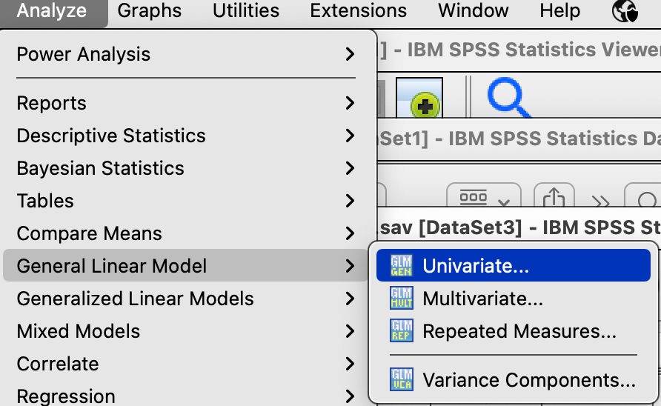
ANOVA in SPSS: Conformity
Analyze → General Linear Model →Univariate

Slide 26
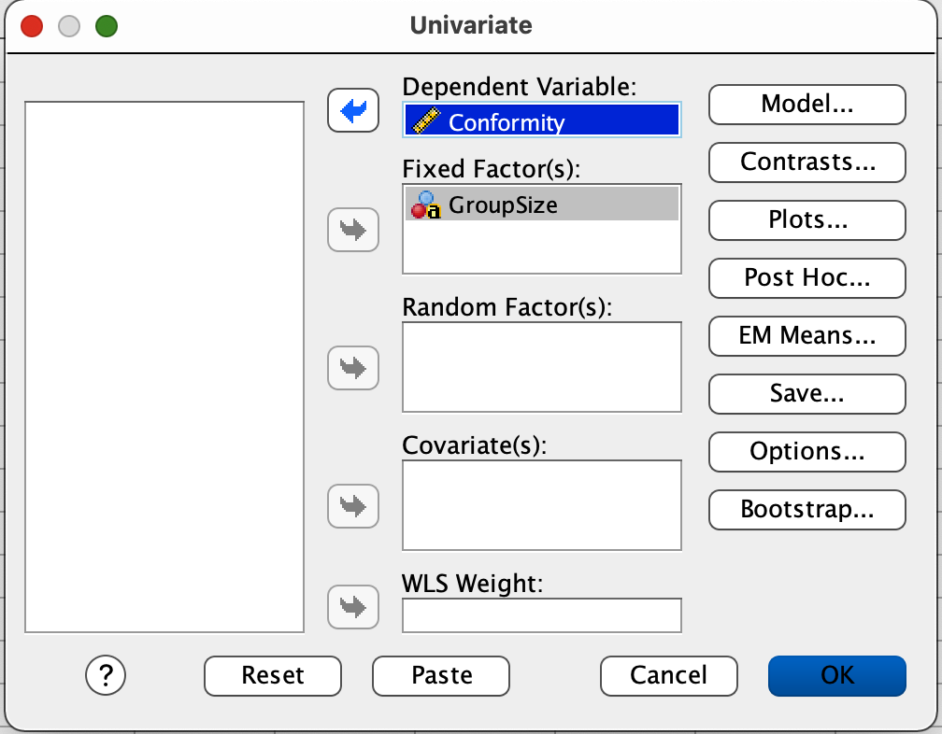
ANOVA in SPSS: Conformity
Slide the IV into the Fixed Factor box.
Slide the DV into the Dependent Variable box.
Then click Options.

Slide 27
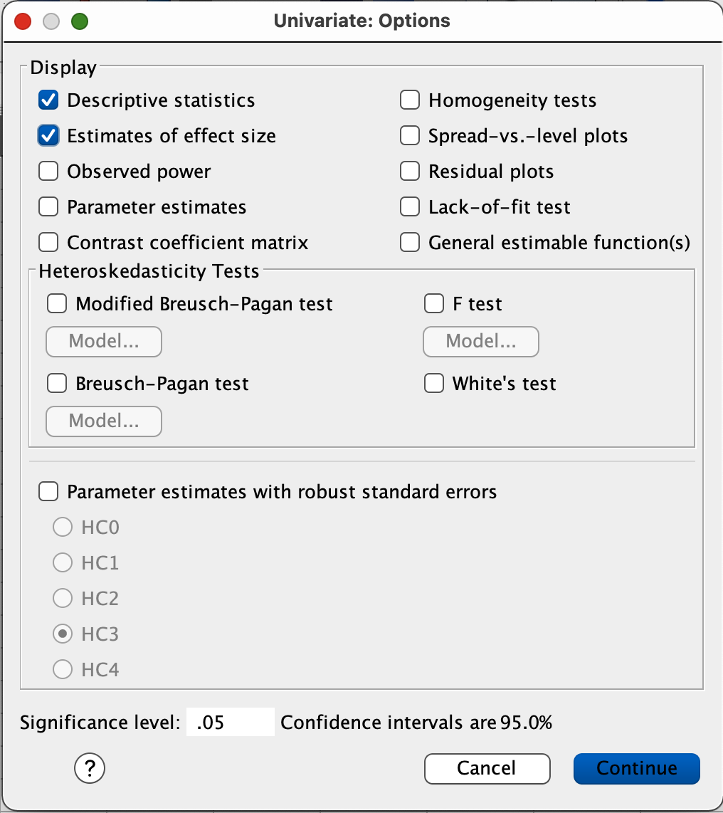
ANOVA in SPSS: Conformity
Check the boxes labeled:
Descriptive statistics and
Estimates of effect size
Click Continue
Click OK

Slide 28
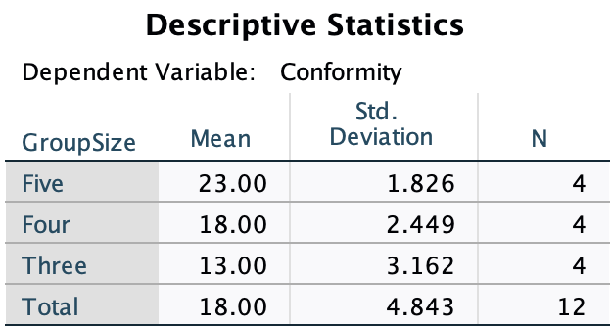
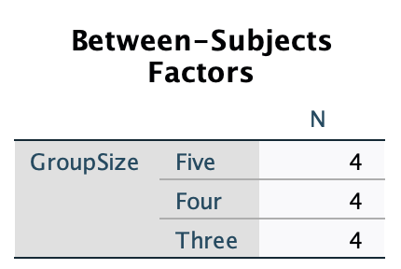
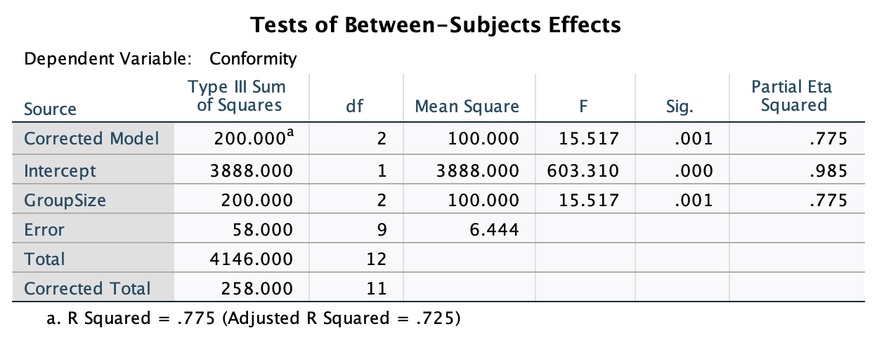
ANOVA in SPSS: Conformity

Slide 29
ANOVA in SPSS: Ladder data
UPDATE when you have the data!!

Slide 30
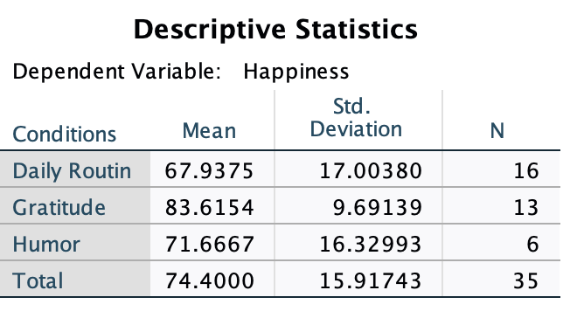
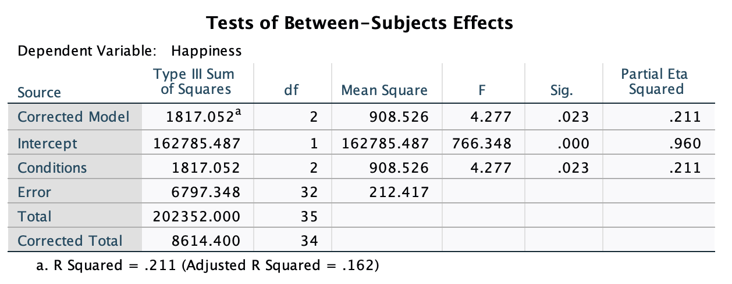
ANOVA in SPSS: Ladder data

Slide 31
Problem Solving
A research team wants to determine how experience affects problem solving. They randomly assign their subjects into three groups: 1/3 solve an easy logic problem; 1/3 solve a difficult logic problem; 1/3 are given an unsolvable logic problem. Then, all three groups are given the same moderately difficult logic problem to solve and the number of minutes required to solve the problem is recorded. Do the data suggest that exposure affects problem solving? Set alpha = .05.
Easy |  | Hard |  | Unsolvable
x |  | x |  | x
4 |  | 2 |  | 7
6 |  | 4 |  | 9
8 |  | 3 |  | 11

Slide 32
Problem Solving
A research team wants to determine how experience affects problem solving. They randomly assign their subjects into three groups: 1/3 solve an easy logic problem; 1/3 solve a difficult logic problem; 1/3 are given an unsolvable logic problem. Then, all three groups are given the same moderately difficult logic problem to solve and the number of minutes required to solve the problem is recorded. Do the data suggest that exposure affects problem solving? Set alpha = .05.
Easy |  | Hard |  | Unsolvable
x |  | x |  | x
4 |  | 2 |  | 7
6 |  | 4 |  | 9
8 |  | 3 |  | 11

Slide 33
SStotal
A research team wants to determine how experience affects problem solving. They randomly assign their subjects into three groups: 1/3 solve an easy logic problem; 1/3 solve a difficult logic problem; 1/3 are given an unsolvable logic problem. Then, all three groups are given the same moderately difficult logic problem to solve and the number of minutes required to solve the problem is recorded. Do the data suggest that exposure affects problem solving? Set alpha = .05.
Easy |  | Hard |  | Unsolvable
x |  | x |  | x
4 |  | 2 |  | 7
6 |  | 4 |  | 9
8 |  | 3 |  | 11
Grand mean = 6 vs.

Slide 34
SStotal=0 Every score would be the same and equal to the grand mean
Easy |  | Hard |  | Unsolvable
x |  | x |  | x
6 |  | 6 |  | 6
6 |  | 6 |  | 6
6 |  | 6 |  | 6
$${SS}_{T}=\sum{\left(X^{2}\right)−\frac{G^{2}}{N}}$$
$${SS}_{T}=\left(108+108+108\right)−\frac{{\left(18+18+18\right)}^{2}}{9}$$
$${SS}_{T}=324−\left(\frac{2916}{9}\right)$$
$${SS}_{T}=324−324 = 0$$

Slide 35
SSbetween
A research team wants to determine how experience affects problem solving. They randomly assign their subjects into three groups: 1/3 solve an easy logic problem; 1/3 solve a difficult logic problem; 1/3 are given an unsolvable logic problem. Then, all three groups are given the same moderately difficult logic problem to solve and the number of minutes required to solve the problem is recorded. Do the data suggest that exposure affects problem solving? Set alpha = .05.
Easy |  | Hard |  | Unsolvable
x |  | x |  | x
4 |  | 2 |  | 7
6 |  | 4 |  | 9
8 |  | 3 |  | 11
M = 6 |  | M = 3 |  | M = 9
Grand mean = 6 vs.

Slide 36
SSbetween = 0 Every treatment mean would be the same and equal to the grand mean
Easy |  | Hard |  | Unsolvable
x |  | x |  | x
4 |  | 6 |  | 3
6 |  | 7 |  | 9
8 |  | 5 |  | 6
M = 6 |  | M = 6 |  | M = 6
$${SS}_{B}=\left[\sum{\left(\frac{T^{2}}{n}\right)}\right]−\frac{G^{2}}{N}$$
$${SS}_{B}=\left[\frac{{18}^{2}}{3}+\frac{{18}^{2}}{3}+\frac{{18}^{2}}{3}\right]−\frac{{54}^{2}}{9}$$
$${SS}_{B}=\left[108+108+108\right]−324$$
${SS}_{B}$= 324-324 = 0

Slide 37
SSerror
A research team wants to determine how experience affects problem solving. They randomly assign their subjects into three groups: 1/3 solve an easy logic problem; 1/3 solve a difficult logic problem; 1/3 are given an unsolvable logic problem. Then, all three groups are given the same moderately difficult logic problem to solve and the number of minutes required to solve the problem is recorded. Do the data suggest that exposure affects problem solving? Set alpha = .05.
Easy |  | Hard |  | Unsolvable
x |  | x |  | x
4 |  | 2 |  | 7
6 |  | 4 |  | 9
8 |  | 3 |  | 11
M = 6 |  | M = 3 |  | M = 9

Slide 38
SSerror = 0 Every treatment mean would be the same and equal to the grand mean
Easy |  | Hard |  | Unsolvable
x |  | x |  | x
6 |  | 3 |  | 9
6 |  | 3 |  | 9
6 |  | 3 |  | 9
M = 6 |  | M = 3 |  | M = 9
$${SS}_{E}=\sum{\left[\sum{\left(x^{2}\right)−\left(\frac{T^{2}}{n}\right)}\right]}$$
${SS}_{E}=\left[108−\frac{{18}^{2}}{3}\right]+\left[27−\frac{9^{2}}{3}\right]$+ $\left[243−\frac{{27}^{2}}{3}\right]$
${SS}_{E}=\left[108−108\right]+\left[27−27\right]$+ $\left[243−243\right]$
${SS}_{E}=0+0$+ $0 =0$

Slide 39
SSbetween
A researcher wants to determine whether Exercise affects stress level. He collects data from nine people: 3 walkers, 3 joggers and 3 runners. They rate their stress from 1 (low) to 10 (high). Do the data suggest that exercise level affects stress? Set alpha = .05.
Easy |  | Hard |  | Unsolvable
x |  | x |  | x
1 |  | 4 |  | 7
2 |  | 5 |  | 8
3 |  | 6 |  | 9
M =2 |  | M=5 |  | M=8
Grand mean = 5

