Slide 1
One-Way ANOVA

Slide 2
Questions about the Video Lectures

Slide 3
What do we do if we have more than 2 samples?
Caffeine and Exam Performance
No Coffee | Little bit | A Lot
78 | 84 | 70
Caffeine, Studying, and Exam Performance
 | No Coffee | Little Bit | Lot
Studied | 82 | 95 | 80
Did not Study | 74 | 73 | 60

Slide 4
Meet ANOVA
Analysis of variance (ANOVA): hypothesis testing procedure that can test mean differences between two or more groups.
Used to distinguish between two hypotheses:
Ho: there really are no differences between the populations of the groups. Observed differences are caused by random, unsystematic sampling error
Ha: the populations really do have different means and the differences in the population means causes the systematic differences between the groups.

Slide 5
Designed Experiments vs. Observational Studies
Observational Studies: Collect what we get
Designed Experiments: Try to hold all variables equal (via random sample) except those we are interested in.
Cause and Effect relationships
"People who eat fish have fewer heart attacks"
Yes, but:
"People who turn their exams in earlier tend to earn higher scores"
Yes, but:

Slide 6
Key Definitions
Caffeine and Exam Performance
No Coffee | Little bit | A Lot
78 | 84 | 70
Dependent Variable: Quantity we are interested in measuring
EX: Exam Performance
Independent Variable: Quantity(ies) that we control; generally those that we think will have a significant effect on DV. Also called Factors
EX: Caffeine Intake

Slide 7
Key Definitions
Caffeine, Studying, and Exam Performance
 | No Coffee | Little Bit | Lot
Studied | 82 | 95 | 80
Did not Study | 74 | 73 | 60
Factor Levels: values associated with a factor
No coffee vs. Little bit vs. Lot
Study vs. Did not study
Treatment: a particular combination of factor levels.
No coffee/studied
Little Bit of Coffee/Did not study

Slide 8
Types of ANOVA designs
Caffeine and Exam Performance
Single Factor Design/
One-way
No Coffee | Little bit | A Lot
78 | 84 | 70
Changes in Exam Performance
Repeated Measures Design
Exam 1 | Exam 2 | Exam 3
85 | 88 | 90
Caffeine, Studying, and Exam Performance
 | None | Little Bit | Lot
Studied | 82 | 95 | 80
Did not Study | 74 | 73 | 60
Two Factor Design/
Factorial Design

Slide 9
Types of ANOVA designs
Caffeine, Studying, and Exam Performance
2 x 3 Between Subjects ANOVA
2 x 3 Within Subjects / RM ANOVA
 | None | Little Bit | Lot
Studied | 82 | 95 | 80
Did not Study | 74 | 73 | 60
Studying and Exam Performance over time
 | Exam 1 | Exam 2 | Exam 3
Studied | 88 | 90 | 95
Did not Study | 75 | 72 | 68

Slide 10
One-WAY ANOVA:
Independent single-factor design

Slide 11
Detergent (One-Way ANOVA)
You have just been given job as Staff Analyst at Consumer Reports magazine. You are given the following data to analyze. The data represent “Gleamyness” readings on fifteen swatches of cotton cloth that were soiled with motor oil and then washed using one of three detergents.
Color | Gleamyness Rating | Mean | Variance | Std. Dev.
Brighty | 77,81,71,76,80 | 77 | 15.50 | 3.937
Gleamy | 72,58,74,66,70 | 68 | 40.00 | 6.325
Shinola | 76,85,82,80,77 | 80 | 13.5 | 3.674

Slide 12
Color | Gleamyness Rating | Mean | Variance | Std. Dev.
Brighty | 77,81,71,76,80 | 77 | 15.50 | 3.937
Gleamy | 72,58,74,66,70 | 68 | 40.00 | 6.325
Shinola | 76,85,82,80,77 | 80 | 13.5 | 3.674
Research Question: Are there any differences in the effectiveness of the laundry detergents?
Ho: µ_{B} = µ_{G} = µ_{S}
Ha: At least two differ, µ_{B} ≠ µ_{G} ≠ µ_{S}

Slide 13
F: test statistic for ANOVA
Color | Gleamyness Rating | Mean | Variance | Std. Dev.
Brighty | 77,81,71,76,80 | 77 | 15.50 | 3.937
Gleamy | 72,58,74,66,70 | 68 | 40.00 | 6.325
Shinola | 76,85,82,80,77 | 80 | 13.5 | 3.674

Slide 14
F: test statistic for ANOVA
Color | Gleamyness | Mean | Variance | Std. Dev.
Brighty | 77,81,71,76,80 | 77 | 15.50 | 3.937
Gleamy | 72,58,74,66,70 | 68 | 40.00 | 6.325
Shinola | 76,85,82,80,77 | 80 | 13.5 | 3.674
We will need to calculate:
Total variability in the data
Variation due to the treatment effect
Variation due to chance

Slide 15
SS total
(total variability)
SS between
(variability due to tx)
SS Within/Error
(variability due to error)

Slide 16
Logic of F-test (ANOVA)
Assume all units have the same value except for variation due to:
Chance
treatment
How one partitions the variance into chance (error) and treatment is going to depend on
WHO is doing the partitioning and
WHY one is conducting the experiment.
Performance on the Midterm Exam depends on:
IQ
Study
Mood
Good Hair Day

Slide 17
F: test statistic for ANOVA
Color | Gleamyness Rating | Mean | Variance | Std. Dev.
Brighty | 77,81,71,76,80 | 77 | 15.50 | 3.937
Gleamy | 72,58,74,66,70 | 68 | 40.00 | 6.325
Shinola | 76,85,82,80,77 | 80 | 13.5 | 3.674
vs. Grand mean = 75
1. Total variability in the data is reflected by the difference between each individual score and the grand mean
Called SStotal or SST

Slide 18
Calculating SStotal
Brighty |  | Gleamy |  | Shinola
x | x² | x | x² | x | x²
77 | 5929 | 72 | 5184 | 76 | 5776
81 | 6561 | 58 | 3364 | 85 | 7225
71 | 5041 | 74 | 5476 | 82 | 6724
76 | 5776 | 66 | 4356 | 80 | 6400
80 | 6400 | 70 | 4900 | 77 | 5929
T_{B} | ∑(x²) | T_{G} | ∑(x²) | T_{S} | ∑(x²)
385 | 29707 | 340 | 23280 | 400 | 32054

Slide 19
F: test statistic for ANOVA
Color | Gleamyness Rating | Mean | Variance | Std. Dev.
Brighty | 77,81,71,76,80 | 77 | 15.50 | 3.937
Gleamy | 72,58,74,66,70 | 68 | 40.00 | 6.325
Shinola | 76,85,82,80,77 | 80 | 13.5 | 3.674
vs. Grand mean = 75
2. Variation due to the effect of treatment is reflected by the difference between the different treatment means and the grand mean.
Called SSbetween or SSB

Slide 20
Calculating SSbetween
Brighty |  | Gleamy |  | Shinola
x | x² | x | x² | x | x²
77 | 5929 | 72 | 5184 | 76 | 5776
81 | 6561 | 58 | 3364 | 85 | 7225
71 | 5041 | 74 | 5476 | 82 | 6724
76 | 5776 | 66 | 4356 | 80 | 6400
80 | 6400 | 70 | 4900 | 77 | 5929
T_{B} | ∑(x²) | T_{G} | ∑(x²) | T_{S} | ∑(x²)
385 | 29707 | 340 | 23280 | 400 | 32054

Slide 21
F: test statistic for ANOVA
Color | Gleamyness Rating | Mean | Variance | Std. Dev.
Brighty | 77,81,71,76,80 | 77 | 15.50 | 3.937
Gleamy | 72,58,74,66,70 | 68 | 40.00 | 6.325
Shinola | 76,85,82,80,77 | 80 | 13.5 | 3.674
vs.
vs.
vs.
3. Variation due to chance is reflected by the difference between the units (subjects) within a given treatment and the mean for that treatment.
Called SSerror or SSE or SSW (SS within)

Slide 22
Calculating SSerror
Brighty |  | Gleamy |  | Shinola
x | x² | x | x² | x | x²
77 | 5929 | 72 | 5184 | 76 | 5776
81 | 6561 | 58 | 3364 | 85 | 7225
71 | 5041 | 74 | 5476 | 82 | 6724
76 | 5776 | 66 | 4356 | 80 | 6400
80 | 6400 | 70 | 4900 | 77 | 5929
T_{B} | ∑(x²) | T_{G} | ∑(x²) | T_{S} | ∑(x²)
385 | 29707 | 340 | 23280 | 400 | 32054

Slide 23
Brighty |  | Gleamy |  | Shinola
x | x² | x | x² | x | x²
77 | 5929 | 72 | 5184 | 76 | 5776
81 | 6561 | 58 | 3364 | 85 | 7225
71 | 5041 | 74 | 5476 | 82 | 6724
76 | 5776 | 66 | 4356 | 80 | 6400
80 | 6400 | 70 | 4900 | 77 | 5929
T_{B} | ∑(x²) | T_{G} | ∑(x²) | T_{S} | ∑(x²)
385 | 29707 | 340 | 23280 | 400 | 32054
666 =
390 +
276

Slide 24
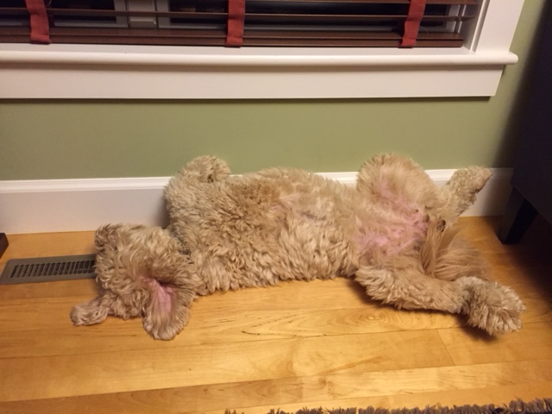
Exhausted yet?
Hang in there, we have a df issue to address

Slide 25
Mean Square
SSB and SSE are based on largely different numbers of observations. We correct for this by dividing by the degrees of freedom.
Mean square (MS) = Variance = SS / df
MSbetween = SS / (p-1)
MSerror = SS / (N-p)
 | df
SST | N-1
SSB | p-1
SSE | N-p
where N = number of observations
where p = number of treatments

Slide 26
Calculating MS
Brighty |  | Gleamy |  | Shinola
x | x² | x | x² | x | x²
77 | 5929 | 72 | 5184 | 76 | 5776
81 | 6561 | 58 | 3364 | 85 | 7225
71 | 5041 | 74 | 5476 | 82 | 6724
76 | 5776 | 66 | 4356 | 80 | 6400
80 | 6400 | 70 | 4900 | 77 | 5929
T_{B} | ∑(x²) | T_{G} | ∑(x²) | T_{S} | ∑(x²)
385 | 29707 | 340 | 23280 | 400 | 32054
 | SS | Df | MS
Between | 390 | p-1 3-1 2 | 195
Error | 276 | N-P 15-3 12 | 23
Note: dftotal = N-1 = 14 = (2+12)

Slide 27
Calculating MS
Brighty |  | Gleamy |  | Shinola
x | x² | x | x² | x | x²
77 | 5929 | 72 | 5184 | 76 | 5776
81 | 6561 | 58 | 3364 | 85 | 7225
71 | 5041 | 74 | 5476 | 82 | 6724
76 | 5776 | 66 | 4356 | 80 | 6400
80 | 6400 | 70 | 4900 | 77 | 5929
T_{B} | ∑() | T_{G} | ∑() | T_{S} | ∑()
385 | 29707 | 340 | 23280 | 400 | 32054
SStotal = 666 df=N-1=15-1=14 MStotal = (not a thing)
SSbetween = 390 df=p-1=3-1=2 MSbet =390/2=195
SSerror = 276 df=N-p=15-3=12 MSerr=276/12=23
Source | SS | df | MS | F
Between | 390 | 2 | 195
Error | 276 | 12 | 23
Total | 666 | 14

Slide 28
Calculating MS
Brighty |  | Gleamy |  | Shinola
x | x² | x | x² | x | x²
77 | 5929 | 72 | 5184 | 76 | 5776
81 | 6561 | 58 | 3364 | 85 | 7225
71 | 5041 | 74 | 5476 | 82 | 6724
76 | 5776 | 66 | 4356 | 80 | 6400
80 | 6400 | 70 | 4900 | 77 | 5929
T_{B} | ∑() | T_{G} | ∑() | T_{S} | ∑()
385 | 29707 | 340 | 23280 | 400 | 32054
SStotal = 666 df=N-1=15-1=14 MStotal = (not a thing)
SSbetween = 390 df=p-1=3-1=2 MSbet =390/2=195
SSerror = 276 df=N-p=15-3=12 MSerr=276/12=23
Source | SS | df | MS | F
Between | 390 | 2 | 195 | 8.47
Error | 276 | 12 | 23
Total | 666 | 14
Finally…our test statistic!!!

Slide 29
Ok…now what?
You FINALLY calculated an F statistic!
This is F observed
SO now we need to compare this with an F Critical Value to see if we can reject the null:
F_{crit}(df_{num}, df_{denom}, α) F_{crit} (2, 12, α_{.05})
df between
df error
p-1
N -p

Slide 30
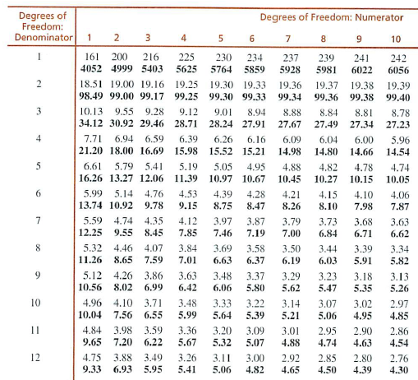
F(df_{num}, df_{denom}, α)
F(2, 12, .05)
F crit =3.88
$$F obs=8.47$$

Slide 31
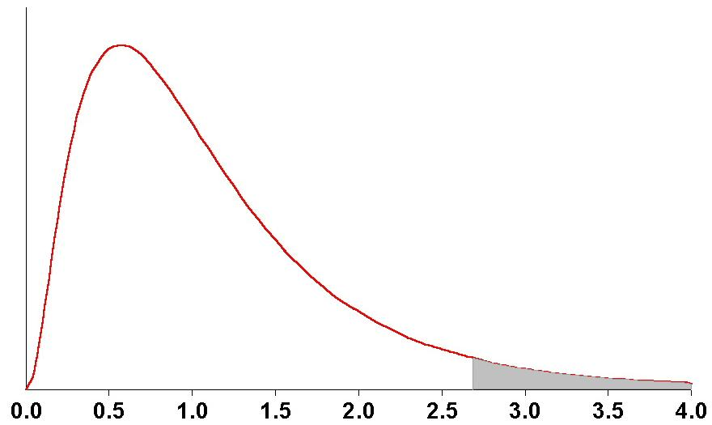
F distribution
*If null is true then F should be 1.0

Slide 32
Detergent | Mean
Brighty | 77
Gleamy | 68
Shinola | 80
F obs = 8.47 F crit = 3.88
F obs > F crit
therefore we will reject the null
Interpretation: There is a significant difference in the effectiveness of the three detergents.
But which detergents are different from one another?
Need post-hoc tests to figure out where the difference is
…..stay tuned

Slide 33
Detergent example: ANOVA table
Source | SS | df | MS | F
Treatment Error Total | 390.00 276.00 666.00 | 2 12 14 | 195.00 23.00 | 8.47
Reporting results:
F (2, 12) = 8.47, p < .05
p-1
N -p
F statistic

Slide 34
SStotal=0
Runners |  | Joggers |  | Walkers
x |  | x |  | x
5 |  | 5 |  | 5
5 |  | 5 |  | 5
5 |  | 5 |  | 5
Grand mean = 5 vs.

Slide 35
SSbetween = 0
Runners |  | Joggers |  | Walkers
x |  | x |  | x
3 |  | 4 |  | 5
5 |  | 5 |  | 5
7 |  | 6 |  | 5
M =5 |  | M=5 |  | M=5
Grand mean = 5
Notes:
.

Slide 36
SSerror = 0
A researcher wants to determine whether Exercise affects stress level. He collects data from nine people: 3 walkers, 3 joggers and 3 runners. They rate their stress from 1 (low) to 10 (high). Do the data suggest that exercise level affects stress? Set alpha = .05.
Runners |  | Joggers |  | Walkers
x |  | x |  | x
2 |  | 5 |  | 8
2 |  | 5 |  | 8
2 |  | 5 |  | 8
M =2 | + | M=5 | + | M=8

Slide 37
SSerror = 0
Runners |  | Joggers |  | Walkers
x |  | x |  | x
2 |  | 5 |  | 8
2 |  | 5 |  | 8
2 |  | 5 |  | 8
M =2 | + | M=5 | + | M=8

Slide 38
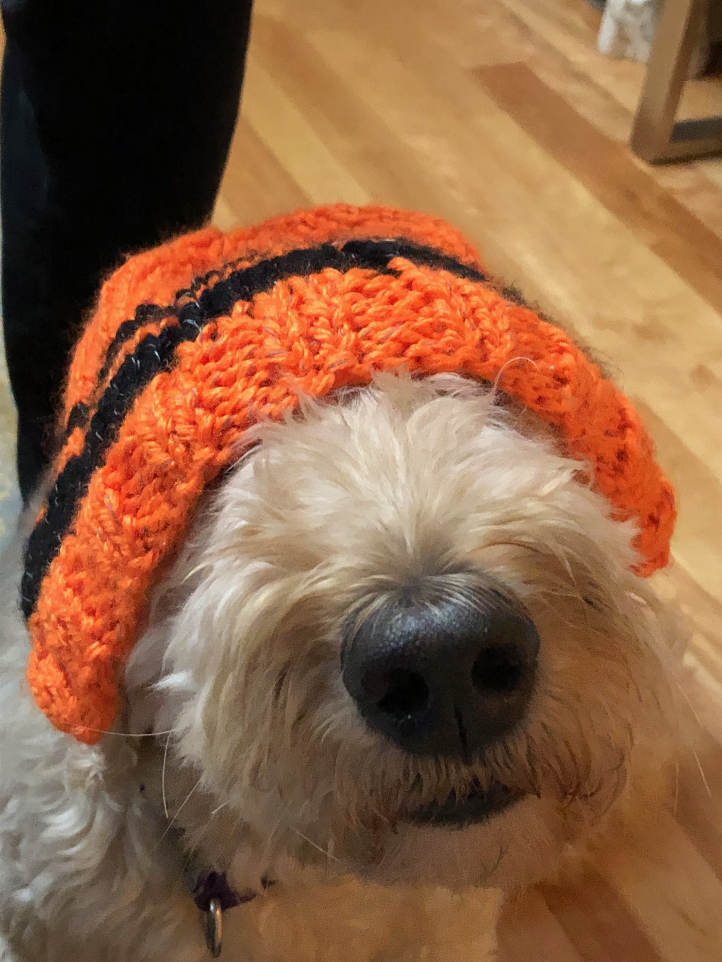
Are you kidding me? I can’t take any more of this ANOVA garbage. And take off this ridiculous hat. You know I don’t like wearing it.

Slide 39
Post-Hoc Tests
ANOVA test: Is there a significant difference in the DV depending on the factor level?
When we reject Ho: We conclude there is a difference between at least two groups (but we don’t know where that difference is)
How do we know which groups differ?
Post-hoc tests: additional hypothesis tests done after an ANOVA to determine which mean differences are significant
Only performed if:
You reject the null for the ANOVA
You have 3 or more factor levels

Slide 40
Type I Error Rate
Test 1: M1 vs. M2 alpha = .05
Test 2: M1 vs. M3 alpha = .05
Test 3: M2 vs. M3 alpha = .05
Type I Error rate:
Comparisonwise: Probability of making a Type I error for an individual test (equal to the value of alpha)
Experimentwise: Total probability of a Type I error accumulated across individual tests

Slide 41
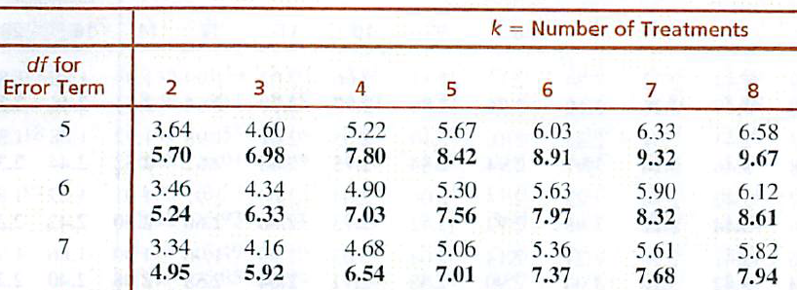
Post-hoc tests using HSD
Tukey’s (HSD) | Compute a minimum difference needed between treatments to conclude significance * “should” have equal groups

Slide 42
Detergents (One-Way ANOVA)
You have just been given job as Staff Analyst at Consumer Reports magazine. You are given the following data to analyze. The data represent “Gleamyness” readings on fifteen swatches of cotton cloth that were soiled with motor oil and then washed using one of three detergents.
Detergent | Mean
Brighty | 77
Gleamy | 68
Shinola | 80
Source | SS | df | MS | F
Treatment Error Total | 390.00 276.00 666.00 | 2 12 14 | 195.00 23.00 | 8.47

Slide 43
Calculating Tukey's HSD – Detergent Problem
Source | SS | df | MS | F
Treatment Error Total | 390.00 276.00 666.00 | 2 12 14 | 195.00 23.00 | 8.47
You can figure out the size of each group just from looking at the ANOVA table!
Total df = 14 = N-1
….that means 15 subjects total
Treatment df = 2 = p -1
….that means there were 3 treatments
So… 15 subjects/ 3 treatments = 5 per group

Slide 44
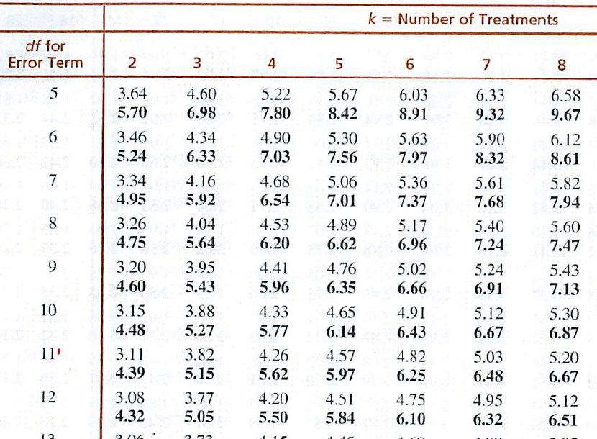
Calculating Tukey's HSD – Detergent Problem
Finding q:
Column: # of treatments (k) = 3
Row: df_{error} = 12
unbolded α = .05; bolded α =.01

Slide 45
Calculating Tukey's HSD – Detergent Problem
Detergent | Mean
Brighty | 77
Gleamy | 68
Shinola | 80
Brighty- Gleamy=77- 68 = │9│ > 8.09 Significant diff.
Brighty– Shinola=77- 80 = │-3│ < 8.09 not significant
Shinola- Gleamy=80 - 68 = │12│ > 8.09 Significant diff.

Slide 46
Final ANOVA interpretation
Detergent | Mean
Brighty | 77
Gleamy | 68
Shinola | 80
Interpretation: The results of the one-way ANOVA indicated that there were significant differences between the effectiveness of the three detergents, F (2, 12) = 8.47, p < .05. Post-hoc comparisons indicated that Shinola (M = 80) and Brighty (M = 77) were both more effective than Gleamy (M = 68). However, the difference between Brighty and Shinola was too small for us to conclude that they differed in terms of effectiveness.

Slide 47
Effect size
Measure of how large the treatment effect is
η² ⁼ eta squared=$\frac{SSB}{SST}=\frac{54}{60}=.90$
Interpretation: Exercise level explains $90\%$ of the variation in stress levels
Source | SS | df | MS | F
Between Error Total | 54.00 6.00 60.00 | 2 6 8 | 27.00 1.00 | 27.00

Slide 48
One-Way ANOVA
OVERVIEW

Slide 49
Questions about the Video Lectures

Slide 50
Sources of variability
The scores in the data set as a whole are relatively spread apart or relatively bunched together.
The scores in the a treatment are relatively close to one another or relatively spread apart.
The means are relatively similar to the Grand Mean or are relatively dissimilar from the Grand Mean
SStotal?
SSbetween?
SSwithin?

Slide 51
Mood and memory
A psychologist wants to know if mood effects memory. He manipulates mood by playing different groups of subjects happy music, sad music, or neutral music. There were 12 subjects in each condition. The means appear in the table below.
What is the IV? What is the DV?
How many factor(s) are in the experiment?
How many levels does the factor have?
What is the null hypothesis for this experiment?
What is the alternative hypothesis for the experiment?
Identify a source of treatment variability?
Identify one source of chance variability.
What is critical value for F?
Interpret the data if Tukey’s HSD = 1.2.
Positive | Neutral | Negative
8.4 | 6.2 | 7.5

Slide 52
Is this a significant difference?
M₁
M₂
M₃
M_{G}

Slide 53
Is this a significant difference?
M₁
M₂
M₃
M_{G}

Slide 54
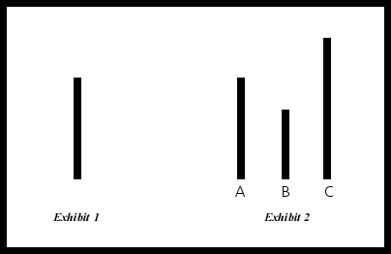
Group Size and Conformity
You are interested in the classic conformity studies conducted by Ashe. You want to replicate findings that group size matters. You randomly assign participants to one of three conditions: 3 person, 4 person, or 5 person groups. You then conduct the classic Ashe experiment and measure the number of times the participant conforms over 25 trials. Does your study suggest that group size affects the likelihood of conformity? Alpha =.05

Slide 55
Group Size and Conformity
You are interested in the classic conformity studies conducted by Ashe. You want to replicate findings that group size matters. You randomly assign participants to one of three conditions: 3 person, 4 person, or 5 person groups. You then conduct the classic Ashe experiment and measure the number of times the participant conforms over 25 trials. Does your study suggest that group size affects the likelihood of conformity? Alpha =.05
3 Person | 4 Person | 5 Person
10, 11, 14, 17 | 16, 16, 19, 21 | 22, 24, 25, 21
What’s the IV?
What’s the DV?

Slide 56
Group Size and Conformity
3 Person |  | 4 Person |  | 5 Person
x | x² | x | x² | x | x²
10 | 100 | 16 | 256 | 22 | 484
11 | 121 | 16 | 256 | 24 | 576
14 | 196 | 19 | 361 | 25 | 625
17 | 289 | 21 | 441 | 21 | 441
T_{3p} | ∑(x²) | T_{4p} | ∑(x²) | T_{5p} | ∑(x²)
52 | 706 | 72 | 1314 | 92 | 2126
Ho? Ha?
SST; SSB; SSE
MSB; MSE
F ratio
Reject the null?
Interpret?
Post hoc

Slide 57
Group Size and Conformity
3 Person |  | 4 Person |  | 5 Person
x | x² | x | x² | x | x²
10 | 100 | 16 | 256 | 22 | 484
11 | 121 | 16 | 256 | 24 | 576
14 | 196 | 19 | 361 | 25 | 625
17 | 289 | 21 | 441 | 21 | 441
T_{3p} | ∑(x²) | T_{4p} | ∑(x²) | T_{5p} | ∑(x²)
52 | 706 | 72 | 1314 | 92 | 2126
Ho: μ_{3p} = μ_{4p}= μ_{5p}
Ha: μ_{3p} ≠ μ_{4p} ≠ μ_{5p}

Slide 58
Group Size and Conformity
3 Person |  | 4 Person |  | 5 Person
x | x² | x | x² | x | x²
10 | 100 | 16 | 256 | 22 | 484
11 | 121 | 16 | 256 | 24 | 576
14 | 196 | 19 | 361 | 25 | 625
17 | 289 | 21 | 441 | 21 | 441
T_{3p} | ∑(x²) | T_{4p} | ∑(x²) | T_{5p} | ∑(x²)
52 | 706 | 72 | 1314 | 92 | 2126
MSB =SSB/df
= 200/(3-1)
= 200/2
= 100

Slide 59
Group Size and Conformity
3 Person |  | 4 Person |  | 5 Person
x | x² | x | x² | x | x²
10 | 100 | 16 | 256 | 22 | 484
11 | 121 | 16 | 256 | 24 | 576
14 | 196 | 19 | 361 | 25 | 625
17 | 289 | 21 | 441 | 21 | 441
T_{3p} | ∑(x²) | T_{4p} | ∑(x²) | T_{5p} | ∑(x²)
52 | 706 | 72 | 1314 | 92 | 2126
MSE = SSE / df
= 58 / (12-3)
= 58/9
= 6.44

Slide 60
Group Size and Conformity
F = MSB / MSE = 100/6.44 = 15.52
F critical = 4.26; reject the null
Source | SS | df | MS | F
Treatment Error Total | 200.00 58.00 258.00 | 2 9 11 | 100.00 6.44 | 15.52
F (2, 9) = 15.52, p < .05

Slide 61
Tukey’s HSD
3 person | 4 person | 5 person
M = 13 | M = 18 | M = 23

Slide 62
Tukey’s HSD
3 person | 4 person | 5 person
M = 13 | M = 18 | M = 23
q (α = .05; k=3, df = 9) = 3.95
3person – 4 person =13 - 18= │-5│ < 5.01 Not Sig.
3 person – 5 person= 13 – 23= │ -10│ > 5.01 Sig. Diff.
4 person – 5 person = 18 - 23= │ -5│ < 5.01 Not Sig.

Slide 63
Reporting the Results
A one-way ANOVA was conducted to determine if the size of the confederate group influenced conformity in the classic ‘Ashe paradigm’. The ANOVA yielded a significant difference across groups: F (2, 9) = 15.52, p < .05; η² = 0.78. A Tukey test indicated that significantly more conformity was observed in the 5-person condition than the 3-person condition. The 4-person condition did not differ significantly from either of the other groups.

Slide 64
Filling in an ANOVA table - Equations
$$SStotal=SSbetween+SSerror$$
$$SSbetween=SStotal−SSerror$$
MS$=\frac{SS}{df}$
$$SSerror=SStotal−SSbetween$$
df$=\frac{SS}{MS}$
$$dftotal=dfbetween+dferror$$
$$dfbetween=dftotal−dferror$$
SS$=MS×df$
$$dferror=dftotal−dfbetween$$
$$F=\frac{MSbetween}{MSerror}$$
$$DFtotal=N−1$$
$$DFbetween=P−1$$
MSerror$=\frac{MSbetween}{F}$
$$DFerror=N−P$$
MSbetween$=MSerror×F$

Slide 65
Filling in an ANOVA table
Source | SS | df | MS | F
Treatment Error Total | 120.00 | 56 | 40.00 10.00
Fill in the blanks.
2) How many obs were in the experiment (N)?
3) How many levels of the IV were there?
4) How many treatments were there?
5) How many obs were in each treatment (n)?

Slide 66
Filling in an ANOVA table
Source | SS | df | MS | F
Treatment Error Total |  | 2 104 | 900 | 9.00
Fill in the blanks.
2) How many obs were in the experiment (N)?
3) How many levels of the IV were there?
4) How many treatments were there?
5) How many obs were in each treatment (n)?

Slide 67
ANOVA with SPSS - Alcohol
Earlier this semester, we looked at whether alcohol consumption in Mass was greater during the pandemic (2020) by conducting a one-sample t-test comparing the average of 2020, with the overall average. Does anyone remember what we found?

Slide 68
Total
 |  | Total | Beer | Wine | Spirits
2020 | Mean | 1258885 | 419357 | 547043 | 290483
Total | Mean | 1251279 | 442376 | 503967 | 304936
(n=47) | Std. Dev | 230117 | 69138 | 140800 | 66856
Critical value for Z: Zcrit = $±1.96$
Decision regarding the null?
What does the decision tell us about total alcohol consumption during the COVIDs?
$z=\frac{M−μ}{σ/{\sqrt{n}}}=\frac{1258885−1251279}{{230117}/{\sqrt{47}}}$ = $\frac{7606}{33566}=0.23$

Slide 69
Beer
 |  | Total | Beer | Wine | Spirits
2020 | Mean | 1258885 | 419357 | 547043 | 290483
Total | Mean | 1251279 | 442376 | 503967 | 304936
(n=47) | Std. Dev | 230117 | 69138 | 140800 | 66856
Critical value for Z: Zcrit = $±1.96$
Decision regarding the null?
What does the decision tell us about beer consumption during the COVIDs?
$z=\frac{M−μ}{σ/{\sqrt{n}}}=\frac{419357−442376}{{69138}/{\sqrt{47}}}$ = $\frac{−23018}{10084}=−2.28$

Slide 70
Wine
 |  | Total | Beer | Wine | Spirits
2020 | Mean | 1258885 | 419357 | 547043 | 290483
Total | Mean | 1251279 | 442376 | 503967 | 304936
(n=47) | Std. Dev | 230117 | 69138 | 140800 | 66856
Critical value for Z: Zcrit = $±1.96$
Decision regarding the null?
What does the decision tell us about wine consumption during the COVIDs?
$z=\frac{M−μ}{σ/{\sqrt{n}}}=\frac{547043−503967}{{140800}/{\sqrt{47}}}$ = $\frac{43076}{20538}=2.10$

Slide 71
Spirits
 |  | Total | Beer | Wine | Spirits
2020 | Mean | 1258885 | 419357 | 547043 | 290483
Total | Mean | 1251279 | 442376 | 503967 | 304936
(n=47) | Std. Dev | 230117 | 69138 | 140800 | 66856
Critical value for Z: Zcrit = $±1.96$
Decision regarding the null?
What does the decision tell us about spirits consumption during the COVIDs?
$z=\frac{M−μ}{σ/{\sqrt{n}}}=\frac{290483−304936}{{66856}/{\sqrt{47}}}$ = $\frac{−14452}{9752}=−1.48$

Slide 72
ANOVA with SPSS - Alcohol
Earlier this semester, we looked at whether alcohol consumption in Mass was greater during the pandemic (2020) by conducting a one-sample t-test comparing the average of 2020, with the overall average. Does anyone remember what we found?
But now, we know a better way. Let’s ask whether there were differences across the years using ANOVA.

Slide 73
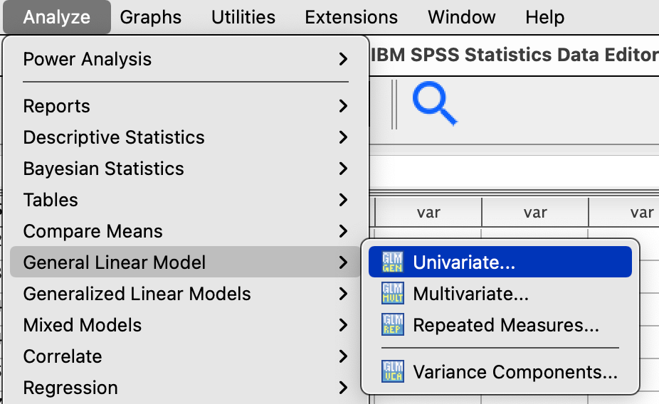
ANOVA with SPSS - Alcohol
Here’s how we do it:

Slide 74
ANOVA with SPSS - Alcohol
Here’s how we do it:

Slide 75
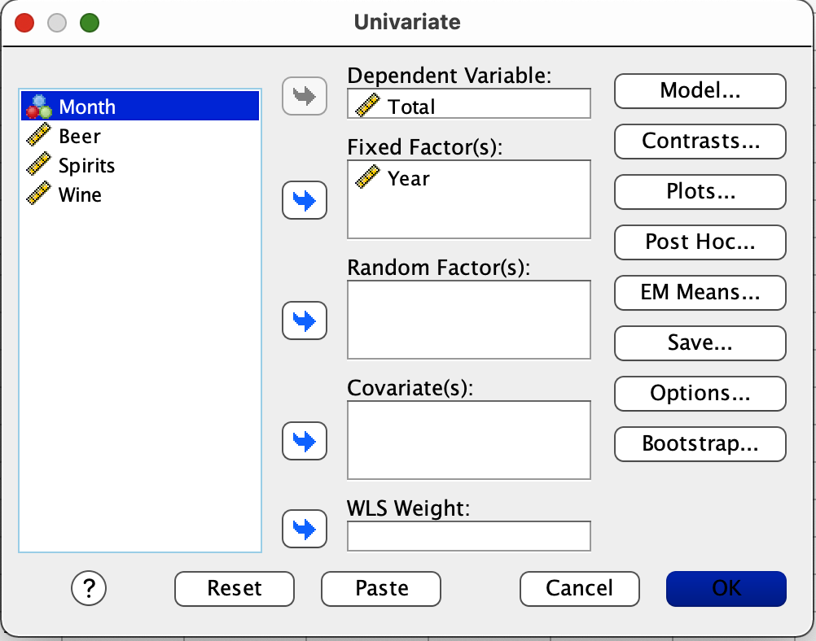
ANOVA with SPSS - Alcohol
Here’s how we do it:

Slide 76
ANOVA with SPSS - Alcohol
Here’s how we do it:

Slide 77
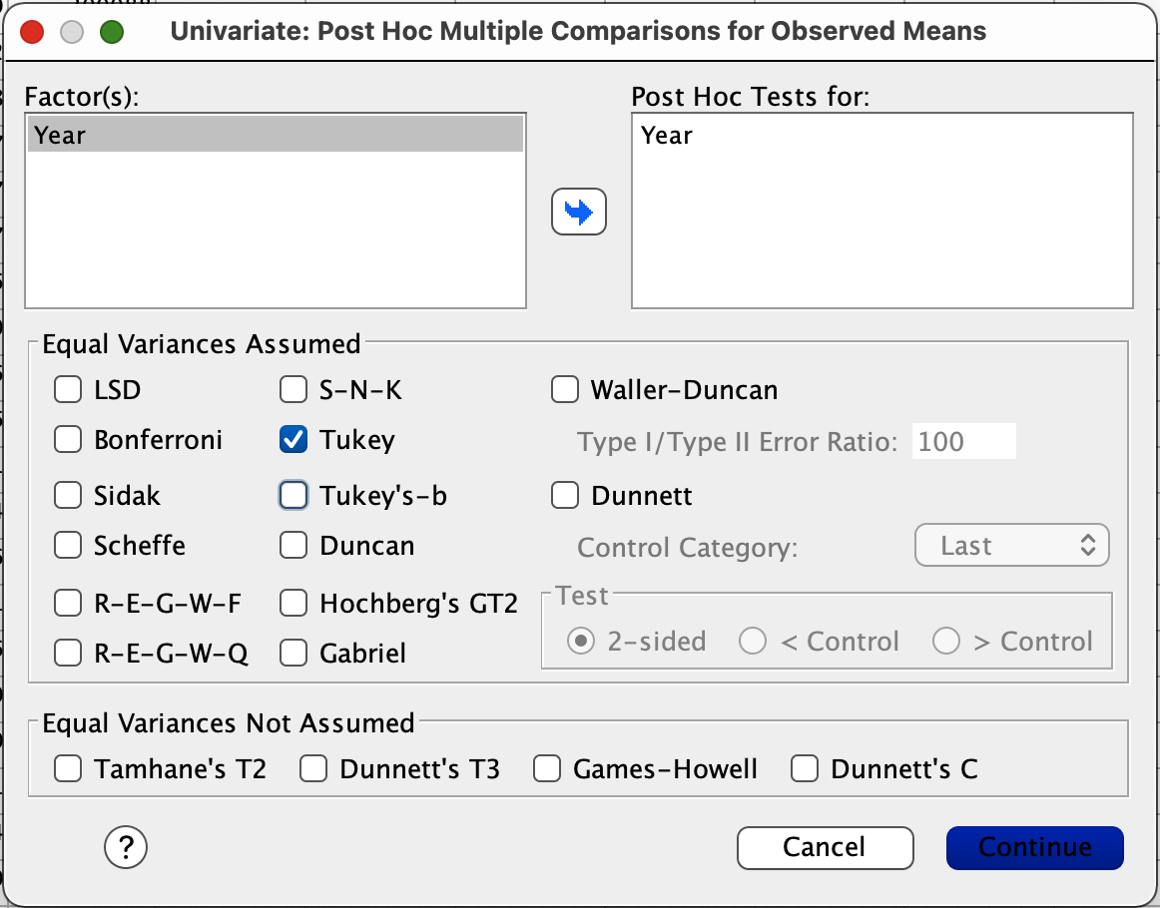
ANOVA with SPSS - Alcohol
Here’s how we do it:

Slide 78
ANOVA with SPSS - Alcohol
Here’s how we do it:

Slide 79
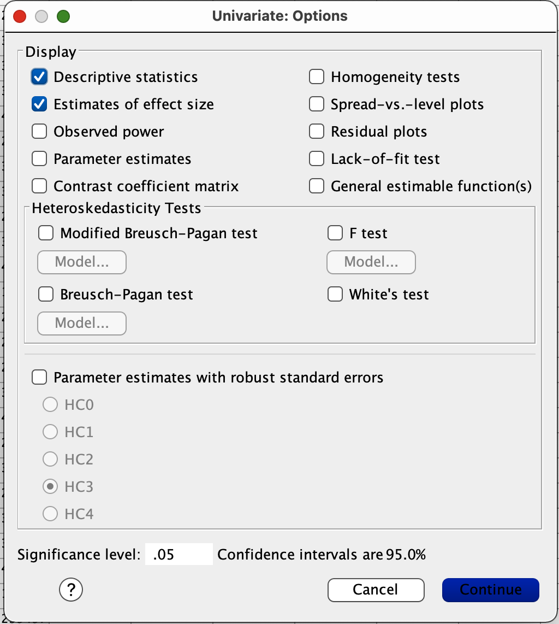
ANOVA with SPSS - Alcohol
Here’s how we do it:

Slide 80
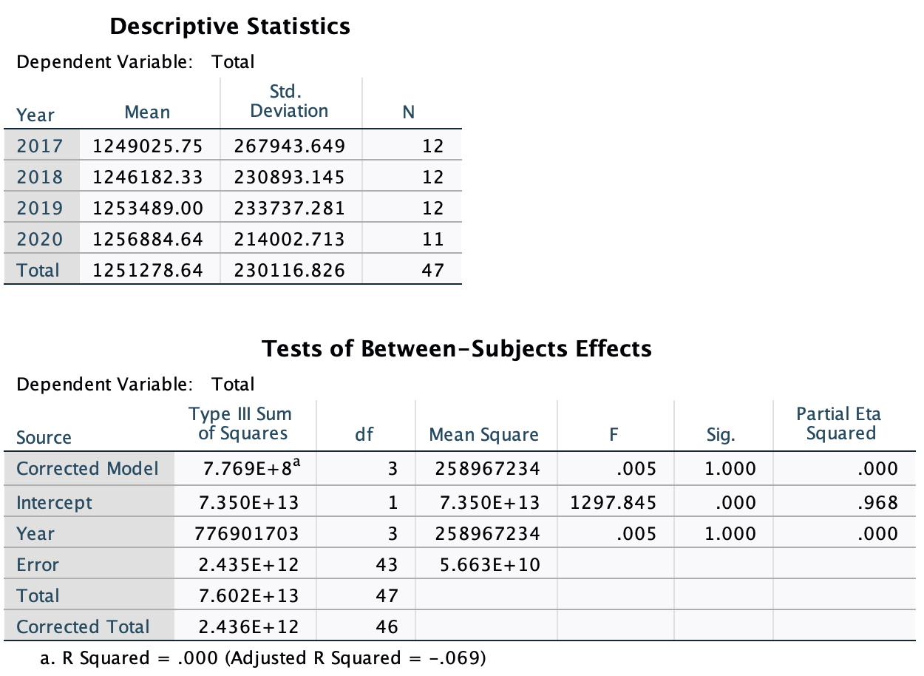
ANOVA with SPSS - Alcohol
Here’s how we do it:

Slide 81
ANOVA with SPSS - Alcohol
Now, let’s you try it for:
Beer
Wine
Spirits

Slide 82
Interpreting a Journal Article

Slide 83
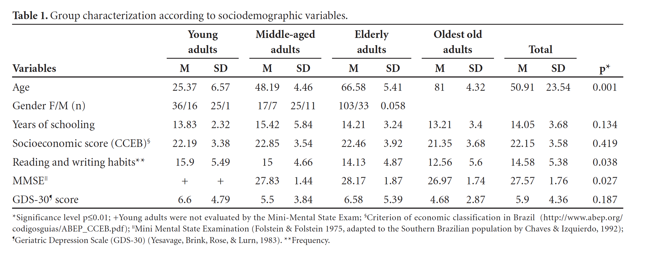
Interpreting a Journal Article
On which measures were significant differences observed?
What important information is not included in this table?

Slide 84
Interpreting a Journal Article
On which measures were significant differences observed?
Which groups performed differently from one another?

