Slide 1
One-Way ANOVA
Part Deux!!

Slide 2
One-Way Anova: The Briefing
We are continuing our ANOVA journey
Last class, we talked about:
different sources of variability (total; treatment; error)
How to calculate the measures of variability
How degrees of freedom are relevant
Mean Square and our F statistic
What it means to reject/fail to reject the null hypothesis
Where did we come up short:
Rejecting the null does not help us decide which levels of the IV are different from one another – Tukey’s HSD
We also need a measure of effect size - $η^{2}$

Slide 3
Questions about the Video Lectures

Slide 4
Tukey’s HSD: Group Size and Conformity
3 person | 4 person | 5 person
M = 13 | M = 18 | M = 23
q (α = .05; k=3, df = 9) = 3.95
$$HSD=q\sqrt{{MSE}/n}$$
3person – 4 person =13 - 18= │-5│ < 5.01 Not Sig.
3 person – 5 person= 13 – 23= │ -10│ > 5.01 Sig. Diff.
4 person – 5 person = 18 - 23= │ -5│ < 5.01 Not Sig.

Slide 5
Tukey’s HSD: Group Size and Conformity
3 person | 4 person | 5 person
M = 13 | M = 18 | M = 23
q (α = .05; k=3, df = 9) = 3.95
$$HSD=q\sqrt{{MSE}/n}$$

Slide 6
Tukey’s HSD: Group Size and Conformity
3 person | 4 person | 5 person
M = 13 | M = 18 | M = 23
q (α = .05; k=3, df = 9) = 3.95
$$HSD=q\sqrt{{MSE}/n}=3.95\sqrt{{6.44}/4}=3.95\left(1.27\right)=5.01$$
3person – 4 person =13 - 18= │-5│ < 5.01 Not Sig.
3 person – 5 person= 13 – 23= │ -10│ > 5.01 Sig. Diff.
4 person – 5 person = 18 - 23= │ -5│ < 5.01 Not Sig.

Slide 7
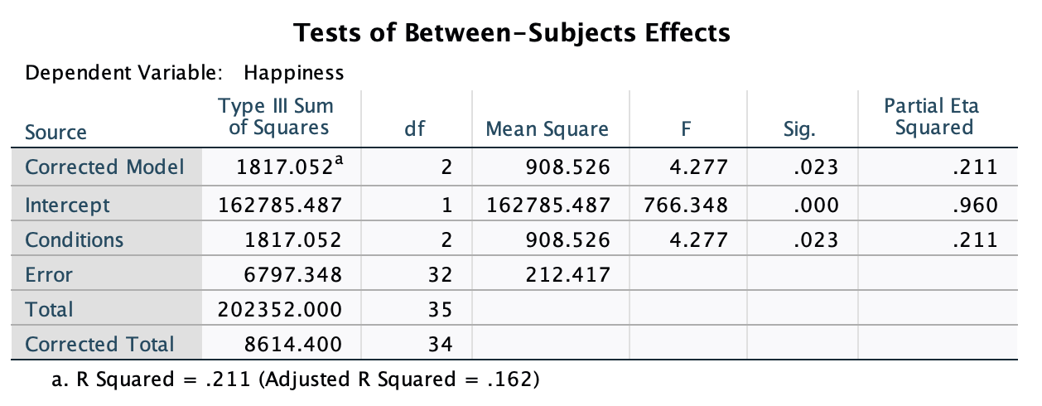
Tukey’s HSD: Ladder Data
UPDATE when you have the data!!
Routine | Humor | Gratitude
M = 67.9 | M = 71.7 | M = 83.6
q (α = .05; k=3, df = 32) = 3.49
$$HSD=q\sqrt{{MSE}/n}$$

Slide 8
Tukey’s HSD: Ladder Data
Routine | Humor | Gratitude
M = 67.9 | M = 71.7 | M = 83.6
q (α = .05; k=3, df = 32) = 3.49
$$HSD=q\sqrt{{MSE}/n}=3.49\sqrt{{212.42}/{12}}=3.49\left(4.21\right)=14.68$$
Routine – Humor = 67.9 – 71.7 = │-2.8│ < 14.68 Not Sig.
Routine – Gratitude = 67.9 – 83.6 = │ -15.70│ > 14.68 Sig. Diff.
Humor – Gratitude = 71.7 – 83.6 = │ -11.90│ < 14.68 Not Sig.

Slide 9
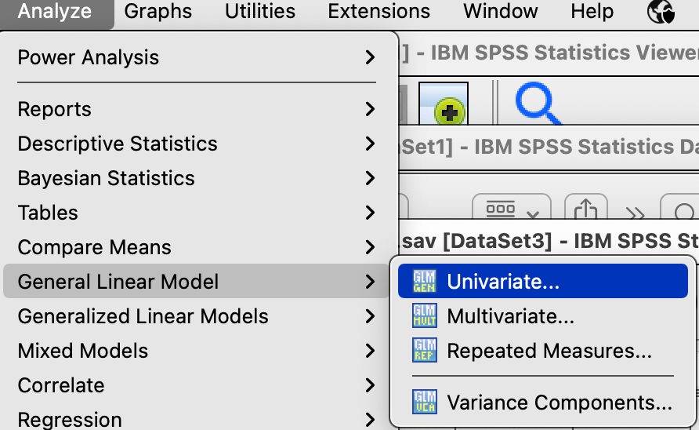
Tukey’s HSD in SPSS: Conformity
Analyze → General Linear Model →Univariate

Slide 10
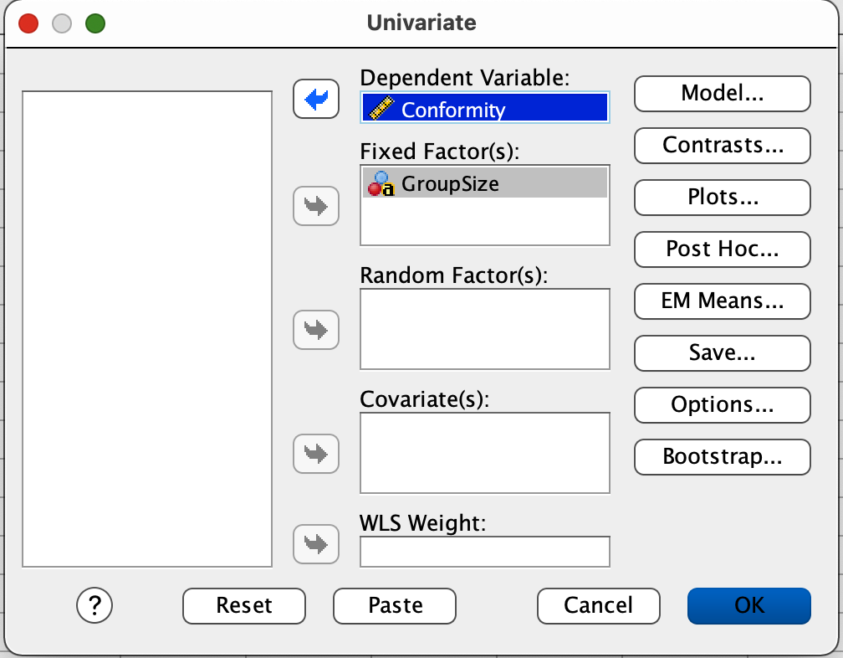
Tukey’s HSD in SPSS: Conformity
Slide the IV into the Fixed Factor box.
Slide the DV into the Dependent Variable box.
Then click Options.

Slide 11
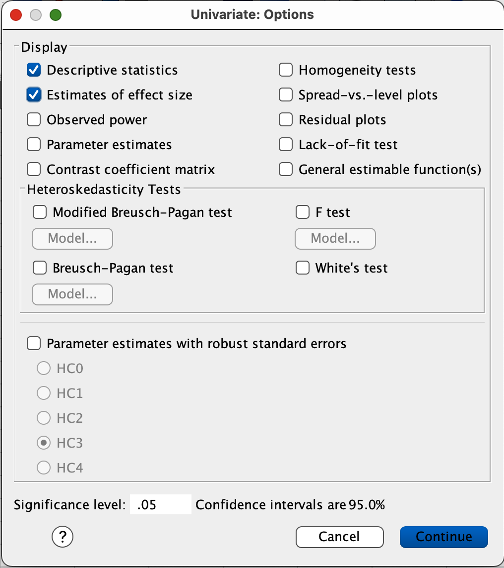
Tukey’s HSD in SPSS: Conformity
Check the boxes labeled:
Descriptive statistics and
Estimates of effect size
Click Continue
Click OK

Slide 12
Tukey’s HSD in SPSS: Conformity
Click Post Hoc…

Slide 13
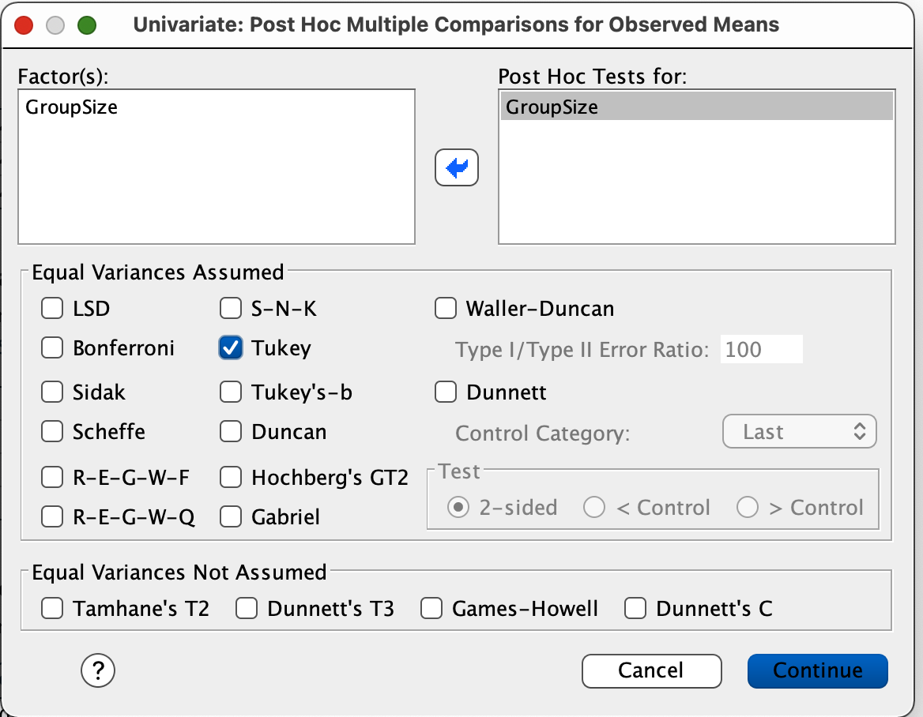
Tukey’s HSD in SPSS: Conformity
Slide GroupSize into the Post Hoc Tests for box.
Select the box labeled Tukey
Click Continue
Click OK

Slide 14
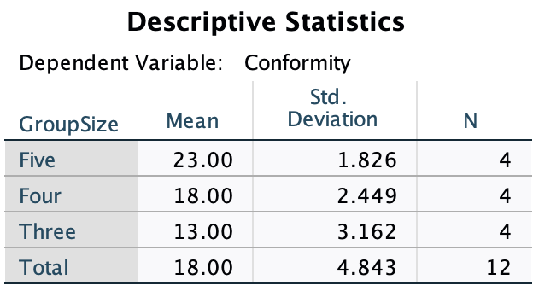
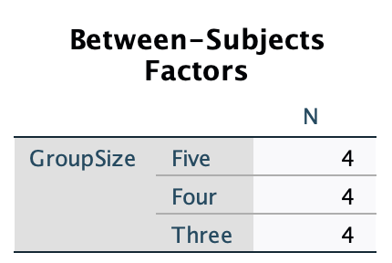
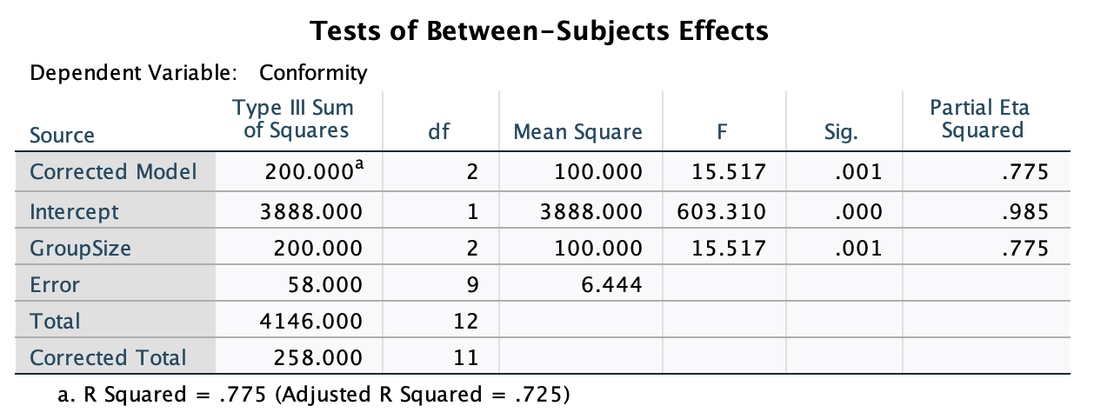
Tukey’s HSD in SPSS: Conformity

Slide 15
Tukey’s HSD in SPSS: Conformity

Slide 16
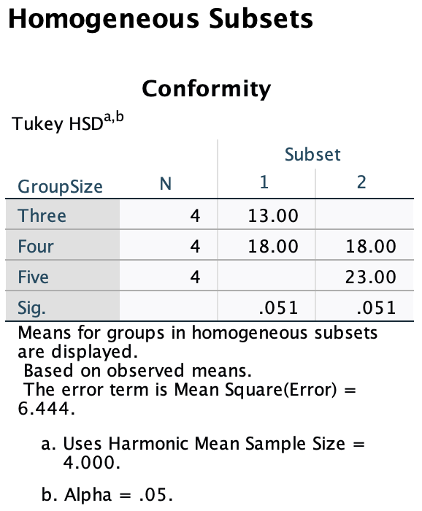
Tukey’s HSD in SPSS: Conformity

Slide 17
Tukey’s HSD in SPSS: Ladder data
UPDATE when you have the data!!

Slide 18
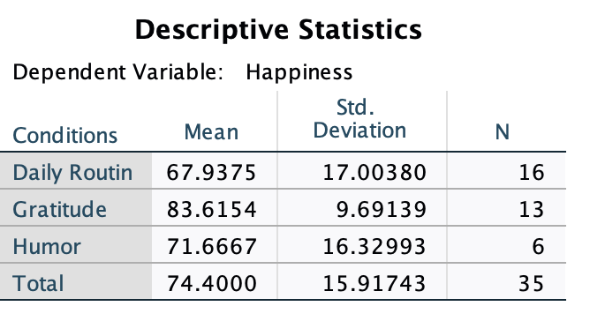
ANOVA in SPSS: Ladder data

Slide 19
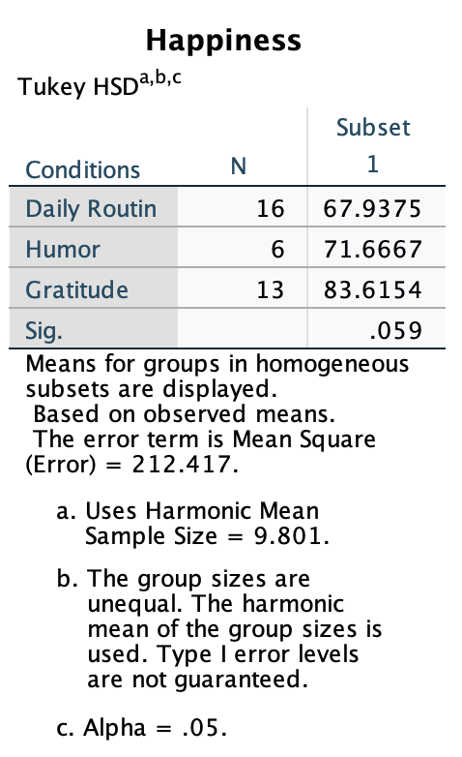
Tukey’s HSD in SPSS: Ladder data

Slide 20
Filling in an ANOVA table - Equations
$$SStotal=SSbetween+SSerror$$
$$SSbetween=SStotal−SSerror$$
MS$=\frac{SS}{df}$
$$SSerror=SStotal−SSbetween$$
df$=\frac{SS}{MS}$
$$dftotal=dfbetween+dferror$$
$$dfbetween=dftotal−dferror$$
SS$=MS×df$
$$dferror=dftotal−dfbetween$$
$$F=\frac{MSbetween}{MSerror}$$
$$DFtotal=N−1$$
$$DFbetween=P−1$$
MSerror$=\frac{MSbetween}{F}$
$$DFerror=N−P$$
MSbetween$=MSerror×F$

Slide 21
Filling in an ANOVA table
Source | SS | df | MS | F
Treatment Error Total | 120.00 | 56 | 40.00 10.00
Fill in the blanks.
2) How many obs were in the experiment (N)?
3) How many levels of the IV were there?
4) How many treatments were there?
5) How many obs were in each treatment (n)?

Slide 22
Filling in an ANOVA table
Source | SS | df | MS | F
Treatment Error Total |  | 2 104 | 900 | 9.00
Fill in the blanks.
2) How many obs were in the experiment (N)?
3) How many levels of the IV were there?
4) How many treatments were there?
5) How many obs were in each treatment (n)?

Slide 23
$η^{2}$: Conformity
$$η^{2}=\frac{SSbt}{SStotal}=\frac{200}{258}=.775$$

Slide 24
$η^{2}$: Ladder Data
$$η^{2}=\frac{SSbt}{SStotal}=\frac{1817.052}{8614.40}=.211$$

Slide 25
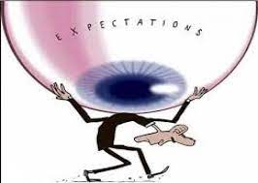
CherYan & Bodenhausen (2000)
What is stereotype threat?
What is the proposed mechanism by which stereotype threat operates?
Why did this study address the performance of Asian-American women on a math task?
What was the question that Cheryan and Bodenhausen (2000) addressed?
What was their hypothesis?
What did Cheryan and Bodenhausen manipulate?
Notes:
1 Been shown in connection to race, SES and to affect groups with high and low performing stereotypes about them
2. Concerns about confirming the stereotype are distracting; which reduces performance.
3. Conflicting stereotypes: women are negatively stereotypes; Asians are positively stereotypes
4. What is the mechanism by which identity activation can benefit performance?
5. Private confidence may be better than public confidence; If I expect to do well vs. if others expect me to do well.
5. The salience of the identity manipulation.

Slide 26
CherYan & Bodenhausen (2000)
Method:
Recruited 49 Asian-American women; all reported that math ability was important to them (group testing)
Task was advertised as ‘Predictors of Math Ability’
Self-esteem measures: My race/gender is considered good.
Challenging math test
What was the IV?
How many levels?
What were the levels?

Slide 27
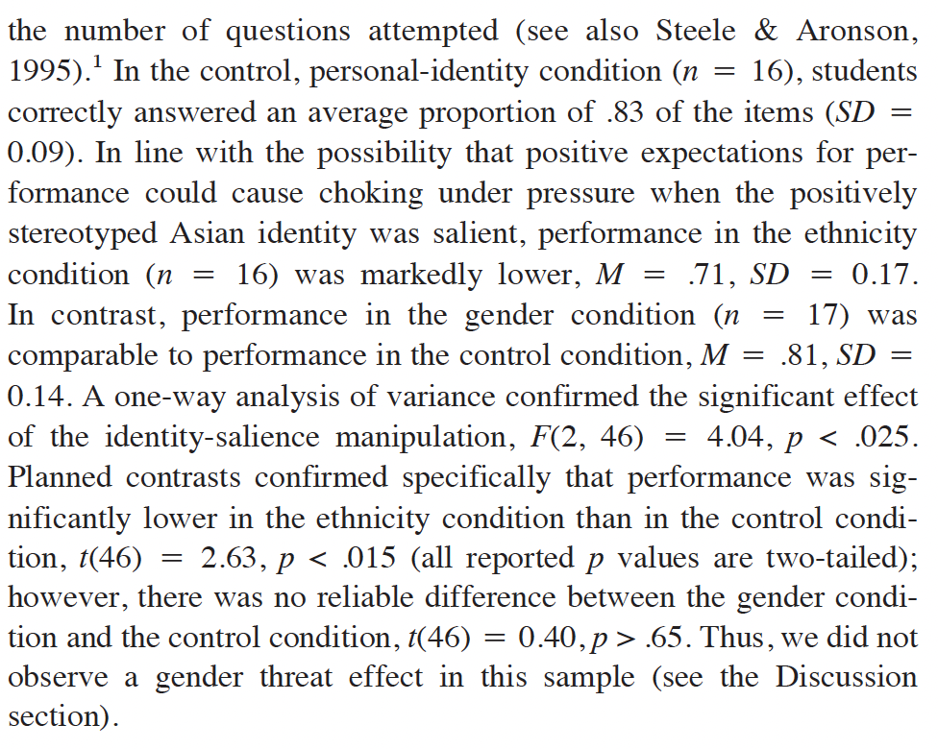
CherYan & Bodenhausen (2000)
Control | Race | Gender
.83 (.09) | .71 (.17) | .81 (.14)

Slide 28
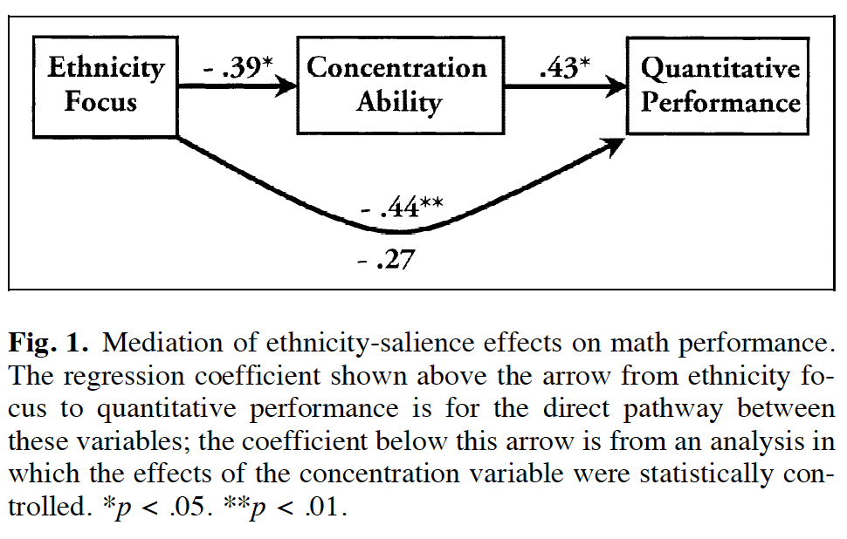
CherYan & Bodenhausen (2000)
Control | Race | Gender
.83 (.09) | .71 (.17) | .81 (.14)
Source | SS | Df | MS | F
Treatment |  | 2 |  | 4.04
Error |  | 46
Total |  | 48

Slide 29
CherYan & Bodenhausen (2000)
Source | SS | Df | MS | F
Treatment |  | 2 |  | 4.04
Error |  | 46
Total |  | 48
Notes:
It wasn’t lack of sleep or motivation;
They think it was concentration ability

Slide 30
Interpreting a Journal Article

Slide 31
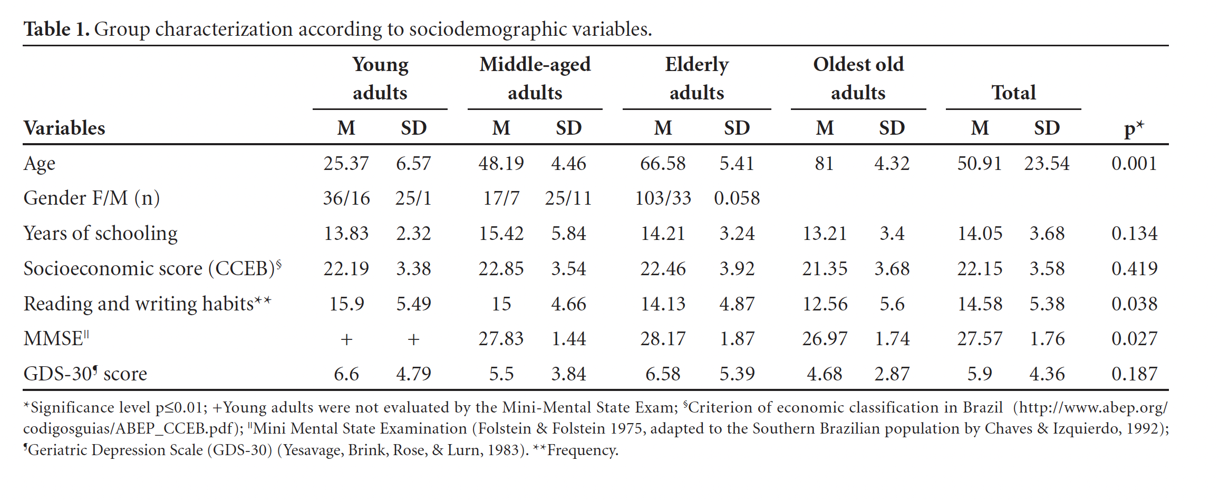
Interpreting a Journal Article
On which measures were significant differences observed?
What important information is not included in this table?
Notes:
Tukey’s HSD;
Notice that they chose p <.01?!?

Slide 32
Interpreting a Journal Article
On which measures were significant differences observed?
Which groups performed differently from one another?

