Slide 1
ANOVA: Factorial Design
Part I

Slide 2
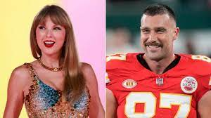

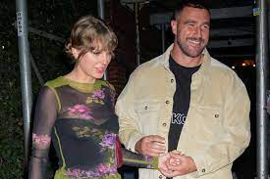
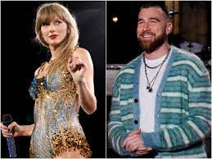
Swift Stats / Kelce Stats
Huge leap forward (Jump then Fall).
Now we have TWO IVs (not 22).
Biggest changes:
  BS ANOVA: SStotal = SSbt + SSerror
  RM ANOVA: SStotal = SSbt + SSwi
    SSwi = SSbs + SSerror
  Factorial ANOVA: SStotal = SSbt + SSerror
    SSbt = SSa + SSb + SSa*b

Slide 3
TOTAL VARIABILITY
SS_{total}
Between Treatment
Variability
SS_{between treatment}
Within Treatment
Variability
SS_{Within/ERROR}
Factor A Variability
SS_{A}
Factor B Variability
SS_{B}
Interaction Variability
SS_{AB}

Slide 4


What’s Old & What’s New
Source | Formula | df
SStotal | Σ(x²) – (G)²/N | N-1 | Old
SSbt | Σ[(T²/n)] - (G²/N) | p-1 | Old
SSerror | Σ[Σ(x²) - (T²/n)] | N-p | Old
SSa | Σ(T_{a}²/n) - G²/N | a-1 | New
SSb | Σ(T_{b}²/n) - G²/N | b-1 | New
SSa*b | SSBT-SSA-SSB | df_{bt}– df_{A}-df_{B} | New
MSbt |  |  | Old
MSerror |  |  | Old
$$\frac{{SS}_{bt}}{{df}_{bt}}$$
$$\frac{{SS}_{error}}{{df}_{error}}$$

Slide 5


For Lab:
Re-read the methods section of the Eskine et al. (2011) study…it’s been awhile
…and you’re likely to understand more than you did at the beginning of the semester

Slide 6
Two-way ANOVA
Research suggests that personality is reflected in the way people talk and write about past experiences. An experiment was conducted in which individuals who were either high or low in neuroticism wrote a narrative about either a positive or a negative experience from their past.
The research question was whether neuroticism would predict the number of negative emotion words included in the narrative in each narrative and whether the pattern of negativity would vary as a function of the narrative type.

Slide 7
Types of Effects in Factorial Designs
Main Effects: Do the different levels of a given factor affect the dependent variable?
  Do people high in neuroticism use more negative words than people low in neuroticism?
  Do people use more negative words when they describe low points relative to high points?
Interactions: Does the effect of one factor depend upon the level of a second factor?
  Does the effect of neuroticism differ for positive and negative narratives?

Slide 8
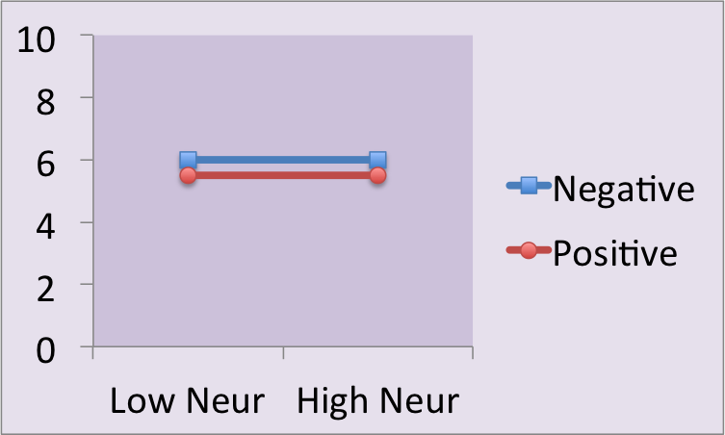
Two-Way ANOVA Outcomes
 | Lo N | Hi N | M
Neg | 6 | 6 | 6
Pos | 5.5 | 5.5 | 5.5
M | 5.75 | 5.75
Main Effect of Neuroticism: NO
Main Effect of Narrative: NO
Interaction Effect: NO

Slide 9
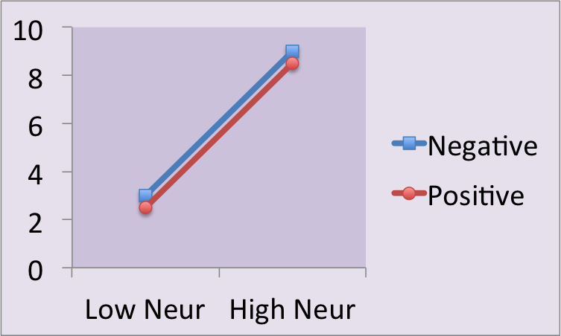
Two-Way ANOVA Outcomes
 | Lo N | Hi N | M
Neg | 3 | 9 | 6
Pos | 2.5 | 8.5 | 5.5
M | 2.75 | 8.75
Main Effect of Neuroticism: YES
Main Effect of Narrative: NO
Interaction Effect: NO

Slide 10
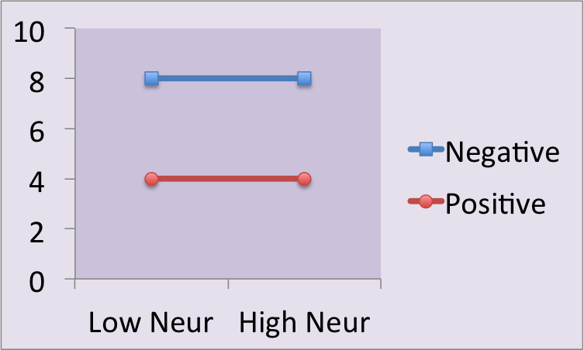
Two-Way ANOVA Outcomes
 | Lo N | Hi N | M
Neg | 8 | 8 | 8
Pos | 4 | 4 | 4
M | 6 | 6
Main Effect of Neuroticism: NO
Main Effect of Narrative: YES
Interaction Effect: NO

Slide 11
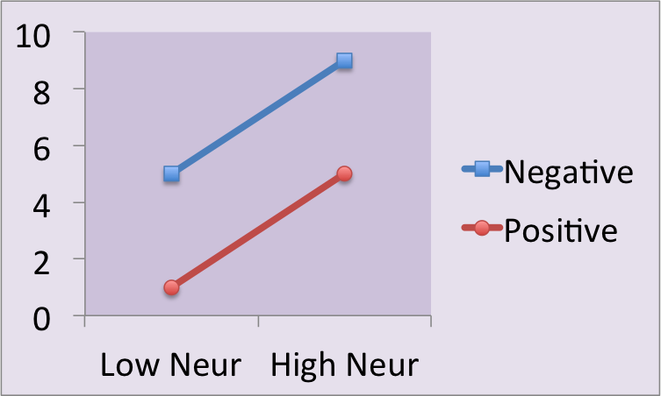
Two-Way ANOVA Outcomes
 | Lo N | Hi N | M
Neg | 5 | 9 | 7
Pos | 1 | 5 | 3
M | 3 | 7
Main Effect of Neuroticism: YES
Main Effect of Narrative: YES
Interaction Effect: NO

Slide 12
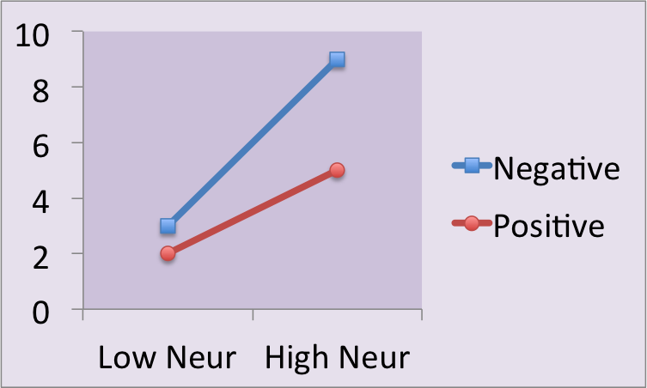
Two-Way ANOVA Outcomes
 | Lo N | Hi N | M
Neg | 3 | 9 | 6
Pos | 2 | 5 | 3.5
M | 2.5 | 7
Main Effect of Neuroticism: YES
Main Effect of Narrative: YES
Interaction Effect: YES

Slide 13
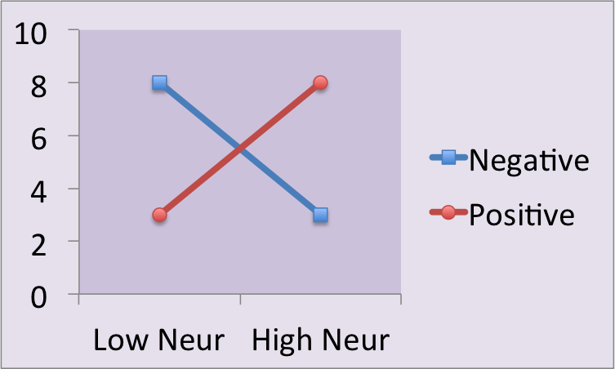
Two-Way ANOVA Outcomes
 | Lo N | Hi N | M
Neg | 8 | 3 | 5.5
Pos | 3 | 8 | 5.5
M | 5.5 | 5.5
Main Effect of Neuroticism: NO
Main Effect of Narrative: NO
Interaction Effect: YES

Slide 14
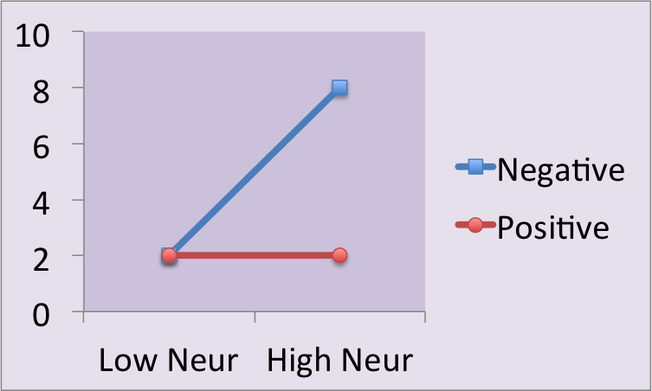
Interaction always takes Precedence!
 | Lo N | Hi N | M
Neg | 2 | 8 | 5
Pos | 2 | 2 | 2
M | 2 | 5
Main Effect of Neuroticism: YES
Main Effect of Narrative: YES
Interaction Effect: YES

Slide 15
More practice with Interpretation
What is the design of the experiment?
Is there a main effect of A?
  Describe the effect.
Is there a main effect of B?
  Describe the effect.
Is there an interaction?
  Describe the effect.

Slide 16
Caspi et al..
DV: self-reported depression symptoms
IV #1: number of stressful life events participants experienced in past year (5 levels)
IV #2: Genetic risk (3 levels: s/s allele; s/l allele, or l/l allele)

Slide 17
McQuade (2017)
DV: Physical aggression (higher suggests more aggression)
IV#1: Children’s level of physical victimization (i.e., how much bullied; 2 levels low and high)
IV#2: Children’s executive functioning skills (EF: cognitive abilities; 3 levels: low, average, high)

Slide 18
Erath et al. (2009)
DV: externalizing problems (e.g., aggression, noncompliance, rule-breaking)
IV#1: Harsh parenting (2 levels: - 1 SD = low and + 1 SD = high)
IV#2: Girls’ stress reaction (e.g., how they respond physiologically to a stressful task; 2 levels: Higher SCLR = high stress reaction; Lower SCLR = low stress reaction)

Slide 19
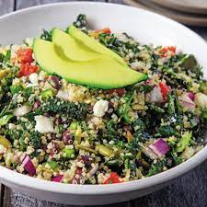
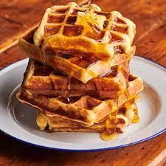
Nothing tastes better than a home-made interaction
Generate a factorial ANOVA ‘experiment’ that has two Independent Variables and one Dependent Variable. Sketch out what the main effects for your variable might be and what a potential interaction effect might look like. When you are ready, send one intrepid soul from your table to a whiteboard to sketch out the data (identifying the IVs and the DV.

Slide 20



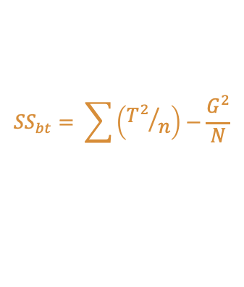




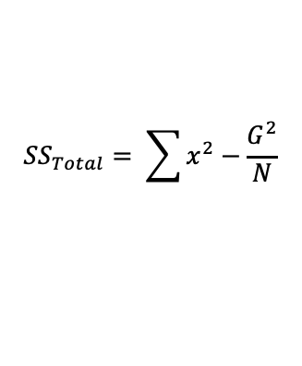



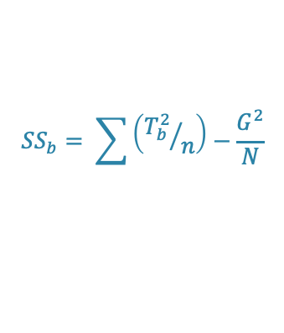




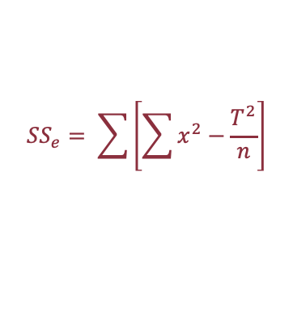



Formula Sheet: Factorial ANOVA
Step 1: One- vs. Two-tailed Test
Step 2: Determine Ho and Ha (omnibus; main effects; interaction)
Step 3: Critical value for Alpha (omnibus; main effects; interaction)
Step 4: Calculate
  SSt = SSbt + SSe
  SSbt = SSa + SSb + SSa*b
  MSbt; MSa; MSb; MSa*b; MSe
  F ratios (omnibus; main effects; interaction)
Step 5: Decision regarding the null
Step 6: Tukey test (don’t need it!)
Step 7: Interpret the the results
$${SS}_{Total}= \sum{x^{2}−\frac{G^{2}}{N}}$$
$${SS}_{bt}= \sum{\left({T^{2}}/n\right)−\frac{G^{2}}{N}}$$
$${SS}_{e}= \sum{\left[\sum{x^{2}}−\frac{T^{2}}{n}\right]}$$
$${SS}_{a}= \sum{\left({T_{a}^{2}}/n\right)−\frac{G^{2}}{N}}$$
$${SS}_{b}= \sum{\left({T_{b}^{2}}/n\right)−\frac{G^{2}}{N}}$$
$${SS}_{a∗b}={SS}_{bt}−({SS}_{a}+{SS}_{b)}$$
$${df}_{total}=N−1$$
$${df}_{bt}=ab−1$$
$${df}_{error} =N−\left(ab\right)$$
$${df}_{a}=a−1$$
$${df}_{b}=b−1$$
$${df}_{a∗b}={df}_{a}∗{df}_{b}$$
$${MS}_{bt}=\frac{{SS}_{bt}}{{df}_{bt}}$$
$${MS}_{a}=\frac{{SS}_{a}}{{df}_{a}}$$
$${MS}_{b}=\frac{{SS}_{b}}{{df}_{b}}$$
$${MS}_{a∗b}=\frac{{SS}_{a∗b}}{{df}_{a∗b}}$$
$${MS}_{e}=\frac{{SS}_{e}}{{df}_{e}}$$
$$F_{bt}=\frac{{MS}_{bt}}{{MS}_{e}}$$
$$F_{a}=\frac{{MS}_{a}}{{MS}_{e}}$$
$$F_{b}=\frac{{MS}_{b}}{{MS}_{e}}$$
$$F_{a∗b}=\frac{{MS}_{a∗b}}{{MS}_{e}}$$

Slide 21
Context Dependent Learning
Evidence suggests that memory is best when the learning environment is the same as the test environment. In other words, you should study in the classroom where the test will take place. In one famous studies, mountain climbers learned a set of words either at base camp or the summit and then were tested either at base camp or the summit. 20 subjects participated; 5 in each group. Learning location was first independent variable; test location was the second independent variable. The data are presented in the table on the next slide. Conduct a 2-way ANOVA to examine the effect of these two variables on the subjects' desire to wait with another person (α = .05).

Slide 22
Context Dependent Learning
n = 5 per group | Test Phase
Learning Phase | Summit | Base Camp
Summit | M = 4 Σx = 20 Σx² = 88 | M = 4 Σx = 20 Σx² = 86
Base Camp | M = 5 Σx = 25 Σx² = 129 | M = 8 Σx = 40 Σx² = 324

Slide 23
Context Dependent Learning
n = 5 per group | Test Phase
Learning Phase | Summit | Base Camp
Summit | M = 4 Σx = 20 Σx² = 88 | M = 4 Σx = 20 Σx² = 86
Base Camp | M = 5 Σx = 25 Σx² = 129 | M = 8 Σx = 40 Σx² = 324
SST = Σx² - G²/N
= (88 + 86 + 129 + 324) - (20 + 20 + 25 + 40)²/20
= 627 - 105²/20
= 627 - 551.25 = 75.75

Slide 24
Context Dependent Learning
n = 5 per group | Test Phase
Learning Phase | Summit | Base Camp
Summit | M = 4 Σx = 20 Σx² = 88 | M = 4 Σx = 20 Σx² = 86
Base Camp | M = 5 Σx = 25 Σx² = 129 | M = 8 Σx = 40 Σx² = 324
SSBT = Σ(T²/n) - G²/N
= (20²/5) + (20²/5) + (25²/5) + (40²/5) - 551.25
= 80 + 80 + 125 + 320 – 551.25
= 605 - 551.25 = 53.75

Slide 25
Context Dependent Learning
n = 5 per group | Test Phase
Learning Phase | Summit | Base Camp
Summit | M = 4 Σx = 20 Σx² = 88 | M = 4 Σx = 20 Σx² = 86
Base Camp | M = 5 Σx = 25 Σx² = 129 | M = 8 Σx = 40 Σx² = 324
SSE = SST - SSBT
= 75.75 - 53.75
= 22.00

Slide 26
Context Dependent Learning
n = 5 per group | Test Phase
Learning Phase | Summit | Base Camp
Summit | M = 4 Σx = 20 Σx² = 88 | M = 4 Σx = 20 Σx² = 86
Base Camp | M = 5 Σx = 25 Σx² = 129 | M = 8 Σx = 40 Σx² = 324
  Or…
  SSE = Σ(Σx² - T²/n)
= (88-80) + (86-80) + (129-125) + (324-320)
= 8 + 6 + 4 + 4
= 22.00

Slide 27
TOTAL VARIABILITY
SS_{total}
75.75
53.75
22.00
Between Treatment
Variability
SS_{between treatment}
Within Treatment
Variability
SS_{Within/ERROR}
?
?
?
Variability due to Learning
SS_{A}
Variability due to Test
SS_{B}
Interaction Variability
SS_{AB}

Slide 28
Partitioning SSBT
n = 5 per grp | Test Phase
Learning Phase | Summit | Base Camp
Summit | M = 4 Σx = 20 Σx² = 88 | M = 4 Σx = 20 Σx² = 86
Base Camp | M = 5 Σx = 25 Σx² = 129 | M = 8 Σx = 40 Σx² = 324
SS_{learn} = Σ[(T_{S}²/n)] - G²/N
= (20+20)²/10 + (25+40)²/10 - 551.25
= (40²/10) + (65²/10) - 551.25
= 160 + 422.5 - 551.25
= 582.5 - 551.25 = 31.25

Slide 29
Partitioning SSBT
n = 5 per grp | Test Phase
Learning Phase | Summit | Base Camp
Summit | M = 4 Σx = 20 Σx² = 88 | M = 4 Σx = 20 Σx² = 86
Base Camp | M = 5 Σx = 25 Σx² = 129 | M = 8 Σx = 40 Σx² = 324
SS_{test} = Σ[(T_{C}²/n)] - G²/N
= (20+25)²/10 + (20+40)²/10 - 551.25
= (45²/10) + (60²/10) - 551.25
= 202.5 + 360 - 551.25
= 562.5 - 551.25 = 11.25

Slide 30
Partitioning SSBT
n = 5 per group | Test Phase
Learning Phase | Summit | Base Camp
Summit | M = 4 Σx = 20 Σx² = 88 | M = 4 Σx = 20 Σx² = 86
Base Camp | M = 5 Σx = 25 Σx² = 129 | M = 8 Σx = 40 Σx² = 324
SS_{SxC} = SSBT - (SS_{subj} + SS_{conf})
= 53.75 - (31.25 + 11.25)
= 53.75 - 42.5
= 11.25

Slide 31
TOTAL VARIABILITY
SS_{total}
75.75
53.75
22.00
Between Treatment
Variability
SS_{between treatment}
Within Treatment
Variability
SS_{Within/ERROR}
31.25
11.25
11.25
Variability due to Learning
SS_{A}
Variability due to Test
SS_{B}
Interaction Variability
SS_{AB}

Slide 32
Context Dependent Learning ANOVA table
Source | SS | df | MS | F
Model Error Total
Source | SS | df | MS | F
Learning Test LxT
 |  | Test
 |  | Summit | BaseCmp
Learning | Summit | 4 | 4 | 4
 | BaseCmp | 5 | 8 | 6.5
 |  | 4.5 | 6

Slide 33
Context Dependent Learning ANOVA table
Source | SS | df | MS | F
Model Error Total | 53.75 22.00 75.75
F crit (3,16) = 3.24
Source | SS | df | MS | F
Learning Test LxT | 31.25 11.25 11.25
F crit (1,16) = 4.49
 |  | Test
 |  | Summit | BaseCmp
Learning | Summit | 4 | 4 | 4
 | BaseCmp | 5 | 8 | 6.5
 |  | 4.5 | 6

Slide 34
Context Dependent Learning ANOVA table
Source | SS | df | MS | F
Model Error Total | 53.75 22.00 75.75 | 3 16 19 | 17.92 1.38 | 13.03
F crit (3,16) = 3.24
Source | SS | df | MS | F
Learning Test LxT | 31.25 11.25 11.25
F crit (1,16) = 4.49
 |  | Test
 |  | Summit | BaseCmp
Learning | Summit | 4 | 4 | 4
 | BaseCmp | 5 | 8 | 6.5
 |  | 4.5 | 6

Slide 35
Context Dependent Learning ANOVA table
Source | SS | df | MS | F
Model Error Total | 53.75 22.00 75.75 | 3 16 19 | 17.92 1.38 | 13.03
F crit (3,16) = 3.24
Source | SS | df | MS | F
Learning Test LxT | 31.25 11.25 11.25 | 1 1 1 | 31.25 11.25 11.25 | 22.73 8.18 8.18
F crit (1,16) = 4.49
 |  | Test
 |  | Summit | BaseCmp
Learning | Summit | 4 | 4 | 4
 | BaseCmp | 5 | 8 | 6.5
 |  | 4.5 | 6

Slide 36
Learning as a function of the mis/match between test learning and test locations

Slide 37
Reporting the results of a 2-Way ANOVA
There was a significant main effect of learning location, F (1, 16) = 22.73, p < .05; memory was better when learning took place at base camp. The main effect of testing location was also significant, F (1, 16) = 8.18, p < .05; memory was also better when people were tested at base camps. Finally, the interaction effect was significant, F (1, 16) = 8.18, p < .05. Whereas test location did not make a difference for people who learned at the summit (M = 4 for both treatments), memory was better for people who learned at base camp if they were also tested at base camp (M = 8), rather than tested at the summit (M = 5).

Slide 38
Reporting the results of a 2-Way ANOVA
There was a significant main effect of learning location, F (1, 16) = 22.73, p < .05; memory was better when learning took place at base camp. The main effect of testing location was also significant, F (1, 16) = 8.18, p < .05; memory was also better when people were tested at base camps. Finally, the interaction effect was significant, F (1, 16) = 8.18, p < .05. Whereas test location did not make a difference for people who learned at the summit (M = 4 for both treatments), memory was better for people who learned at base camp if they were also tested at base camp (M = 8), rather than tested at the summit (M = 5).

Slide 39
Reporting the results of a 2-Way ANOVA
There was a significant main effect of learning location, F (1, 16) = 22.73, p < .05; memory was better when learning took place at base camp. The main effect of testing location was also significant, F (1, 16) = 8.18, p < .05; memory was also better when people were tested at base camps. Finally, the interaction effect was significant, F (1, 16) = 8.18, p < .05. Whereas test location did not make a difference for people who learned at the summit (M = 4 for both treatments), memory was better for people who learned at base camp if they were also tested at base camp (M = 8), rather than tested at the summit (M = 5).

