Slide 1
ANOVA: Factorial Design
Part II

Slide 4
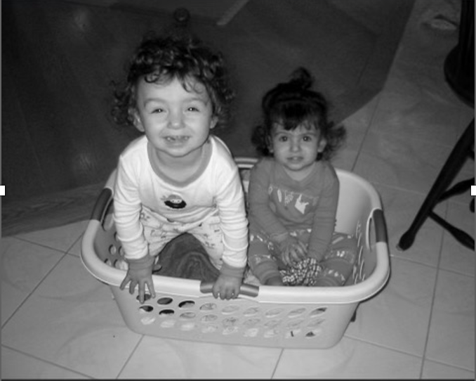

Slide 5
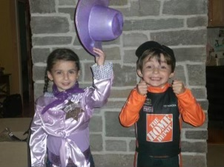

Slide 8
Questions about the video Lectures…

Slide 9
Calculating simple main effects
When there is a significant interaction, we will perform a separate analysis of variance for each column (or row) to examine individual group differences.
Caffeine, Studying, and Exam Performance
 | No Coffee | 1-2 Cups | > 2 Cups
Studied | 82 | 95 | 80
Did not Study | 74 | 73 | 60

Slide 10
Calculating simple main effects
One-way ANOVA for No Coffee condition: compare studied vs. not
Caffeine, Studying, and Exam Performance
 | No Coffee | 2 Cups | > 2 Cups
Studied | 82 | 95 | 80
Did not Study | 74 | 73 | 60
One-way ANOVA

Slide 11
Calculating simple main effects
One-way ANOVA for 2 cups condition: compare studied vs. not
Caffeine, Studying, and Exam Performance
 | 1-2 Cups | > 2 Cups
Studied | 95 | 80
Did not Study | 73 | 60
One-way ANOVA

Slide 12
Calculating simple main effects
One-way ANOVA for > 2 cups condition: compare studied vs. not
Caffeine, Studying, and Exam Performance
One-way ANOVA
 | > 2 Cups
Studied | 80
Did not Study | 60

Slide 13
Calculating simple main effects
And/or…
4. One-way ANOVA for the studied condition:
no vs. 2 vs. >2 cups
5. One-way ANOVA for the did not study condition:
no vs. 2 vs. >2 cups
Caffeine, Studying, and Exam Performance
 | No Coffee | 1-2 Cups | > 2 Cups
Studied | 82 | 95 | 80
Did not Study | 74 | 73 | 60
One-Way
ANOVA
One-Way
ANOVA

Slide 14
Movie Time questionnaire

Slide 15
Filling in an ANOVA table - Equations
$$SStotal=SSbetween+SSerror$$
$$SSbetween=SStotal−SSerror$$
MS$=\frac{SS}{df}$
$$SSerror=SStotal−SSbetween$$
df$=\frac{SS}{MS}$
$$dftotal=dfbetween+dferror$$
$$dfbetween=dftotal−dferror$$
SS$=MS×df$
$$dferror=dftotal−dfbetween$$
$$F=\frac{MSbetween}{MSerror}$$
$$DFtotal=N−1$$
$$DFbetween=P−1$$
MSerror$=\frac{MSbetween}{F}$
$$DFerror=N−P$$
MSbetween$=MSerror×F$

Slide 16
Filling in an ANOVA table - Equations
$$SSbt=SSa+SSb+SSaxb$$
$$dfbt=dfa+dfb+dfaxb$$
$$DFa=a−1$$
$$DFb=b−1$$
$$DFaxb=dfa∗dfb$$
$$Fa=\frac{MSa}{MSerror}$$
$$Fb=\frac{MSb}{MSerror}$$
$$Faxb=\frac{MSaxb}{MSerror}$$

Slide 17
ANOVA table Problem
There were 20 subjects per treatment (n = 20).
T | SS | df | MS | F | P-value
Model Error Total | 1055.00 |  | 25.00 |  | .001
Source | SS | df | MS | F | P-value
A B AxB |  | 2 4 | 50.00 | 4.00 | .001 .014 .004

Slide 18
ANOVA table Problem
There were 12 subjects per treatment (n = 12).
T | SS | df | MS | F | P-value
Model Error Total | 786.00 |  | 45.00 |  | .001
Source | SS | df | MS | F | P-value
A B AxB |  | 2 2 | 54.00 | 4.00 | .001 .014 .004

Slide 19
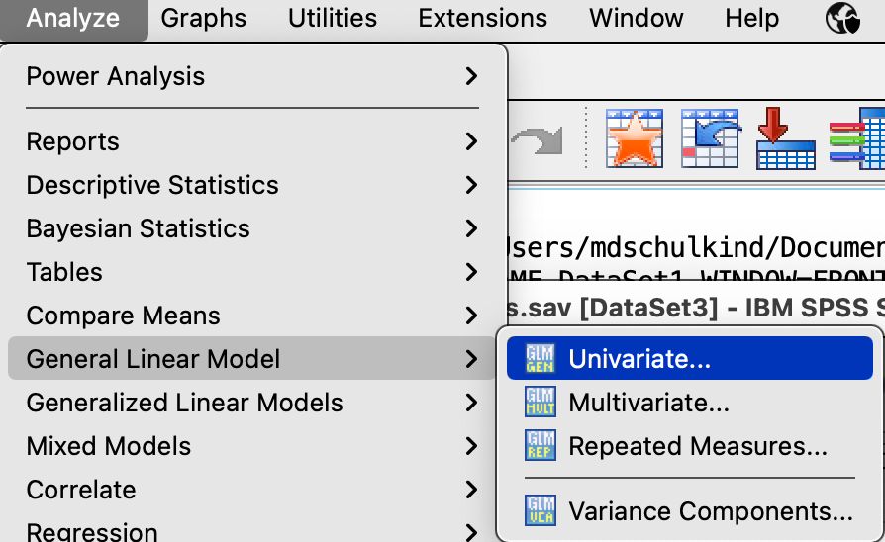
Factorial ANOVA in SPSS
Analyze → General Linear Model →Univariate

Slide 20
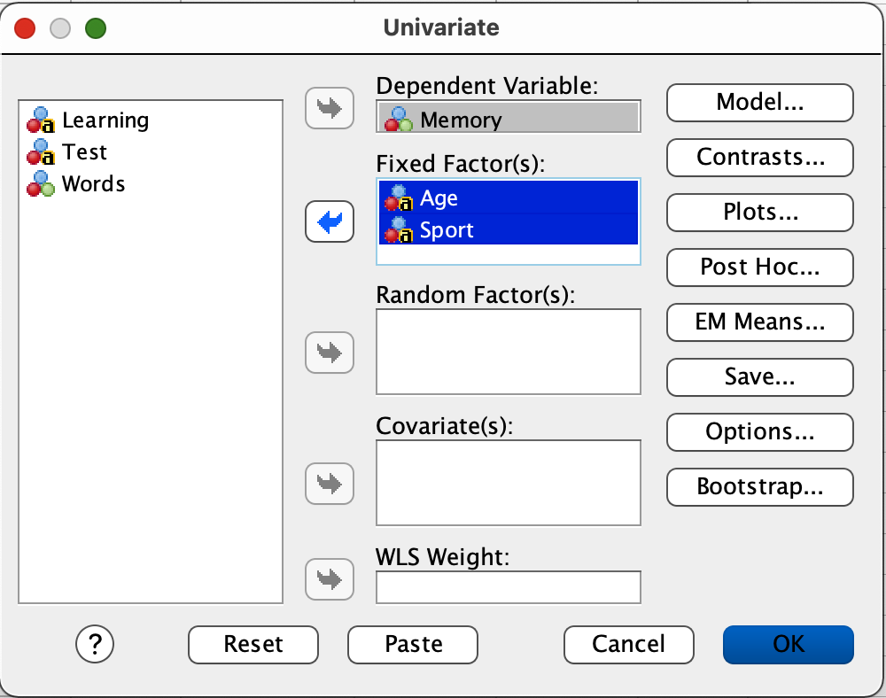
Factorial ANOVA in SPSS
Slide both IVs into the Fixed Factor box.
Slide the DV into the Dependent Variable box.
Then click Options.

Slide 21
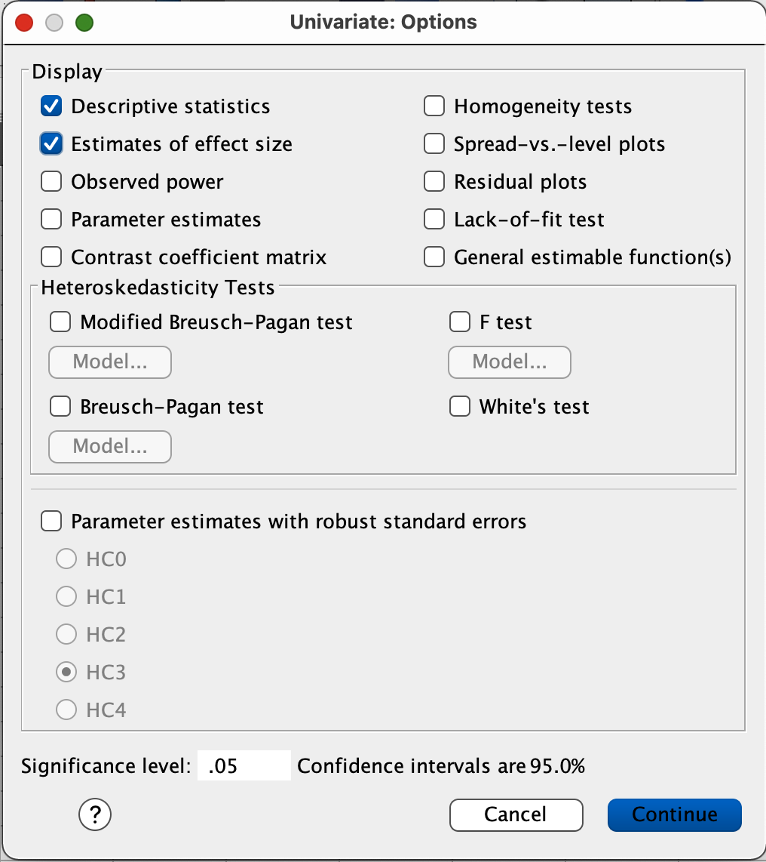
Factorial ANOVA in SPSS
Check the boxes labeled:
Descriptive statistics and
Estimates of effect size
Click Continue
Click OK

Slide 22
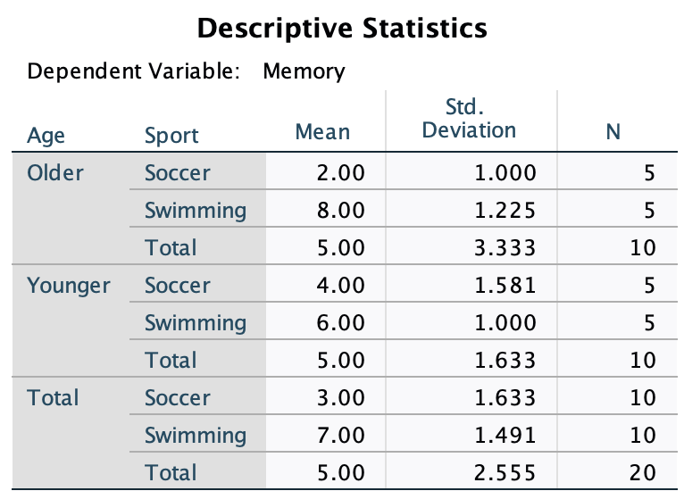
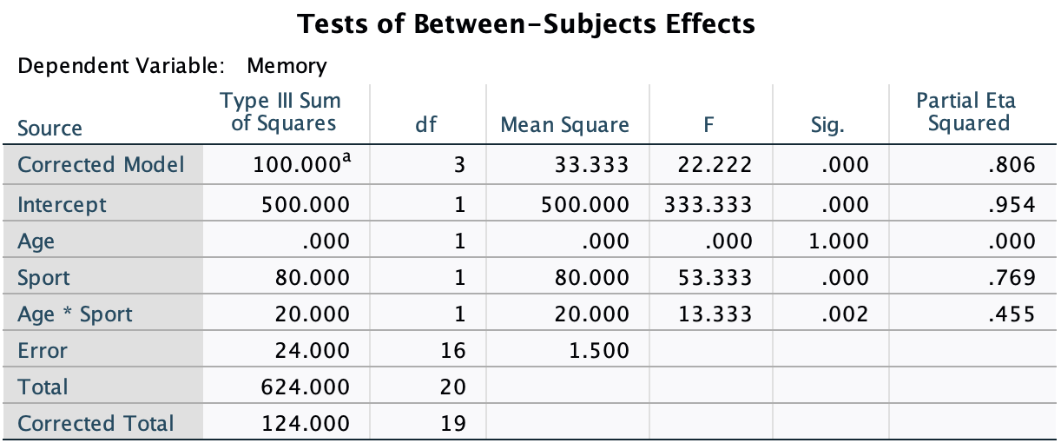
Factorial ANOVA in SPSS

Slide 23
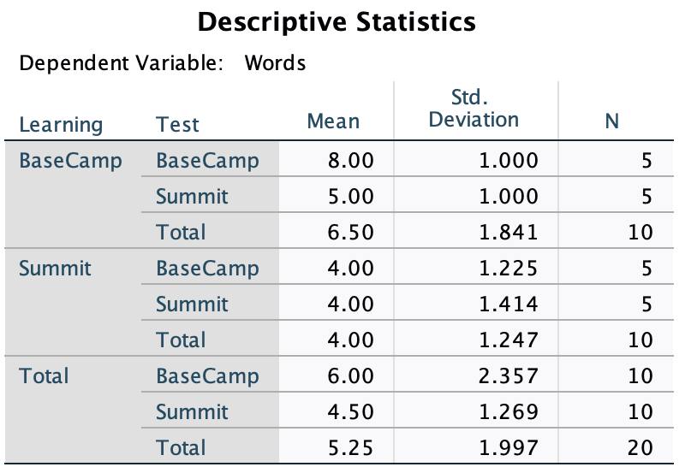
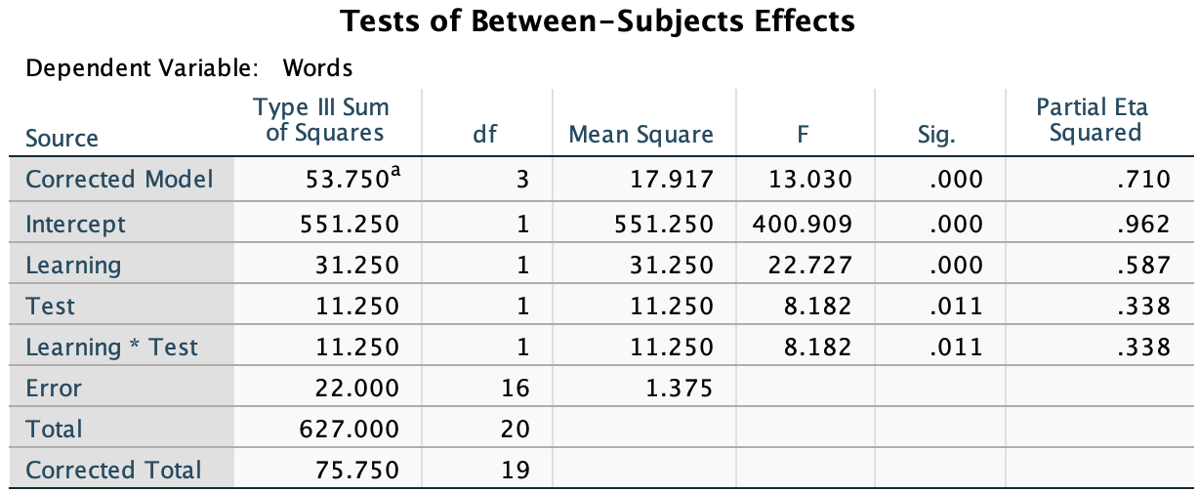
Factorial ANOVA in SPSS
You try it for the Context Dependent Memory example

Slide 24
Movie Time questionnaire
Run a factorial ANOVA to determine if any of the peculiar questions that I asked affects how many times people saw one of the movies of the summer?
What are the IVs?
What is the DV?
What does your analysis tell us?

Slide 26
Malter, et al. (2021)
What main question did Malter et al. Ask?
What did they expect to find?
Why?
Notes:
Do people feel morally responsible for negative outcomes when they have more agency?
More agency = more responsibility

Slide 27
Questions to answer for each Experiment by table
What was/were the Independent variable(s)?
What was/were the dependent variable(s)?
What was the design of the experiment?
Was there a significant main effect of either IV?
Explain what the effects Mean
Was there a significant interaction effect?
Interpret the interaction (if it was significant)
What conclusions do Malter, et al. draw on the basis of these data?

Slide 28
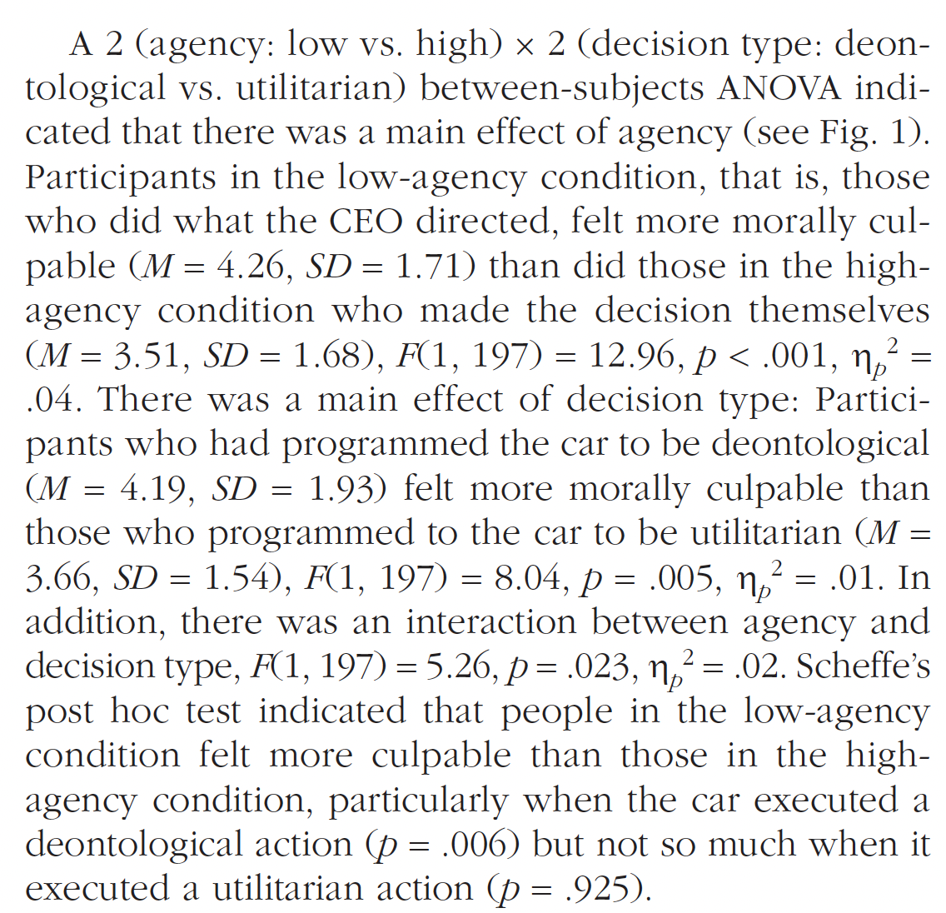
Experiment 1
Notes:
Agency; Program rule
Culpability = responsibility; guilty; regret
2 x 2
Main effect of Program and agency
Interaction effect
People felt LESS responsible when they made the decision themselves.

Slide 29
Questions to answer for each Experiment by table
What was/were the Independent variable(s)?
What was/were the dependent variable(s)?
What was the design of the experiment?
Was there a significant main effect of either IV?
Explain what the effects Mean
Was there a significant interaction effect?
Interpret the interaction (if it was significant)
What conclusions do Malter, et al. draw on the basis of these data?

Slide 30
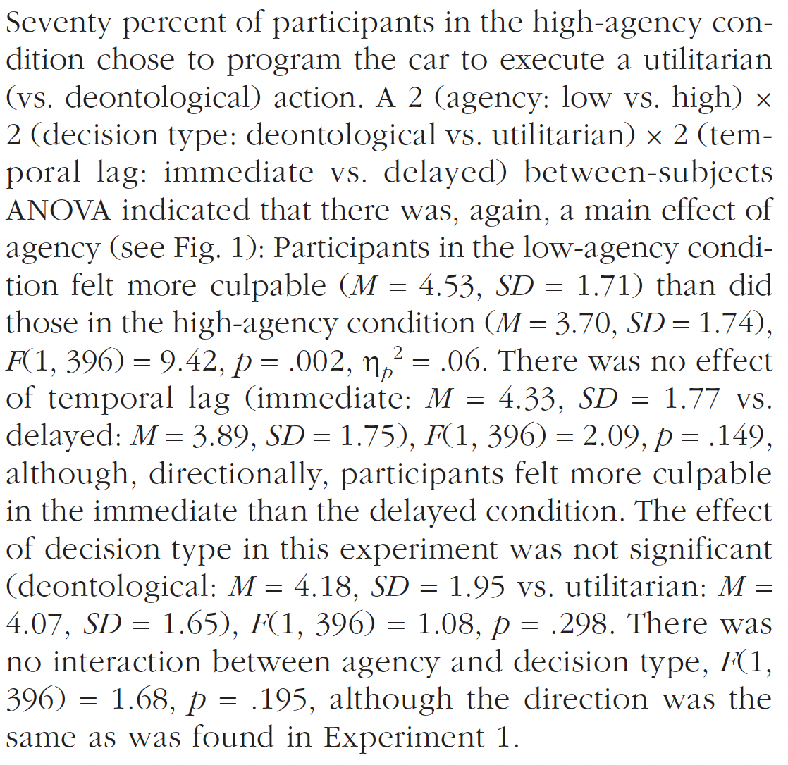
Experiment 2
Notes:
Agency; Program rule; time frame
Culpability = responsibility; guilty; regret
2 x 2 x 2
Main effect of agency but not time lag
No interaction effect
People felt LESS responsible when they made the decision themselves.

Slide 31
Questions to answer for each Experiment by table
What was/were the Independent variable(s)?
What was/were the dependent variable(s)?
What was the design of the experiment?
Was there a significant main effect of either IV?
Explain what the effects Mean
Was there a significant interaction effect?
Interpret the interaction (if it was significant)
What conclusions do Malter, et al. draw on the basis of these data?

Slide 32
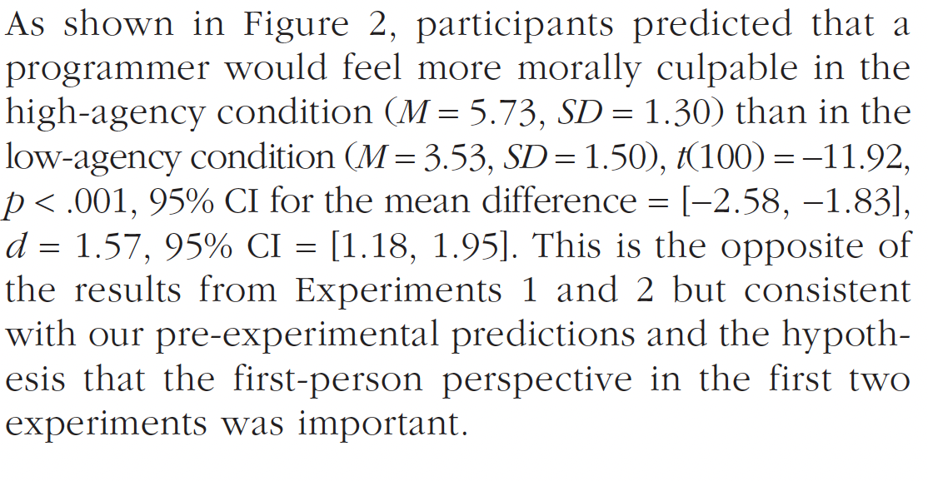
Experiment 3
Notes:
Agency;
Culpability = responsibility; guilty; regret
One-way repeated measures (I think)
Main effect of agency
No interaction effect because one way ANOVA
Others would feel MORE responsible when they made the decision themselves.

Slide 33
Questions to answer for each Experiment by table
What was/were the Independent variable(s)?
What was/were the dependent variable(s)?
What was the design of the experiment?
Was there a significant main effect of either IV?
Explain what the effects Mean
Was there a significant interaction effect?
Interpret the interaction (if it was significant)
What conclusions do Malter, et al. draw on the basis of these data?

Slide 34
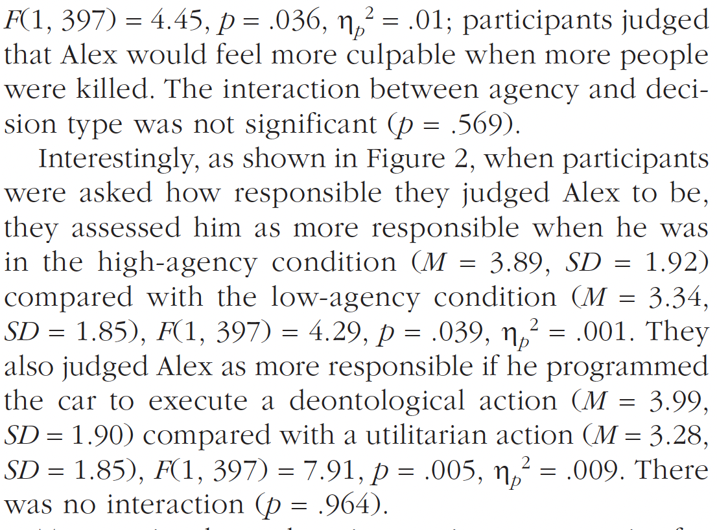
Experiment 4
Notes:
Agency; Alex or judgment of Alex
Culpability = responsibility; guilty; regret
2 x 2
No effect of agency but main effect of decision type
No interaction effect
People judged other less than they thought other would judge self

Slide 35
Questions to answer for each Experiment by table
What was/were the Independent variable(s)?
What was/were the dependent variable(s)?
What was the design of the experiment?
Was there a significant main effect of either IV?
Explain what the effects Mean
Was there a significant interaction effect?
Interpret the interaction (if it was significant)
What conclusions do Malter, et al. draw on the basis of these data?

Slide 36
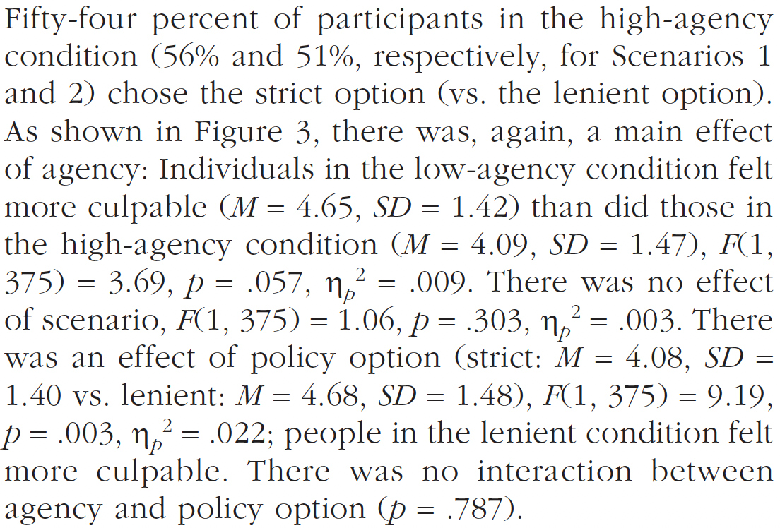
Experiment 5
Notes:
Agency; Scenario; Strictness
Culpability = responsibility; guilty; regret
2 x 2 x 2
Main effect of agency; but not policy; but STRICTNESS
No interaction effect
Judged themselves as more responsible when Low Agency; and More responsible if they chose lenient policy

Slide 37
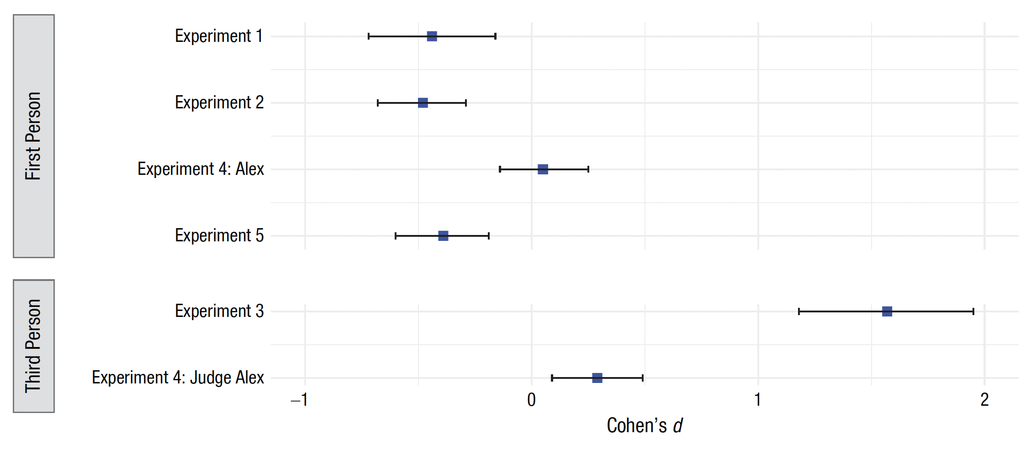
What is Cohen’s d?
Notes:
We hold others LESS responsible when carrying out orders given by others, but
We hold ourselves MORE responsible when carrying out orders given by others?

Slide 38
What does it all mean?
How do Malter, et al. (2021) resolve the inconsistency between their findings and those of previous work?
Why would this be the case?
How do these data ‘fit’ with your impressions of classic experiments like Milgram?
Notes:
Previous work did not distinguish between first and third person.
People felt they should have pushed back against the authority figure.
People do what they are told even if they might feel guilty about it later.

