Slide 1
ANOVA: Factorial Design

Slide 2
Factorial Design
What about the Eskine, et al. (2011)?
Taste Manipulation X Political View
3 Factor Levels: Neutral Sweet Disgusting | 2 Factor Levels: Liberal Conservative
3 X 2
Notes:
.

Slide 3
Types of Effects in Factorial Designs
Main Effects: Do the different levels of a given factor affect the dependent variable?
  Do emotions (e.g., disgust) affect moral judgments?
  Do liberal and conservatives differ in terms of moral judgments?
Interactions: Does the effect of one factor depend upon the level of a second factor?
  Is the effect of emotion on moral judgments different for liberals and conservatives?

Slide 4
Two-way ANOVA
Research suggests that personality is reflected in the way people talk and write about past experiences. An experiment was conducted in which individuals who were either high or low in neuroticism wrote a narrative about either a positive or a negative experience from their past.
The research question was whether neuroticism would predict the number of negative emotion words included in the narrative in each narrative and whether the pattern of negativity would vary as a function of the narrative type.

Slide 5
Types of Effects in Factorial Designs
Main Effects: Do the different levels of a given factor affect the dependent variable?
  Do people high in neuroticism use more negative words than people low in neuroticism?
  Do people use more negative words when they describe low points relative to high points?
Interactions: Does the effect of one factor depend upon the level of a second factor?
  Does the effect of neuroticism differ for positive and negative narratives?

Slide 6
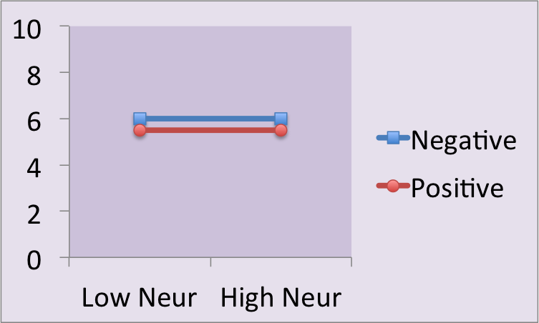
Two-Way ANOVA Outcomes
 | Lo N | Hi N | M
Neg | 6 | 6 | 6
Pos | 5.5 | 5.5 | 5.5
M | 5.75 | 5.75
Main Effect of Neuroticism: NO
Main Effect of Narrative: NO
Interaction Effect: NO

Slide 7
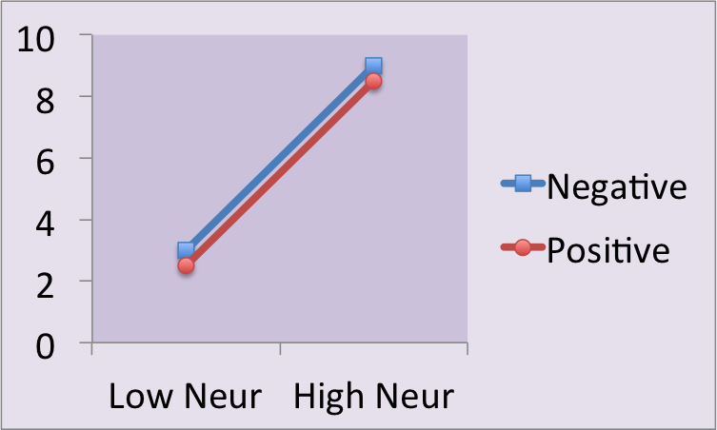
Two-Way ANOVA Outcomes
 | Lo N | Hi N | M
Neg | 3 | 9 | 6
Pos | 2.5 | 8.5 | 5.5
M | 2.75 | 8.75
Main Effect of Neuroticism: YES
Main Effect of Narrative: NO
Interaction Effect: NO

Slide 8
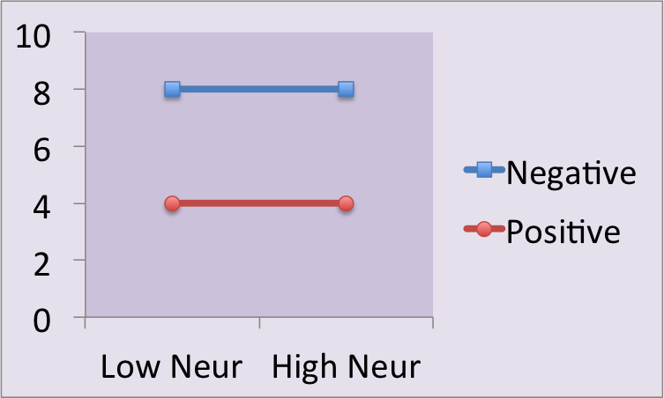
Two-Way ANOVA Outcomes
 | Lo N | Hi N | M
Neg | 8 | 8 | 8
Pos | 4 | 4 | 4
M | 6 | 6
Main Effect of Neuroticism: NO
Main Effect of Narrative: YES
Interaction Effect: NO

Slide 9
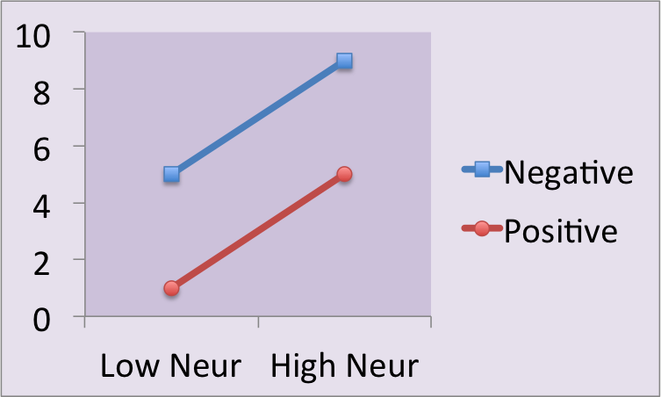
Two-Way ANOVA Outcomes
 | Lo N | Hi N | M
Neg | 5 | 9 | 7
Pos | 1 | 5 | 3
M | 3 | 7
Main Effect of Neuroticism: YES
Main Effect of Narrative: YES
Interaction Effect: NO

Slide 10
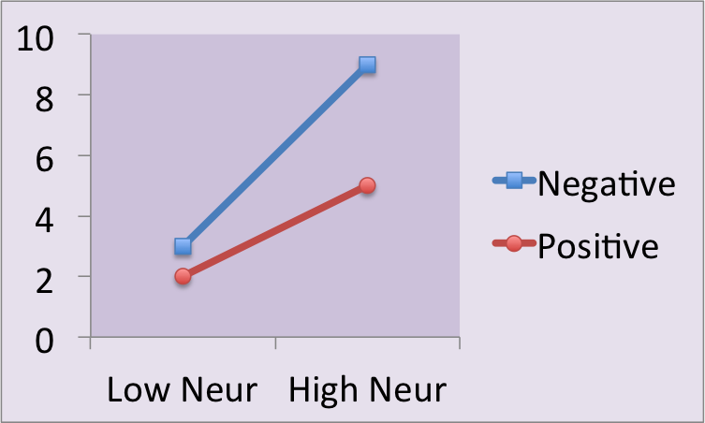
Two-Way ANOVA Outcomes
 | Lo N | Hi N | M
Neg | 3 | 9 | 6
Pos | 2 | 5 | 3.5
M | 2.5 | 7
Main Effect of Neuroticism: YES
Main Effect of Narrative: YES
Interaction Effect: YES

Slide 11
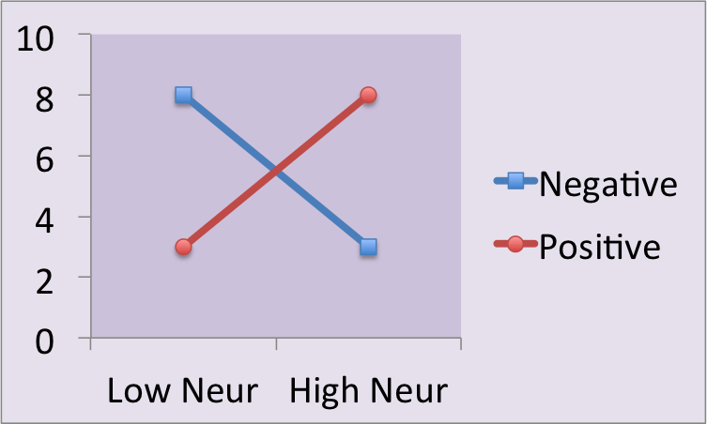
Two-Way ANOVA Outcomes
 | Lo N | Hi N | M
Neg | 8 | 3 | 5.5
Pos | 3 | 8 | 5.5
M | 5.5 | 5.5
Main Effect of Neuroticism: NO
Main Effect of Narrative: NO
Interaction Effect: YES

Slide 12
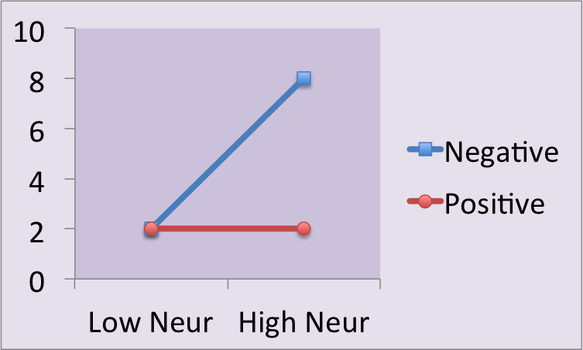
Interaction always takes Precedence!
 | Lo N | Hi N | M
Neg | 2 | 8 | 5
Pos | 2 | 2 | 2
M | 2 | 5
Main Effect of Neuroticism: YES
Main Effect of Narrative: YES
Interaction Effect: YES

Slide 13
Factorial Experiments (n-way ANOVA)
Main Effects
  Attending Class improves your grade
  People think biological women are more attractive on red backgrounds than on white
Interaction
  Attending class only improves your grade IF you also do your homework
  Biological males rate women as more attractive on red backgrounds but biological women rate them as more attractive on white backgrounds.

Slide 14
TOTAL VARIABILITY
SS_{total}
Between Treatment
Variability
SS_{between treatment}
Within Treatment
Variability
SS_{Within/ERROR}
Factor A Variability
SS_{A}
Factor B Variability
SS_{B}
Interaction Variability
SS_{AB}

Slide 15
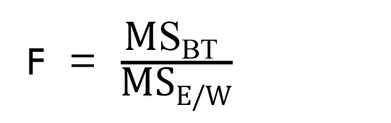
Omnibus test (test of the overall model)
  Ho: All group means are equal
  Ha: At least two group means differ
 |  | Formula | df
SS_{TOTAL} | SAME | Σ(x²) - G²/N | N-1
SS_{between treatments} | SAME | Σ[(T²/n)] - G²/N | ab-1
SS_{WITHIN/ERROR} | SAME | Σ[Σ(x²) – (T²/n)] or….SST-SSBT | N-ab
a = number of levels for Factor A
b = number of levels for Factor B
F = $\frac{\text{M}\text{S}\text{BT} }{\text{MS}\text{E}\text{/}\text{W}}$

Slide 16
If we reject the omnibus null…
 | Low Neur (B) | High Neur (B)
Negative Event (A) | M = 3 | M = 9
Positive Event (A) | M = 2 | M = 5
Main effect Factor A
  Ho: No differences b/t any levels of Factor A
  Ha: At least two levels of factor A differ.
Main effect Factor B
  Ho: No differences b/t any levels of Factor B
  Ha: At least two levels of factor B differ.

Slide 17
If we reject the omnibus null…
 | Low Neur (B) | High Neur (B)
Negative Event (A) | 2, 3, 4 | 8, 9, 10 | Ta = 36
Positive Event (A) | 1, 2, 3 | 4, 5, 6 | Ta = 21
 | Tb = 15 | Tb = 42 | G = 57
SS and F for factor A
SS and F for factor B
df=a-1 F=MS_{A}/MS_{E}
df=b-1 F=MS_{B}/MS_{E}

Slide 18
If we reject the omnibus null…
 | Low Neur (B) | High Neur (B)
Negative (A) | 2, 3, 4 | 8, 9, 10 | Ta = 36
Positive (A) | 1, 2, 3 | 4, 5, 6 | Ta = 21
 | Tb = 15 | Tb = 42 | G = 57
SS and F for factor A
df=a-1 F=MS_{A}/MS_{E}

Slide 19
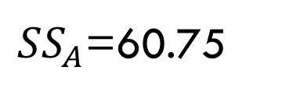
If we reject the omnibus null…
 | Low Neur (B) | High Neur (B)
Negative (A) | 2, 3, 4 | 8, 9, 10 | Ta = 36
Positive (A) | 1, 2, 3 | 4, 5, 6 | Ta = 21
 | Tb = 15 | Tb = 42 | G = 57
SS and F for factor B
df=a-1 F=MS_{A}/MS_{E}
${SS}_{A}$=60.75

Slide 20
If we reject the omnibus null…
 | No stress (B) | recent stress (B)
High genetic risk (A) | M = 6 | M = 12
Low genetic risk (A) | M = 2 | M = 2
Interaction Effects
  Ho: Factors A and B do not interact
  Ha: Factors A and B interact

Slide 21
If we reject the omnibus null…
SS and F for interaction:
The AxB interaction is defined as the “extra” mean differences not accounted for by the main effects
SS_{AxB}= SS_{between treatments} – SS_{A}-SS_{B}
df_{AxB}= df_{between treatments} – df_{A}-df_{B}
F=MS_{AxB}/MS_{E}
Between Treatment
Variability
SS_{between treatment}
Factor A Variability
SS_{A}
Factor B Variability
SS_{B}
Interaction Variability
SS_{AB}

Slide 22
Source | SS | df | MS | F
Between | Σ[(T²/n)] - G²/N | ab-1 | SSBT/df_{bt} | MSBT/MSE
Within/ Error | Σ[Σ(x²) – (T²/n)] | N-ab | SSE/df_{E}
Total | Σ(x²) - G²/N | N-1
Source | SS | df | MS | F
Factor A | Σ(T_{a}²/n) - G²/N | a-1 | SSA/df_{a} | MSA/MSE
Factor B | Σ(T_{b}²/n) - G²/N | b-1 | SSB/df_{b} | MSB/MSE
Interact | SSBT-SSA-SSB | df_{bt}– df_{A}-df_{B} | SSAB/df_{ab} | MSAxB/MSE

Slide 23
Full Example: Soccer Heading
Does playing soccer lead to neurological damage from heading the ball? Perhaps…but maybe the results don’t show up until later. Downs et al (2002) collect data on older and younger soccer players and swimmers. They administer a cognitive test to these subjects and measured the results. Do the data suggest that cognitive ability differs depending on the sport played and age of participant? Alpha = .05
 | Soccer | Swimming
Younger | 2, 4, 5, 3, 6 | 7, 7, 5, 5, 6
Older | 3, 1, 2, 3, 1 | 10, 8, 7, 7, 8

Slide 24
Full Example: Soccer Heading
 | Soccer | Swimmer
Older
x | 2, 4, 5, 3, 6 | 7, 7, 5, 5, 6
M
Σx
Σx²
Younger
x | 3, 1, 2, 3, 1 | 10, 8, 7, 7, 8
M
Σx
Σx²

Slide 25
Soccer Heading: SSt
 | Soccer | Swimmer
Older
x | 2, 4, 5, 3, 6 | 7, 7, 5, 5, 6
M | 4 | 6
Σx | 20 | 30
Σx² | 90 | 184
Younger
x | 3, 1, 2, 3, 1 | 10, 8, 7, 7, 8
M | 2 | 8
Σx | 10 | 40
Σx² | 24 | 326

Slide 26
Soccer Heading: SSbt
 | Soccer | Swimmer
Older
x | 2, 4, 5, 3, 6 | 7, 7, 5, 5, 6
M | 4 | 6
Σx | 20 | 30
Σx² | 90 | 184
Younger
x | 3, 1, 2, 3, 1 | 10, 8, 7, 7, 8
M | 2 | 8
Σx | 10 | 40
Σx² | 24 | 326

Slide 27
Soccer Heading: SSerr
 | Soccer | Swimmer
Older
x | 2, 4, 5, 3, 6 | 7, 7, 5, 5, 6
M | 4 | 6
Σx | 20 | 30
Σx² | 90 | 184
Younger
x | 3, 1, 2, 3, 1 | 10, 8, 7, 7, 8
M | 2 | 8
Σx | 10 | 40
Σx² | 24 | 326

Slide 28
Soccer Heading: SSerr
 | Soccer | Swimmer
Older
x | 2, 4, 5, 3, 6 | 7, 7, 5, 5, 6
M | 4 | 6
Σx | 20 | 30
Σx² | 90 | 184
Younger
x | 3, 1, 2, 3, 1 | 10, 8, 7, 7, 8
M | 2 | 8
Σx | 10 | 40
Σx² | 24 | 326

Slide 29
ANOVA Table
Source | SS | df | MS | F
Model (BT) Error Total | 100 24 124
Model = between treatment
Error = within
Source | SS | df | MS | F
Sport Age SxA

Slide 30
Looking up the F critical values
Omnibus:
  Fob =22.22
  Df_{bt}= ab – 1; df_{error}= N– ab
  Fcrit (3,16) = 3.24
  Decision: reject the null
  Interpretation: There is a significant difference between at least two of the groups
 |  | Sport
 |  | Soccer | Swimmer
Age | younger | 4 | 6 | 5
 | older | 2 | 8 | 5
 |  | 3 | 7

Slide 31
ANOVA Table
Source | SS | df | MS | F
Model (BT) Error Total | 100 24 124 | 3 16 19 | 33.33 1.50 | 22.22
Model = between treatment
Error = within
Source | SS | df | MS | F
Sport Age SxA

Slide 32
Partitioning main effects and interaction
 | Soccer | Swimming
Older
x | 2, 4, 5, 3, 6 | 7, 7, 5, 5, 6
M | 4 | 6
Σx | 20 | 30
Σx² | 90 | 184
Younger
x | 3, 1, 2, 3, 1 | 10, 8, 7, 7, 8
M | 2 | 8
Σx | 10 | 40
Σx² | 24 | 326

Slide 33
Partitioning main effects and interaction
 | Soccer | Swimming
Older
x | 2, 4, 5, 3, 6 | 7, 7, 5, 5, 6
M | 4 | 6
Σx | 20 | 30
Σx² | 90 | 184
Younger
x | 3, 1, 2, 3, 1 | 10, 8, 7, 7, 8
M | 2 | 8
Σx | 10 | 40
Σx² | 24 | 326

Slide 34
Partitioning main effects and interaction
 | Soccer | Swimmer
Older
x | 2, 4, 5, 3, 6 | 7, 7, 5, 5, 6
M | 4 | 6
Σx | 20 | 30
Σx² | 90 | 184
Younger
x | 3, 1, 2, 3, 1 | 10, 8, 7, 7, 8
M | 2 | 8
Σx | 10 | 40
Σx² | 24 | 326
SS_{SxA} = SSBT - SS_{sport} - SS_{age}
= 100 - 80 - 0
= 20

Slide 35
ANOVA Table
Source | SS | df | MS | F
Model (BT) Error Total | 100 24 124 | 3 16 19 | 33.33 1.50 | 22.22
Model = between treatment
Error = within
Source | SS | df | MS | F
Sport Age SxA | 80 0 20

Slide 36
ANOVA Table
Source | SS | df | MS | F
Model (BT) Error Total | 100 24 124 | 3 16 19 | 33.33 1.50 | 22.22
Model = between treatment
Error = within
Source | SS | df | MS | F
Sport Age SxA | 80 0 20 | 1 1 1 | 80 0 20 | 53.33 0.00 13.33

Slide 37
Looking up the F critical values
Main effect of sport:
  Fobs sport=53.33
  df_{Sport} = a – 1, df_{error} =N – ab
  Fcrit (1,16) =4.49
  Decision: reject the null
  Interpretation: Soccer players scored significantly lower than swimmers on the cognitive test.
 |  | Sport
 |  | Soccer | Swimmer
Age | younger | 4 | 6 | 5
 | older | 2 | 8 | 5
 |  | 3 | 7

Slide 38
Looking up the F critical values
Main effect of age:
  Fobs age = 0
  df_{age}= b-1, df_{error}= N – ab
  Fcrit (1,16) = 4.49
  Decision: fail to reject the null
  Interpretation: Age does not significantly influence cognitive test scores
 |  | Sport
 |  | Soccer | Swimmer
Age | younger | 4 | 6 | 5
 | older | 2 | 8 | 5
 |  | 3 | 7

Slide 39
Looking up the F critical values
Interaction:
  Fob = 13.33
  df_{sportxage} = (df_{bt}-df_{sport}-df_{age)}, df_{error}=N – ab
  Fcrit (1,16) = 4.49
  Decision: reject the null
  Interpretation: The effect of sport played on test scores depends on the participant’s age.
 |  | Sport
 |  | Soccer | Swimmer
Age | younger | 4 | 6 | 5
 | older | 2 | 8 | 5
 |  | 3 | 7

Slide 40
Graph

Slide 41
Write-up for a 2-Way ANOVA
The analysis indicated that there was an overall main effect, F (3, 16) = 22.22, p < .05. This indicates that our independent variables significantly influenced conceptual thinking performance.

Slide 42
Write-up for a 2-Way ANOVA
The analysis indicated that there was an overall main effect, F (3, 16) = 22.22, p < .05. This indicates that our independent variables significantly influenced conceptual thinking performance. The results indicated a significant main effect of Sport, F (1, 16) = 53.33, p < .05, with soccer players performing worse (M = 3) than swimmers (M = 7). The main effect of age was not significant, F (1, 16) = 0, p > .05. Younger (M = 5) and Older participants (M = 5) did not differ in performance.

Slide 43
Write-up for a 2-Way ANOVA
The analysis indicated that there was an overall main effect, F (3, 16) = 22.22, p < .05. This indicates that our independent variables significantly influenced conceptual thinking performance. The results indicated a significant main effect of Sport, F (1, 16) = 53.33, p < .05, with soccer players performing worse (M = 3) than swimmers (M = 7). The main effect of age was not significant, F (1, 16) = 0, p > .05. Younger (M = 5) and Older participants (M = 5) did not differ in performance. Finally, the interaction effect was significant, F (1, 16) = 13.33, p < .05. Swimmers showed poorer performance at younger ages (6) than at older ages (M =8) but soccer players showed better performance at younger ages (M = 4) than at older ages (M =2).

Slide 44
Assumptions for Factorial Designs
(n-way ANOVA)
Distribution for each treatment (factor level combination) is normal.
2) Homogeneity of variance
3) Each treatment consists of random, independent samples.
4) Balanced design: Equal n in all treatments (but ok if not perfect)

Slide 45
Filling in the blanks
Source | SS | df | MS | F | P
Model Error Total | 2180.00 | 11 119 | 10.00 | 10.00 | .0046
Source | SS | df | MS | F | P
A B AxB | 45.00 98.00 957.00 | 3 2 |  | 1.50 | .2493 .0371 .0011
What is SS Model and SS Error?
How many total subjects in the experiment?
How many levels for Factor A?
How many levels for Factor B?

Slide 46
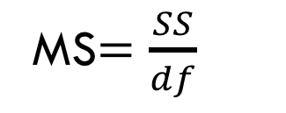
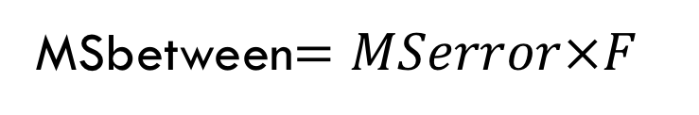
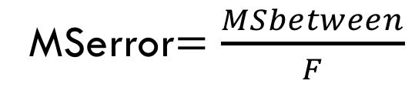




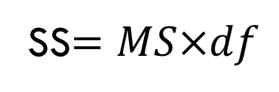

Filling in an ANOVA table - Equations
$$SStotal=SSbetween+SSerror$$
$$SSbetween=SStotal−SSerror$$
MS$=\frac{SS}{df}$
$$SSerror=SStotal−SSbetween$$
df$=\frac{SS}{MS}$
$$dftotal=dfbetween+dferror$$
$$dfbetween=dftotal−dferror$$
SS$=MS×df$
$$dferror=dftotal−dfbetween$$
$$F=\frac{MSbetween}{MSerror}$$
$$DFtotal=N−1$$
$$DFbetween=P−1$$
MSerror$=\frac{MSbetween}{F}$
$$DFerror=N−P$$
MSbetween$=MSerror×F$

Slide 47
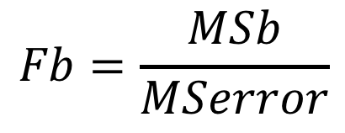
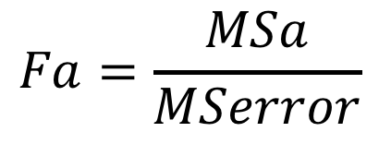




Filling in an ANOVA table - Equations
$$SSbt=SSa+SSb+SSaxb$$
$$dfbt=dfa+dfb+dfaxb$$
$$DFa=a−1$$
$$DFb=b−1$$
$$DFaxb=dfa∗dfb$$
$$Fa=\frac{MSa}{MSerror}$$
$$Fb=\frac{MSb}{MSerror}$$
$$Faxb=\frac{MSaxb}{MSerror}$$

Slide 48
Filling in the blanks
Source | SS | df | MS | F | P
Model Error Total | 2180.00 | 11 119 | 10.00 | 10.00 | .0046
Source | SS | df | MS | F | P
A B AxB | 45.00 98.00 957.00 | 3 2 |  | 1.50 | .2493 .0371 .0011
What is SS Model and SS Error?
How many total subjects in the experiment?
How many levels for Factor A?
How many levels for Factor B?

Slide 49
Filling in the blanks
Source | SS | df | MS | F | P
Model Error Total | 2180.00 | 11 119 | 10.00 | 10.00 | .0046
Source | SS | df | MS | F | P
A B AxB | 45.00 98.00 957.00 | 3 2 |  | 1.50 | .2493 .0371 .0011
5) Which factors are significant if alpha is set at .05?
6) Fill in the other blanks

Slide 50
Filling in the blanks
Source | SS | df | MS | F | P
Model Error Total | 2180.00 | 11 119 | 10.00 | 10.00 | .0046
Source | SS | df | MS | F | P
A B AxB | 45.00 98.00 957.00 | 3 2 |  | 1.50 | .2493 .0371 .0011

Slide 51
Factorial ANOVA steps
Define null and alternative for:
  Omnibus, main effects, and interaction
Set alpha
Calculate sums of squares:
  Total, Between treatments, Error/within
Partition SS between treatments into:
  SS for each main effect and SS interaction

Slide 52
Factorial ANOVA steps
Calculate mean squares and F ratios:
  omnibus, main effects, interaction
Identify F critical values for:
  omnibus, main effects, interaction
Make decisions about rejecting the null
Interpret results

Slide 53
Social support in Stressful Situations
The subjects in an experiment were told that they were going to experience a mildly painful medical procedure. They were asked to rate how much they would like to wait with another subject, who was a confederate, and either identified as male or female. The two independent variables were the gender of the subject, and the gender of the confederate. 20 subjects participated; 5 in each group. The data are presented in the table below. Conduct a 2-way ANOVA to examine the effect of these two variables on the subjects' desire to wait with another person (α = .05).

Slide 54
Social support in Stressful Situations
n = 5 per group | Confederate
Subject | Male | Female
Male | M = 4 Σx = 20 Σx² = 88 | M = 4 Σx = 20 Σx² = 86
Female | M = 5 Σx = 25 Σx² = 129 | M = 8 Σx = 40 Σx² = 324

Slide 55
Social Support Solution
n = 5 per group | Confederate
Subject | Male | Female
Male | M = 4 Σx = 20 Σx² = 88 | M = 4 Σx = 20 Σx² = 86
Female | M = 5 Σx = 25 Σx² = 129 | M = 8 Σx = 40 Σx² = 324
SST = Σx² - G²/N
= (88 + 86 + 129 + 324) - (20 + 20 + 25 + 40)²/20
= 627 - 105²/20
= 627 - 551.25 = 75.75

Slide 56
Social Support Solution
n = 5 per group | Confederate
Subject | Male | Female
Male | M = 4 Σx = 20 Σx² = 88 | M = 4 Σx = 20 Σx² = 86
Female | M = 5 Σx = 25 Σx² = 129 | M = 8 Σx = 40 Σx² = 324
SSBT = Σ(T²/n) - G²/N
= (20²/5) + (20²/5) + (25²/5) + (40²/5) - 551.25
= 80 + 80 + 125 + 320 – 551.25
= 605 - 551.25 = 53.75

Slide 57
Social Support Solution
n = 5 per group | Confederate
Subject | Male | Female
Male | M = 4 Σx = 20 Σx² = 88 | M = 4 Σx = 20 Σx² = 86
Female | M = 5 Σx = 25 Σx² = 129 | M = 8 Σx = 40 Σx² = 324
SSE = SST - SSBT
= 75.75 - 53.75
= 22.00

Slide 58
Social Support Solution
n = 5 per group | Confederate
Subject | Male | Female
Male | M = 4 Σx = 20 Σx² = 88 | M = 4 Σx = 20 Σx² = 86
Female | M = 5 Σx = 25 Σx² = 129 | M = 8 Σx = 40 Σx² = 324
  Or…
  SSE = Σ(Σx² - T²/n)
= (88-80) + (86-80) + (129-125) + (324-320)
= 8 + 6 + 4 + 4
= 22.00

Slide 59
TOTAL VARIABILITY
SS_{total}
75.75
53.75
22.00
Between Treatment
Variability
SS_{between treatment}
Within Treatment
Variability
SS_{Within/ERROR}
?
?
?
Variability due to subject
SS_{A}
Variability due to confederate
SS_{B}
Interaction Variability
SS_{AB}

Slide 60
Partitioning SSBT
n = 5 per grp | Confederate
Subject | Male | Female
Male | M = 4 Σx = 20 Σx² = 88 | M = 4 Σx = 20 Σx² = 86
Female | M = 5 Σx = 25 Σx² = 129 | M = 8 Σx = 40 Σx² = 324
SS_{subj} = Σ[(T_{S}²/n)] - G²/N
= (20+20)²/10 + (25+40)²/10 - 551.25
= (40²/10) + (65²/10) - 551.25
= 160 + 422.5 - 551.25
= 582.5 - 551.25 = 31.25

Slide 61
Partitioning SSBT
n = 5 per grp | Confederate
Subject | Male | Female
Male | M = 4 Σx = 20 Σx² = 88 | M = 4 Σx = 20 Σx² = 86
Female | M = 5 Σx = 25 Σx² = 129 | M = 8 Σx = 40 Σx² = 324
SS_{confed}= Σ[(T_{C}²/n)] - G²/N
= (20+25)²/10 + (20+40)²/10 - 551.25
= (45²/10) + (60²/10) - 551.25
= 202.5 + 360 - 551.25
= 562.5 - 551.25 = 11.25

Slide 62
Partitioning SSBT
n = 5 per group | Confederate
Subject | Male | Female
Male | M = 4 Σx = 20 Σx² = 88 | M = 4 Σx = 20 Σx² = 86
Female | M = 5 Σx = 25 Σx² = 129 | M = 8 Σx = 40 Σx² = 324
SS_{SxC} = SSBT - (SS_{subj} + SS_{conf})
= 53.75 - (31.25 + 11.25)
= 53.75 - 42.5
= 11.25

Slide 63
TOTAL VARIABILITY
SS_{total}
75.75
53.75
22.00
Between Treatment
Variability
SS_{between treatment}
Within Treatment
Variability
SS_{Within/ERROR}
31.25
11.25
11.25
Variability due to subject
SS_{A}
Variability due to confederate
SS_{B}
Interaction Variability
SS_{AB}

Slide 64
Social Support ANOVA table
Source | SS | df | MS | F
Model Error Total
Source | SS | df | MS | F
Subject Confed SxC
 |  | Confederate
 |  | Male | Female
Subject | Male | 4 | 4 | 4
 | Female | 5 | 8 | 6.5
 |  | 4.5 | 6

Slide 65
Social Support ANOVA table
Source | SS | df | MS | F
Model Error Total | 53.75 22.00 75.75
F crit (3,16) = 3.24
Source | SS | df | MS | F
Subject Confed SxC | 31.25 11.25 11.25
F crit (1,16) = 4.49
 |  | Confederate
 |  | Male | Female
Subject | Male | 4 | 4 | 4
 | Female | 5 | 8 | 6.5
 |  | 4.5 | 6

Slide 66
Social Support ANOVA table
Source | SS | df | MS | F
Model Error Total | 53.75 22.00 75.75 | 3 16 19 | 17.92 1.38 | 13.03
F crit (3,16) = 3.24
Source | SS | df | MS | F
Subject Confed SxC | 31.25 11.25 11.25
F crit (1,16) = 4.49
 |  | Confederate
 |  | Male | Female
Subject | Male | 4 | 4 | 4
 | Female | 5 | 8 | 6.5
 |  | 4.5 | 6

Slide 67
Social Support ANOVA table
Source | SS | df | MS | F
Model Error Total | 53.75 22.00 75.75 | 3 16 19 | 17.92 1.38 | 13.03
F crit (3,16) = 3.24
Source | SS | df | MS | F
Subject Confed SxC | 31.25 11.25 11.25 | 1 1 1 | 31.25 11.25 11.25 | 22.73 8.18 8.18
F crit (1,16) = 4.49
 |  | Confederate
 |  | Male | Female
Subject | Male | 4 | 4 | 4
 | Female | 5 | 8 | 6.5
 |  | 4.5 | 6

Slide 68
Participant Gender and Confederate Gender Predicting Preference to Wait with Another Person

Slide 69
Reporting the results of a 2-Way ANOVA
The 2x2 ANOVA indicated that there was an overall effect, F (3, 16) = 13.03, p < .05, suggesting the independent variables influenced how much people wanted to wait with someone else. There was a significant main effect of subject gender, F (1, 16) = 22.73, p < .05; women indicated a greater desire to wait with someone else than men. The main effect of confederate gender was also significant, F (1, 16) = 8.18, p < .05. People preferred to wait with a woman rather than a man. Finally, the interaction effect was significant, F (1, 16) = 8.18, p < .05. Males’ ratings were the same regardless of whether the confederate was male (M = 4) or female (M=4) but females’ ratings were higher if the confederate was a female (M 8), rather than a male (M = 5).

Slide 70
Reporting the results of a 2-Way ANOVA
The 2x2 ANOVA indicated that there was an overall effect, F (3, 16) = 13.03, p < .05, suggesting the independent variables influenced how much people wanted to wait with someone else. There was a significant main effect of subject gender, F (1, 16) = 22.73, p < .05; women indicated a greater desire to wait with someone else than men. The main effect of confederate gender was also significant, F (1, 16) = 8.18, p < .05. People preferred to wait with a woman rather than a man. Finally, the interaction effect was significant, F (1, 16) = 8.18, p < .05. Males’ ratings were the same regardless of whether the confederate was male (M = 4) or female (M=4) but females’ ratings were higher if the confederate was a female (M 8), rather than a male (M = 5).

Slide 71
Reporting the results of a 2-Way ANOVA
The 2x2 ANOVA indicated that there was an overall effect, F (3, 16) = 13.03, p < .05, suggesting the independent variables influenced how much people wanted to wait with someone else. There was a significant main effect of subject gender, F (1, 16) = 22.73, p < .05; women indicated a greater desire to wait with someone else than men. The main effect of confederate gender was also significant, F (1, 16) = 8.18, p < .05. People preferred to wait with a woman rather than a man. Finally, the interaction effect was significant, F (1, 16) = 8.18, p < .05. Males’ ratings were the same regardless of whether the confederate was male (M = 4) or female (M=4) but females’ ratings were higher if the confederate was a female (M 8), rather than a male (M = 5).

Slide 72
Calculating simple main effects
When there is a significant interaction, we will perform a separate analysis of variance for each column (or row) to examine individual group differences.
Caffeine, Studying, and Exam Performance
 | No Coffee | 1-2 Cups | > 2 Cups
Studied | 82 | 95 | 80
Did not Study | 74 | 73 | 60

Slide 73
Calculating simple main effects
One-way ANOVA for No Coffee condition: compare studied vs. not
Caffeine, Studying, and Exam Performance
 | No Coffee | 2 Cups | > 2 Cups
Studied | 82 | 95 | 80
Did not Study | 74 | 73 | 60
One-way ANOVA

Slide 74
Calculating simple main effects
One-way ANOVA for 2 cups condition: compare studied vs. not
Caffeine, Studying, and Exam Performance
 | 1-2 Cups | > 2 Cups
Studied | 95 | 80
Did not Study | 73 | 60
One-way ANOVA

Slide 75
Calculating simple main effects
One-way ANOVA for > 2 cups condition: compare studied vs. not
Caffeine, Studying, and Exam Performance
One-way ANOVA
 | > 2 Cups
Studied | 80
Did not Study | 60

Slide 76
Calculating simple main effects
And/or…
4. One-way ANOVA for the studied condition:
no vs. 2 vs. >2 cups
5. One-way ANOVA for the did not study condition:
no vs. 2 vs. >2 cups
Caffeine, Studying, and Exam Performance
 | No Coffee | 1-2 Cups | > 2 Cups
Studied | 82 | 95 | 80
Did not Study | 74 | 73 | 60
One-Way
ANOVA
One-Way
ANOVA

Slide 77
More practice with Interpretation

Slide 78
Caspi et al..
DV: self-reported depression symptoms
IV #1: number of stressful life events participants experienced in past year (5 levels)
IV #2: Genetic risk (3 levels: s/s allele; s/l allele, or l/l allele)

Slide 79
McQuade (2017)
DV: Physical aggression (higher suggests more aggression)
IV#1: Children’s level of physical victimization (i.e., how much bullied; 2 levels low and high)
IV#2: Children’s executive functioning skills (EF: cognitive abilities; 3 levels: low, average, high)

Slide 80
Erath et al. (2009)
DV: externalizing problems (e.g., aggression, noncompliance, rule-breaking)
IV#1: Harsh parenting (2 levels: - 1 SD = low and + 1 SD = high)
IV#2: Girls’ stress reaction (e.g., how they respond physiologically to a stressful task; 2 levels: Higher SCLR = high stress reaction; Lower SCLR = low stress reaction)

