Slide 2
Malter, et al. (2021)
What main question did Malter et al. Ask?
What did they expect to find?
Why?
Notes:
Do people feel morally responsible for negative outcomes when they have more agency?
More agency = more responsibility

Slide 3
Questions to answer for each Experiment by table
What was/were the Independent variable(s)?
What was/were the dependent variable(s)?
What was the design of the experiment?
Was there a significant main effect of either IV?
Explain what the effects Mean
Was there a significant interaction effect?
Interpret the interaction (if it was significant)
What conclusions do Malter, et al. draw on the basis of these data?

Slide 4
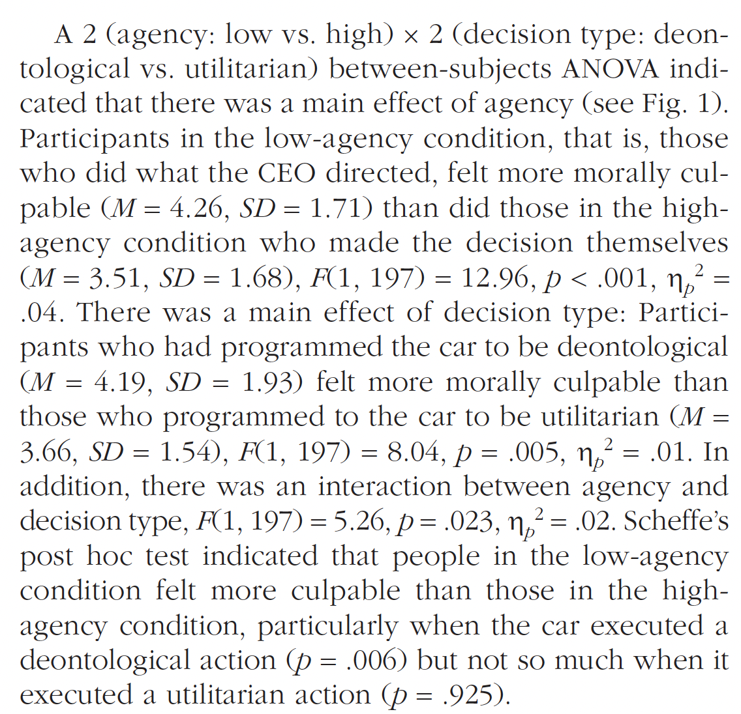
Experiment 1
Notes:
Agency; Program rule
Culpability = responsibility; guilty; regret
Main effect of Program and agency
Interaction effect

Slide 5
Questions to answer for each Experiment by table
What was/were the Independent variable(s)?
What was/were the dependent variable(s)?
What was the design of the experiment?
Was there a significant main effect of either IV?
Explain what the effects Mean
Was there a significant interaction effect?
Interpret the interaction (if it was significant)
What conclusions do Malter, et al. draw on the basis of these data?

Slide 6
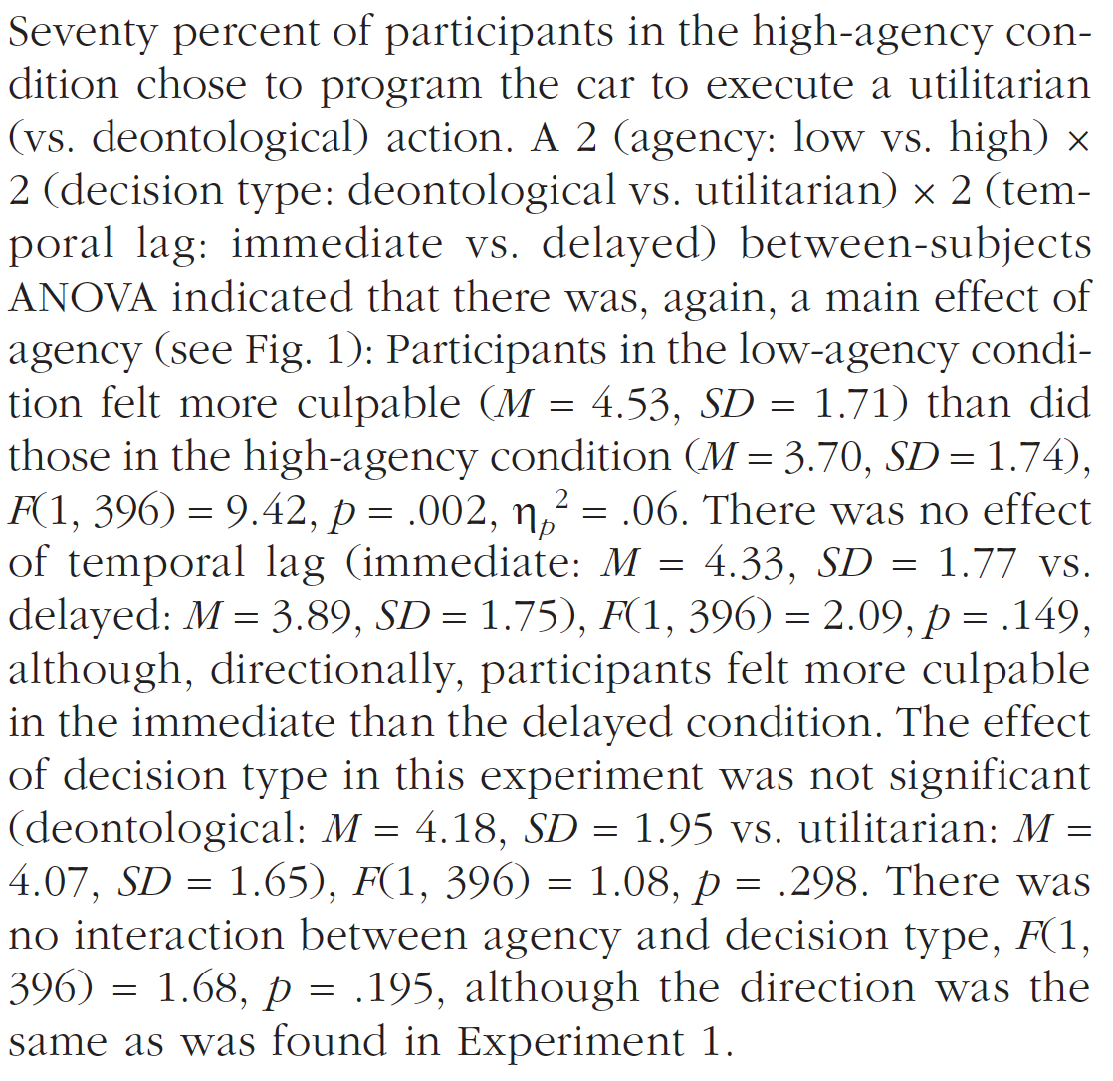
Experiment 2

Slide 7
Questions to answer for each Experiment by table
What was/were the Independent variable(s)?
What was/were the dependent variable(s)?
What was the design of the experiment?
Was there a significant main effect of either IV?
Explain what the effects Mean
Was there a significant interaction effect?
Interpret the interaction (if it was significant)
What conclusions do Malter, et al. draw on the basis of these data?

Slide 8
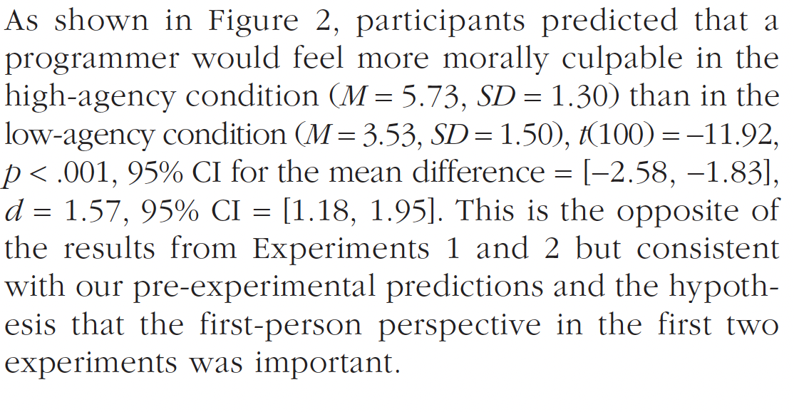
Experiment 3
Notes:
Agency; Program rule
Culpability = responsibility; guilty; regret
Main effect of Program and agency
Interaction effect

Slide 9
Questions to answer for each Experiment by table
What was/were the Independent variable(s)?
What was/were the dependent variable(s)?
What was the design of the experiment?
Was there a significant main effect of either IV?
Explain what the effects Mean
Was there a significant interaction effect?
Interpret the interaction (if it was significant)
What conclusions do Malter, et al. draw on the basis of these data?

Slide 10
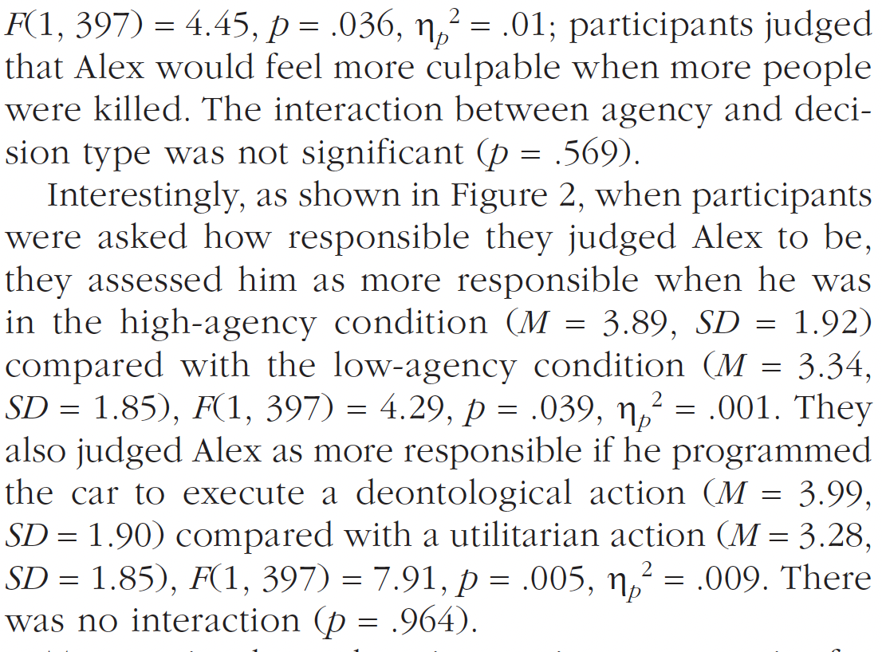
Experiment 4

Slide 11
Questions to answer for each Experiment by table
What was/were the Independent variable(s)?
What was/were the dependent variable(s)?
What was the design of the experiment?
Was there a significant main effect of either IV?
Explain what the effects Mean
Was there a significant interaction effect?
Interpret the interaction (if it was significant)
What conclusions do Malter, et al. draw on the basis of these data?

Slide 12
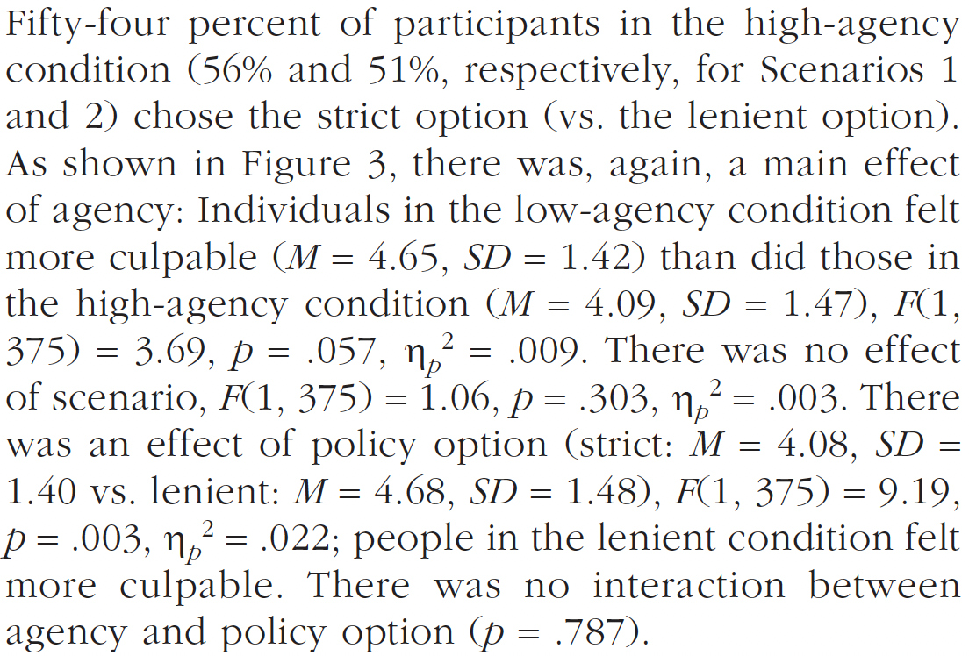
Experiment 5
Notes:
Agency; Program rule
Culpability = responsibility; guilty; regret
Main effect of Program and agency
Interaction effect

Slide 13
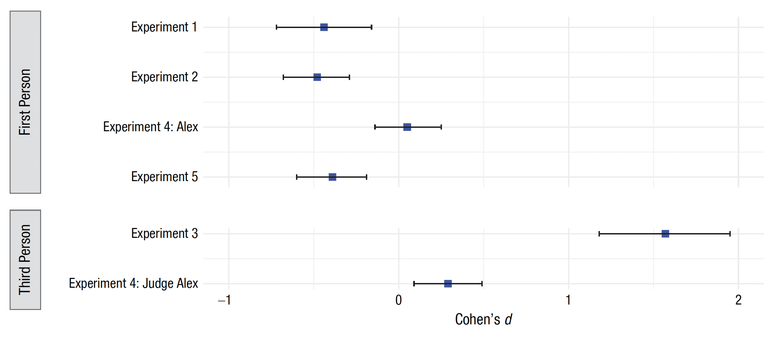
What is Cohen’s d?

Slide 14
What does it all mean?
How do Malter, et al. (2021) resolve the inconsistency between their findings and those of previous work?
Why would this be the case?
How do these data ‘fit’ with your impressions of classic experiments like Milgram?
Notes:
We hold others LESS responsible when carrying out orders given by others, but
We hold ourselves MORE responsible when carrying out orders given by others?

