Slide 1
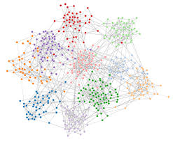
Correlation

Slide 2
Where we’ve been….
…Where we’re going
(aka: The Run Down)

Slide 3
So far….
We have examined IVs that are categorical:
And DVs that are continuous/dimensional:
Gratitude
Humor
Daily Routine
Happiness

Slide 4
Now we’ll deal with…
IVs that are that are continuous/dimensional :
And DVs that are continuous/dimensional:
Number of close friends
Level of stress

Slide 5
CI vs. ANOVA vs. Regression
CI | Estimation
 | What is μ?
ANOVA (t-test) | Comparison
 | Are there group differences?
Correlation / Regression | Prediction and Estimation
 | Does knowing X help me predict Y?

Slide 6
Correlation Coefficient:
strength (consistency) of Relationship
r = +1
r = -1
Perfect positive relationship
Perfect negative relationship
positive relationship
no relationship
negative relationship
r = positive # less than 1
r = 0
r = negative # greater than -1

Slide 7
Correlation Coefficient
Pearson’s product moment coefficient of correlation : a measure of the strength of the linear relationship between two variables.
r
Pearson’s r
correlation coefficient
$$r= \frac{Covariation (xy)}{RandomVariation (xy)}$$
$$\frac{SP}{{SS}_{x} \& {SS}_{y}}$$

Slide 8
Questions

Slide 9
Let’s collect some data
Please complete this Google form.
Then, chill while I grind this into an SPSS data set.

Slide 10
Hypothesis Tests with Correlation
Step 1: define null and alternative
Ho: ρ = 0 (there is no correlation in the population)
Ha: ρ ≠ 0 (there is a correlation in the population)
Step 2: set alpha
Step 3: calculate r
Step 4: Look up critical value for pearson correlation
df = n-2
Step 5: if │r│ is greater than or equal to critical value: reject the null
Step 6: interpret results
$$SP= \sum{\left(xy\right)} −\left(\frac{\left(\sum{x}\right)\left(\sum{y}\right)}{n}\right)$$
${SS}_{x}= \sum{x^{2}}−$ $\left(\frac{{\left(\sum{x}\right)}^{2}}{n}\right)$
${SS}_{y}= \sum{y^{2}}−$ $\left(\frac{{\left(\sum{y}\right)}^{2}}{n}\right)$
$$r= {SP}/{\sqrt{\left({SS}_{x}\right)\left({SS}_{y}\right)}}$$

Slide 11
Homesickness
How are we going to combat homesickness? Maybe the key is to call your parents more often. I asked a group of students how often they call home in a typical week and how homesick they felt. The data appear below. Calculate the correlation coefficient, the coefficient of determination, and interpret those results including a statement of whether calling home is a significant predictor of homesickness.
 | Scores |  | Products | Sum of squares
 | Calls (X) | Homesick (Y) | (X)(Y) | x² | y²
Tiffany | 4 | 10
Sophia | 6 | 8
Nicky | 8 | 7
Lorna | 3 | 6
Gloria | 9 | 4
 | ∑x = | ∑y = | ∑(xy) = | ∑x² ⁼ | ∑y² ⁼

Slide 12
Scores |  | Products | Sum of squares
Calls (X) | Homesick (Y) | (X)(Y) | x² | y²
4 | 10 | 40 | 16 | 100
6 | 8 | 48 | 36 | 64
8 | 7 | 56 | 64 | 49
3 | 6 | 18 | 9 | 36
9 | 4 | 36 | 81 | 16
∑x = 30 | ∑y = 35 | ∑(xy) = 198 | ∑x² ⁼ 206 | ∑y² ⁼ 265
$$SP= \sum{\left(xy\right)} −\left(\frac{\left(\sum{x}\right)\left(\sum{y}\right)}{n}\right)$$
= 198 - $\left(\frac{\left(30\right)\left(35\right)}{5}\right)$
= 198 – 210
= -12

Slide 13
Scores |  | Products | Sum of squares
Calls (X) | Homesick (Y) | (X)(Y) | x² | y²
4 | 10 | 40 | 16 | 100
6 | 8 | 48 | 36 | 64
8 | 7 | 56 | 64 | 49
3 | 6 | 18 | 9 | 36
9 | 4 | 36 | 81 | 16
∑x = 30 | ∑y = 35 | ∑(xy) = 198 | ∑x² ⁼ 206 | ∑y² ⁼ 265
${SS}_{x}= \sum{x^{2}}−$ $\left(\frac{{\left(\sum{x}\right)}^{2}}{n}\right)$
= 206 -$\left(\frac{{\left(30\right)}^{2}}{5}\right)$
= 206 – 180
= 26
${SS}_{y}= \sum{y^{2}}−$ $\left(\frac{{\left(\sum{y}\right)}^{2}}{n}\right)$
= 265 -$\left(\frac{{\left(35\right)}^{2}}{5}\right)$
= 265 – 245
= 20

Slide 14
Scores |  | Products | Sum of squares
Calls (X) | Homesick (Y) | (X)(Y) | x² | y²
4 | 10 | 40 | 16 | 100
6 | 8 | 48 | 36 | 64
8 | 7 | 56 | 64 | 49
3 | 6 | 18 | 9 | 36
9 | 4 | 36 | 81 | 16
∑x = 30 | ∑y = 35 | ∑(xy) = 198 | ∑x² ⁼ 206 | ∑y² ⁼ 265
SP = -12 SSx = 26 SSy = 20
$$r= {SP}/{\sqrt{\left({SS}_{x}\right)\left({SS}_{y}\right)}}$$
$$={−12}/{\sqrt{(26)(20)}} = \frac{−12}{22.805}$$
= -0.526

Slide 15
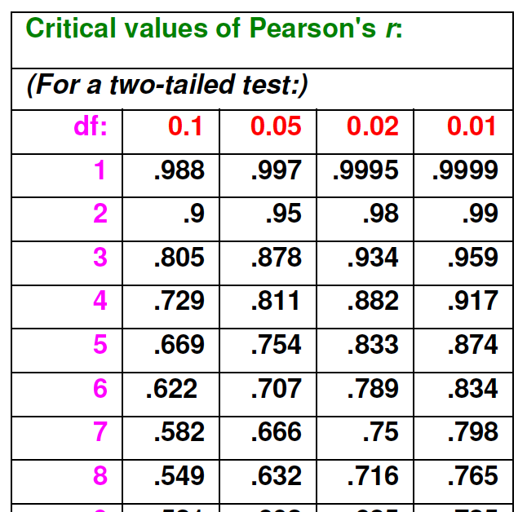
Critical value for r

Slide 16
There is a negative correlation between calling home and homesickness; calling home more often leads to less homesickness. This relationship is not significant: r (3) = -0.526, p > .05, r2 = 0.277.

Slide 17
What can we use correlations for?
Prediction
If you know someone’s score on one variable can you predict their score on another?
Validity
How do scores on a new test relate to scores on a well established test?
Reliability
Are measurements consistent across time?
Theory Verification
If theory suggests two variables should be related, then they should be correlated in expected direction

Slide 18
Any Questions?

Slide 19
Real Research Examples

Slide 21
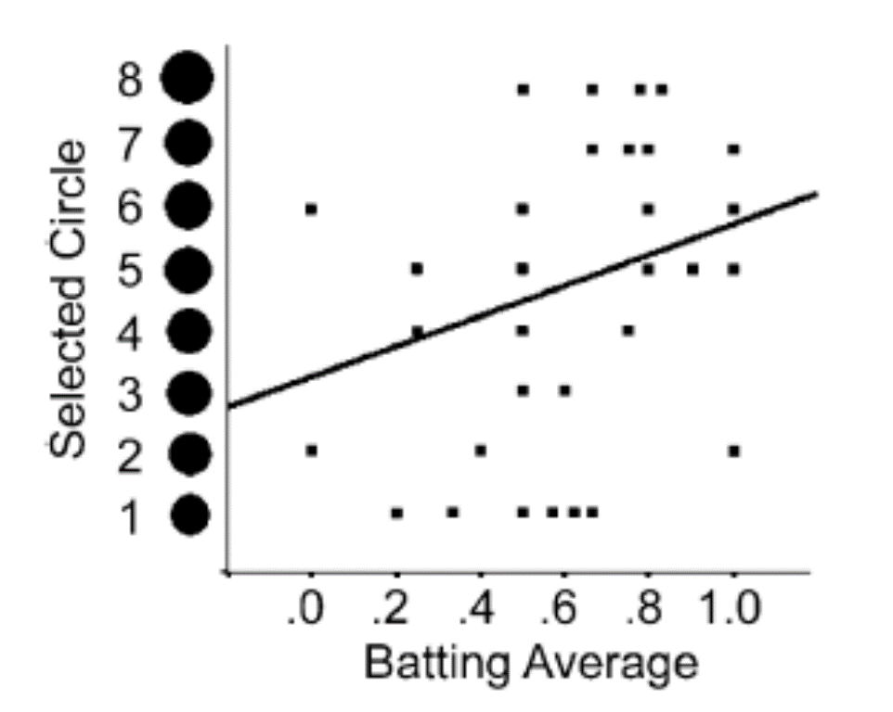

Slide 22
Happiness data
What are some reasonable questions to ask about this dataset?
Tell me the ‘story’ of this data set.
Perform some analyses to help us understand what predicts happiness.

