Slide 1
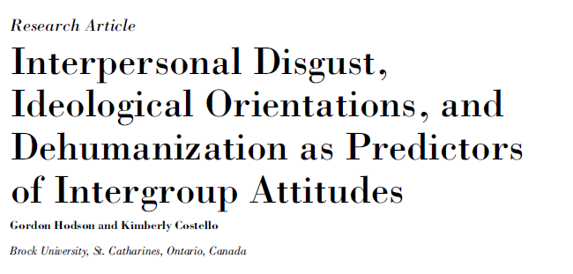

Slide 2
Does Disgust relate to inter-group attitudes?
We found:
Disgust influences moral judgments
Other research finds:
Disgust → avoidance and distancing
Prejudice involves avoidance and distancing
Therefore….
Disgust → Prejudice/ out-group attitudes

Slide 3
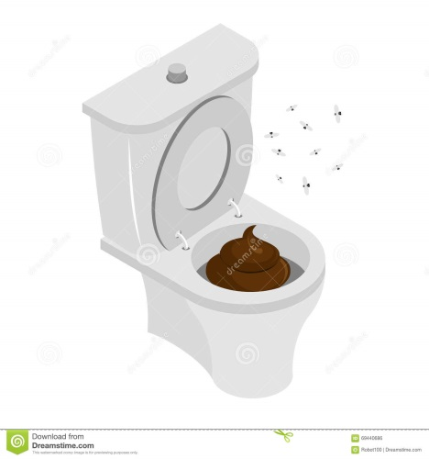
Disgust Sensitivity
People may differ in how easily they are disgusted by different things.
Types of disgust:
Core: “A bowel movement left unflushed in a public toilet”
Sex and death: ‘‘Touching a dead body’’
Interpersonal : ‘‘You sit down on a public bus, and feel that the seat is still warm from the last person who sat there’’
Notes:
Core is about protection from disease and infection
sex and death is about distancing oneself from reminders of animal nature or morality. A situation that might elicit death related disgust would be touching a dead body
What seems to be the defining feature of interpersonal disgust?
Interpersonal disgust is concerns with interpersonal contamination both physically and in terms of ones’ soul or essence. A situation that might elicit interpersonal disgust is if you sit down on a public bus and feel that the seat is still warm
Now which type of disgust sensitivity did Hodson and Costello think would be most strongly related to prejudice and negative attitudes towards outgroup members?

Slide 4
Hodson and Costello (2007)
Main Hypothesis:
People with heightened interpersonal disgust sensitivity should have more negative attitudes towards outgroups
Secondary Aims:
Is this a function of concerns about disease? (e.g., perceived vulnerability to disease)
Is this explained by higher right-winged authoritarian attitudes or social dominance orientation
Notes:
Why disgust sensitivity?
Disgust signals danger; if disgusted by a person, you will avoid them.
More likely to be disgusted by things/ or people that/who are different from us.
RWA – things were better in the old days
SDO – there are inherent inequalities between people and society should reflect that.

Slide 5
Methods
Who were the participants?
How did they measure attitudes towards groups?
Ethnic foreigners (outgroup)
deviant/low-status (outgroup)
familiar-traditional (outgroup)
English Canadian (in-group)
How did they measure disgust sensitivity?
Interpersonal
Core
Death/body
Sex
How did they measure perceived vulnerability to disease?
Is this a correlational or experimental design?
Overall Disgust
Notes:
Answers these at your tables
Canadians
Temperature scale and ratings scales
Is this

Slide 6
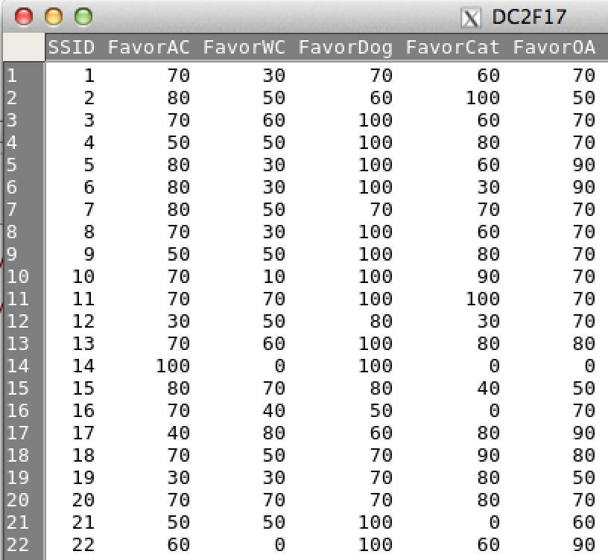
Our Study
Outgroup attitudes:
Williams College Students
Elderly
Dogs (for fun…for later)
Cats (for fun…for later)
Ingroup attitudes:
AC students
Notes:
Why would assessing the same groups as hodson and costello be potentially problematic in an Amherst College sample?

Slide 7
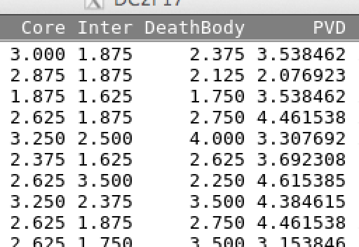
Our Study
Disgust sensitivity
Rated 1 -4, ↑ more sensitive
Interpersonal
Core
Death/body envelope
CORE→
INTER→
DEATHBODY→
Notes:
Removed Sex digust questions because they were pretty disgusting.
Ethics of making people uncomfortable. The ends didn’t justify the means.

Slide 8
Our Study
Perceived Vulnerability to Disease
Rated 1 – 7, ↑ more vulnerability
‘‘I suffer quite intense symptoms when I do get sick’’
‘‘I avoid using public telephones because of the risk that I may catch something from the previous user’’

Slide 9
Additional measures for you to analyze in your final project (How FUN!)
Political view, gender identity, age, AC year…
Personality traits (e.g., extroversion)
Self-esteem
Germ-phobia
Motivations to control prejudice
Social dominance orientation
Right-wing authoritarianism
….and much much more!

Slide 10
Preliminary Analyses
Mean and SD of main variables:
Attitudes (AC, Williams, Elderly)
mean sd se(mean) n
FavorAC 68.33333 22.65315 2.067940 120
FavorOA 68.33333 18.93524 1.728543 120
FavorWC 46.58333 20.64082 1.884240 120

Slide 11
Preliminary Analyses
Mean and SD of main variables:
Disgust (Interpersonal, Core, Death)
1
2
3
4
mean sd se
Core 2.63 0.49 0.04
DeathBody 2.62 0.65 0.06
Inter 2.11 0.57 0.05

Slide 12
Preliminary Analyses
Mean and SD of main variables:
Perceived Vulnerability to Disease
1
2
3
4
5
6
7
mean sd se
3.85 0.73 0.067

