Slide 1
Simple Linear Regression

Slide 2
Online Dating
Match.com is launching their new dating technology “Love speak” which allows users to post messages to other users’ profiles. They want to know if posting increases the number of in-person dates. They collect a sample of 8 online daters and measure the number of posts they make and the number of in-person dates they go on over the course of a month. Conduct a regression analysis to determine if LS posts significantly predict in person dates. Set alpha at .05

Slide 3
Data
x (#posts) | y (# in person dates) | x² | y² | xy
3 | 2
11 | 6
6 | 0
6 | 4
12 | 7
7 | 5
10 | 5
9 | 3
Conduct a hypothesis test, steps 1 - 8

Slide 4
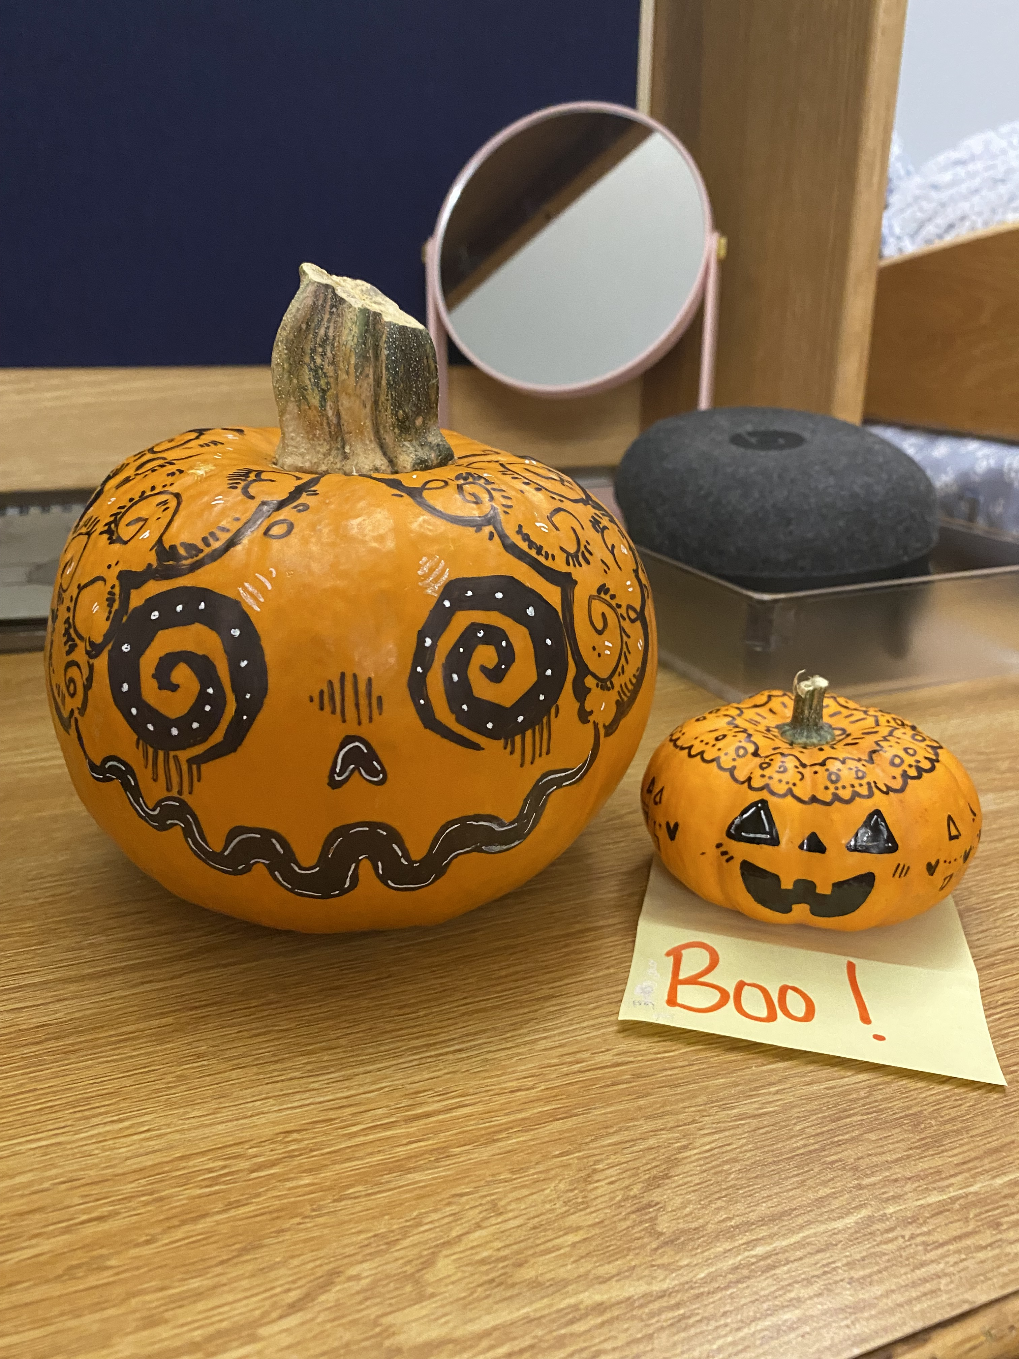
Online Dating
x (#posts) | y (# in person dates) | x² | y² | xy
3 | 2 | 9 | 4 | 6
11 | 6 | 121 | 36 | 66
6 | 0 | 36 | 0 | 0
6 | 4 | 36 | 16 | 24
12 | 7 | 144 | 49 | 84
7 | 5 | 49 | 25 | 35
10 | 5 | 100 | 25 | 50
9 | 3 | 81 | 9 | 27
Σx = 64 | Σy = 32 | Σ(x²) = 576 | Σ(y²) = 164 | Σ(xy) = 292
Step 1: Specify the null and alternative hypotheses.
  Ho: b = 0; Ha: b ≠ 0
Step 2: Designate the rejection region by selecting α = .05
Step 3: Obtain and F critical value
df (1, n-2) = (1, 6); Fcrit = 5.99

Slide 5
Online Dating
x (#posts) | y (# in person dates) | x² | y² | xy
Σx = 64 | Σy = 32 | Σ(x²) = 576 | Σ(y²) = 164 | Σ(xy) = 292
Find the regression equation:

Slide 6
Online Dating
x (#posts) | y (# in person dates) | x² | y² | xy
Σx = 64 | Σy = 32 | Σ(x²) = 576 | Σ(y²) = 164 | Σ(xy) = 292
Find the regression equation:
Slope (b) = SP / SSx
= 36/64
= .56
Intercept (a) = M_{y} – (b* M_{x})
= 4 – (.56* 8)
= -.48
Ŷ= 0.56X - 0.48
My=4 Mx=8

Slide 7
Online Dating
x (#posts) | y (# in person dates) | x² | y² | xy
Σx = 64 | Σy = 32 | Σ(x²) = 576 | Σ(y²) = 164 | Σ(xy) = 292
Find r²:
SP= 36 SSx = 64

Slide 8
Review
Correlation: statistical technique used to describe the relationship between two interval or ratio variables
Defined by r
Sign tells us direction of relationship (+ vs. -)
Value tells us consistency of relationship (-1 to +1)
But what if we want to do more?

Slide 9
Life Satisfaction
Correlation: Do any of the following factors predict life satisfaction?
  Money
  Grades
  Relationship status
  Health
Regression: If I know about your ________, (finances, GPA, relationships, health), I can predict your life satisfaction.

Slide 10
The Regression Line
Basics of linear equations
Ŷ = β₀ + β₁X
…..(or perhaps you know it as y = mx + b)
Ŷ = predicted dependent variable (e.g., popularity)
X = independent (predictor) variable (e.g., relational aggression)
β₁ = slope
β₀ = y-intercept

Slide 11
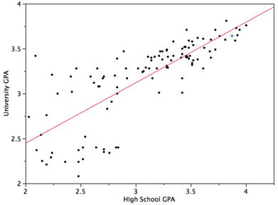
College GPA' = (0.675)(High School GPA) + 1.097
Ŷ = 0.675 X + 1.097
What would be the predicted GPA of someone with a 3.0 high school GPA?
College GPA' = (0.675)(3.0) + 1.097 = 3.122.

Slide 12
X
X
College GPA' = (0.675)(High School GPA) + 1.097
Ŷ = 0.675 X + 1.097
College GPA' = (0.675)(3.0) + 1.097 = 3.122.
College GPA' = (0.675)(2.0) + 1.097 = 2.447
3.122 – 2.447=0.675 (slope: change in Y for each 1 pt change in X)
X
X

Slide 13

Any Questions?

Slide 14
Regression in SPSS
Does weekend bedtime predict hours or TV viewing?
Predictor (IV): Week end bed time
Response (DV): hours of TV
Step 1: Specify the null and alternative hypotheses.
  Ho: β₁ = 0
  Ha: β₁ ≠ 0
Step 2: Designate the rejection region by selecting α = .05
Step 3: Will judge significance using p-value method!

Slide 15
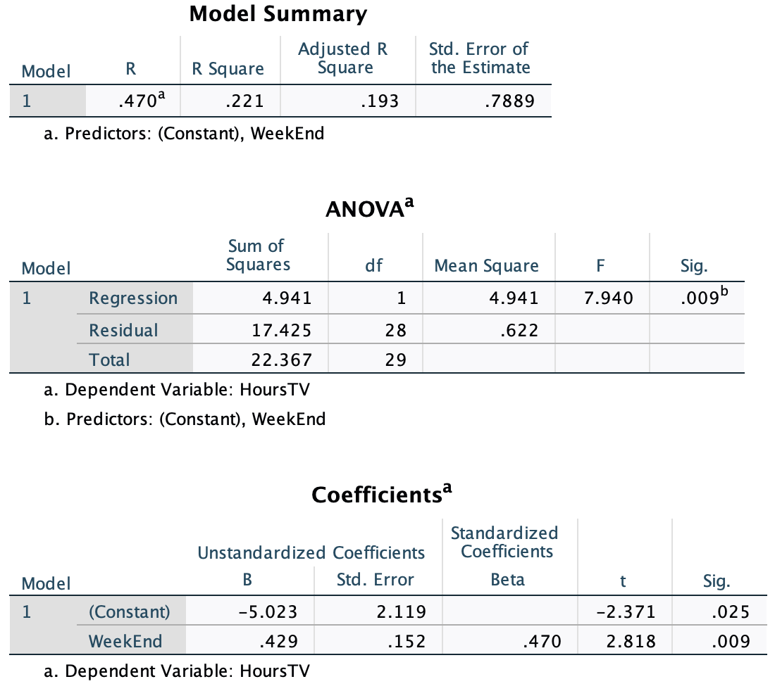
Regression in RC: WE bed & TV

Slide 16
Writing up results of regression
Weekend bedtime was a significant predictor of television viewing, F (1, 28) = 7.94, p = .01, r² = .2209. The r² indicates that weekend bedtime explains 22.09% of the variance in TV viewing. The slope of the regression equation was significant (β₁ = 0.4291, p = .01) and indicated that people who went to sleep later tended to watch more TV (shame!). The regression equation relating weekend bedtime and TV viewing was:
TV = -5.0234 + .4291(WE).

Slide 17
Real data examples

Slide 18
-What is R²?
-What is the standardized slope?
-What does the standardized slope suggest about change in X vs. Y?

Slide 19
-Is self-esteem more strongly related to positivity or to negativity?
-Calculate and interpret R² for the association between self-esteem and positivity

Slide 21
Predicting COVID violations

Slide 22
Predicting COVID violations
Use the data we collected in class last time to determine whether any of the variables we collected predict COVID violations?
  Analyze → Regression → Linear
  One variable at a time
  Is COVID violations going to be the dependent or independent variable?

Slide 23
Predicting Happiness
Use the data in the happiness data set to determine whether any of these variables predict happiness?
  Analyze → Regression → Linear
  One variable at a time

