Slide 1
Simple Linear Regression
Part I

Slide 2

Any Questions?

Slide 3
The best time to wear a striped sweater is…
Does the number of stripes in a sweater affect the itchiness of a sweater? I tried on 50 sweaters at local retailers (e.g., The Gap; PacSun; Stripes R Us). I gave each sweater an itchiness rating on a 10-point scale (higher values equal greater itchiness) and also counted the number of stripes. The sweaters ranged from 2 to 11 stripes (because you can’t have one stripe).
Calculate the regression equation from the data in the table below.
X: # of Stripes | Y: Itchiness | X² | Y² | X*Y
Σ = 350 | Σ = 300 | Σ = 2950 | Σ = 1982 | Σ = 1850

Slide 4
Striped sweater regression line
Are more stripes associated with more or less itchiness? Is the relationship between stripes and itchiness direct or inverse?
Calculate the predicted itchiness for a sweater with 18 stripes. Is this value meaningful?
If I learned how to knit and added an additional stripe to a sweater from my sample, how much would I expect its itchiness rating to change?

Slide 5
Striped sweater regression line
X: # of Stripes | Y: Itchiness | X² | Y² | X*Y
Σ = 350 | Σ = 300 | Σ = 2950 | Σ = 1982 | Σ = 1850
SSx = Σ(x²) – [(Σx)² / n]
= 2950 – [(350)² / 50]
= 2950 – (122500 / 50)
= 2950 – 2450 = 500
SP = Σ(xy) – [Σ(x)Σ(y) / n]
= 1850 – [(350)(300) / 50]
= 1850 – (105000 /50)
= 1850 – 2100 = -250

Slide 6
Striped sweater regression line
X: # of Stripes | Y: Itchiness | X² | Y² | X*Y
Σ = 350 | Σ = 300 | Σ = 2950 | Σ = 1982 | Σ = 1850
SSx = 500
SP = -250
b = SP / SSx
= -250 / 500 = -0.5
a = M_{y} – (b* M_{x})
= 6 – (-.5)(7)
= 9.5
Ŷ = 9.5 – 0.5(X)

Slide 7
Striped sweater regression line
Ŷ = 9.5 – 0.5(X)
Calculate the predicted itchiness for a sweater with 18 stripes. Is this value meaningful?
If I learned how to knit and added an additional stripe to a sweater from my sample, how much would I expect its itchiness rating to change?
Ŷ = 9.5 – 0.5(X)
Ŷ = 9.5 – 0.5(18) = 0.5
I would expect it to be .5 units less itchy b/c the slope is -0.5.

Slide 8
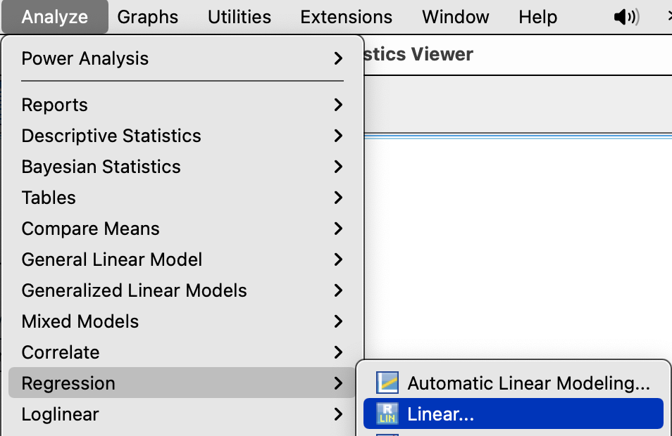
Striped sweater regression in SPSS
Analyze → Regression →Linear

Slide 9
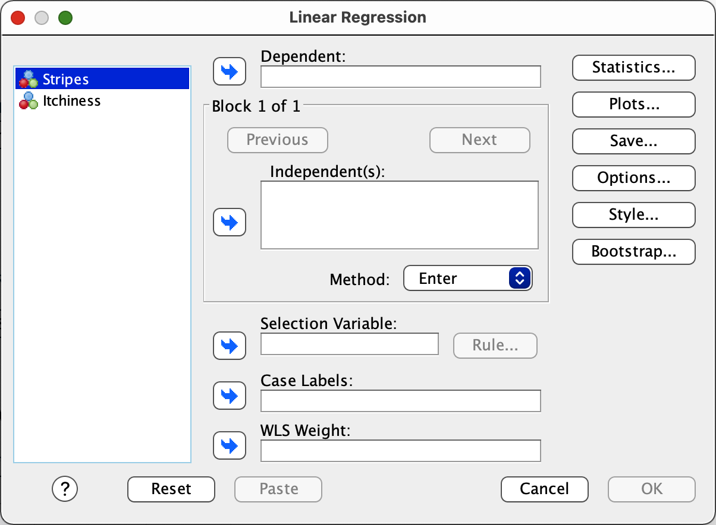
Striped sweater regression in SPSS
Slide the DV into the Dependent box.
Slide the IV into the Independent(s) box.
  Which is which?
Click OK.

Slide 10
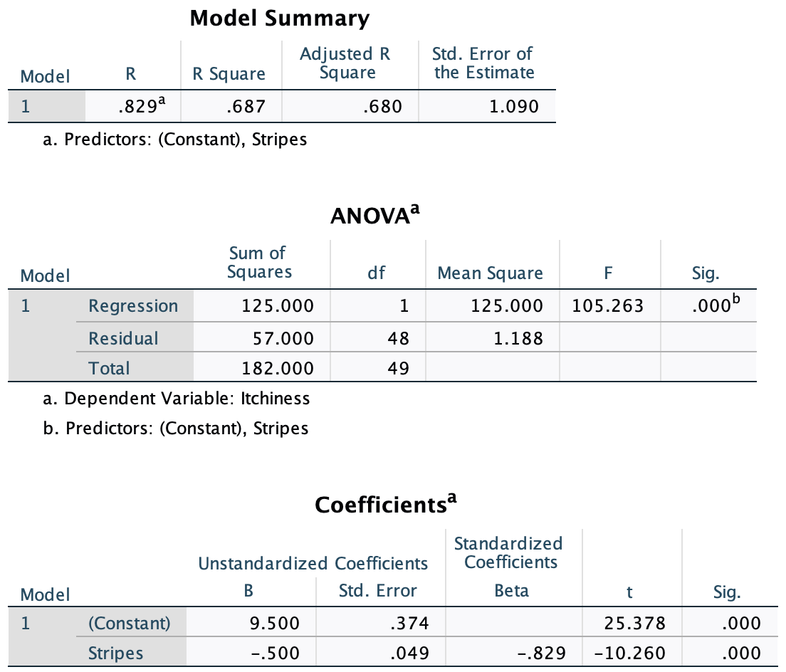
Regression in SPSS: Striped Sweaters

Slide 11
Predicting COVID violations

Slide 12
Predicting COVID violations
Use the data we collected in class last time to determine whether any of the variables we collected predict COVID violations?
  Analyze → Regression → Linear
  One variable at a time
  Is COVID violations going to be the dependent or independent variable?

Slide 13
World Happiness data – Part II
What are some reasonable questions to ask about this dataset?
Tell me the ‘story’ of this data set.
  Perform some correlation regression analyses to help us understand what predicts happiness.

Slide 14
World Happiness data – Part II
What are some reasonable questions to ask about this dataset?
Tell me the ‘story’ of this data set.
  Perform some correlation regression analyses to help us understand what predicts happiness.
  Compare the results from the correlation and regression analyses. What does this comparison suggest?

Slide 15
Real data examples

Slide 16
-What is R²?
-What is the standardized slope?
-What does the standardized slope suggest about change in X vs. Y?

Slide 17
-Is self-esteem more strongly related to positivity or to negativity?
-Calculate and interpret R² for the association between self-esteem and positivity

Slide 19
Predicting Happiness
Use the data in the happiness data set to determine whether any of these variables predict happiness?
  Analyze → Regression → Linear
  One variable at a time

