Slide 1
Simple Linear Regression
Part II

Slide 2
Discussion Questions
Who at your table missed TD the most over the break? I will try to guess.
What are the 2 (two; to; too) most interesting, notable things that you remember about simple regression from before the break?

Slide 3
The Rundown (old edition)
Regression and correlation are largely the same as we will see.
Both are designed to help us determine whether two continuous variables share a relationship.
Correlation tells us about the magnitude and direction of the relationship
Regression does the same, but adds a piece:
Prediction

Slide 4
The Rundown
We can use regression models to predict how someone will perform on some unknown dimension if we know where they fall on a known dimension.
Correlation | Regression
Does high school GPA predict college GPA? | If someone’s high school GPA is X, what will their college GPA be?
Does SAT score predict college GPA? | If someone’s SAT score was X, what will their college GPA be?
Which one is a better predictor of college GPA? | Which one is a better predictor of college GPA?

Slide 5
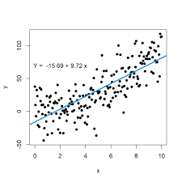
The Rundown
How do we make predictions?
We calculate a regression line which consists of the slope and the y-intercept.

Slide 6
I have a question for you…
What IS the regression line? Explain what the regression line is in simple, plain, ol’ regular English. Then toss up your definition on this Google sheet.

Slide 7
The Rundown (Modern edition)
What is new for today?
We are still doing regression
We are still calculating the slope and y-intercept.
We are still using the regression line to make predictions about y.
The new question…is it significant?
Is X a significant predictor of Y?
Does it help us predict Y better than chance?
How in H-E- are we going to do that?

Slide 8
The Rundown (Modern edition)
What do we know?
SS_{y}
r²
How does that help us?
What is r² * SS_{y}?
What is (1- r²) * SS_{y}?
Ain’t it always that way? We are going to compare:
Variability due to our IV: r² * SS_{y}
Variability due to chance: (1- r²) * SS_{y}
Of course, we have some df issues and some MS issues to deal with but that’ll be all right because…
Notes:
SSy tells us the total variability in our data set.
R2 tells us how much of the variability we can account for with our data.
What is r² * SS_{y}? Tells us how much variability is due to IV
What is (1- r²) * SS_{y}? Tells us how much variability is due to chance
Of course we have some df and MS to deal with, but that’s no problem for us because we bleeping rule?

Slide 9
We are as terrible as the dawn;
And as treacherous as the sea
Stronger than the foundations of the earth
All shall love us and despair!

Slide 10
Any Questions?

Slide 11
The best time to wear a striped sweater is…
Does the number of stripes in a sweater affect the itchiness of a sweater? I tried on 50 sweaters at local retailers (e.g., The Gap; PacSun; Stripes R Us). I gave each sweater an itchiness rating on a 10-point scale (higher values equal greater itchiness) and also counted the number of stripes. The sweaters ranged from 2 to 11 stripes (because you can’t have one stripe).
Calculate the regression equation from the data in the table below.
X: # of Stripes | Y: Itchiness | X² | Y² | X*Y
Σ = 350 | Σ = 300 | Σ = 2950 | Σ = 1982 | Σ = 1850

Slide 12
Striped sweater hypothesis test
X: # of Stripes | Y: Itchiness | X² | Y² | X*Y
Σ = 350 | Σ = 300 | Σ = 2950 | Σ = 1982 | Σ = 1850
 |  | SSx = 500 |  | SP = -250
Let’s conduct the hypothesis test to determine if stripes is a SIGNIFICANT predictor of itchiness.
Step 1: Calculate SS_{residual}
Step 2: Calculate SS_{regression}
Step 3: Figure out the df to calculate MS
Step 4: Use the MS to calculate an F-value

Slide 13
Striped sweater hypothesis test
X: # of Stripes | Y: Itchiness | X² | Y² | X*Y
Σ = 350 | Σ = 300 | Σ = 2950 | Σ = 1982 | Σ = 1850
 |  | SSx = 500 |  | SP = -250
Formulas we will need:
${SS}_{residual}=\left(1−r^{2}\right){SS}_{y}$
$r={SP}/{\sqrt{\left({SS}_{x}\right)\left({SS}_{y}\right)}}$
${SS}_{regression}=\left(r^{2}\right){SS}_{y}$
For Simple Regression
$dfregression$ = 1
$dfresidual$ = n-2
$$MS=\frac{SS}{df}$$
$$F=\frac{{MS}_{regression}}{{MS}_{residual}}$$

Slide 14
Striped sweater hypothesis test
X: # of Stripes | Y: Itchiness | X² | Y² | X*Y
Σ = 350 | Σ = 300 | Σ = 2950 | Σ = 1982 | Σ = 1850
 |  | SSx = 500 | SSy = 182 | SP = -250
Step 1: Calculate SS_{residual}
${SS}_{residual}=\left(1−r^{2}\right){SS}_{y}$
$r={SP}/{\sqrt{\left({SS}_{x}\right)\left({SS}_{y}\right)}}$
$r={−250}/{\sqrt{\left(500\right)182}} ={−250}/{301.66}=−.829$

Slide 15
Striped sweater hypothesis test
X: # of Stripes | Y: Itchiness | X² | Y² | X*Y
Σ = 350 | Σ = 300 | Σ = 2950 | Σ = 1982 | Σ = 1850
 |  | SSx = 500 | SSy = 182 | SP = -250
Step 1: Calculate SS_{residual}
${SS}_{residual}=\left(1−r^{2}\right){SS}_{y}$
${SS}_{residual}=\left(1−{.829}^{2}\right)182$
${SS}_{residual}=\left(1−.687\right)182$
${SS}_{residual}=\left(.313\right)182=57$

Slide 16
Striped sweater hypothesis test
X: # of Stripes | Y: Itchiness | X² | Y² | X*Y
Σ = 350 | Σ = 300 | Σ = 2950 | Σ = 1982 | Σ = 1850
 |  | SSx = 500 | SSy = 182 | SP = -250
r² = .686
Step 2: Calculate SS_{regression}
${SS}_{regression}=\left(r^{2}\right){SS}_{y}$
${SS}_{regression}=\left(.686\right)182$
${SS}_{regression}=$ 125

Slide 17
Striped sweater hypothesis test
Source | SS | df | MS | F
Treatment Error Total
Source | SS | df | MS | F
Regression Residual Total

Slide 18
Striped sweater hypothesis test
Source | SS | df | MS | F
Regression Residual Total | 125 57 182
For Simple Regression
$dfregression$ = 1
$dfresidual$ = n-2 = 50-2 = 48

Slide 19
Striped sweater hypothesis test
Source | SS | df | MS | F
Regression Residual Total | 125 57 182 | 1 48 | 125.00 1.19
For Simple Regression
$$MS=\frac{SS}{df}$$

Slide 20
Striped sweater hypothesis test
Source | SS | df | MS | F
Regression Residual Total | 125 57 182 | 1 48 | 125.00 1.19 | 105.26
For Simple Regression
$$F=\frac{{MS}_{regression}}{{MS}_{residual}}$$

Slide 21
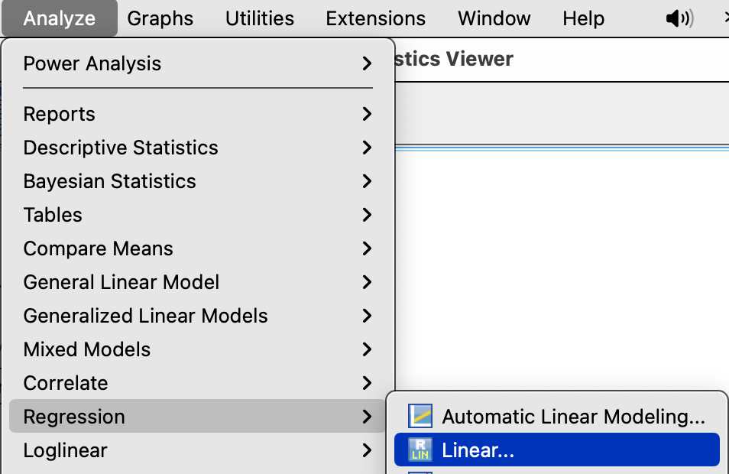
Striped sweater regression in SPSS
Analyze → Regression →Linear

Slide 22
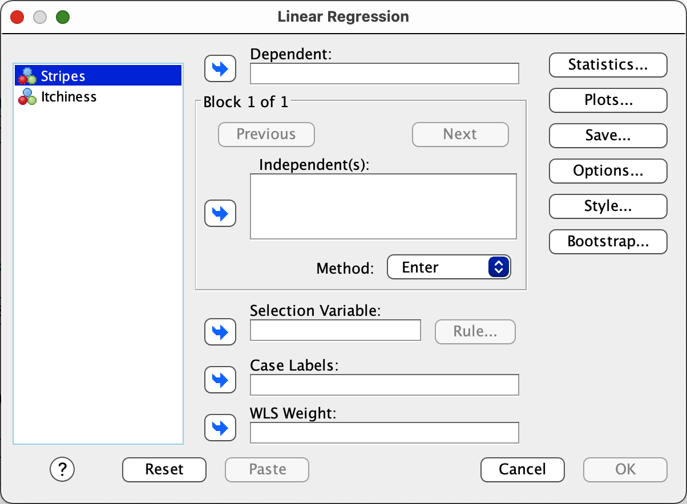
Striped sweater regression in SPSS
Slide the DV into the Dependent box.
Slide the IV into the Independent(s) box.
Which is which?
Click OK.

Slide 23
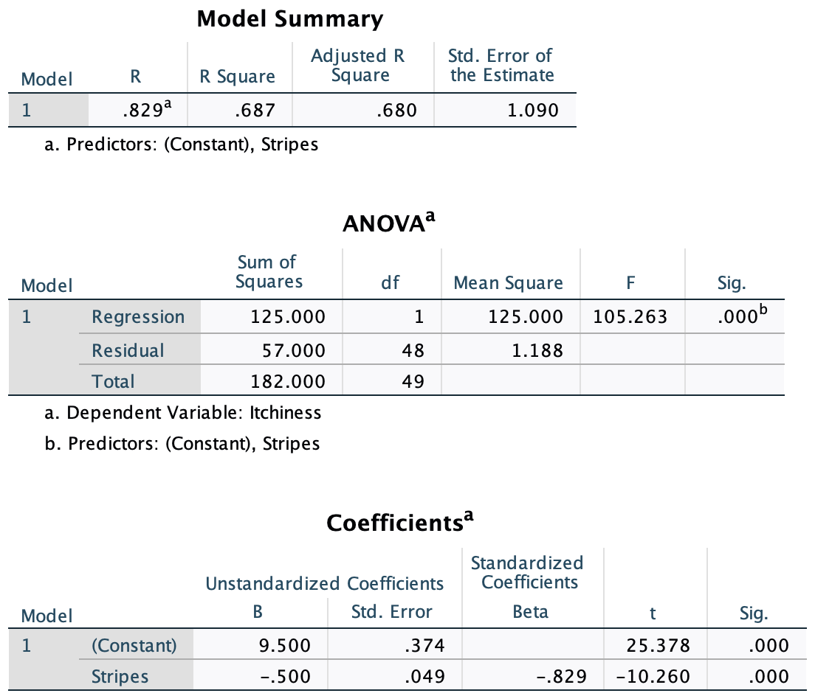
Regression in SPSS: Striped Sweaters

Slide 24
Predicting COVID violations

Slide 25
Predicting Food pilfery
Use the data we collected in class last time to determine whether any of the variables we collected predict Food pilfery?
Analyze → Regression → Linear
One variable at a time
Is COVID violations going to be the dependent or independent variable?

Slide 26
World Happiness data – Part II
What are some reasonable questions to ask about this dataset?
Tell me the ‘story’ of this data set.
Perform some correlation regression analyses to help us understand what predicts happiness.
What factors are significant predictors of happiness?

Slide 27
World Happiness data – Part II
What are some reasonable questions to ask about this dataset?
Tell me the ‘story’ of this data set.
Perform some correlation regression analyses to help us understand what predicts happiness.
Compare the results from the correlation and regression analyses. What does this comparison suggest?

Slide 28
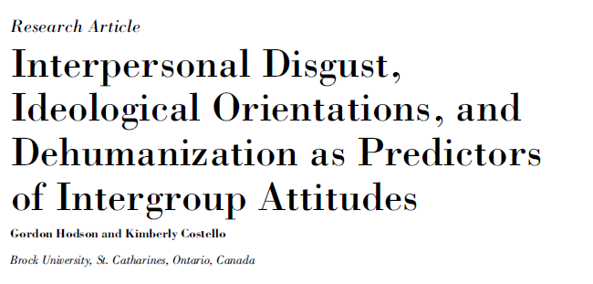

Slide 29
Does Disgust relate to inter-group attitudes?
Eskine, et al. (2007) found that:
Disgust influences moral judgments
Other research finds:
Disgust → avoidance and distancing
Prejudice involves avoidance and distancing
Therefore….
Disgust → Prejudice/ out-group attitudes
Notes:
Just as morality is not necessarily a cognitive mental evaluation, so too, may be prejudice

Slide 30
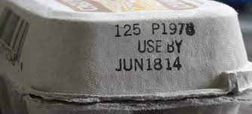
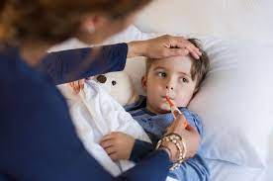
Questions for Discussion
According to the authors, from whence does disgust arise?
What types of disgust do the authors identify and what do each mean?
Which type of disgust do the authors’ focus on and why?
What are the authors’ primary and secondary questions/hypotheses?

Slide 31
Disgust Sensitivity
People may differ in how easily they are disgusted by different things.
Types of disgust:
Core: “A bowel movement left unflushed in a public toilet”
Sex and death: ‘‘Touching a dead body’’
Interpersonal : ‘‘You sit down on a public bus, and feel that the seat is still warm from the last person who sat there’’

Slide 32
Questions for Discussion
According to the authors, from whence does disgust arise?
What types of disgust do the authors identify and what do each mean?
Which type of disgust do the authors’ focus on and why?
What are the authors’ primary and secondary questions/hypotheses?
Notes:
Taste sensitivity to protect us from things that might make us ill
Core – illness; Sex and death – we are animals; Interpersonal – purity of the soul
Interpersonal – more emotional and irrational and about others.

Slide 33
Hodson and Costello (2007)
Main Hypothesis:
People with heightened interpersonal disgust sensitivity should have more negative attitudes towards outgroups
Secondary Aims:
Is this a function of concerns about disease? (e.g., perceived vulnerability to disease)
Does digust/prejudice link related to avoidance or perpetuation of a hierarchy
Is this explained by higher right-winged authoritarian attitudes (RWA) or social dominance orientation (SDO)

Slide 34
Methods
Who were the participants?
How did they measure attitudes towards groups?
Ethnic foreigners (outgroup)
deviant/low-status (outgroup)
familiar-traditional (outgroup)
English Canadian (in-group)
How did they measure disgust sensitivity?
Interpersonal
Core
Death/body
Sex
How did they measure perceived vulnerability to disease?
Is this a correlational or experimental design?
Big Five Personality scale
Overall Disgust

Slide 35
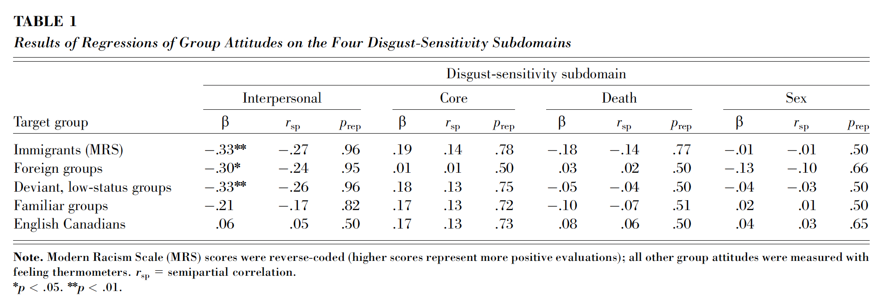
Results
Ignore r_{sp} and p_{rep}
What are the noteworthy results and what do they mean?

Slide 36
Results
Collinearity problem…if two variables are correlated with one another, it’s hard to determine whether one or both are actually related to the variable of interest.
Interpersonal disgust predicts prejudice.
PVD is highly correlated with interpersonal disgust.
So, PVD will also be correlated with prejudice.
Are they actually independent of one another?

Slide 37
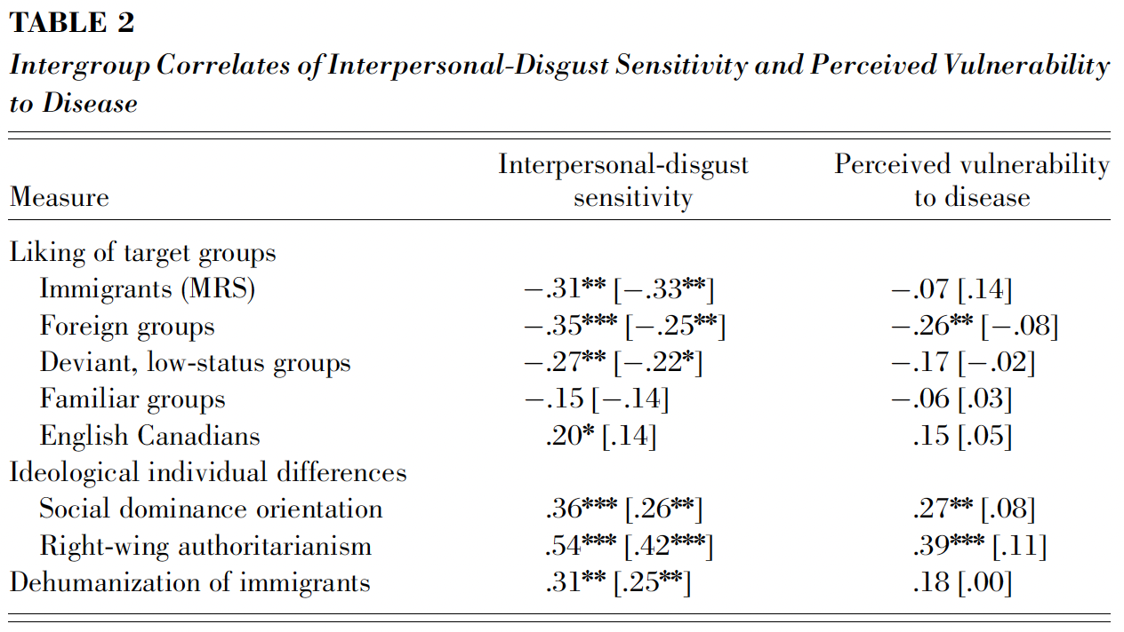
Results
Mathematically eliminate the effect of the other variable.

