Slide 2
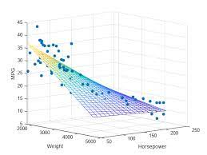
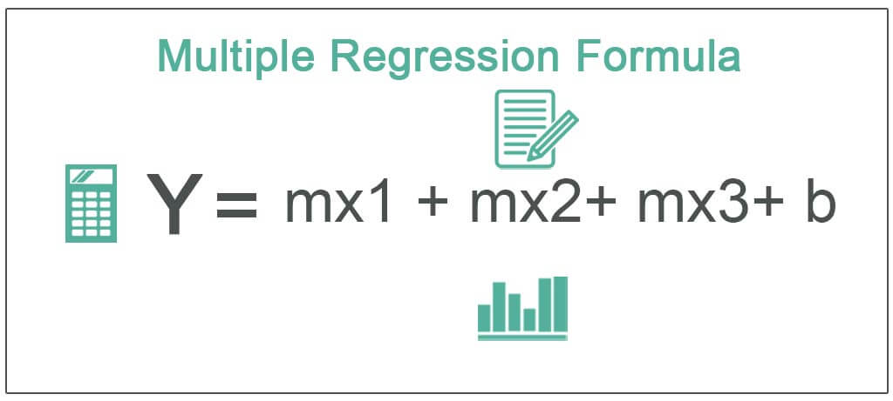
Multiple Regression

Slide 3
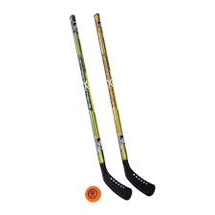
The RunDown
The world is a complex place. Our behavior is multiply determined, so simple regression models are often insufficient to do the job.
For example, performance in this class is probably related to:
Comfort with math
Experience with statistics
How in the H-E- are we going to deal with that?
The answer obviously is multiple regression!!!
Multiple regression allows us to simultaneously fit linear regression lines in n dimensions. (multi-variable calculus)
Put more simply MR allows us to assess the predictive value of multiple predictor (X) variables simultaneously.

Slide 4
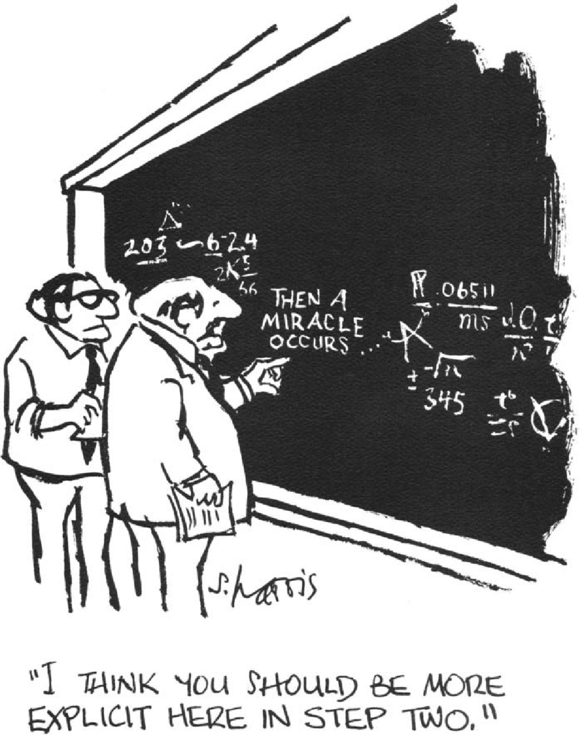
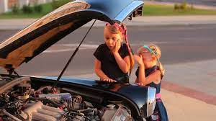
The RunDown
The good news and the bad news about multiple regression…

Slide 6
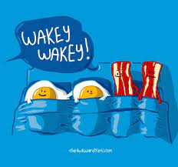
Multiple regression

Slide 7
Issues of collinearity
Collinearity is observed when your predictor variables are correlated with one another.
SAT
GPA
30%
IQ
10%
5%

Slide 8
Issues of collinearity
Collinearity is observed when your predictor variables are correlated with one another.
PPM
This is a problem because it’s unclear how to partition the overlapping variance. Could go to PPM…could go to PPR.
Solution: partial correlations.
Dates
30%
PPR
10%
5%

Slide 9
Collinearity
Think about some of the variables from the brief questionnaire you just completed.
Which ones are likely to be correlated with one another? Why?
What effect do you think that might have on the regression analysis? In other words, how might it color your interpretation of the results of the regression analysis?
How might you address these concerns, perhaps in a follow-up study?
How might you address these concerns right now?
Notes:
5. Run correlations to check.

Slide 10
Computing the Regression Equation
Still using least squared method to produce the equation that yields the best estimate of Y (Ŷ).
Ŷ= β₁X₁ + β₂X₂ + β₀
Takes into account the covariation of x1 and x2
β₀=M_{Y} - β₁M_{X1} - β₂M_{X2}

Slide 12
Childhood Memories
Some researchers believe that children have difficulty remembering what they cannot express verbally (especially when their memory is tested verbally). An experiment was conducted in which 20 children listened to a story. Six months later, their memory for that story was measured using a 10-question survey. Their vocabulary was measured using a standard vocabulary test. If time allowed, the children were read the book multiple times to see if repetitions influenced memory. Use the data on the following page to calculate the regression equation relating vocabulary and parental education to memory.

Slide 13
Childhood Memories
 | Y Memory | X1 Vocab | X2 Repetition | X1Y | X2Y | X1X2
Mean | 6 | 7 | 2
Σx | 120 | 140 | 40
Σ(x²) or Σ(x*y) | 840 | 1056 | 112 | 881 | 235 | 290
[(Σx)^{2]}/n or (Σx)(Σy) / n
SS or SP
$$β_{0}=M_{Y}−{β_{1}M}_{1}−{β_{2}M}_{X2}$$
$$β_{1}=\frac{\left({SP}_{X1Y}\right)\left({SS}_{X2}\right)−\left({SP}_{X1X2}\right)\left({SP}_{X2Y}\right)}{\left({SS}_{X1}\right)\left({SS}_{X2}\right)−{\left({SP}_{X1X2}\right)}^{2}}$$
$$β_{2}=\frac{\left({SP}_{X2Y}\right)\left({SS}_{X1}\right)−\left({SP}_{X1X2}\right)\left({SP}_{X1Y}\right)}{\left({SS}_{X1}\right)\left({SS}_{X2}\right)−{\left({SP}_{X1X2}\right)}^{2}}$$

Slide 14
Childhood Memories
 | Y Memory | X1 Vocab | X2 Repetition | X1Y | X2Y | X1X2
Mean | 6 | 7 | 2
Σx | 120 | 140 | 40
Σ(x²) or Σ(x*y) | 840 | 1056 | 112 | 881 | 235 | 290
[(Σx)^{2]}/n or (Σx)(Σy) / n | 720 | 980 | 80 | 840 | 240 | 280
SS or SP

Slide 15
Childhood Memories
 | Y Memory | X1 Vocab | X2 Repetition | X1Y | X2Y | X1X2
Mean | 6 | 7 | 2
Σx | 120 | 140 | 40
Σ(x²) or Σ(x*y) | 840 | 1056 | 112 | 881 | 235 | 290
[(Σx)^{2]}/n or (Σx)(Σy) / n | 720 | 980 | 80 | 840 | 240 | 280
SS or SP | 120 | 76 | 32 | 41 | -5 | 10

Slide 16
Childhood Memories
 | Y Memory | X1 Vocab | X2 Repetition | X1Y | X2Y | X1X2
Mean | 6 | 7 | 2
Σx | 120 | 140 | 40
Σ(x²) or Σ(x*y) | 840 | 1056 | 112 | 881 | 235 | 290
[(Σx)^{2]}/n or (Σx)(Σy) / n | 720 | 980 | 80 | 840 | 240 | 280
SS or SP | 120 | 76 | 32 | 41 | -5 | 10
$$β_{1}=\frac{\left({SP}_{X1Y}\right)\left({SS}_{X2}\right)−\left({SP}_{X1X2}\right)\left({SP}_{X2Y}\right)}{\left({SS}_{X1}\right)\left({SS}_{X2}\right)−{\left({SP}_{X1X2}\right)}^{2}}$$
$β_{1}=\frac{\left(41\right)\left(32\right)−\left(10\right)\left(−5\right)}{\left(76\right)\left(32\right)−{\left(10\right)}^{2}}=\frac{1312+50}{2432−100}=\frac{1362}{2332}$ = 0.584

Slide 17
Childhood Memories
 | Y Memory | X1 Vocab | X2 Repetition | X1Y | X2Y | X1X2
Mean | 6 | 7 | 2
Σx | 120 | 140 | 40
Σ(x²) or Σ(x*y) | 840 | 1056 | 112 | 881 | 235 | 290
[(Σx)^{2]}/n or (Σx)(Σy) / n | 720 | 980 | 80 | 840 | 240 | 280
SS or SP | 120 | 76 | 32 | 41 | -5 | 10
$$β_{2}=\frac{\left({SP}_{X2Y}\right)\left({SS}_{X1}\right)−\left({SP}_{X1X2}\right)\left({SP}_{X1Y}\right)}{\left({SS}_{X1}\right)\left({SS}_{X2}\right)−{\left({SP}_{X1X2}\right)}^{2}}$$
$β_{2}=\frac{\left(−5\right)\left(76\right)−\left(10\right)\left(41\right)}{\left(76\right)\left(32\right)−{\left(10\right)}^{2}}=\frac{−380−410}{2432−100}=\frac{−790}{2332}$ = -0.339

Slide 18
Childhood Memories
 | Y Memory | X1 Vocab | X2 Repetition | X1Y | X2Y | X1X2
Mean | 6 | 7 | 2
Σx | 120 | 140 | 40
Σ(x²) or Σ(x*y) | 840 | 1056 | 112 | 881 | 235 | 290
[(Σx)^{2]}/n or (Σx)(Σy) / n | 720 | 980 | 80 | 840 | 240 | 280
SS or SP | 120 | 76 | 32 | 41 | -5 | 10
$$β_{0}=M_{Y}−{β_{1}M}_{1}−{β_{2}M}_{X2}$$
$$β_{0}=6−.584\left(7\right)+.339\left(2\right)$$
$$β_{0}=6−4.088+.678 =2.59$$

Slide 19
Childhood Memories
 | Y Memory | X1 Vocab | X2 Repetition | X1Y | X2Y | X1X2
Mean | 6 | 7 | 2
Σx | 120 | 140 | 40
Σ(x²) or Σ(x*y) | 840 | 1056 | 112 | 881 | 235 | 290
[(Σx)^{2]}/n or (Σx)(Σy) / n | 720 | 980 | 80 | 840 | 240 | 280
SS or SP | 120 | 76 | 32 | 41 | -5 | 10
Final regression equation:
Ŷ= 2.59 + 0.584 X₁ - 0.339 X₂

Slide 20
Way easier way to do this…
SPSS!!!!
So…let’s check our work!

Slide 21
Multiple Regression in SPSS
Match.com example (from lecture)
Childhood memories (from just a few seconds ago)

Slide 22
Hypothesis Testing For Multiple Regression
1. Does our overall model explain a significant proportion of the variability in Y?
Compute Omnibus F-test
2. Is the slope of each predictor significant?
Follow-up t-tests
Similar to conducting post-hoc tests
ONLY interpret IF Omnibus F is significant
Tells us if slope is likely different from zero in population

Slide 23
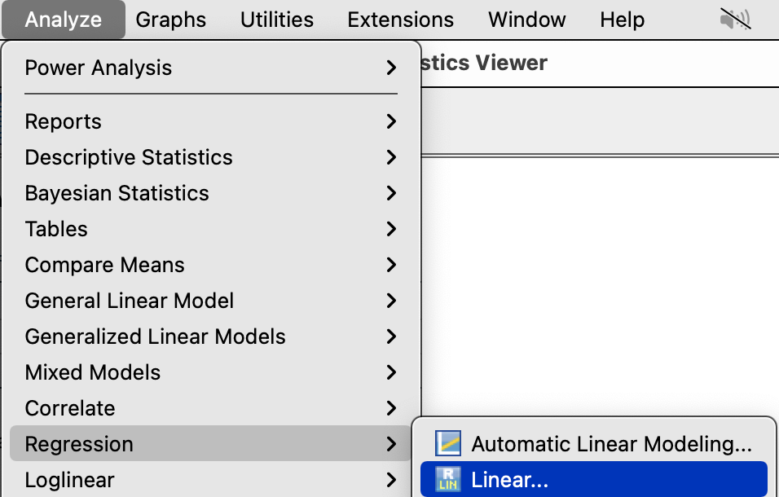
Multiple Regression in SPSS
Match.com example (from lecture)
Analyze → Regression →Linear

Slide 24
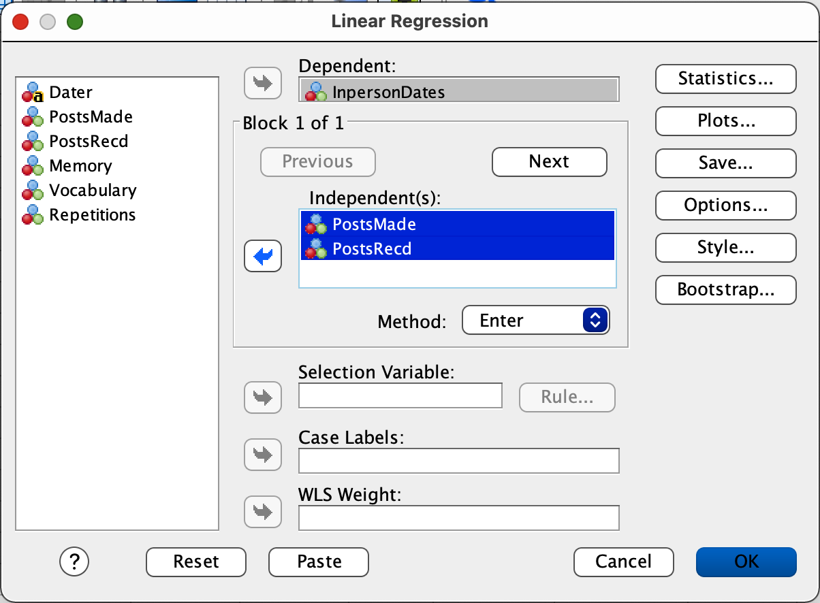
Multiple Regression in SPSS
Identify the
DV
Identify the predictors (IVs)
Slide into the appropriate boxes
Click OK.

Slide 25
Hypothesis Testing For Multiple Regression
Overall significant effect: F (2, 7) = 13.35, p = .004

Slide 26
Hypothesis Testing For Multiple Regression
1. Does our overall model explain a significant proportion of the variability in Y?
Compute Omnibus F-test
2. Is the slope of each predictor significant?
Follow-up t-tests
Similar to conducting post-hoc tests
ONLY interpret IF Omnibus F is significant
Tells us if slope is likely different from zero in population

Slide 27
Hypothesis Testing For Multiple Regression
X1 (Posts-made) is a significant predictor of…
X2 (Posts-received) is not a significant predictor of…
…Y (in-person dates)

Slide 28
Hypothesis Testing For Multiple Regression
Final regression equation:
Ŷ= 0.9841X₁ + 0.2647 X₂ + 1.4753

Slide 29
How good is our model?
R² multiple coefficient of determination: Measure of the proportion of variance explained by our model.
Also called “multiple R²”
Same idea as with simple regression.
R² = Variability explained by model
Total variability in the sample
= SSregression
SSy

Slide 30
Using SPSS
$$R^{2}=\frac{SSregression}{SStotal}=\frac{72.886}{92}=.792$$

Slide 31
Let’s write this puppy up!
A multiple regression analysis was conducted to determine if posts-made or posts-received predicted the number of in-person dates one participated in. The overall regression model was significant, F(2,7) = 13.35 p = .004. The slope parameters indicated that posts-made was a significant predictor of dates (t (7) = 3.43, p = .01), but that post-received was not (t (7) = 1.094, p = .31). The final regression equation was: Ŷ= 0.984 X₁ + 0.265 X₂ + 1.475 The model explained 79.22% of the variability in dates received.

Slide 32
Issues of Collinearity…not in the face
We have talked about the problem of collinearity a number of times here, but mostly kind of in the abstract. I want to use the Match.com data to try to be a little more concrete about the problem. Here goes….

Slide 33
Issues of collinearity
Final regression equation:
Ŷ= 0.9841X₁ + 0.2647 X₂ + 1.4753

Slide 34
Issues of collinearity
Sig.
Final regression equation:
Ŷ= 0.9841X₁ + 0.2647 X₂ + 1.4753
Not. Sig.

Slide 35
Issues of collinearity Posts Made: Posts Received:

Slide 36
Multiple Regression in SPSS
Childhood Memories example
Analyze → Regression →Linear

Slide 37
Multiple Regression in SPSS
Identify the
DV
Identify the predictors (IVs)
Slide into the appropriate boxes
Click OK.

Slide 38
Hypothesis Testing For Multiple Regression
1. Does our overall model explain a significant proportion of the variability in Y?
Compute Omnibus F-test
2. Is the slope of each predictor significant?
Follow-up t-tests
Similar to conducting post-hoc tests
ONLY interpret IF Omnibus F is significant
Tells us if slope is likely different from zero in population

Slide 39
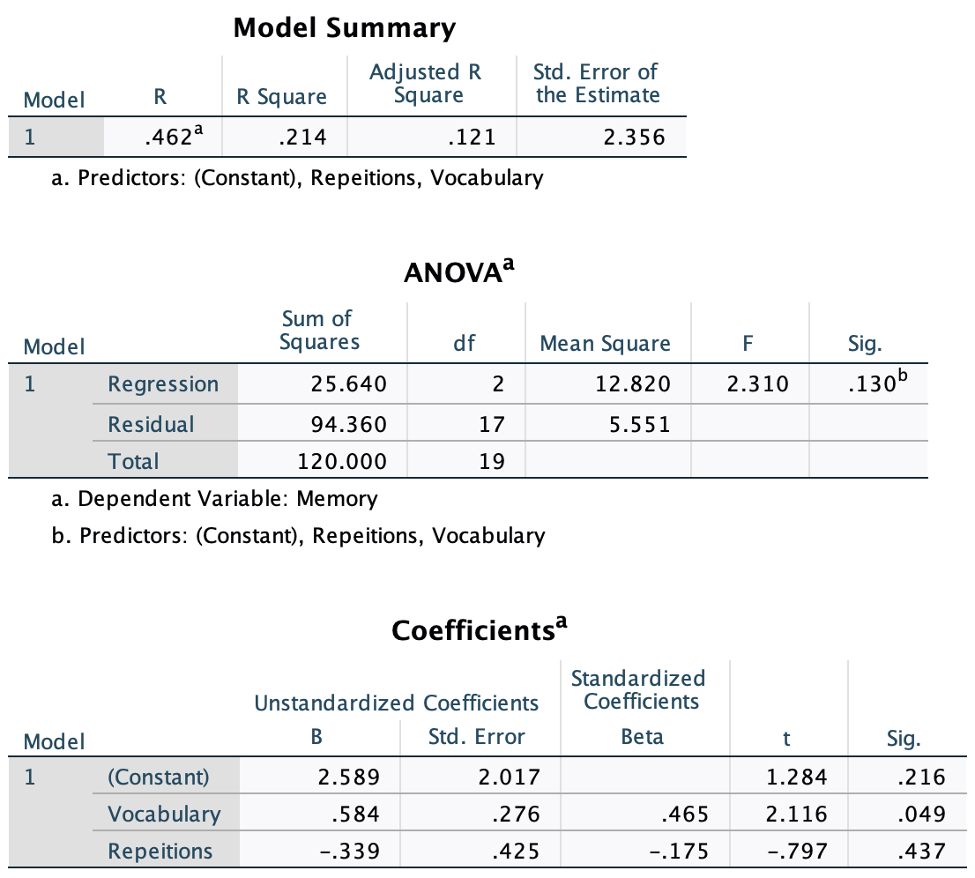
Hypothesis Testing For Multiple Regression
Overall non-significant effect: F (2, 17) = 2.31, p = .130

Slide 40
Hypothesis Testing For Multiple Regression
1. Does our overall model explain a significant proportion of the variability in Y?
Compute Omnibus F-test
2. Is the slope of each predictor significant?
Follow-up t-tests
Similar to conducting post-hoc tests
ONLY interpret IF Omnibus F is significant
Tells us if slope is likely different from zero in population

Slide 41
Hypothesis Testing For Multiple Regression
Vocabulary is a significant predictor of…
Repetitions is not a significant predictor of…
…Memory

Slide 42
Hypothesis Testing For Multiple Regression
Final regression equation:
Ŷ= 2.589 + .584X₁ - 0.339 X₂

Slide 43
Hypothesis Testing For Multiple Regression
R² = .214; so we can explain about 21.4% of children’s memories with our predictors.

