Slide 1
Last bit on socks…probably

Slide 2
Please sort the socks into their appropriate groupings. Bonus points for identifying the groups.
Hint: the correct solution includes 4 groups.

Slide 3
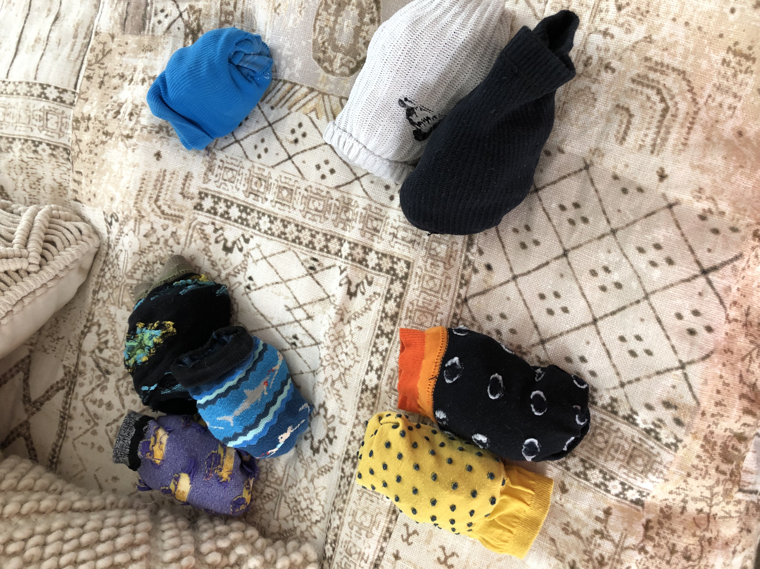
Winter Casual
Winter Running
Dressy - Fun
Dressy - Dull

