Slide 1
Multiple Regression Part II: Model Building!!!

Slide 2
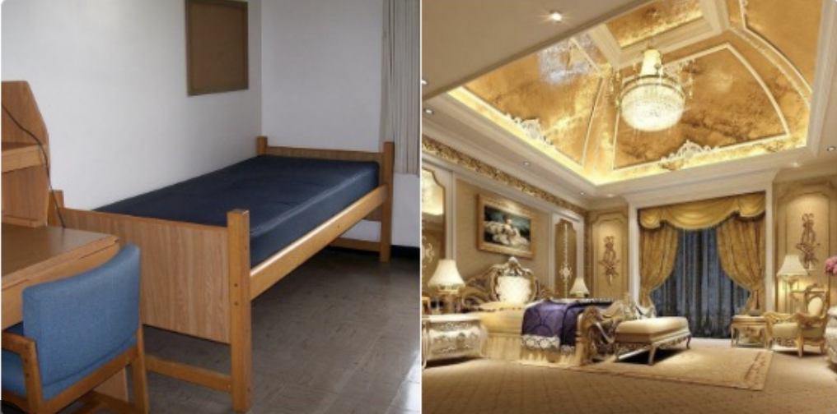
Room Satisfaction Survey

Slide 3
What is model building?
Model building is a technique used to try to find the BEST regression model, i.e., the best set of predictors.
How do we define the BEST model?
Pretty simple in simple regression
Unbiased (what does that mean?)
Minimum error (what does that mean?)
MUUUUUUUCH more ambiguous with with multiple regression

Slide 4
What is model building?
Admission office faces two difficult decision every year
Who do they admit from the cornucopia of uber-talented applicants that will produce the most vibrant, warm, and loving community on campus?
How do they do that? They scan applications consisting of:
High school record
Test scores
Essays
Letters of rec
Extracurriculars
Easy-Peasy, right? Just pick the best?

Slide 5
What is model building?
Who is the best???
Regression/model building provides a method for weighing different attributes even if/especially when those attributes are not directly comparable.
 | A | B | C
HS record | High | Low | Poor
Test Scores | Low | High | Medium
Essays | Medium | Medium | OTC
Letters or rec | High | High | Medium
Extracurriculars | OTC | Low | Low

Slide 6
What is model building?
Briefly, the Second problem is trying to figure out who is actually going to accept and who is going to reject our admission offers?
What happens if too many students decide to matriculate? What happens if too few students decide to matriculate?
No one will confirm that we use these tools, but I am confident that we do. Are they effective?
Do we get the BEST possible classes?
Do we frequently over/under enroll?

Slide 7
What is model building?
Briefly, the Second problem is trying to figure out who is actually going to accept and who is going to reject our admission offers?
What happens if too many students decide to matriculate? What happens if too few students decide to matriculate?
No one will confirm that we use these tools, but I am confident that we do. Are they effective?
Do we get the BEST possible classes?
Do we frequently over/under enroll?

Slide 8
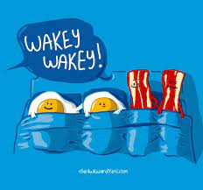
What is model building?
So, let’s look at an example of how model building works together. It CAN BE super complicated; we are going to do it simply, but responsibly.
Start by opening the WakeWakey data set.
We are trying to predict what time people wake up to make a 10:00 class. That is your Y variable.
There are a plethora of predictor (X) variables to choose from. I want you to select a set of X/predictor variables that you think will do an effective job of predicting wake-up time.
When you have made your selections, enter them into the model building google sheet.
Then we’ll do some model-building.

Slide 9
WakeyWakey models
We have now run 6 (maybe) different models trying to predict wake-up times. How do we decide which one is best. There are two factors that we are going to consider:
Parsimony / Simplicity
Fewer factors are preferred to more factors
Power
Explaining more variance – higher R² - is preferred to explaining less variance.
Bearing these principles in mind, which model should we choose? Let’s review our models…

Slide 10
👀 R² method
Identify the variables you wish to include in your INITIAL model.
Run the regression model.
Consider dropping some of your initial set of variables.
Non-significant factors should be dropped.
But sometimes, you may choose to drop significant ones, as well.
You should probably avoid dropping more than 2-3 variables at once because things shift (collinearity).
Re-run your model with your new set of predictors.
Continue to drop variables as appropriate until you have a model that explains the most variance (highest R²) with the fewest predictors.

Slide 11
👀 R² method: Let’s do it!
Identify the variables you wish to include in your INITIAL model.
Run the regression model.
Consider dropping some of your initial set of variables.
Non-significant factors should be dropped.
But sometimes, you may choose to drop significant ones, as well.
You should probably avoid dropping more than 2-3 variables at once because things shift (collinearity).
Re-run your model with your new set of predictors.
Continue to drop variables as appropriate until you have a model that explains the most variance (highest R²) with the fewest predictors.

Slide 13
Wesseldijk, et al. (2021)
What question guided the research?
What potential explanations did they propose?
???
???
What kinds of evidence did they describe?
Music
Sports
Twin studies
What factors make it difficult to assess the effect of age of onset, particularly in a musical context?

Slide 14
Wesseldijk, et al. (2021)
Describe their Experiment.
What were the main DVs?
What were the predictor variables?
What other IVs were assessed?
What sample populations did they choose and why?
How did they hope to use these data to isolate whether a causal relationship exists between early training and expertise?

Slide 15
Sample Populations
Professional musician
Between the ages of 27 and 54
Began training between 2 and 18 years of age
Twins
Same age range
Part of larger database
Had some musical experience
Took standardized test

Slide 16
Measures
Musical experience
Age training began
When training began (eliminated if before age 1 or after age 18)
When it stopped
Hours of practice
Musical Aptitude
Musical Achievement
Different for professionals and twins

Slide 17
Separating Genes and Environment
How did they do this?
How about that section on statistical analyses? I’m glad these folks don’t write the instruction manuals for Ikea furniture?
Good news: we’re going to ignore a lot of it and focus on the stuff that I think will reinforce what we are trying to learn as multiple regression novices.

Slide 18
Descriptive Statistics - Means

Slide 19
Descriptive Statistics - Correlations

Slide 20
Regression models - Experts

Slide 21
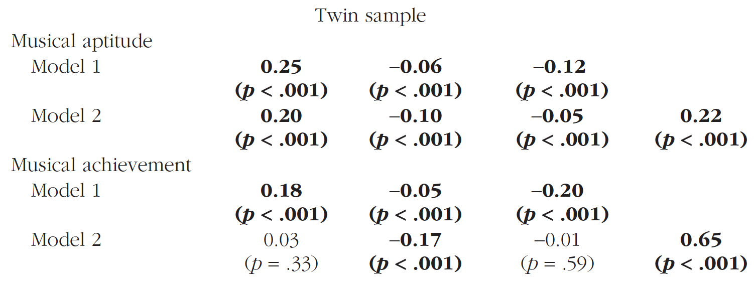
Regression models - Twins

Slide 22
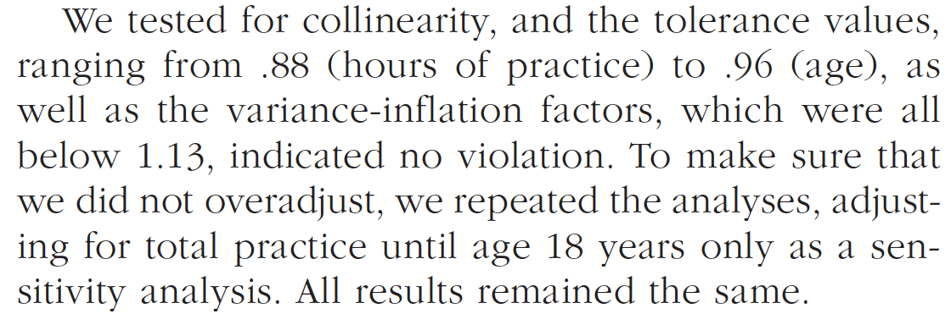
Collinearity problems

Slide 23
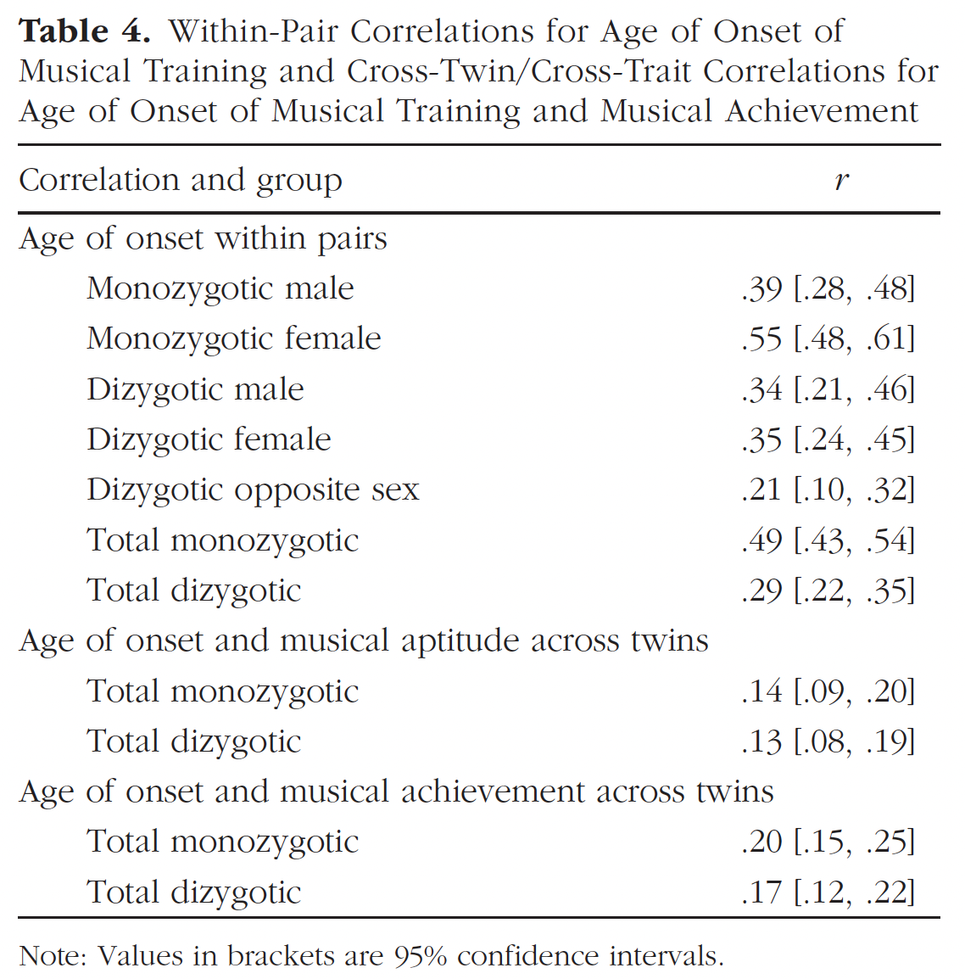
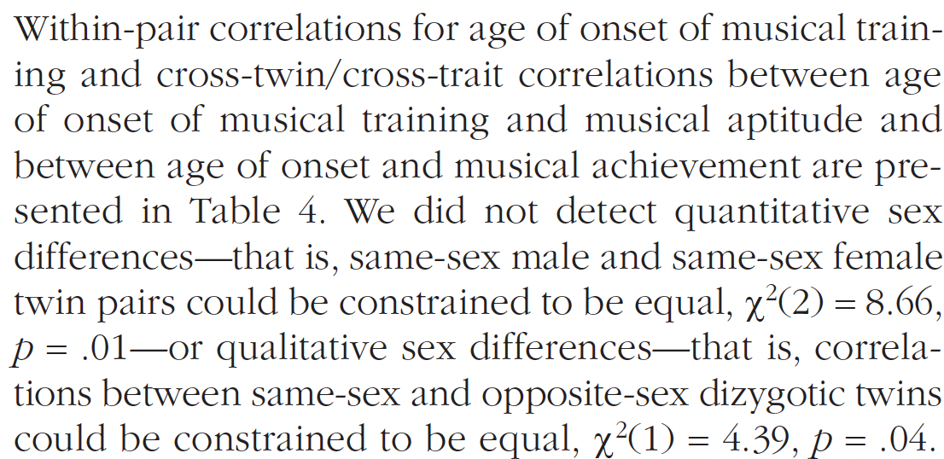
Twin Modeling

Slide 24
ACE analyses
A = Genetic
C = Shared Environmental
E = Non-shared environmental

Slide 25
Genes and Environment Explained

Slide 26
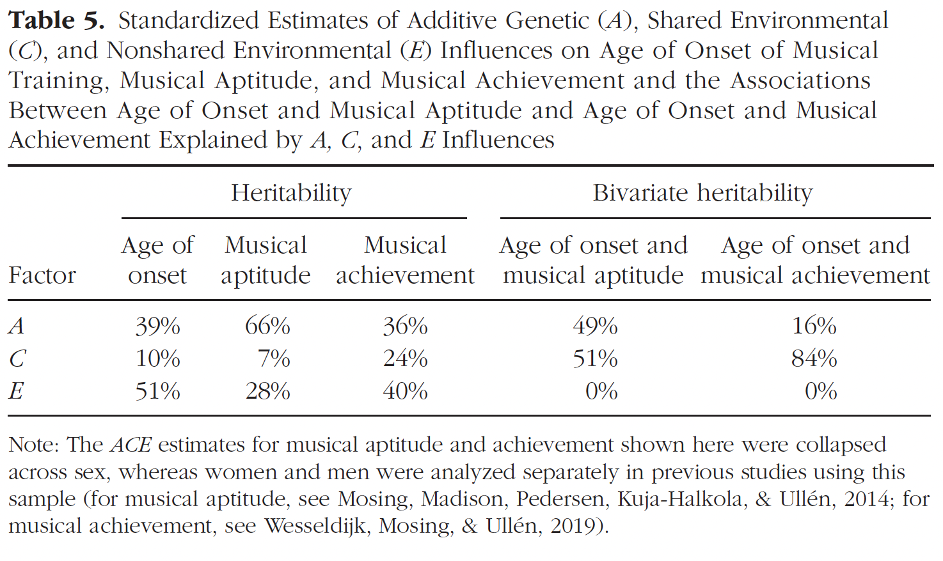
ACE Analyses
Notes:
The fact that E is not significant tells us what? It’s not causal. Why? Because achievement and aptitude are driven by genes (good musicians beget good musicians) and things in the home environment shared by the twins.

Slide 27
What does it all mean?
Does Age of Onset predict Musical aptitude independent of practice?
Does age of onset predict musical achievement independent of practice?
What roles do genes and the environment play in these relationships?

