Slide 2
Wesseldijk, et al. (2021)
What main question did Wesseldijk et al. Ask?
What potential explanations did they propose?
???
???
What kinds of evidence did they describe?
Music
Sports
Twin studies

Slide 3
Wesseldijk, et al. (2021)
Describe their Experiment.
What were the main DVs?
What were the predictor variables?
What other Ivs were assessed?
What sample populations did they choose and why?
How did they hope to use these data to isolate whether a causal relationship exists between early training and expertise?

Slide 4
Sample Populations
Professional musician
Between the ages of 27 and 54
Began training between 2 and 18 years of age
Twins
Same age range
Part of larger database
Had some musical experience
Took standardized test

Slide 5
Measures
Musical experience
Age training began
When training began (eliminated if before age 1 or after age 18)
When it stopped
Hours of practice
Musical Aptitude
Musical Achievement
Different for professionals and twins

Slide 6
Separating Genes and Environment
How did they do this?
How about that section on statistical analyses? I’m glad these folks don’t write the instruction manuals for Ikea furniture?
Good news: we’re going to ignore a lot of it and focus on the stuff that I think will reinforce what we are trying to learn as multiple regression novices.

Slide 7
Descriptive Statistics - Means

Slide 8
Descriptive Statistics - Correlations

Slide 9
Regression models - Experts

Slide 10
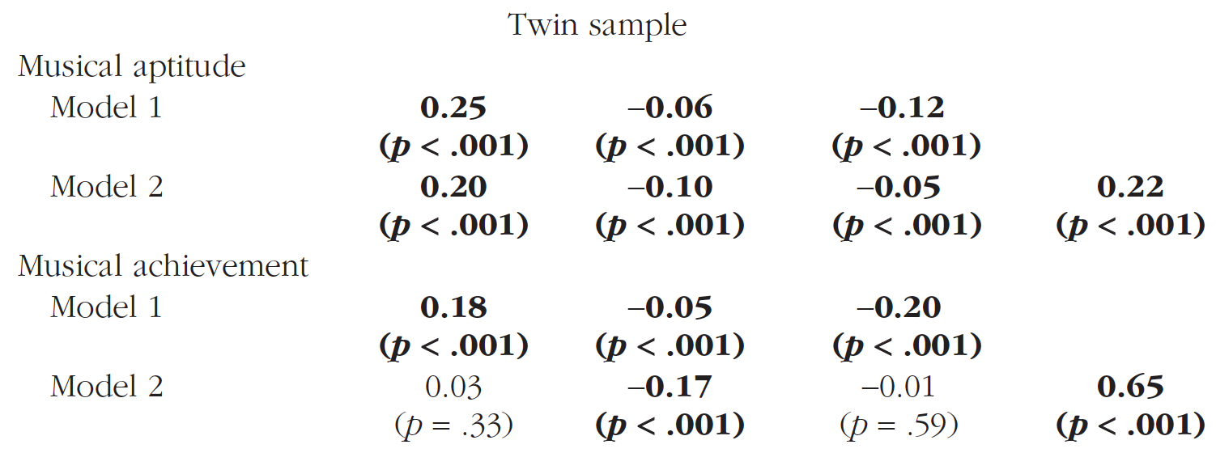
Regression models - Twins

Slide 11
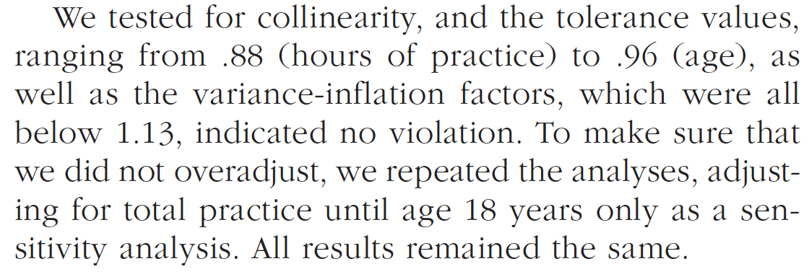
Collinearity problems

Slide 12
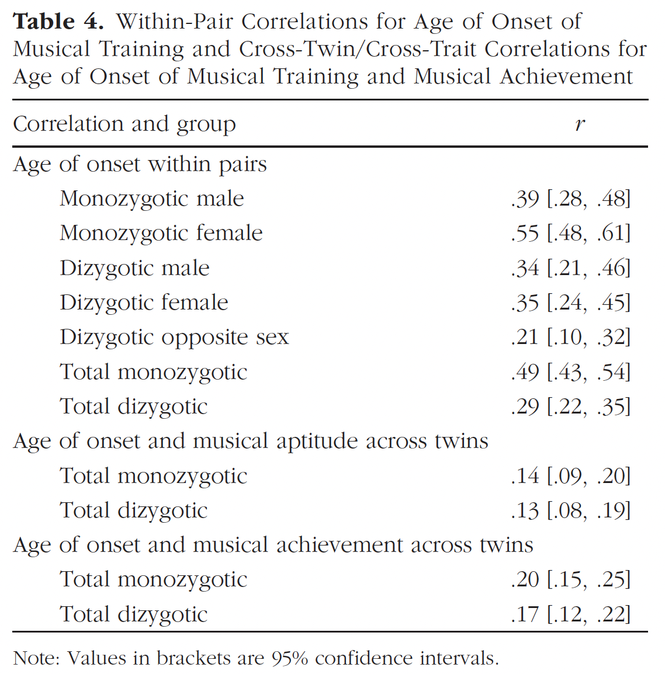
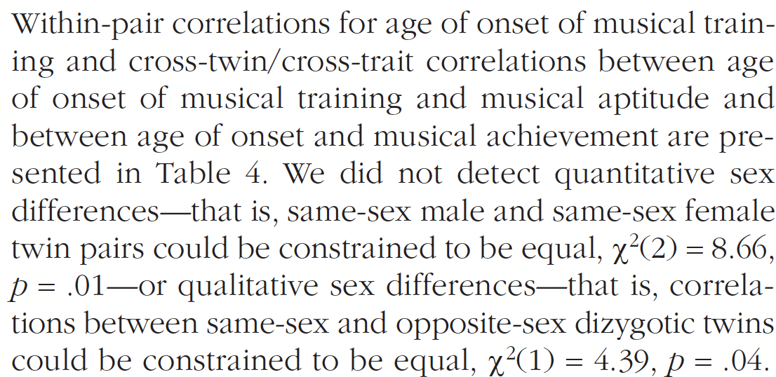
Twin Modeling

Slide 13
ACE analyses
A = Genetic
C = Shared Environmental
E = Non-shared environmental

Slide 14
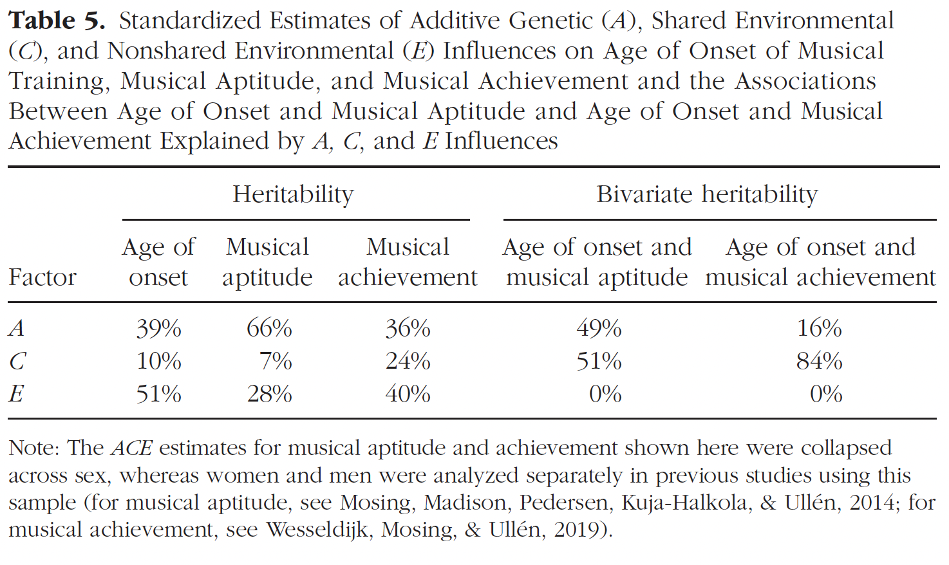
ACE Analyses

Slide 15
What does it all mean?
Does Age of Onset predict Musical aptitude independent of practice?
Does age of onset predict musical achievement independent of practice?
What roles do genes and the environment play in these relationships?

