Slide 1
Instrux for conducting different analyses in SPSS
Finding Means and Standard Deviations
Independent samples t-test
Paired samples t-test
One-way ANOVA (RM ANOVA)
Factorial ANOVA (RM Factorial ANOVA)
Correlation
Regression

Slide 2
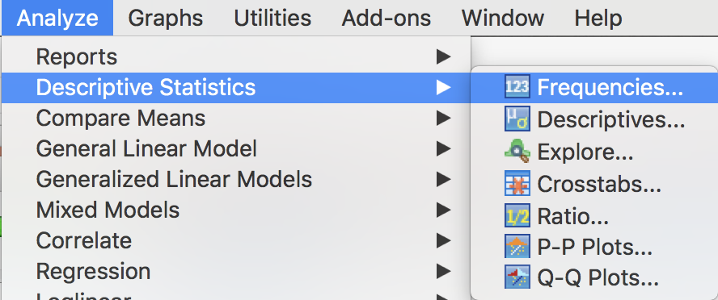
Means and Standard Deviations
Go to Analyze→ Descriptive Statistics → Frequencies

Slide 3
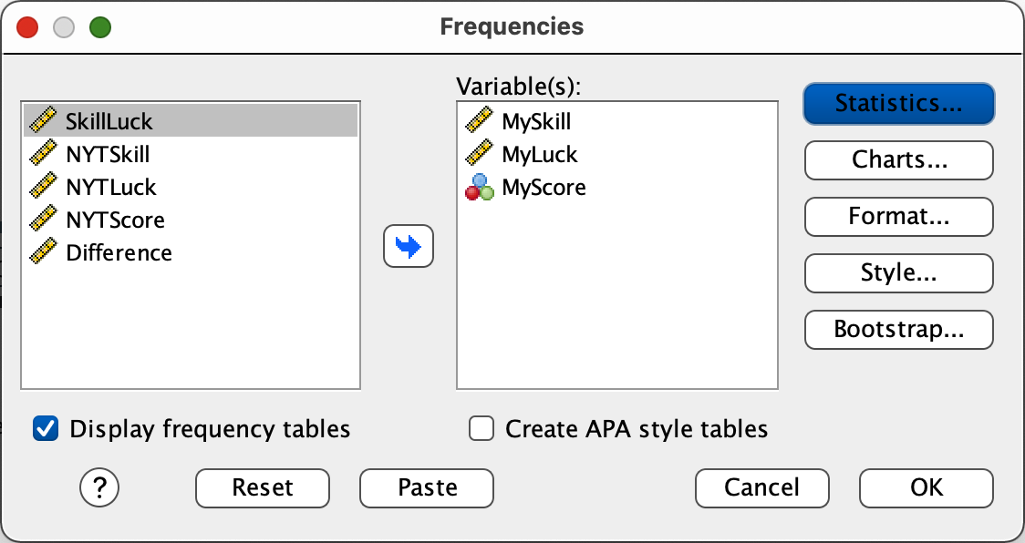
Means and Standard Deviations
Highlight yourDVs on the variable list.
Slide them into the Variable(s) box.
Click the button labeled Statistics in the upper left

Slide 4
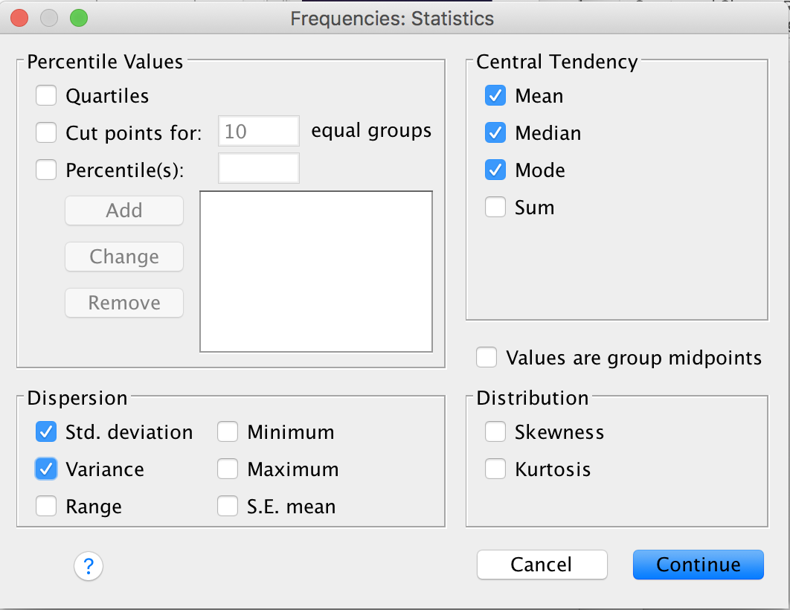
Means and Standard Deviations
Select the Statistics you want to see
Mean, Median, Mode, Std. Deviation, Variance
Click Continue.
Then click OK.

