Slide 1
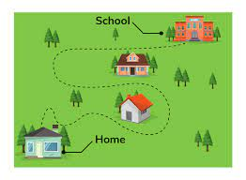
Creating a Graph: Step 1 – Frequency Table
Open your data set.
Analyze → Descriptive Statistics → Frequencies

Slide 2
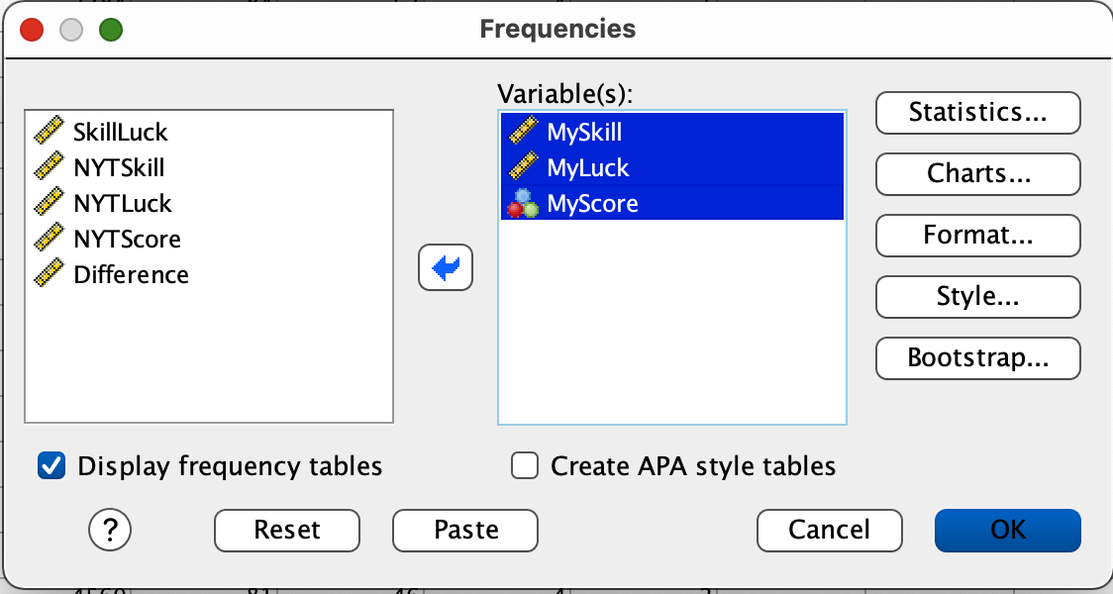
Creating a Frequency Table
SPSS will do this kind of thing for you
Open the WordleBot dataset.
Analyze → Descriptive Statistics → Frequencies
Slide the variables of interest into the Variable(s) box.
Click OK.

Slide 3
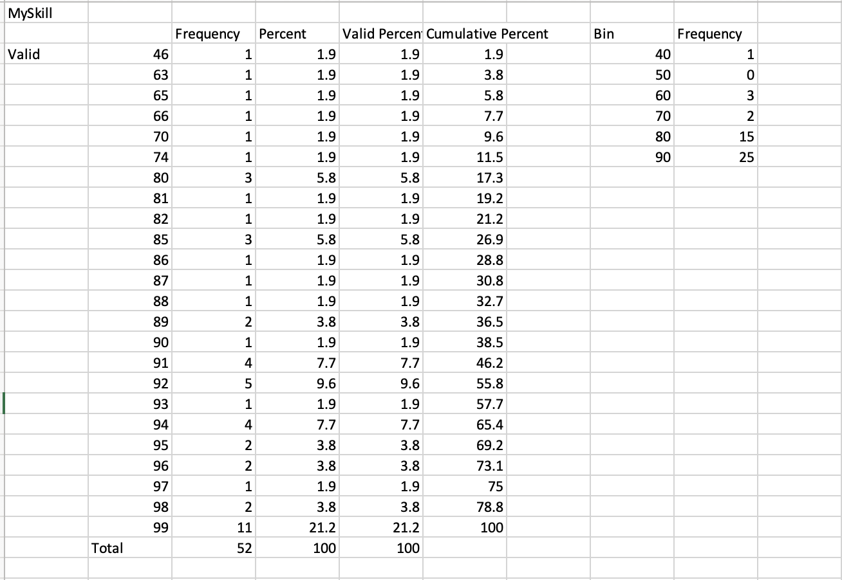
Creating a Frequency Table
Clean up your frequency table to make 5-7 bins or categories.
Then copy and paste your data into a google sheet.
In other words, transform from the table on the left to the one on fth eright.

Slide 4
Making a Histogram
You have a frequency table in a Google sheet.
Highlight the data.
Create a bar graph.
What you say? You don’t know how to do that.

Slide 5
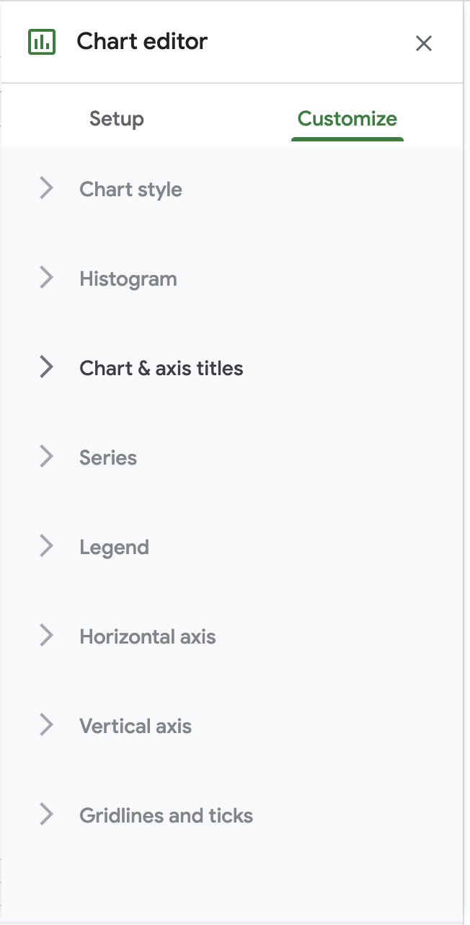
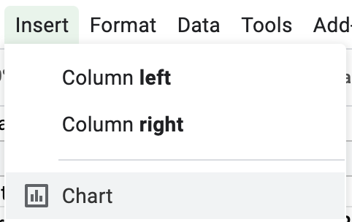
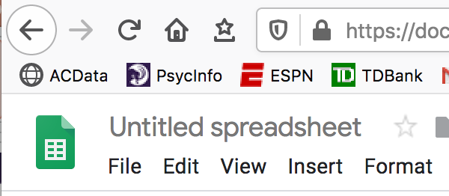
Histogram: Hours of sleep
Click the column head for sleep data (i.e., the frequencies).
Click Insert → Chart
To add titles and axis labels, you need to click Customize.
Use Chart & Axis Titles to set the titles for the charts and two axes.
Scroll through the different options (title; horizontal and vertical axes).
Use Histogram to change the width of your bins (i.e., bucket size)
Last step: Click on ‘Untitled Spreadsheet’ and give the file a name.
Notes:
Can I have a volunteer to explain who FantasyFootball works

