Slide 1
Instrux for conducting different analyses in SPSS
Finding Means and Standard Deviations
Independent samples t-test
Paired samples t-test
One-way ANOVA (RM ANOVA)
Factorial ANOVA (RM Factorial ANOVA)
Correlation
Regression

Slide 2
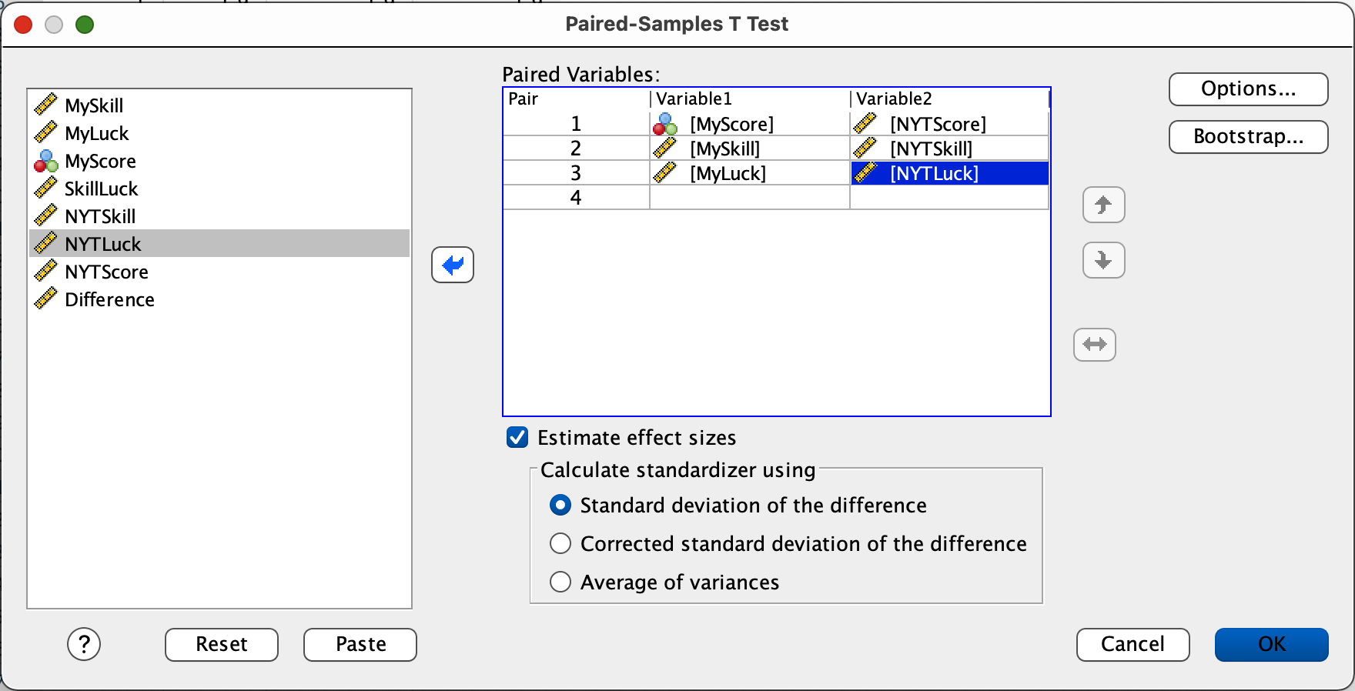
Paired Samples t-test
To conduct the t-test.
Analyze → Compare Means→ Paired t-test
Slide yourDV1 and yourDV2 into the box labeled Paired Variables
Click OK.

