Slide 1
How to reports results from SPSS
Finding Means and Standard Deviations
Independent samples t-test
Paired samples t-test
One-way ANOVA (RM ANOVA)
Factorial ANOVA (RM Factorial ANOVA)
Correlation
Regression

Slide 2
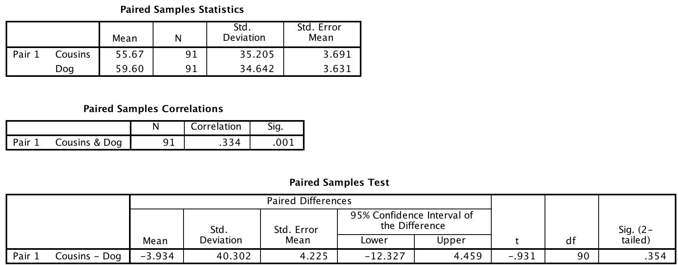
Paired Samples t-test

Slide 3
Paired samples t-test
An paired samples t-test indicate that there was not a significant difference in disgust ratings between the ‘cousins’ (M = 55.7, SD = 35.2) and ‘dog’ vignettes (M = 59.6, SD = 34.6), t (90) = -0.931, p = .354.

