Slide 1
Instrux for conducting different analyses in SPSS
Finding Means and Standard Deviations
Independent samples t-test
Paired samples t-test
One-way ANOVA (RM ANOVA)
Factorial ANOVA (RM Factorial ANOVA)
Correlation
Regression

Slide 2
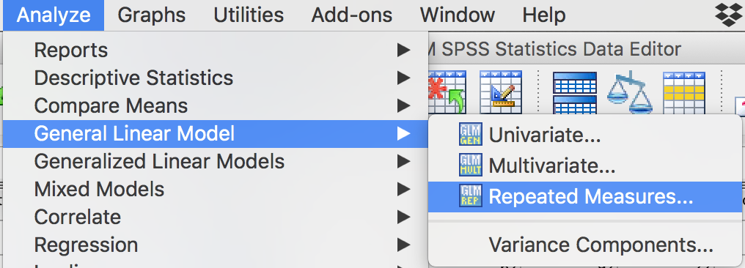
Repeated Measures ANOVA
Analyze → General Linear Model → Repeated Measures

Slide 3
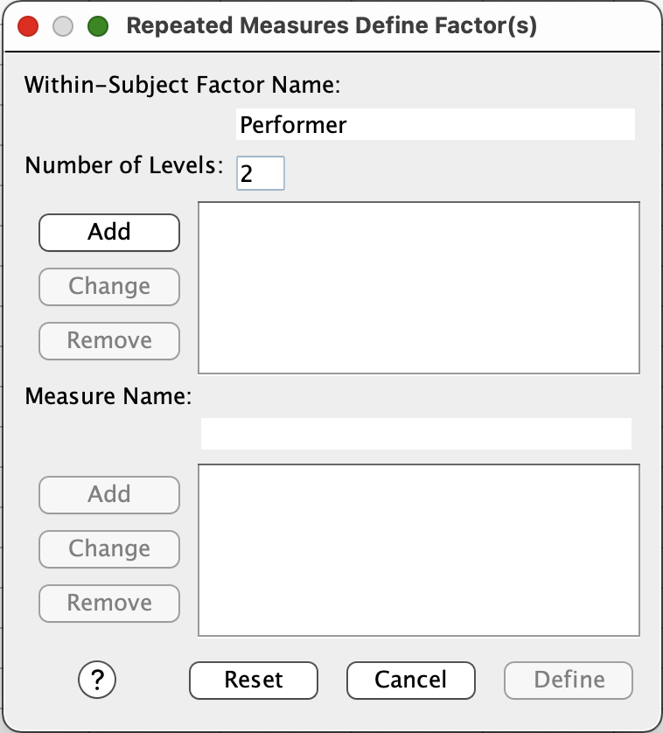
Repeated Measures ANOVA
You need to name your RM factor. Let’s call it Performer. Type Performer in the box labeled Within-Subject Factor Name.
Performer has 2 levels, so enter 2 in the box labeled Number of Levels.
Click Add.
Click Define.

Slide 4
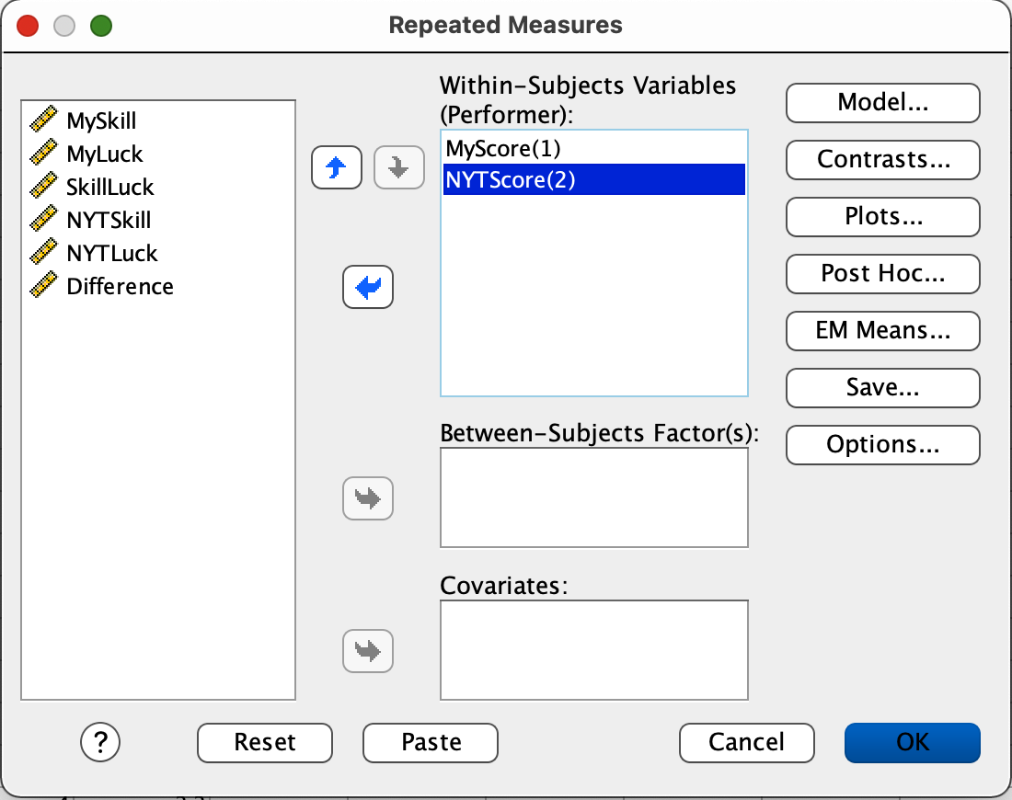
Repeated Measures ANOVA
We need to tell SPSS what variables constitute our two levels of Performer.
Slide MyScore, and NYTScore into the box labeled Within Subjects Variables (Time).
Then click Options.

Slide 5
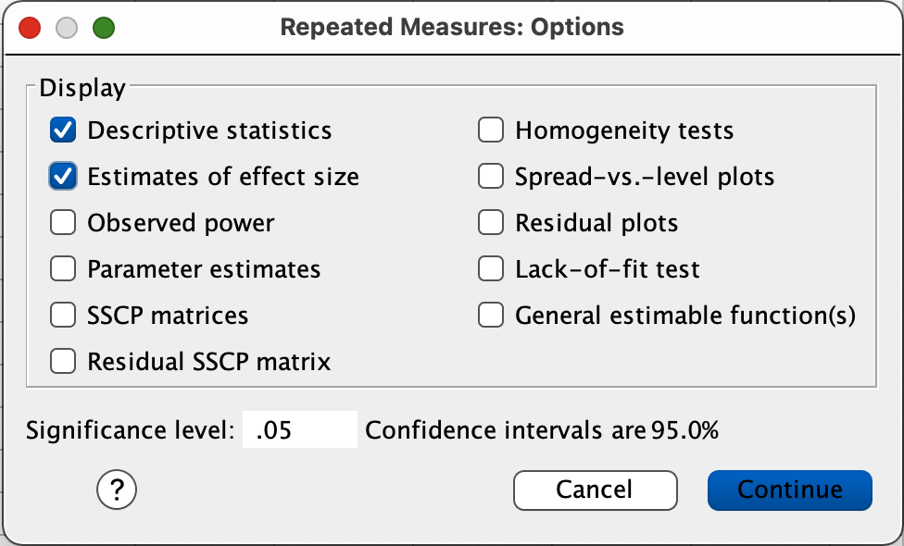
Repeated Measures ANOVA
Click the check box labeled Descriptive statistics
Click the check box labeled Estimates of effect size
Then click Continue.
That will bring you back to the main page; then click OK.

