Slide 1
How to reports results from SPSS
Finding Means and Standard Deviations
Independent samples t-test
Paired samples t-test
One-way ANOVA (RM ANOVA)
Factorial ANOVA (RM Factorial ANOVA)
Correlation
Regression

Slide 2
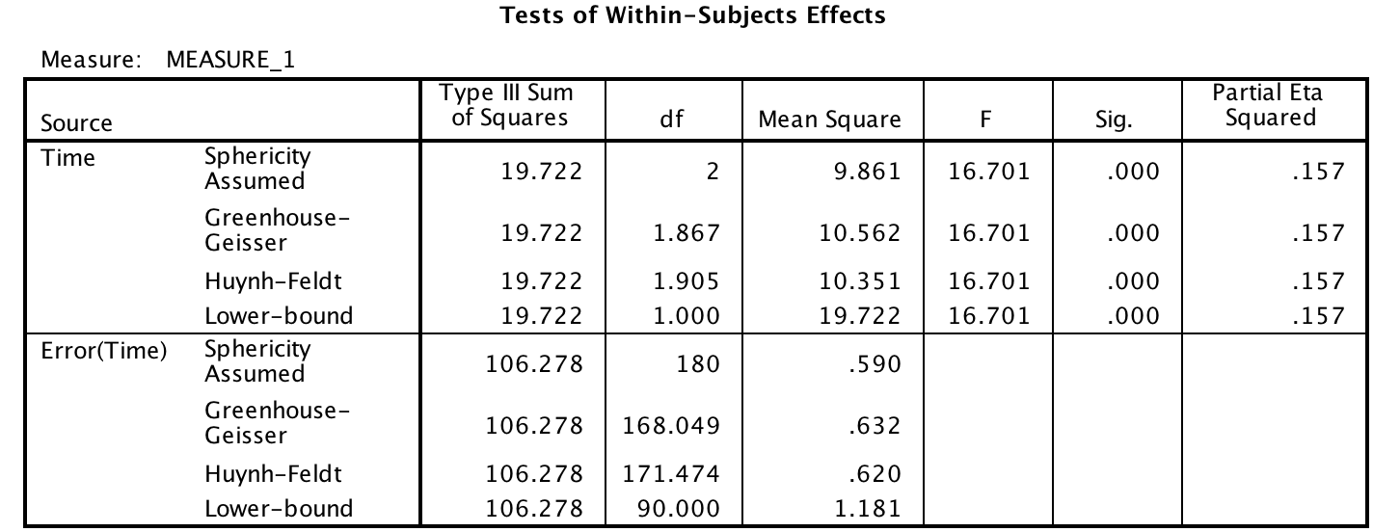
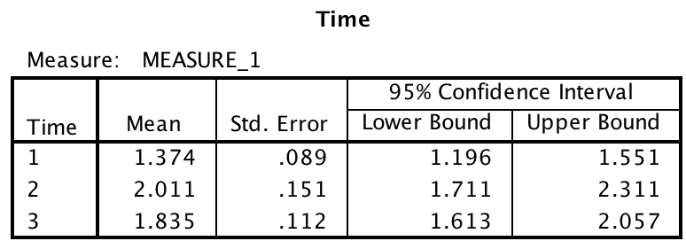
One-way repeated measures ANOVA

Slide 3
One-way repeated measures ANOVA
The repeated measures one-way ANOVA indicated that there was a significant effect of timing on feelings of disgust, F (2, 180) = 16.701, p < .001, η² = .157. Post-hoc tests indicated that people experienced less disgust at the beginning of the experiment (M = 1.37, SE = 0.09) than they did after consuming the jelly bean (M = 2.01, SE = 0.15) or at the end of the experiment (M =1.83, SE = 0.11). The latter two conditions did not differ from one another.

