Slide 1
Instrux for conducting different analyses in SPSS
Finding Means and Standard Deviations
Independent samples t-test
Paired samples t-test
One-way ANOVA (RM ANOVA)
Factorial ANOVA (RM Factorial ANOVA)
Correlation
Regression

Slide 2
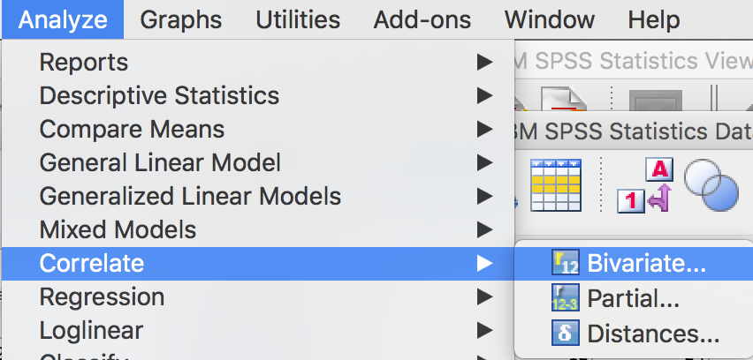
Correlation
Analyze → Correlate → Bivariate

Slide 3
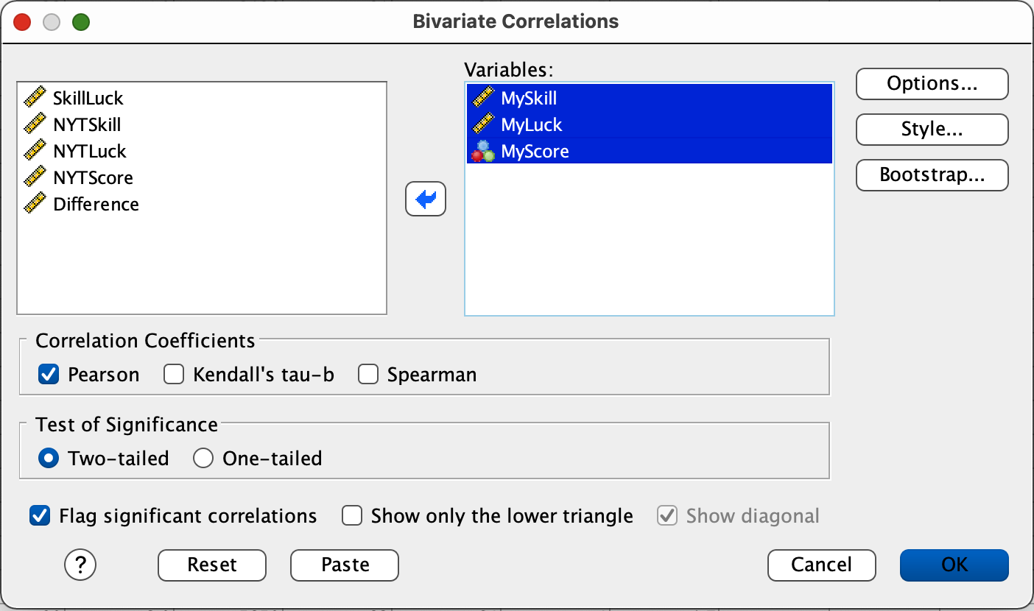
Correlation
Slide your X andY variables into the Variables box.
Then press OK.

