Slide 1
Instrux for conducting different analyses in SPSS
Finding Means and Standard Deviations
Independent samples t-test
Paired samples t-test
One-way ANOVA (RM ANOVA)
Factorial ANOVA (RM Factorial ANOVA)
Correlation
Regression

Slide 2
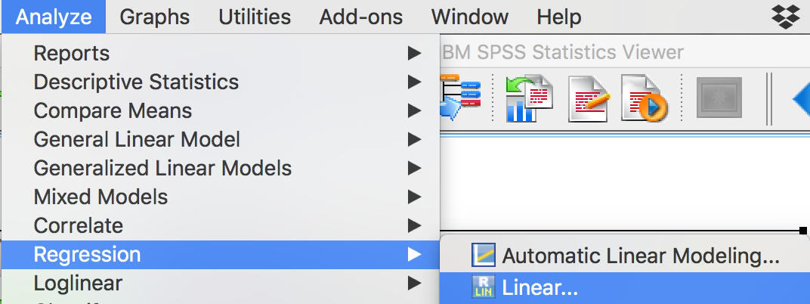
Regression
Analyze → Regression → Linear

Slide 3
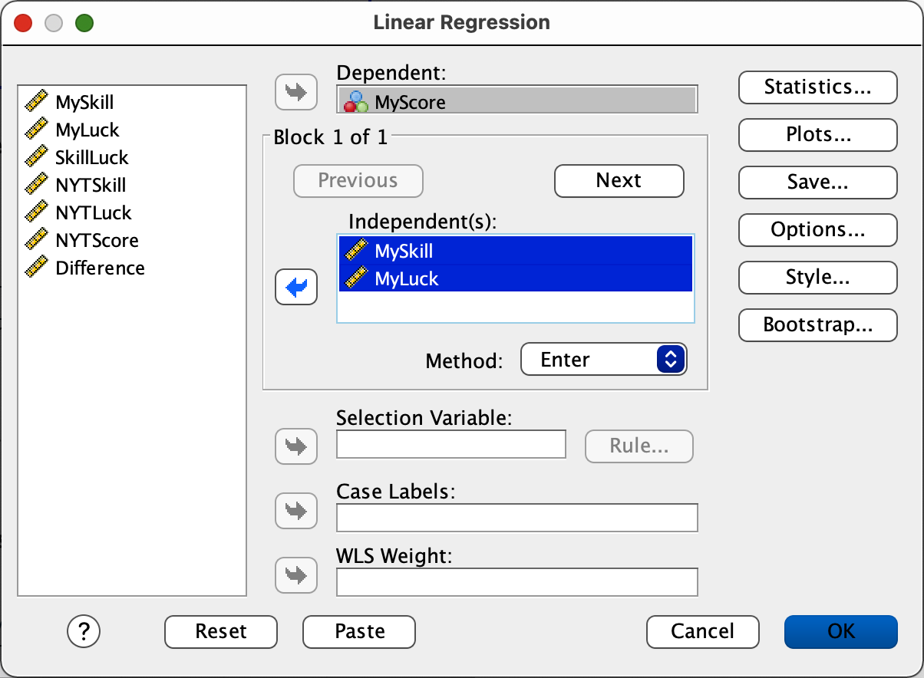
Regression
Slide your Y into the Dependent (DV) box.
Slide your first X into the Independent(s) (IV) box.
Slide your second X into the Independent(s) (IV) box. (and so forth for any additional predictors)
Click OK.

