Slide 1
How to reports results from SPSS
Finding Means and Standard Deviations
Independent samples t-test
Paired samples t-test
One-way ANOVA (RM ANOVA)
Factorial ANOVA (RM Factorial ANOVA)
Correlation
Simple Regression / Multiple Regression

Slide 2
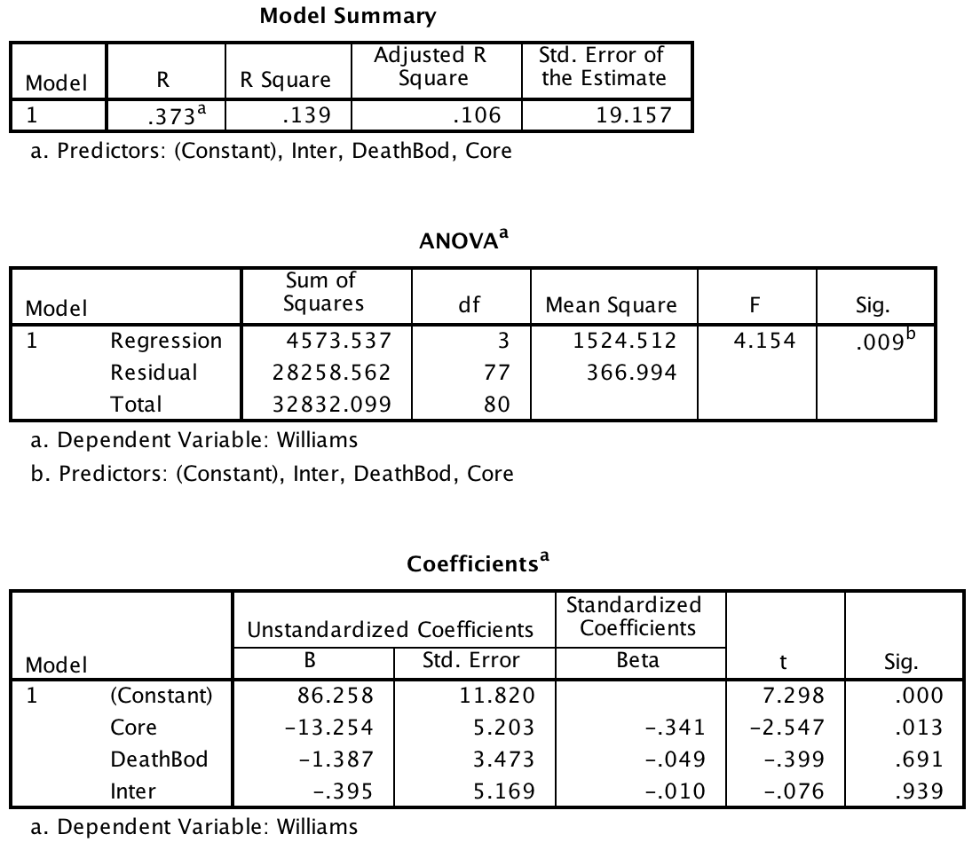
Multiple regression

Slide 3
Multiple regression
A multiple regression analysis indicated that core, interpersonal, and death/body disgust sensitivity explained a significant amount of the variance in attitudes towards Williams college students, F (3, 7) = 4.154, p < .01, R² = .106. The R² indicates that the disgust sensitivity variables explain 10.6% of the variance in attitude ratings. The slope of the regression equation was significant for core disgust (β = -13.254, p = .013), indicating that the more sensitive a person is to core disgust the less they like Williams College students. The slope was not significant for either death/body (β = -1.387, p = .69) or interpersonal disgust (β = -0.395, p = .94) or death/body disgust.

