Slide 1
Statistics for the Behavioral Sciences: Introduction and Key Terms

Slide 2
Key Terms
Statistics - a set of rules and procedures for organizing, summarizing, and interpreting data

Slide 3
Key Terms
Population - the entire set of people or objects that we are interested in studying
Census - an exhaustive collection of data from every member of the population of interest
Sample - a group of observations drawn from a given population
Notes:
Students balk at physio and Stats, could it be because of terminology?

Slide 4
Variable - some characteristic of a population that we are interested in measuring.
By definition, variables are free to vary; that is, every member (unit) of the population can generate different values.

Slide 5
Parameter - the value, usually a number, that describes a population (derived by a census). Does not vary.
Statistic - the value of a variable for a sample drawn from the population. Varies depending upon which members of the population are sampled.
Sampling error: the naturally occurring unsystematic differences that exist from one sample to another

Slide 6
Two different kinds of statistics:
1. Descriptive Statistics - numerical and graphical methods for analyzing patterns within a data set; used to summarize information contained within a data set and present it to an audience.
2. Inferential Statistics - the use of sample information (i.e., descriptive statistics) to make estimates, decisions, predictions and/or other generalizations about the population from which they were drawn.

Slide 7
Relational Aggression in Males and Females
Sample drawn from the population of 4th and 5th graders
Descriptive : organize and simplify:
Mean relational aggression score for Males = 1.6
Mean relational aggression score for Females = 1.9
Inferential: interprets results
Is the 0.3 point difference due to chance (sampling error)?
OR
Is there really a difference between the two groups (in the population)?
How do DSs and ISs relate? DSs are used as the basis to calculate ISs

Slide 8
Combining DS and IS
You got a 70 on the first exam:
Did you do better than average?
Step 1 :Determine an average for the class.
a) Take a census and calculate a parameter
b) Take a sample and calculate a statistic
You and your four friends got: 70, 80, 80, 60, 50
Mean = 68 (that's a DS)

Slide 9
Combining DS and IS
You got a 70 on the first exam:
Did you do better than average?
Step 2 :compare your 70 to 68 (the sample mean)
You did better than the average of the SAMPLE.
To know if you did better than the average of the population, you need to calculate an IS.

Slide 10
Combining DS and IS
IS takes into account not only the magnitude of the statistic, but its variability as well.
What if everyone in the class scored 68, except for one person who scored a 66?
What if everyone else in the class scored in the 80s except for a few people who scored in the 20s?

Slide 11
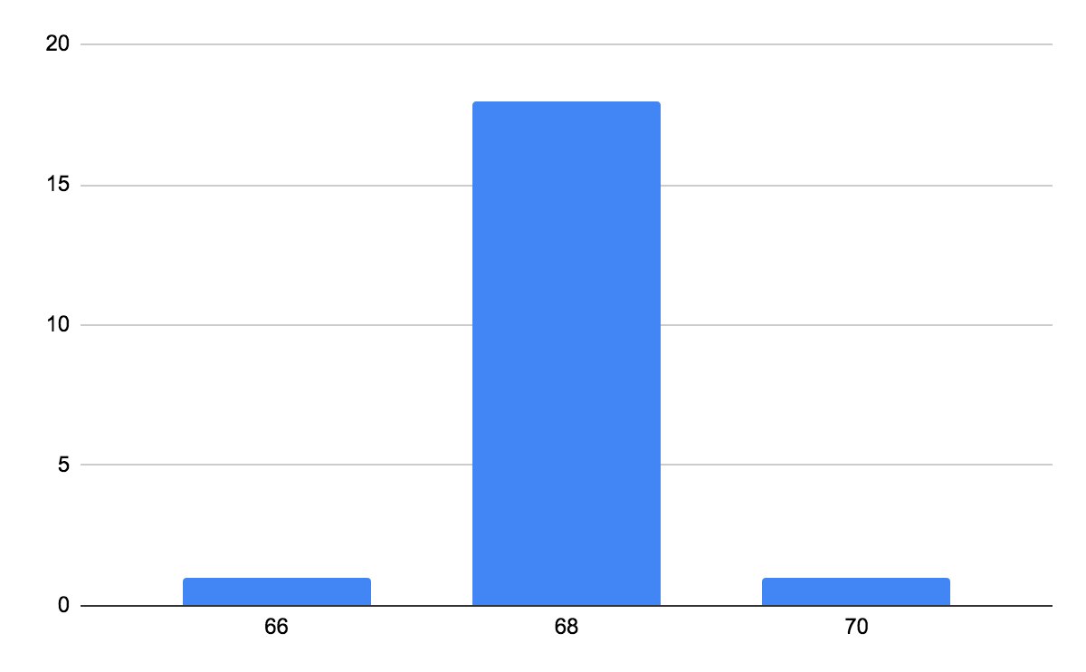
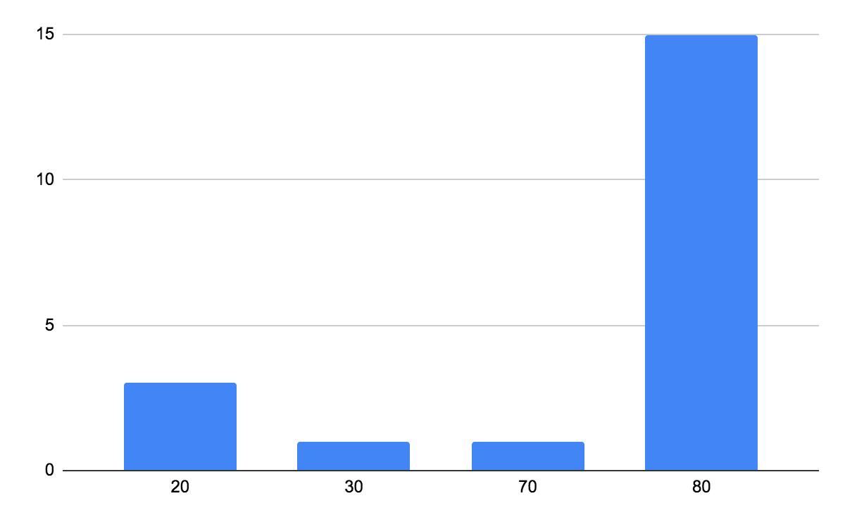
Combining DS and IS
M = 68 M = 68
SD = 0.65 SD = 23.5

Slide 12
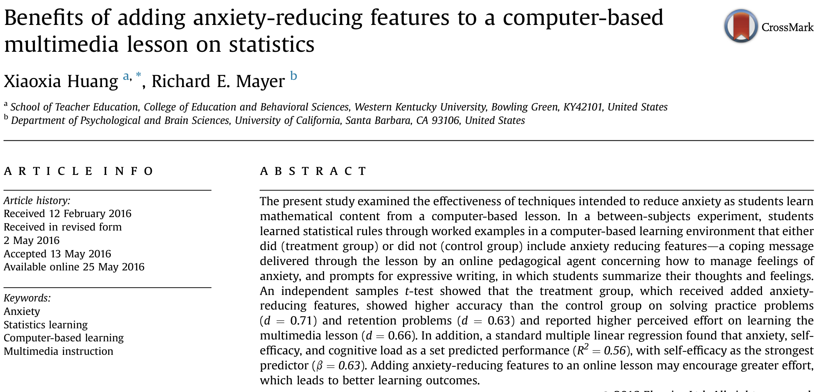
Real world Example:

Slide 13
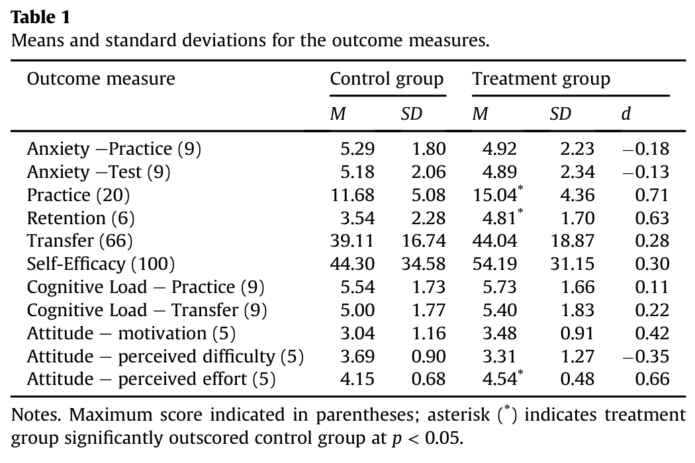
Real world Example:

Slide 14
Data Collection Methods
Observational (Correlational) Methods
Look out into the world and see if two variables tend to co-exist.
Methods: questionnaires, self-reports, or observation
Limitations: no causality, can’t explain the relationship
Notes:
Anxiety and exam performance: do people who are more anxious do better or worse?
Openness to experience and creativity

Slide 15
Data Collection Methods
Experimental Method
One variable is manipulated while the other is observed and measured; controls all other variables to establish a cause-effect relationship
Methods: compare two or more groups, randomly assign to groups
Notes:
One group has anxiety reduction intervention one group does not.
Creativity training course

Slide 16
Differences:
Observational method: key variables are all measured
Measures are often continuous/dimensional
Experimental method: some variables are set by the experimenter, some are measured
Groups are compared
As a result, the experimental method allows the researcher to examine cause and effect relationships.

Slide 17
Real world Example:

Slide 18
Experimental:
Group of Students
Random assignment
Intervention
Control
Manipulate
Self-Efficacy; Anxiety; Knowledge
Self-Efficacy; Anxiety; Knowledge
Measure
Notes:
Anxiety coping strategies; expressive writing

Slide 19
Setting up an experiment: Key terms
Independent Variable = (our predictor) the factor we believe will affect the dependent variable
Dependent Variable = the factor we are trying to predict (depends on the IV)

Slide 20
Setting up an experiment: Key terms
Operational Definition - the way a researcher chooses to define the key constructs (variables) in an experiment.
Stats and Anxiety | Stats and Anxiety
Anxiety Reduction | Coping Strategies Expressive Writing
Intervention Effectiveness | Self-reported Anxiety Self-efficacy Performance
Notes:
Helping behavior: time; amount of help offered;
Anxiety reduction: coping strategies; expressive writing exercise
Effectiveness: self-efficacy

Slide 21
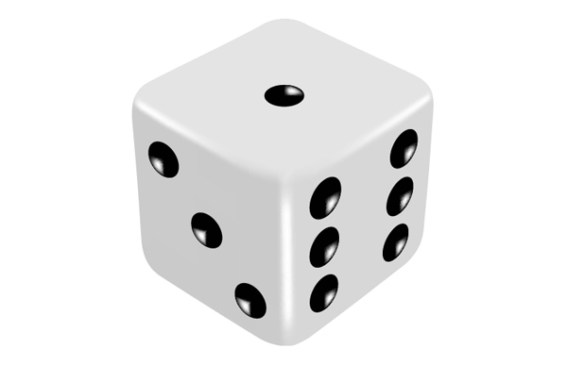
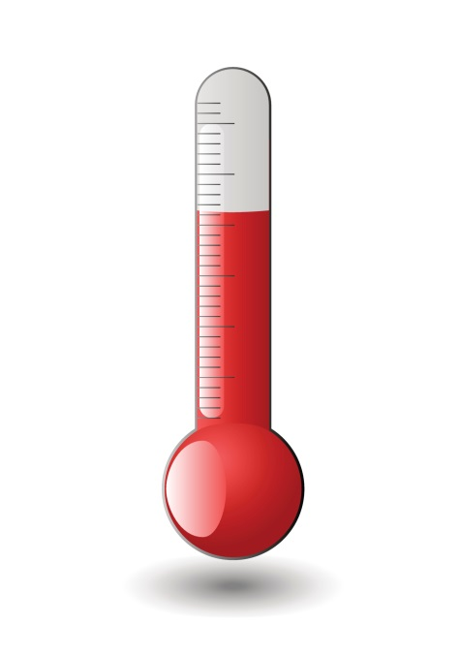
Variables
Discrete variables: separate, indivisible categories. No value between categories can exist.
Example: college major; dots on a die, number of students
Continuous variables: infinite number of possible values that fall between two observed scores
Example: weight, temperature, reaction time

Slide 22
Scales of Measurement
Nominal : labels (names) people to different categories with no numerical relations
Example: Political Party, Favorite #, race
Ordinal : a set of categories that can be ordered along some dimension of size or magnitude
Example: Preference Ratings
(Do you love, like, dislike, or hate math?)

Slide 23
Scales of Measurement
Interval: ordinal + the intervals between categories are identical
Example: Temperature (C, F)
Ratio: interval + an absolute 0 point which corresponds to the absence of the measured quantity
Example: Height, Weight

Slide 24
Crash course in notations
N (or n) = number of subjects in the population (or sample)
X = scores for a particular variable
Y = scores for another variable
Example:
N = 23, n=6
hours of sleep = X
Anxiety about course = Y
X | Y
8 | 1
5 | 3
0 | 1
6 | 2
9 | 1
7 | 4

Slide 25
Crash course in notations
∑ (called sigma) = summation (“sum of the scores”)
Simple Example:
∑ X = 8+5+0+6+9+7
∑ X = 35
X | Y
8 | 1
5 | 3
0 | 1
6 | 2
9 | 1
7 | 4

Slide 26
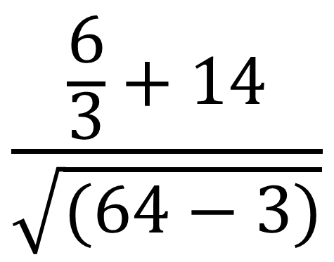
“Please excuse my dear Aunt sally” -- PEMDAS
Order of computation:
Parentheses (X-1)
Exponents X²$or \sqrt{X}$
Multiply or Divide
Add or Subtract

Slide 27
Crash course in notations
∑ (called sigma) = summation (“sum of the scores”)
Little more complicated:
∑ (X-1)² = 49+16+1+26+64+36
=191
X | (X-1)²
8 | (8-1)² | =49
5 | (5-1)² | =16
0 | (0-1)² | =1
6 | (6-1)² | =25
9 | (9-1)² | =64
7 | (7-1)² | =36

Slide 28
Organizing Data
Reason for taking this course
I have to (for my major, to get into grad school etc.)
I want to be able to understand research better
I like math
I got bumped out of all the other psychology courses

