Slide 1
Frequency Distributions

Slide 2
Frequency Distribution – Categorical data
Frequency distribution: an organized tabulation of the number of individuals that fall into each category on the scale of measurement
Class: Category of qualitative data
Class Frequency : the number of observations that fall into a given class
Class | Frequency
Have to | 27
Research | 3
Like Math | 1
Bumped | 0

Slide 3
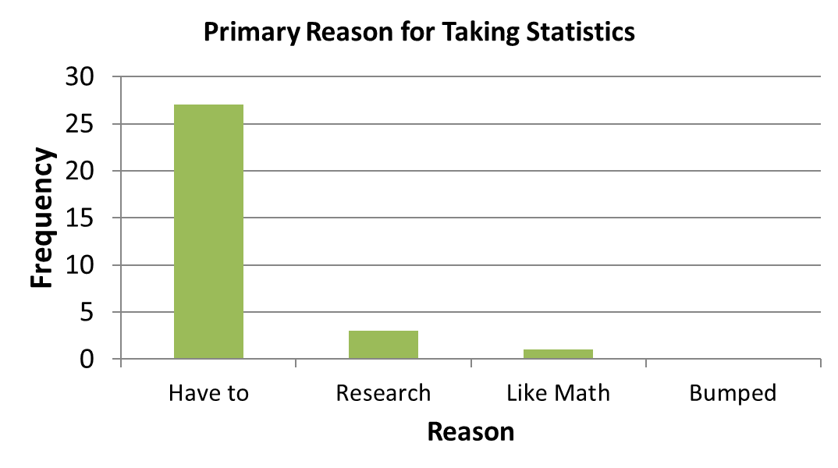
Bar Graph – Categorical Data
Frequency graphs for nominal or ordinal data (bars don’t touch)

Slide 4
Frequency Distribution - Continuous data
Anxiety Scores
Score | Freq
1 | 5
2 | 15
3 | 9
4 | 1
5 | 0

Slide 5
Histogram – Continuous Data
Frequency graphs for interval or ratio data (bars touch)

Slide 6
Additional descriptors of frequency
Proportion (relative frequency): the fraction of the total group that is associated with each score
$$p= \frac{f}{n}$$
Percentage: percent of total group that was associated with each score
percentage = p (100)

Slide 7
My greatest fear about this course:
My greatest fear about this course is (circle best answer):
That I will oversleep and miss it
That I will fail
That I will be totally confused during the lectures
That it will be sooooo boring
Class | Freq | Proportion (relative freq) | Percentage
Oversleep | 10 | .33 | 33%
Fail | 4 | .13 | 13%
Confused | 11 | .37 | 37%
Boring | 5 | .17 | 17%

Slide 8
Comparing two sets of data: Relative frequency
Class | Statistics Freq | Cognitive Freq
Oversleep | 10 | 16
Fail | 4 | 3
Confused | 11 | 25
Boring | 5 | 6
Class | Statistics Relative | Cognitive Relative
Oversleep | .33 | .32
Fail | .13 | .06
Confused | .37 | .50
Boring | .17 | .12

Slide 9
Grouped frequency distribution
What if there are too many different scores?
e.g. height, IQ score, reaction times
Rules:
There should be about 5 to 10 classes
Use a simple width interval when possible (e.g. group by 5’s or 10’s)
The width interval should be the same for each class

Slide 10
21 24 18 16 16 14
12 11 9 9 9 8
7 7 6 5 3 0
Class | Freq
21 | 1
24 | 1
18 | 1
16 | 2
14 | 1
12 | 1
11 | 1
9 | 3
8 | 1
7 | 2
6 | 1
5 | 1
3 | 1
0 | 1
Class | Freq
20-24 | 2
15-19 | 3
10-14 | 3
5-9 | 8
0-4 | 2
Class | Freq
20-29 | 2
10-19 | 6
0 - 9 | 10

Slide 11
Example: Statistics Exam Scores
83 82 63 62 93 78 71 68 33 76 52 97 85 42 46 32 57 59
56 73 74 74 81 76 98 89 88
How will you group scores?
Make a frequency table
Make a histogram

Slide 12
Graphs for populations
Usually hard to get the frequency
BUT we often can estimate the relative frequency
Example: Those with IQ’s between 100 and 115 relative to those with IQ between 130 and 145.
Smooth curves: for relative freq of interval or ratio scales in the population

Slide 13
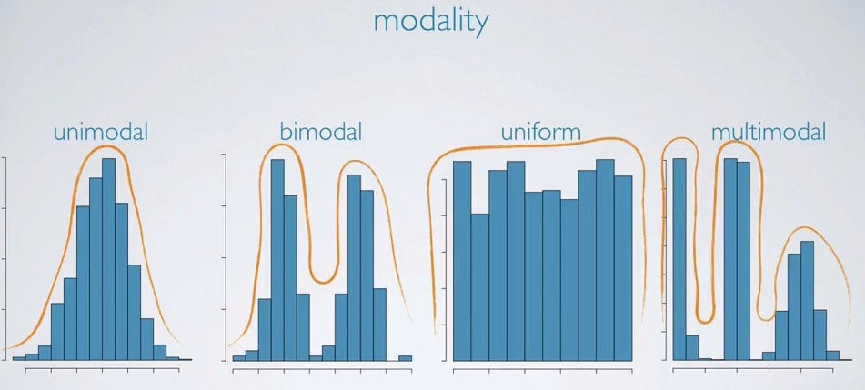
Describing Distributions – Modality
How many ”peaks” are in the distribution?

Slide 14
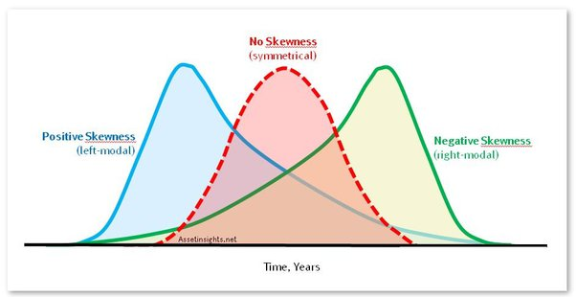
Describing Distributions
Skewness
Positively-Skewed: Possessing a number of outliers at the high end of the distribution
Example: Income, Time to run a mile
Negatively-Skewed : Possessing a number of outliers at the low end of the distribution
Example: Exam scores
Notes:
.

Slide 15
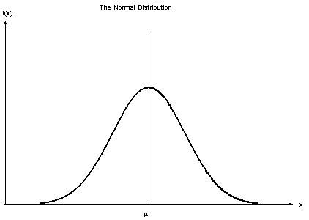
Normal Distribution
Unimodal
Symmetrical distribution (no skew)

Slide 16
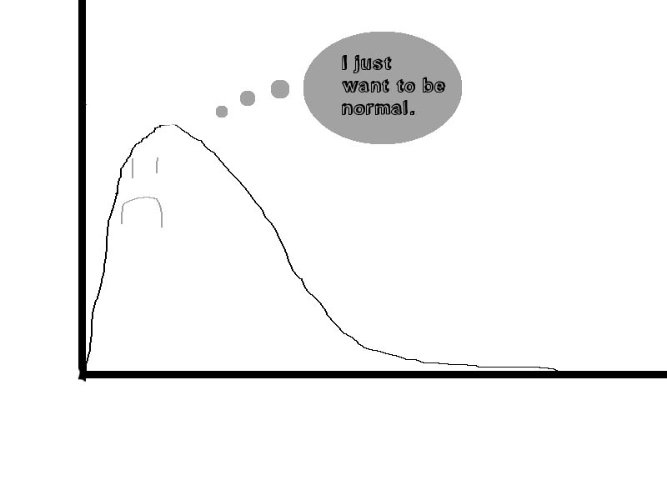

Slide 17
Practice, Practice, Practice
6 9 5 5 4 7 8 5 7 6 4 5 6 5 7
6 6 5 7 4
Place the scores in a frequency distribution
What is the shape of the distribution? (hint: sketch a graph if you need to)

