Slide 1
Making Graphs
RCommander

Slide 2
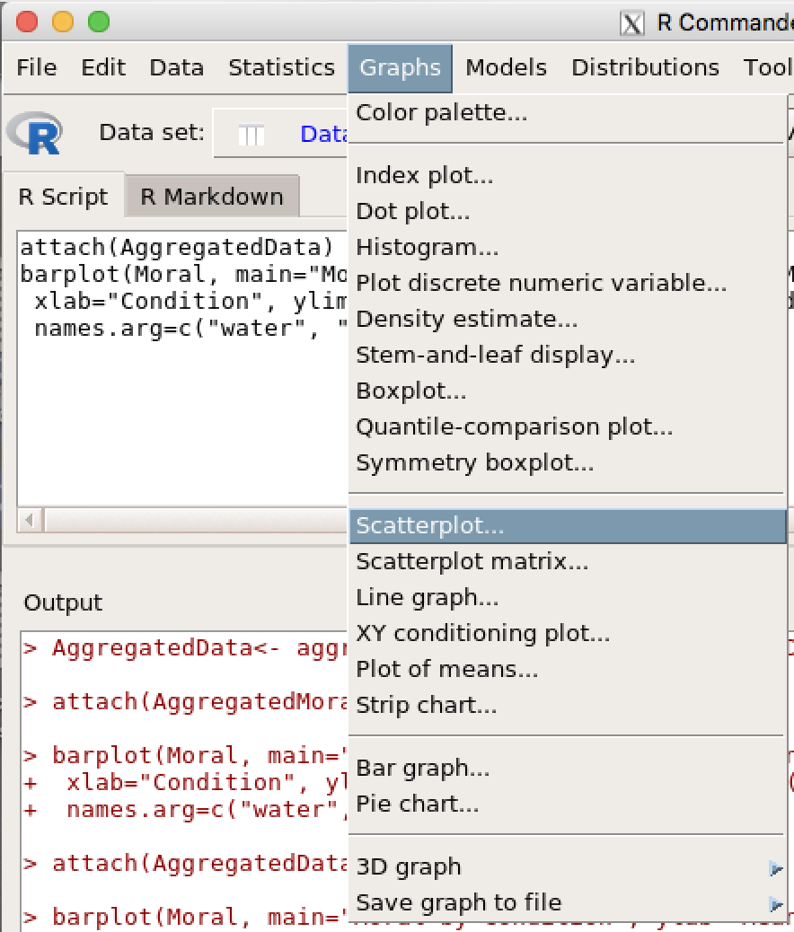
Making a scatterplot

Slide 3
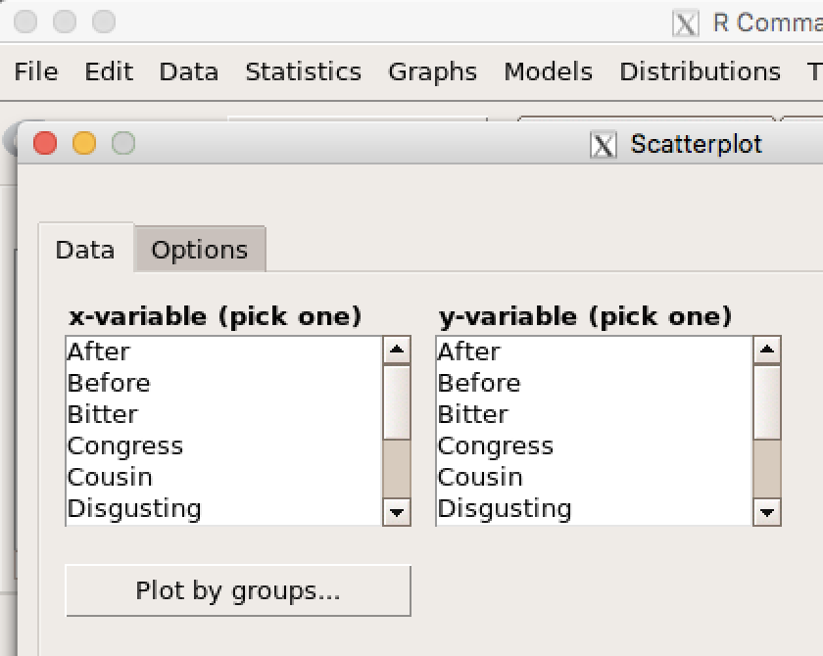
Making a scatterplot
Choose the appropriate X (predictor) and Y (dependent) variables

Slide 4
Frequency Distribution Graphs:
Bar Graphs and HIstograms
Remember: bar graphs and histograms are the same except that
  a bar graph appropriate when your X-axis variable is continuous; as such the bars in a bar graph touch one another
  A histogram is appropriate when your X-axis variable is categorical; as such the bars in a histogram do not touch one another.
The steps for making Bar Graphs and Histographs are identical (after you select which time of graph you are making.

Slide 5
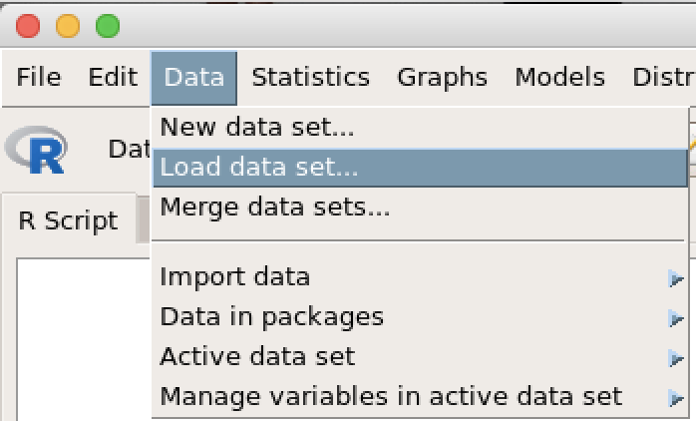
Open your Data set in RCommander
Navigate to the appropriate file and click ‘Open’.

Slide 6
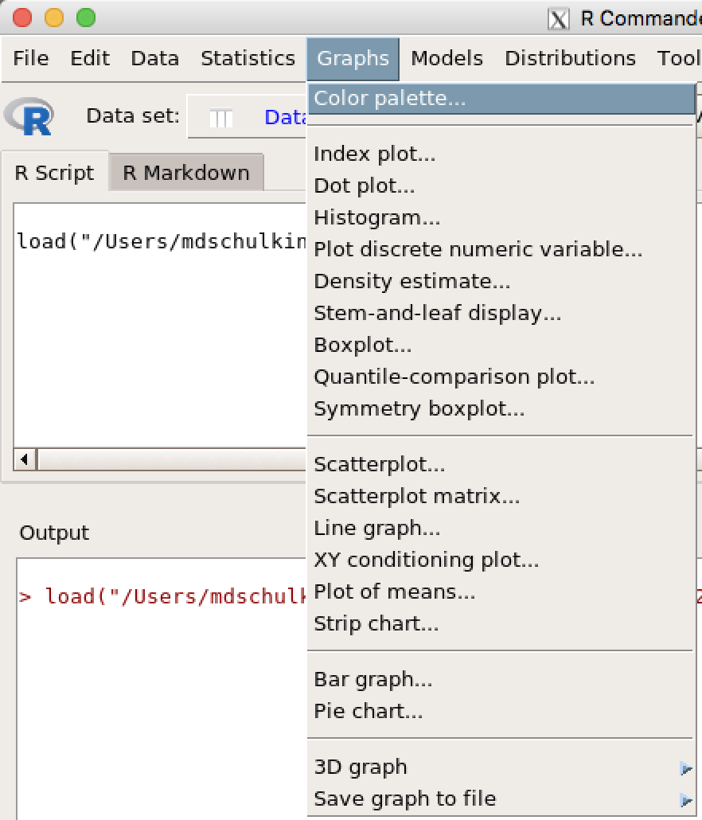
Choose whether you are making a Bar Graph or Histogram
Here for a Histogram
Here for a Bar Graph

Slide 7
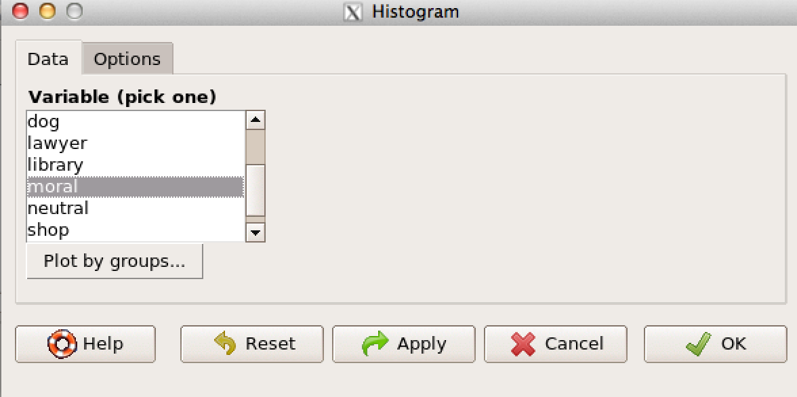
Click on the variables of Interest
Then click the Options tab

Slide 8
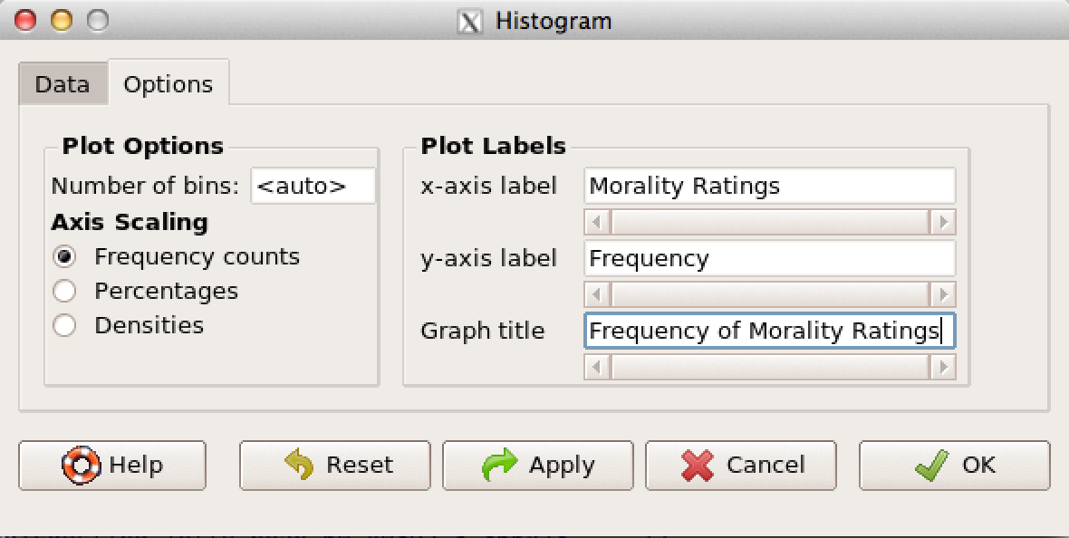
Label the two Axes and give the graph a title
Then Click OK

Slide 9
graphs of Means
Graphs of means are a little harder in RC. You need to use a script file and create a data set that includes only your means. It’s a little more difficult, but we can do it!

Slide 10
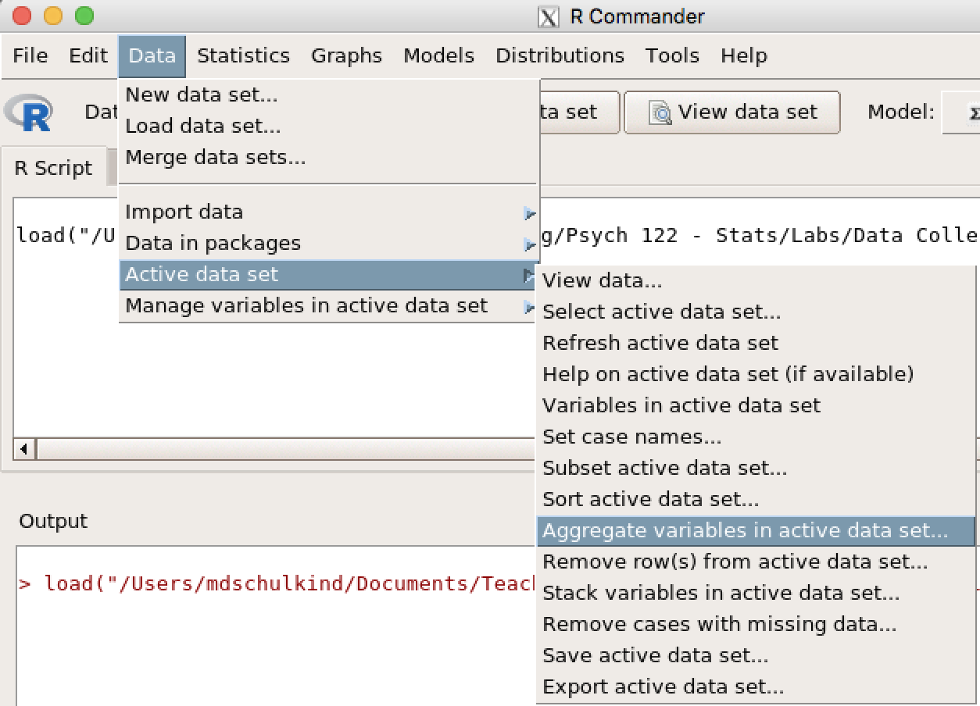
Creating an Aggregated data set

Slide 11
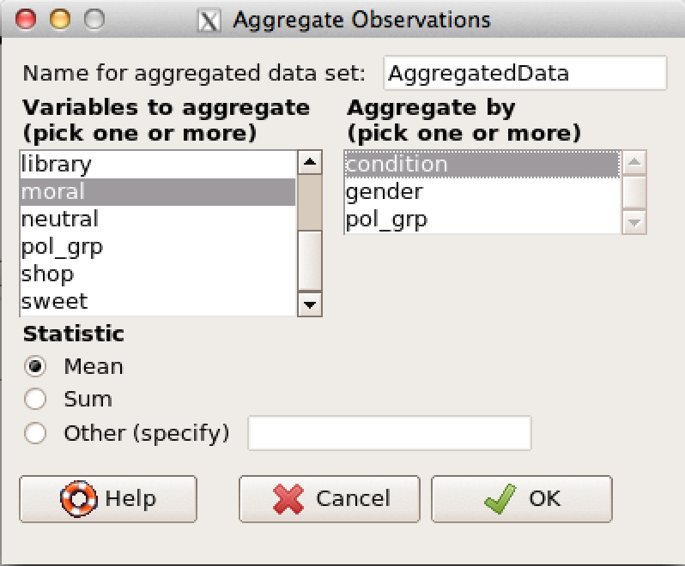
Select the relevant variables
Select your IV here.
Select your DV here.

Slide 12
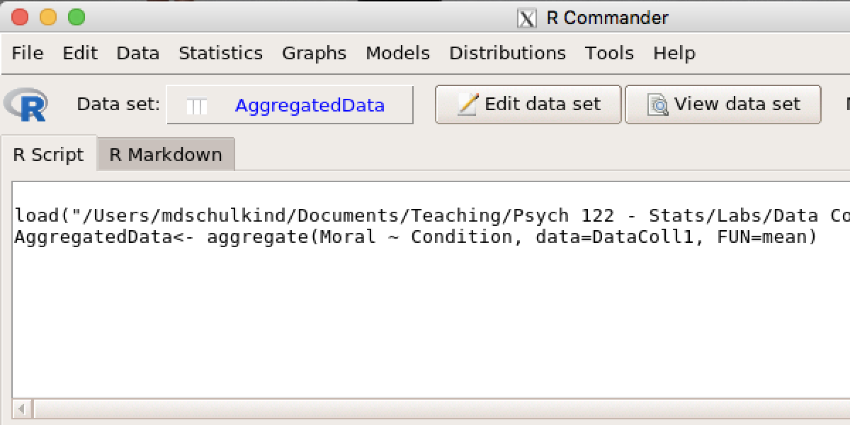
The Active data set is now called ‘AggregatedData’
Click View Data to see what your dataset looks like.

Slide 13
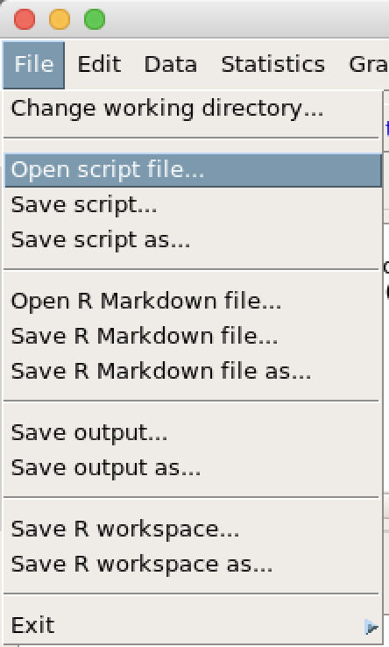
Now it’s time to use the scripts
Download the graphing script file to the Desktop of your computer.
Do not click on it; copying and pasting this file will not work.
When you have saved the file, go to RCommander
Click the ‘File’ menu.
Then click ‘Open script file’
If you asked if you want to save a ‘log file’, say no.

Slide 14
Now it’s time to use the script
The script file will look like this:
attach(AggregatedData)
barplot(moral, main="GraphTitle", ylab="Y-AxisLabel",
xlab="X-AxisLabel", ylim=c(0,100), axis.lty=1, col=c("darkblue","red","hotpink"),
names.arg=c("Bar1Label", " Bar2Label", "Bar3Label"))
Replace the text in red with text that is appropriate for your graph.
You may also change the colors (in green text) to suit your preferences.

Slide 15
Now it’s time to use the scripts
The script file will look like this:
attach(AggregatedData)
barplot(moral, main=”GraphTitle", ylab=”Y-AxisLabel",
xlab=" X-AxisLabel ", ylim=c(0,100), axis.lty=1, col=c("darkblue","red","hotpink"),
names.arg=c(”Bar1Label", " Bar2Label ", " Bar3Label "))
This script assumes that you have one independent variable with three levels; see me if you have more IVs or more or fewer IV levels.

Slide 16
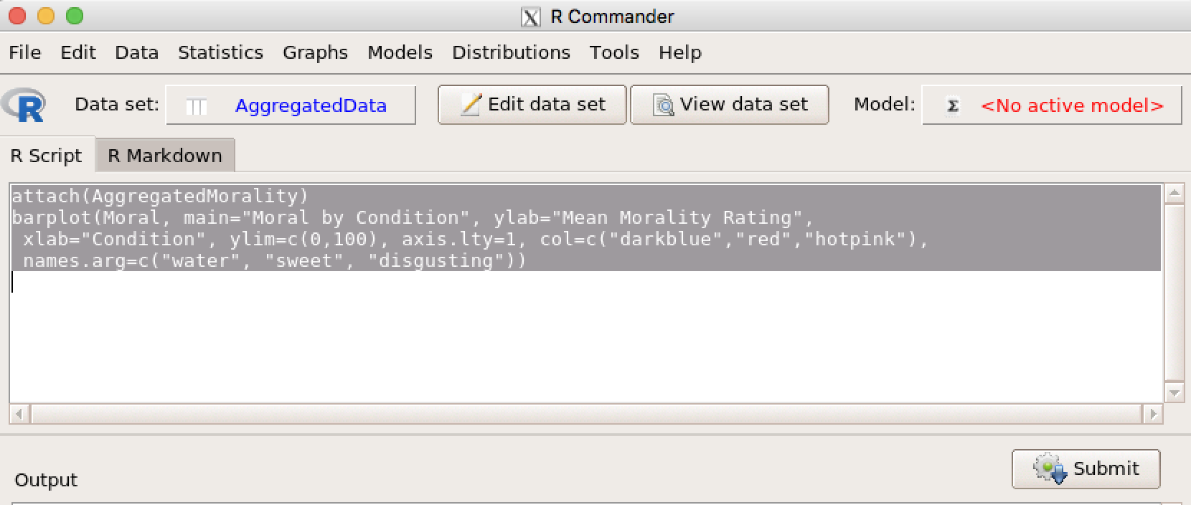
Last Step: Run the script
Highlight ALL of the text and Press the Submit button.
RC always seems to hide graphs behind other windows, so it might not appear even if it is there.

Slide 17
SAVE Your GRAPh!!!!!

