Slide 1
Analyzing Data
A user’s guide

Slide 2
Data analysis programs
R
  if you know what you are doing…not recommended
SPSS
  I can help you with this one…but not available on your own computer
RCommander!!!
  We LOVE IT!!!!

Slide 3
Status of your data
Cleaned
Coded
Formatted properly
In Excel

Slide 4
Downloading Rcommander
(skip if it’s still on your computer from Stats)
Go to the course schedule page
Click the link that says ‘Analysis Materials’
Download the word document for Installing RCommander.
  Choose the right operating system: Windows or Mac

Slide 5

Starting up RCommander
Go to wherever your programs are located
Start up R
Type: library(Rcmdr)

Slide 6
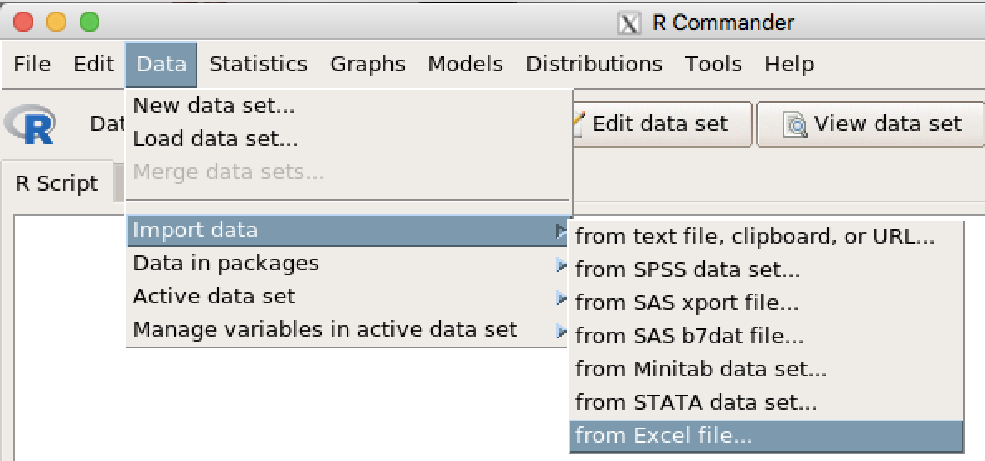
Importing your Excel file into RC

Slide 7
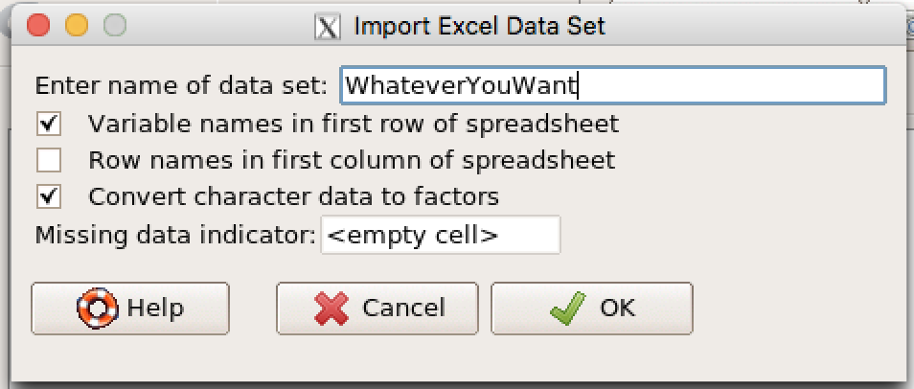
Importing your Excel file into RC
Name the data set WhateverYouWant
Click OK

Slide 8
Importing your data into RCommander

Slide 9
Saving your RC Dataset
This is the MOST IMPORTANT thing you will ever do in your life.

Slide 10
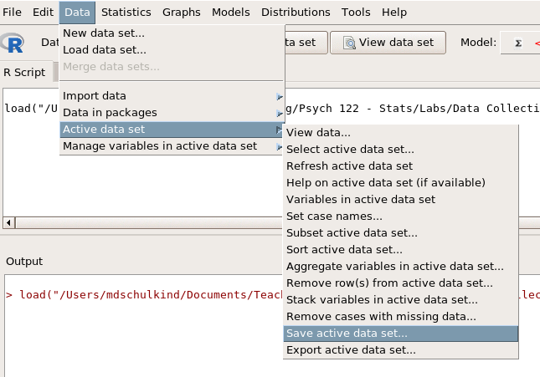
Saving your RC Dataset
Navigate to an appropriate location
Name the data set WhateverYouWant
Click OK

Slide 11
Saving your RC Dataset

Slide 12
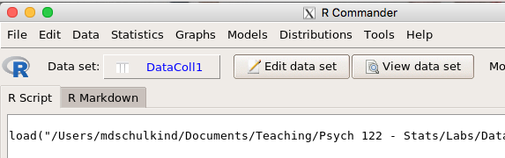
Viewing your RC Dataset
Are all of your variables included?
Are all of your variables labeled properly?
Are all of your subjects included?

Slide 13
Viewing your RC Dataset

