Slide 1
Links for conducting different analyses in RC
Finding Means and Standard Deviations – Go!
Independent samples t-test – Go!
Paired samples t-test – Go!
One-way ANOVA (RM ANOVA) – Go!
Factorial ANOVA (RM Factorial ANOVA) – Go!
Correlation – Go!
Regression – Go!

Slide 2
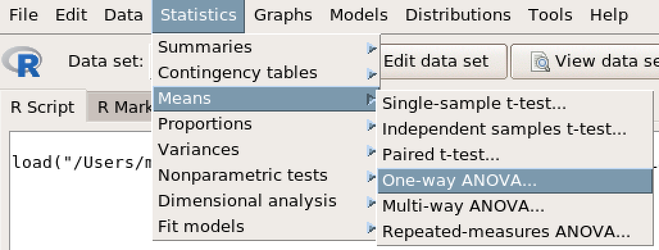
One-Way ANOVA

Slide 3
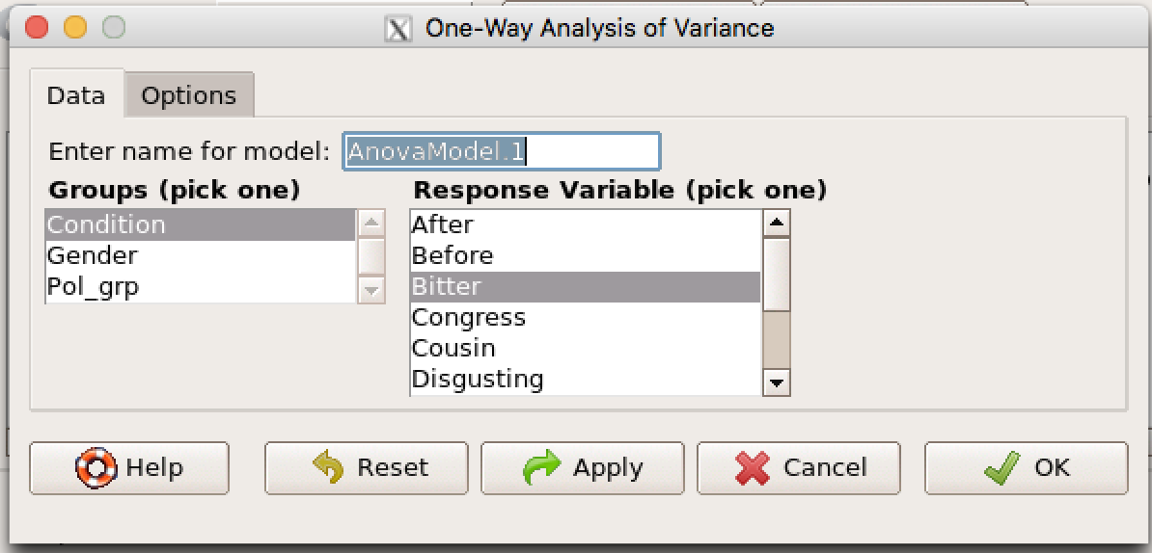
One-Way ANOVA
Select your IV (blue rectangle)
Select your DV (red rectangle)
Click the ‘Options’ tab (purple arrow)

Slide 4
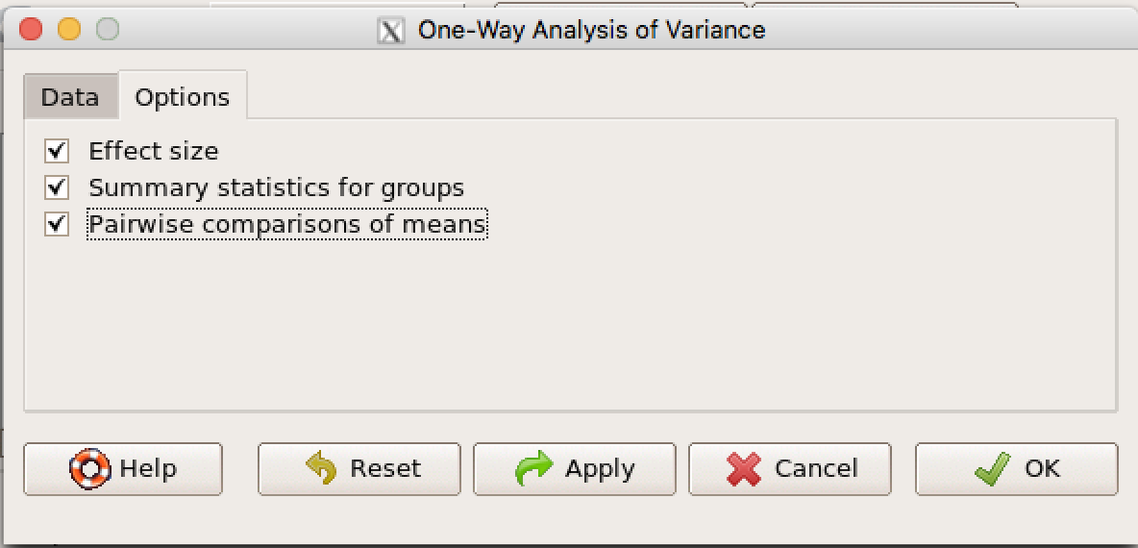
One-Way ANOVA
Check all three check boxes.
Click OK.

