Slide 1
Links for conducting different analyses in RC
Finding Means and Standard Deviations – Go!
Independent samples t-test – Go!
Paired samples t-test – Go!
One-way ANOVA (RM ANOVA) – Go!
Factorial ANOVA (RM Factorial ANOVA) – Go!
Correlation – Go!
Regression – Go!

Slide 2
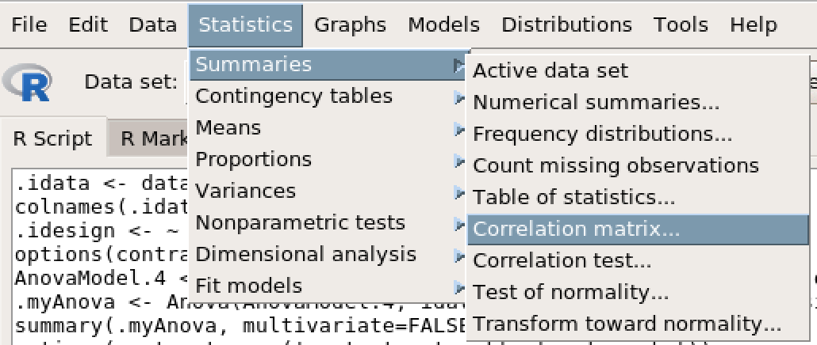
Correlation

Slide 3
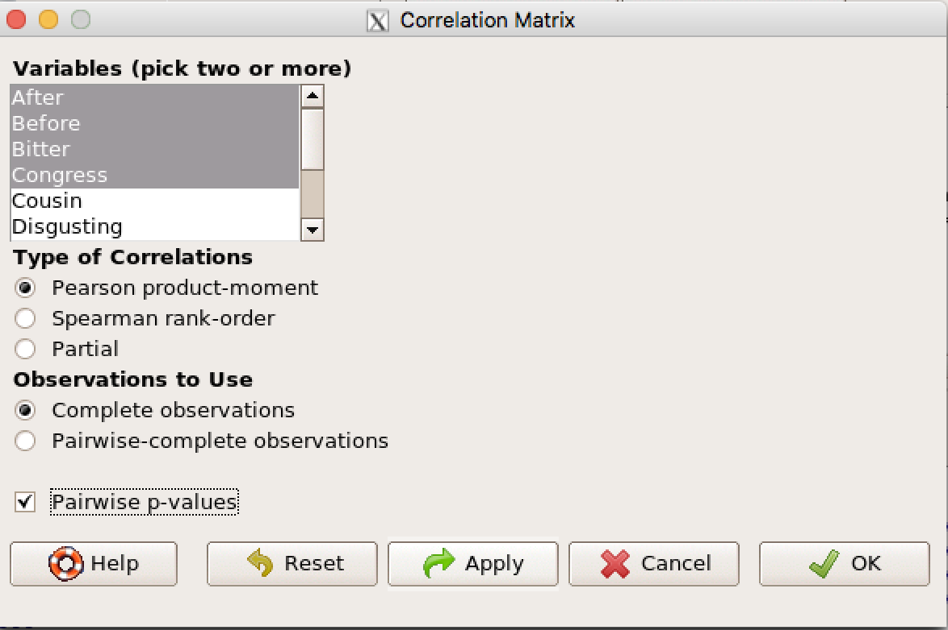
Correlation
Select variables of interest (red rectangle)
Click Pairwise p-values (purple arrow)
Click OK.

