Slide 1
Links for conducting different analyses in RC
Finding Means and Standard Deviations – Go!
Independent samples t-test – Go!
Paired samples t-test – Go!
One-way ANOVA (RM ANOVA) – Go!
Factorial ANOVA (RM Factorial ANOVA) – Go!
Correlation – Go!
Regression – Go!

Slide 2
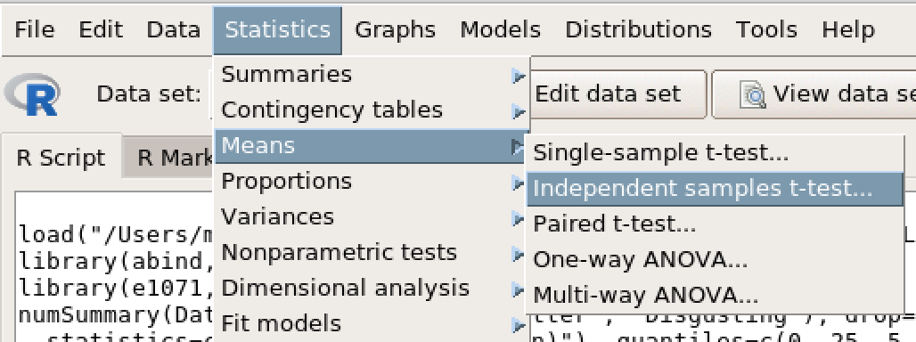
Independent Samples t-test

Slide 3
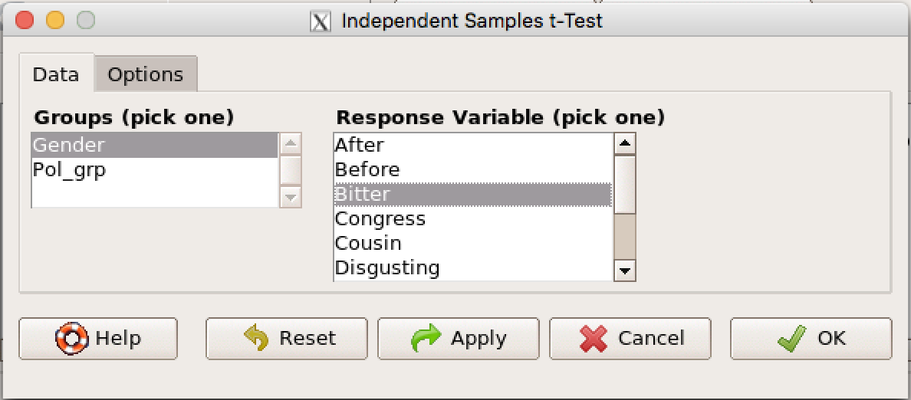
Independent Samples t-test
Select your IV (blue rectangle)
Select your DV (red rectangle)
Click the ‘Options’ tab (purple arrow)

Slide 4
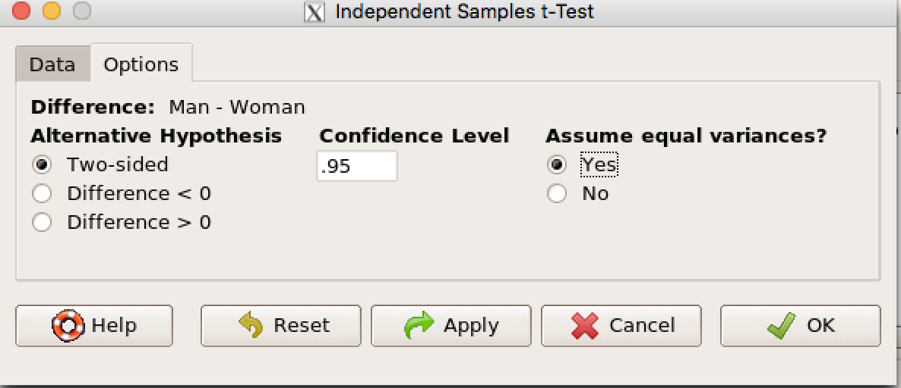
Independent Samples t-test
Check ‘Yes’ under ‘Assume equal variances.
Click OK.

