Slide 1
Links for conducting different analyses in RC
Finding Means and Standard Deviations – Go!
Independent samples t-test – Go!
Paired samples t-test – Go!
One-way ANOVA (RM ANOVA) – Go!
Factorial ANOVA (RM Factorial ANOVA) – Go!
Correlation – Go!
Regression – Go!

Slide 2
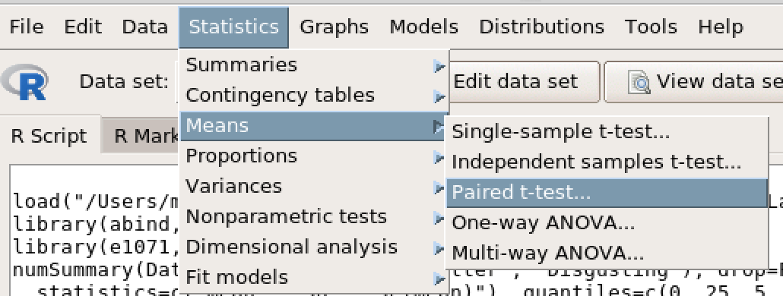
Paired Samples t-test

Slide 3
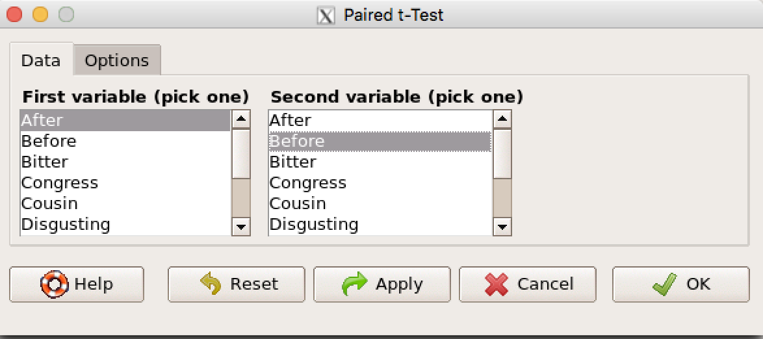
Paired Samples t-test
Choose the two variables you wish to compare.
Click OK.

