Slide 1
Links for conducting different analyses in RC
Finding Means and Standard Deviations – Go!
Independent samples t-test – Go!
Paired samples t-test – Go!
One-way ANOVA (RM ANOVA) – Go!
Factorial ANOVA (RM Factorial ANOVA) – Go!
Correlation – Go!
Regression – Go!

Slide 2
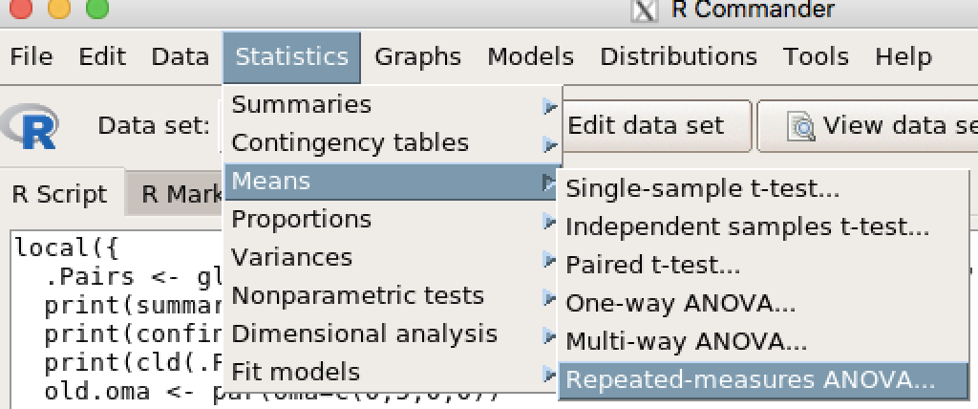
Repeated Measures ANOVA

Slide 3
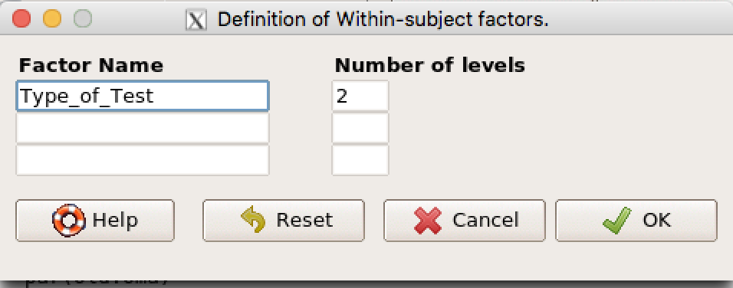
Repeated Measures ANOVA
Enter the name of your IV (e.g., Type_of_test if comparing Convergent and Divergent test.
Enter the number of levels (e.g., 2)
Click OK.

Slide 4
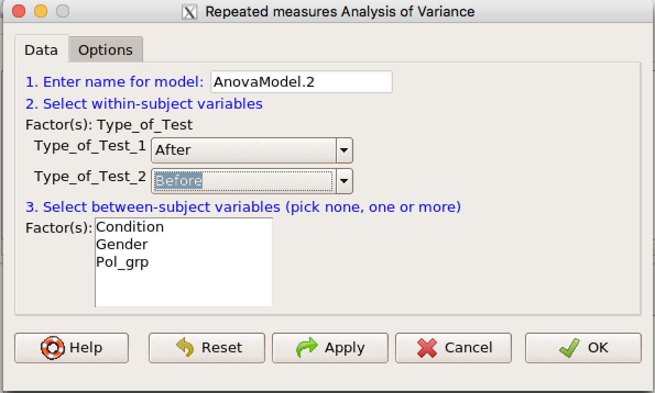
Repeated Measures ANOVA
Ignore #1 and #3.
Use the drop-down menu in #2 (purple arrow) to enter your variables (After and Before in this case).
Click OK.

