Slide 1
Links for conducting different analyses in RC
Finding Means and Standard Deviations – Go!
Independent samples t-test – Go!
Paired samples t-test – Go!
One-way ANOVA (RM ANOVA) – Go!
Factorial ANOVA (RM Factorial ANOVA) – Go!
Correlation – Go!
Regression – Go!

Slide 2
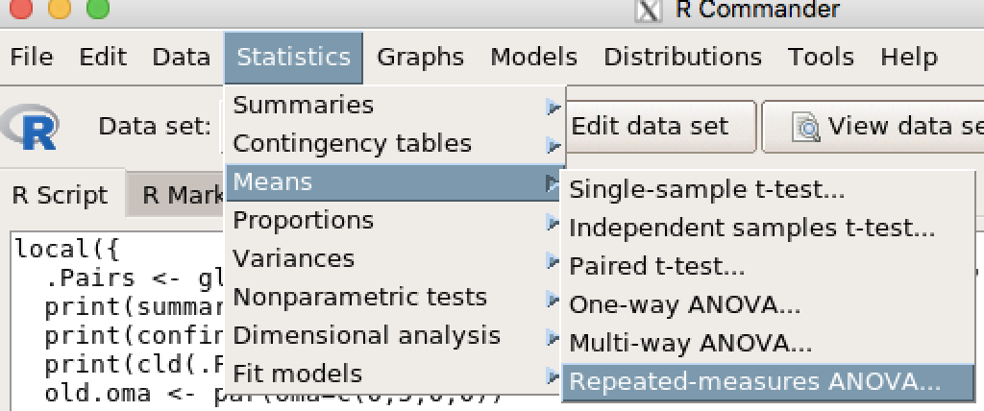
Repeated Measures Factorial ANOVA

Slide 3
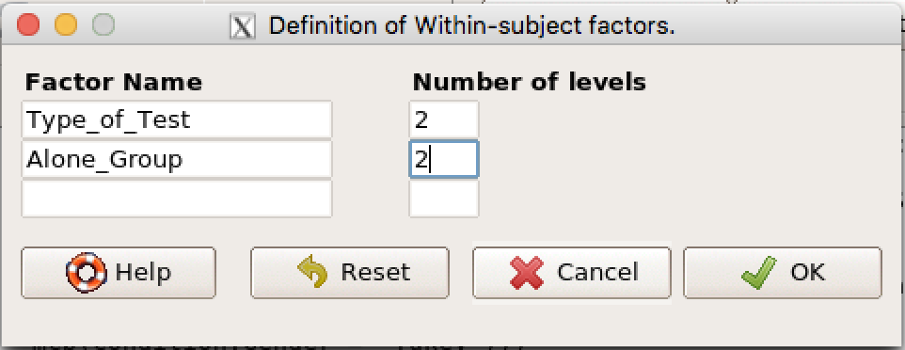
Repeated Measures Factorial ANOVA
Enter the name of your IVs (e.g., Type_of_test and Alone_Group)
Enter the number of levels (e.g., 2)
Click OK.

Slide 4
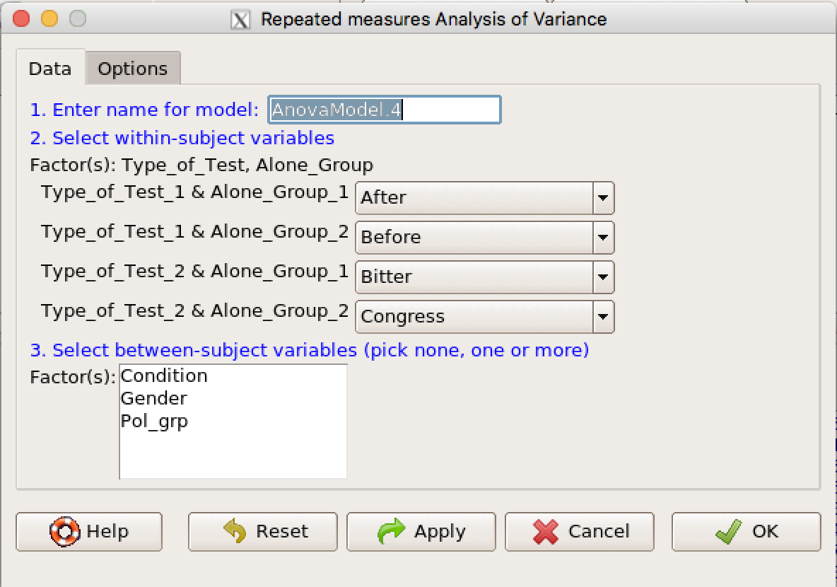
Repeated Measures Factorial ANOVA
Ignore #1.
Use the drop-down menu in #2 (purple arrow) to enter your variables.
Enter between subjects IV in #3 if applicable.
Click OK.

