Slide 1
Analyzing Data
A user’s guide

Slide 2
Data analysis programs
R
  if you know what you are doing…not recommended
SPSS
  I can help you with this one…but not available on your own computer
RCommander!!!
  We LOVE IT!!!!

Slide 3
Status of your data
Cleaned
Coded
Formatted properly
In Excel

Slide 4
Downloading Rcommander
(skip if it’s still on your computer from Stats)
Go to the course schedule page
Click the link that says ‘Analysis Materials’
Download the word document for Installing RCommander.
  Choose the right operating system: Windows or Mac

Slide 5

Starting up RCommander
Go to wherever your programs are located
Start up R
Type: library(Rcmdr)

Slide 6
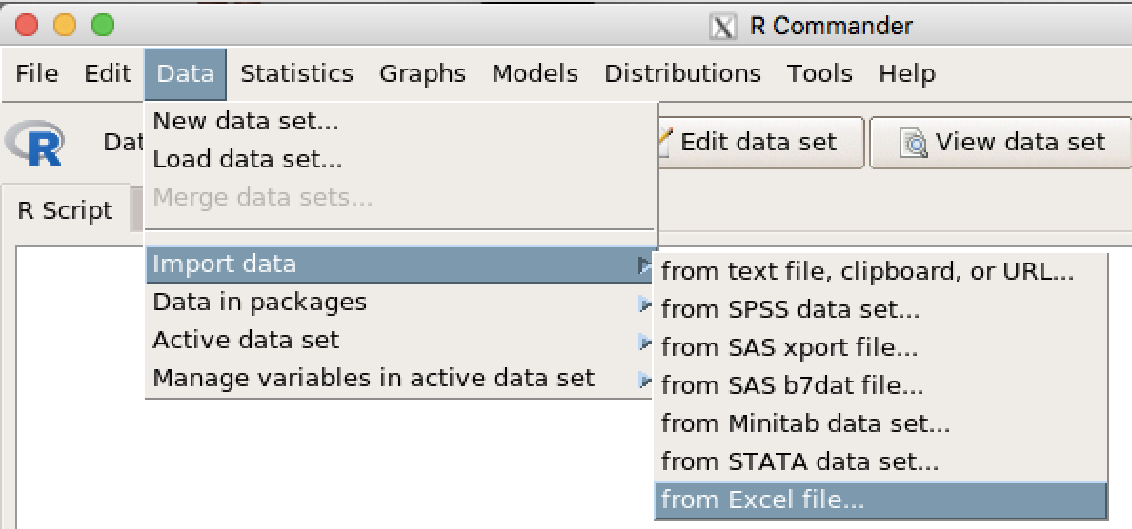
Importing your Excel file into RC

Slide 7
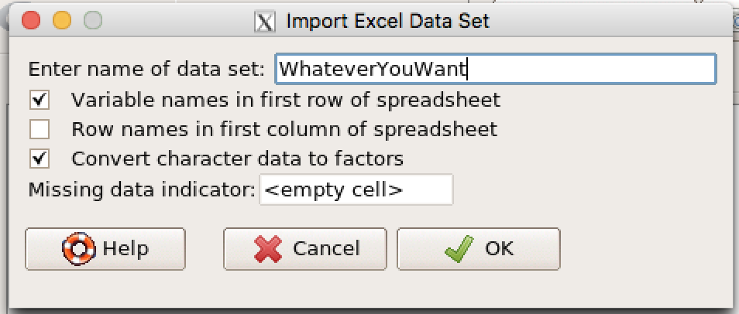
Importing your Excel file into RC
Name the data set WhateverYouWant
Click OK

Slide 8
Importing your data into RCommander

Slide 9
Saving your RC Dataset
This is the MOST IMPORTANT thing you will ever do in your life.

Slide 10
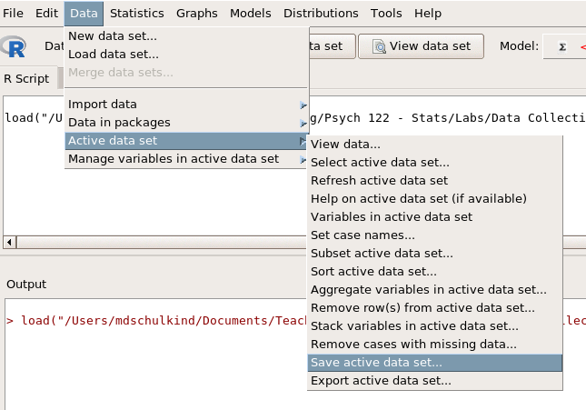
Saving your RC Dataset
Navigate to an appropriate location
Name the data set WhateverYouWant
Click OK

Slide 11
Saving your RC Dataset

Slide 12
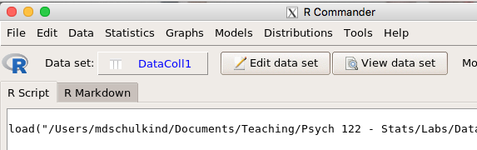
Viewing your RC Dataset
Are all of your variables included?
Are all of your variables labeled properly?
Are all of your subjects included?

Slide 13
Viewing your RC Dataset

Slide 14

Now you are ready to analyze your data

Slide 15

Now you are ready to analyze your data
Whomp-Whomp

Slide 16

Now you are ready to analyze your data

Slide 17
Components of an Analysis Plan
A list of the questions you want to address
  E.G.: Did type of high school influence creativity?
A specification of the Independent and Dependent variables (or predictors and dependent variables).
  IV = Type of high school
  DV = Creativity scores
What kind of analysis you are doing
  T-test? ANOVA? Correlation? Regression?
  Make your best guess…then I will help you.

Slide 18
Links for conducting different analyses in RC
Finding Means and Standard Deviations – Go!
Independent samples t-test – Go!
Paired samples t-test – Go!
One-way ANOVA (RM ANOVA) – Go!
Two-Way ANOVA (RM Two-Way ANOVA) – Go!
Correlation – Go!
Regression – Go!

Slide 19
Links for conducting different analyses in RC
Finding Means and Standard Deviations – Go!
Independent samples t-test – Go!
Paired samples t-test – Go!
One-way ANOVA (RM ANOVA) – Go!
Two-Way ANOVA (RM Two-Way ANOVA) – Go!
Correlation – Go!
Regression – Go!

Slide 20
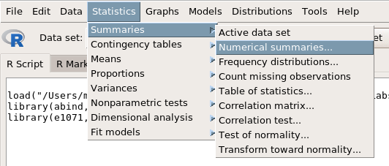
Means and Standard Deviations

Slide 21
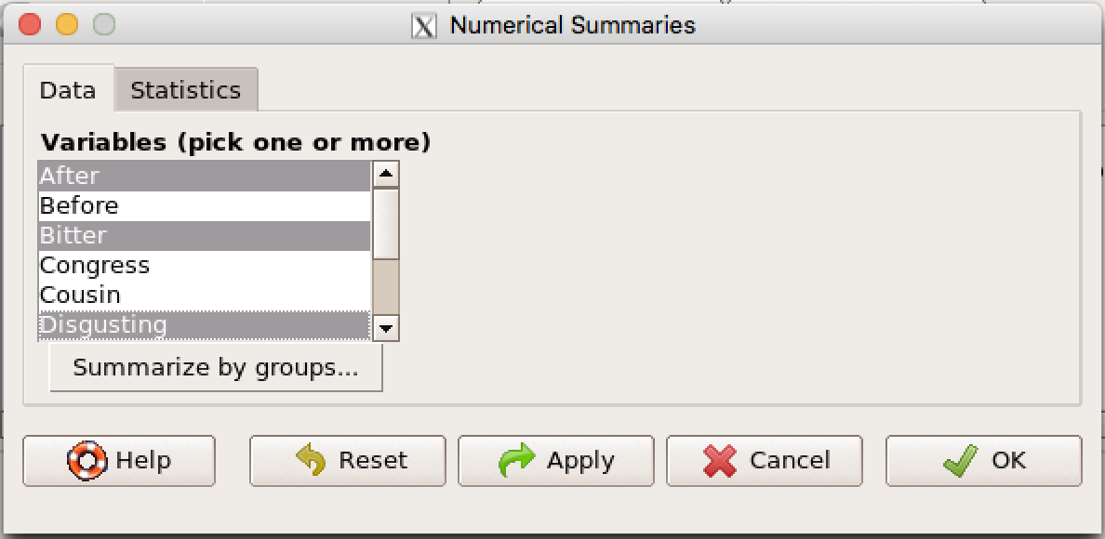
Means and Standard Deviations
Select the variable(s) of interest.
Use the Control button to select multiple variables
Click the ’Statistics’ tab

Slide 22
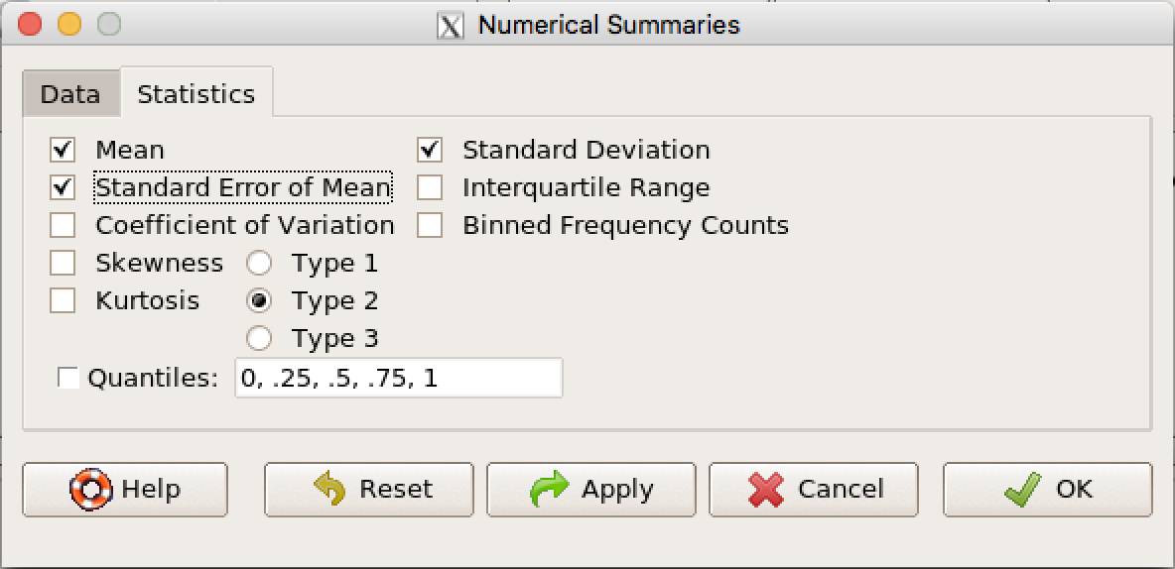
Means and Standard Deviations
Select the statistic(s) of interest.
Click OK

Slide 23
Links for conducting different analyses in RC
Finding Means and Standard Deviations – Go!
Independent samples t-test – Go!
Paired samples t-test – Go!
One-way ANOVA (RM ANOVA) – Go!
Two-Way ANOVA (RM Two-Way ANOVA) – Go!
Correlation – Go!
Regression – Go!

Slide 24
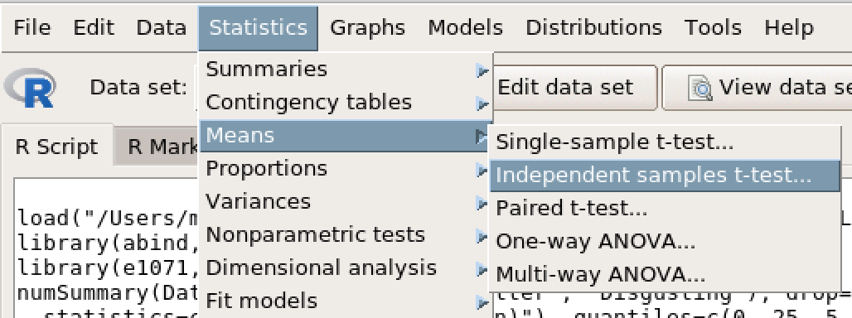
Independent Samples t-test

Slide 25
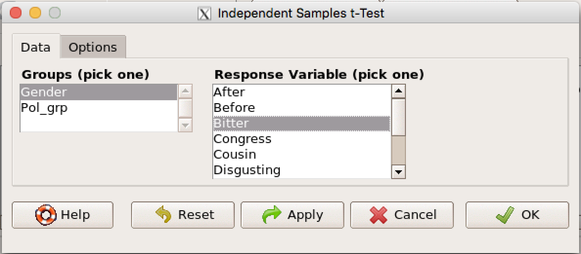
Independent Samples t-test
Select your IV (blue rectangle)
Select your DV (red rectangle)
Click the ‘Options’ tab (purple arrow)

Slide 26
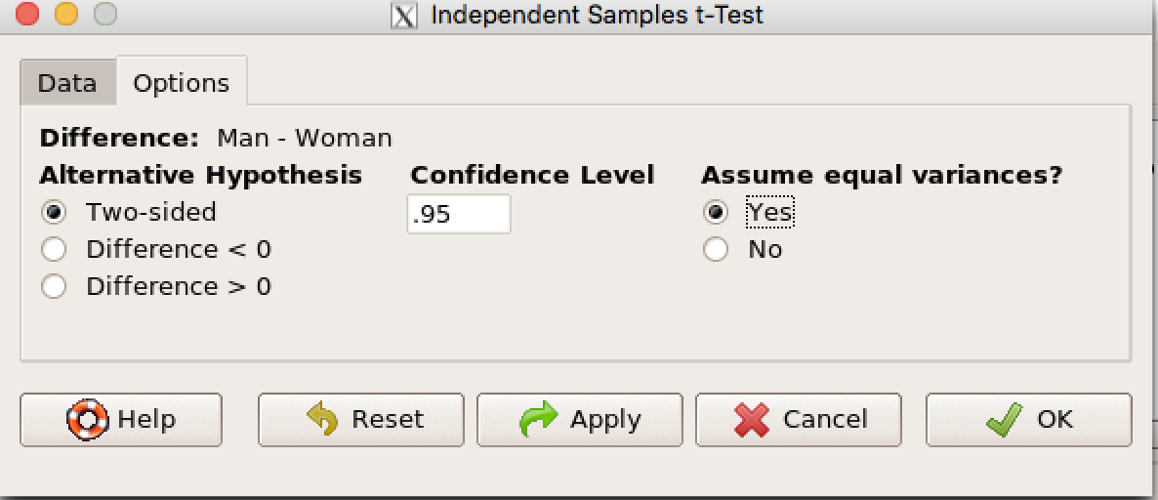
Independent Samples t-test
Check ‘Yes’ under ‘Assume equal variances.
Click OK.

Slide 27
Links for conducting different analyses in RC
Finding Means and Standard Deviations – Go!
Independent samples t-test – Go!
Paired samples t-test – Go!
One-way ANOVA (RM ANOVA) – Go!
Two-Way ANOVA (RM Two-Way ANOVA) – Go!
Correlation – Go!
Regression – Go!

Slide 28
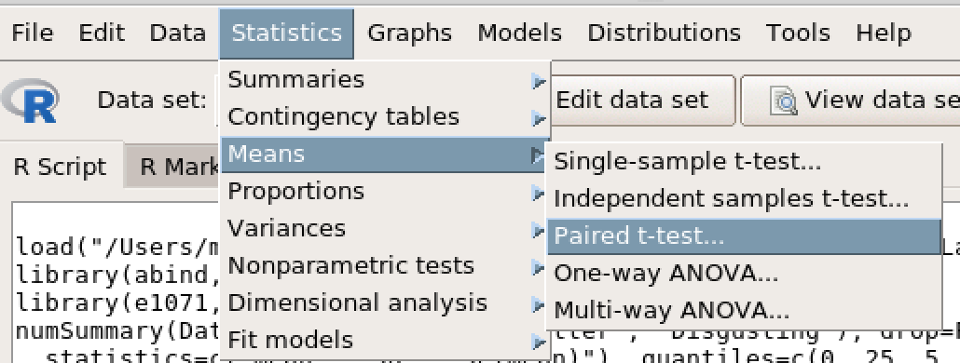
Paired Samples t-test

Slide 29
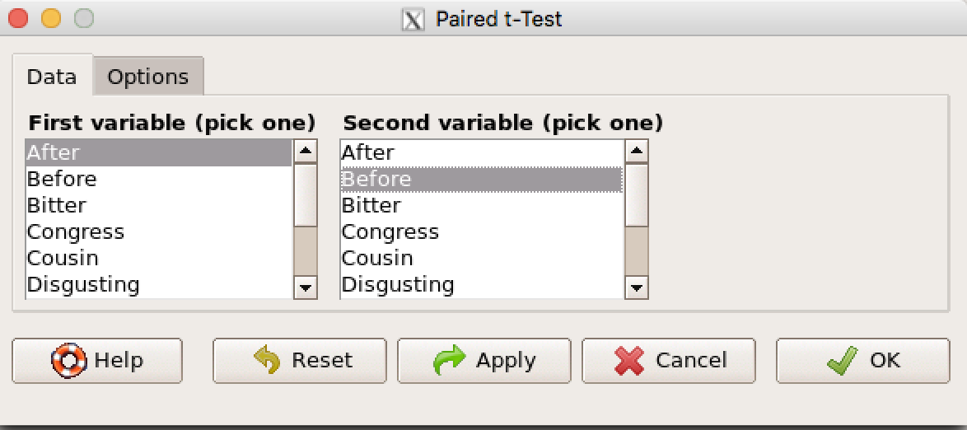
Paired Samples t-test
Choose the two variables you wish to compare.
Click OK.

Slide 30
Links for conducting different analyses in RC
Finding Means and Standard Deviations – Go!
Independent samples t-test – Go!
Paired samples t-test – Go!
One-way ANOVA (RM ANOVA) – Go!
Two-Way ANOVA (RM Two-Way ANOVA) – Go!
Correlation – Go!
Regression – Go!

Slide 31
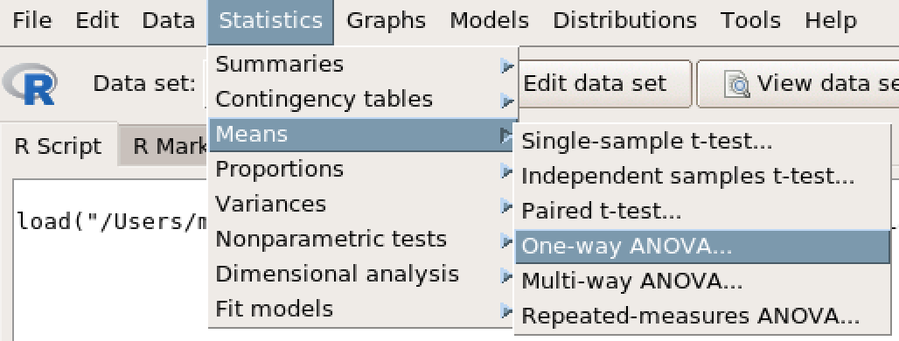
One-Way ANOVA

Slide 32
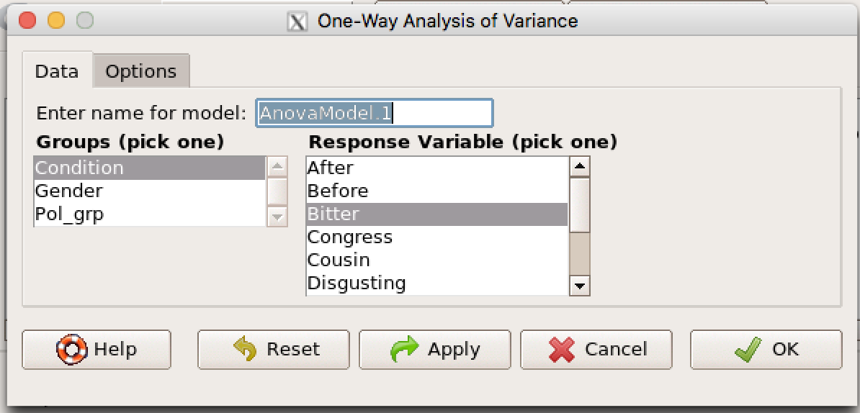
One-Way ANOVA
Select your IV (blue rectangle)
Select your DV (red rectangle)
Click the ‘Options’ tab (purple arrow)

Slide 33
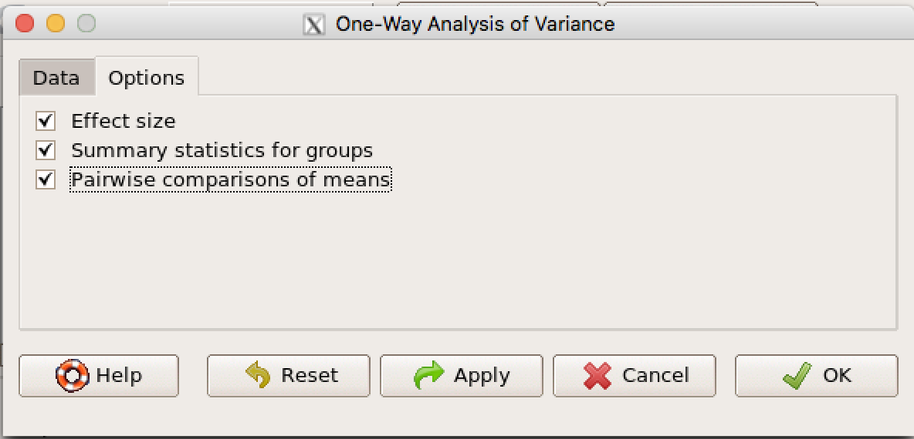
One-Way ANOVA
Check all three check boxes.
Click OK.

Slide 34
Links for conducting different analyses in RC
Finding Means and Standard Deviations – Go!
Independent samples t-test – Go!
Paired samples t-test – Go!
One-way ANOVA (RM ANOVA) – Go!
Two-Way ANOVA (RM Two-Way ANOVA) – Go!
Correlation – Go!
Regression – Go!

Slide 35
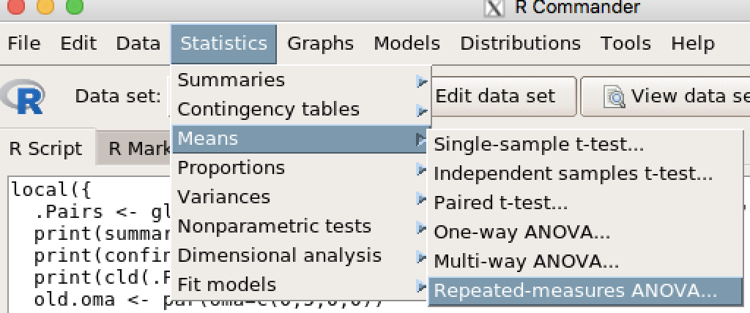
Repeated Measures ANOVA

Slide 36
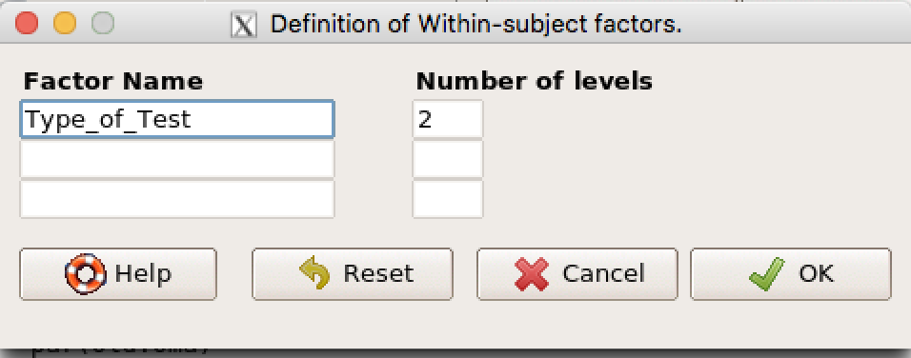
Repeated Measures ANOVA
Enter the name of your IV (e.g., Type_of_test if comparing Convergent and Divergent test.
Enter the number of levels (e.g., 2)
Click OK.

Slide 37
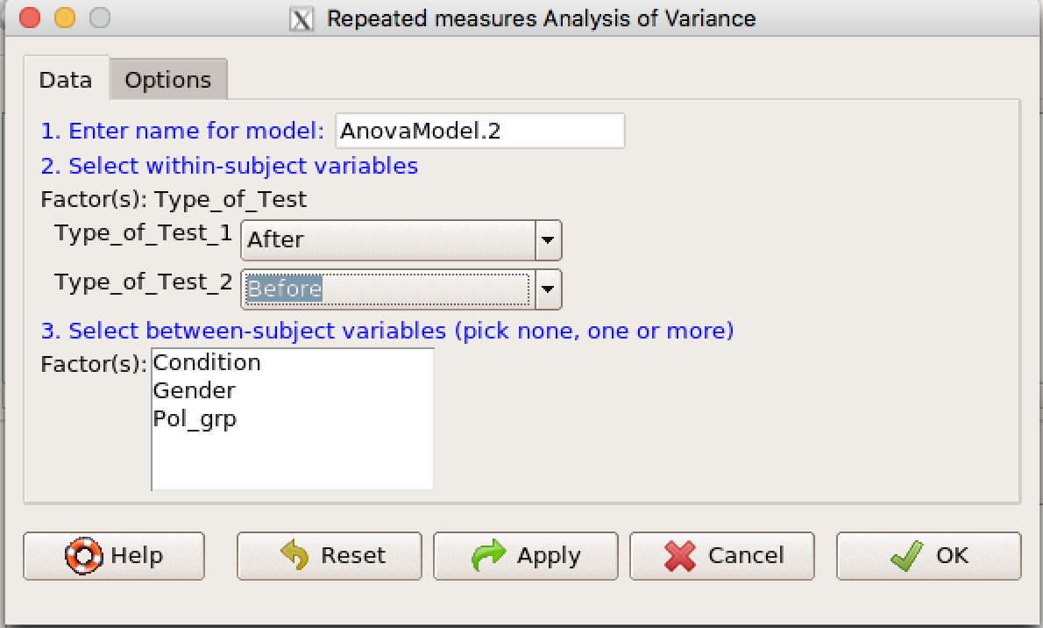
Repeated Measures ANOVA
Ignore #1 and #3.
Use the drop-down menu in #2 (purple arrow) to enter your variables (After and Before in this case).
Click OK.

Slide 38
Links for conducting different analyses in RC
Finding Means and Standard Deviations – Go!
Independent samples t-test – Go!
Paired samples t-test – Go!
One-way ANOVA (RM ANOVA) – Go!
Two-Way ANOVA (RM Two-Way ANOVA) – Go!
Correlation – Go!
Regression – Go!

Slide 39
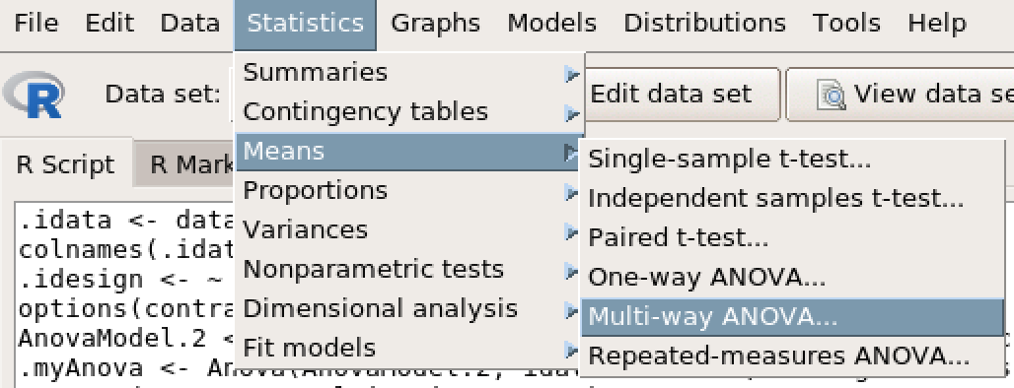
Two-Way ANOVA

Slide 40
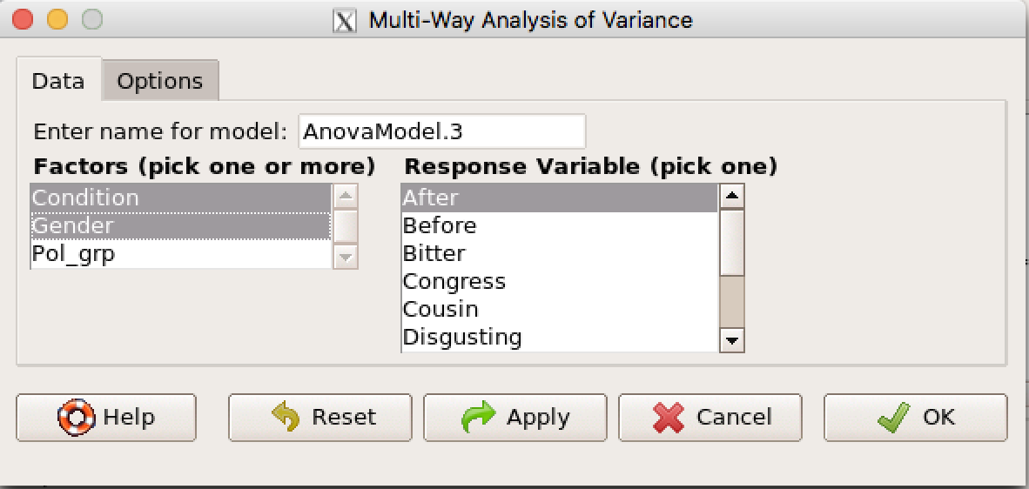
One-Way ANOVA
Select your two IVs (blue rectangle)
Select your DV (red rectangle)
Click the ‘Options’ tab (purple arrow)

Slide 41
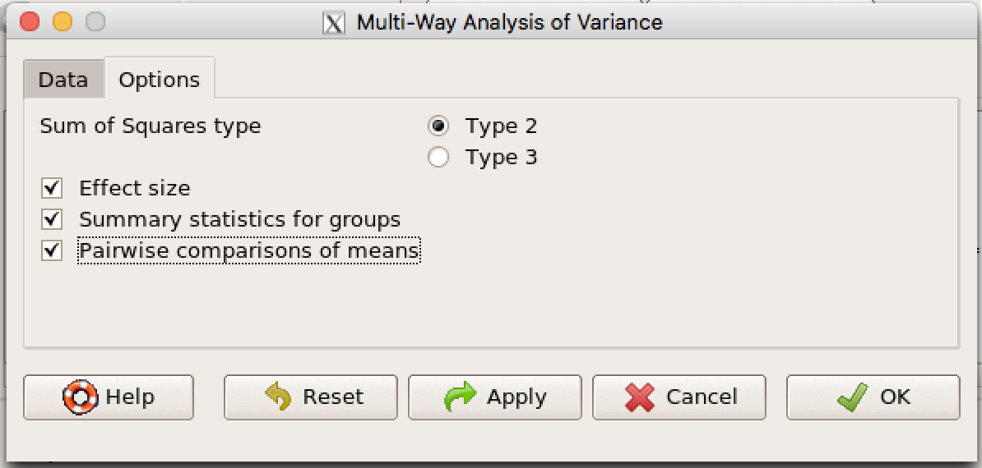
Two-Way ANOVA
Check all three check boxes (red rectangle)
Leave Type 2 checked (purple arrow)
Click OK.

Slide 42
Links for conducting different analyses in RC
Finding Means and Standard Deviations – Go!
Independent samples t-test – Go!
Paired samples t-test – Go!
One-way ANOVA (RM ANOVA) – Go!
Two-Way ANOVA (RM Two-Way ANOVA) – Go!
Correlation – Go!
Regression – Go!

Slide 43
Repeated Measures Two-Way ANOVA

Slide 44
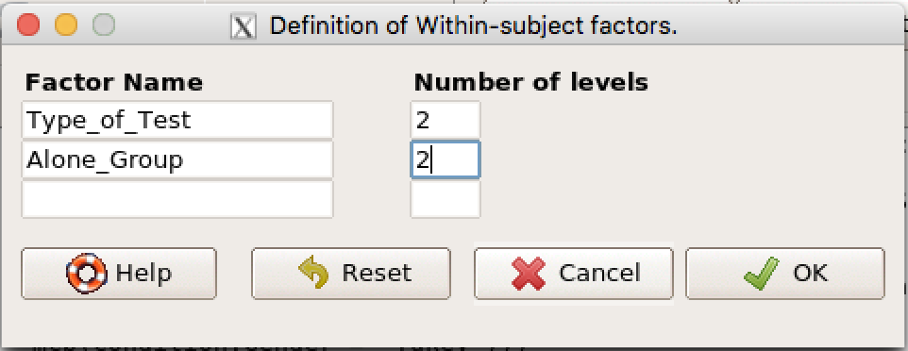
Repeated Measures ANOVA
Enter the name of your IVs (e.g., Type_of_test and Alone_Group)
Enter the number of levels (e.g., 2)
Click OK.

Slide 45
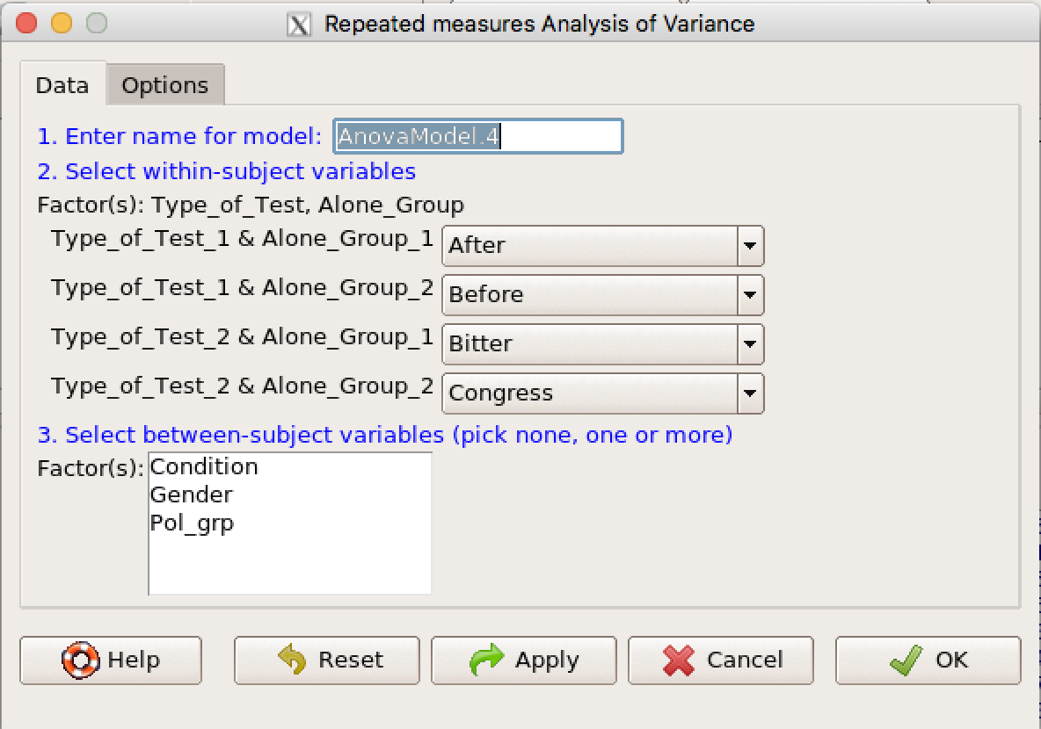
Repeated Measures ANOVA
Ignore #1.
Use the drop-down menu in #2 (purple arrow) to enter your variables.
Enter between subjects IV in #3 if applicable.
Click OK.

Slide 46
Links for conducting different analyses in RC
Finding Means and Standard Deviations – Go!
Independent samples t-test – Go!
Paired samples t-test – Go!
One-way ANOVA (RM ANOVA) – Go!
Two-Way ANOVA (RM Two-Way ANOVA) – Go!
Correlation – Go!
Regression – Go!

Slide 47
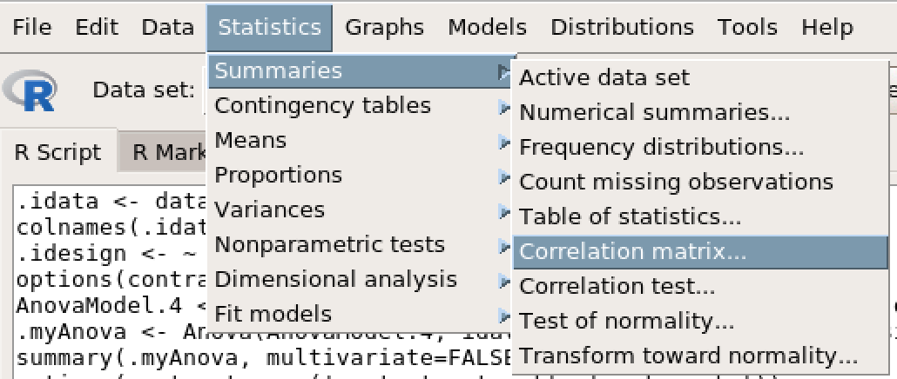
Correlation

Slide 48
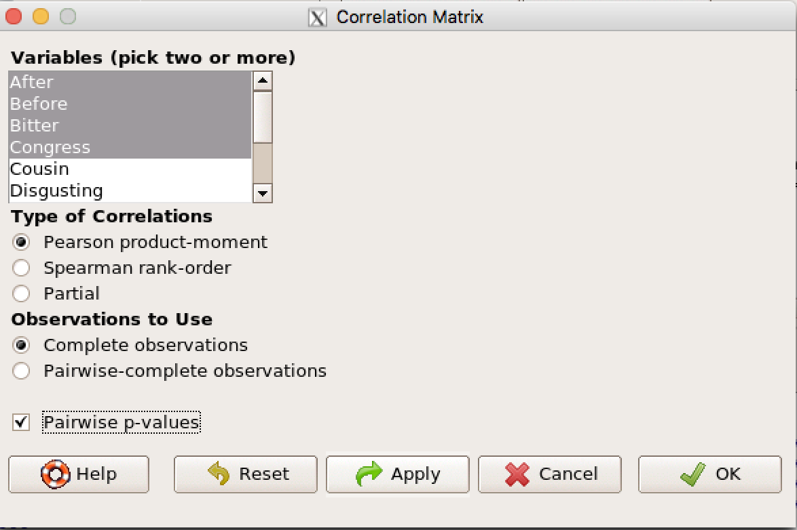
Correlation
Select variables of interest (red rectangle)
Click Pairwise p-values (purple arrow)
Click OK.

Slide 49
Links for conducting different analyses in RC
Finding Means and Standard Deviations – Go!
Independent samples t-test – Go!
Paired samples t-test – Go!
One-way ANOVA (RM ANOVA) – Go!
Two-Way ANOVA (RM Two-Way ANOVA) – Go!
Correlation – Go!
Regression – Go!

Slide 50
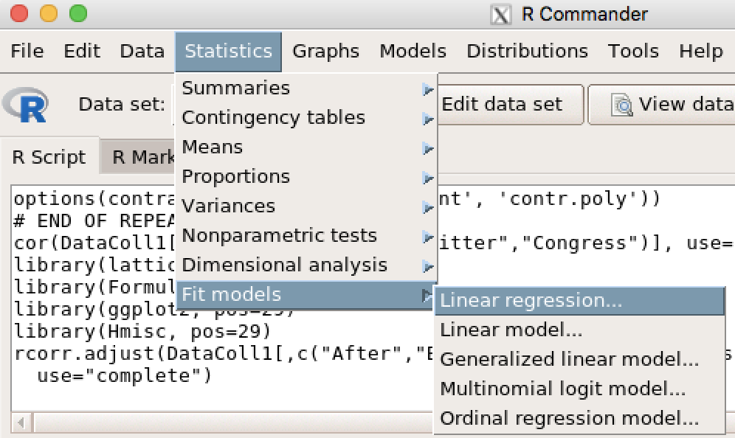
Regression

Slide 51
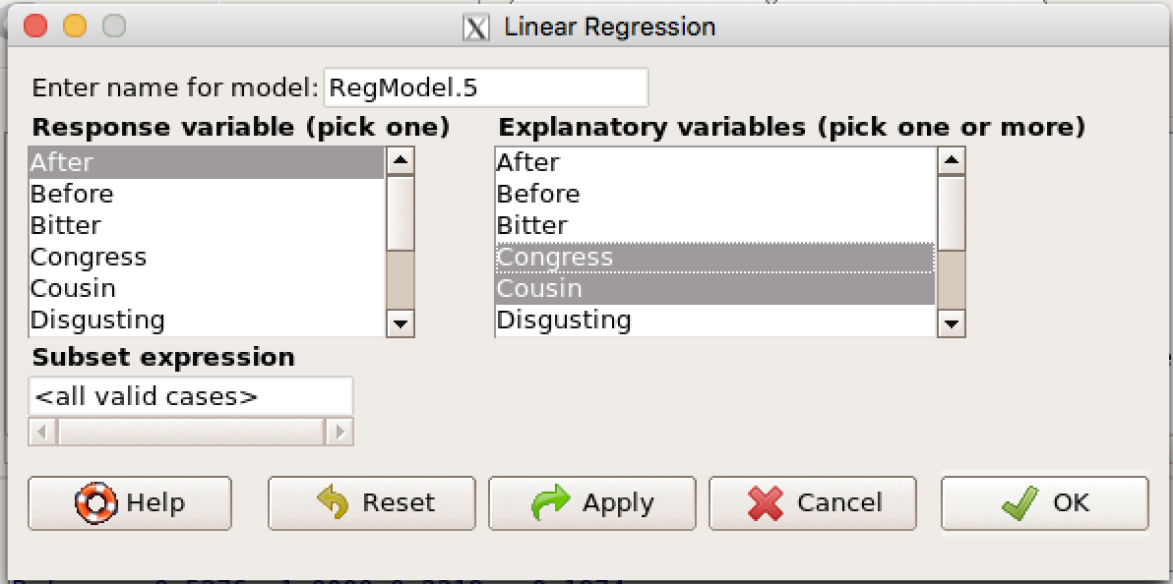
Regression
Select your DV (red rectangle)
Select one or more IVs (blue rectangle)
Click OK.

