Slide 1

Searching the Literature
Helpful guidance from an old friend

Slide 2

What is PsycInfo?
It’s kind of like Google, but without all of the fun stuff!!!
Just Psychology articles
You can search by
Key words,
Authors’ names,
Titles
Journal Name

Slide 3

How do I find PsycInfo?
Here is a link to PsychInfo:
https://libguides.amherst.edu/az/databases?a=p
Or…go to library (amherst.edu/library)
Click ‘Find and Borrow’
Then click ‘A-Z Databases’
Then click on the letter ‘P’
Then scroll down to ‘PsycInfo’
Note below is something called ‘PsycTests’
Good resource for finding creativity measures

Slide 4
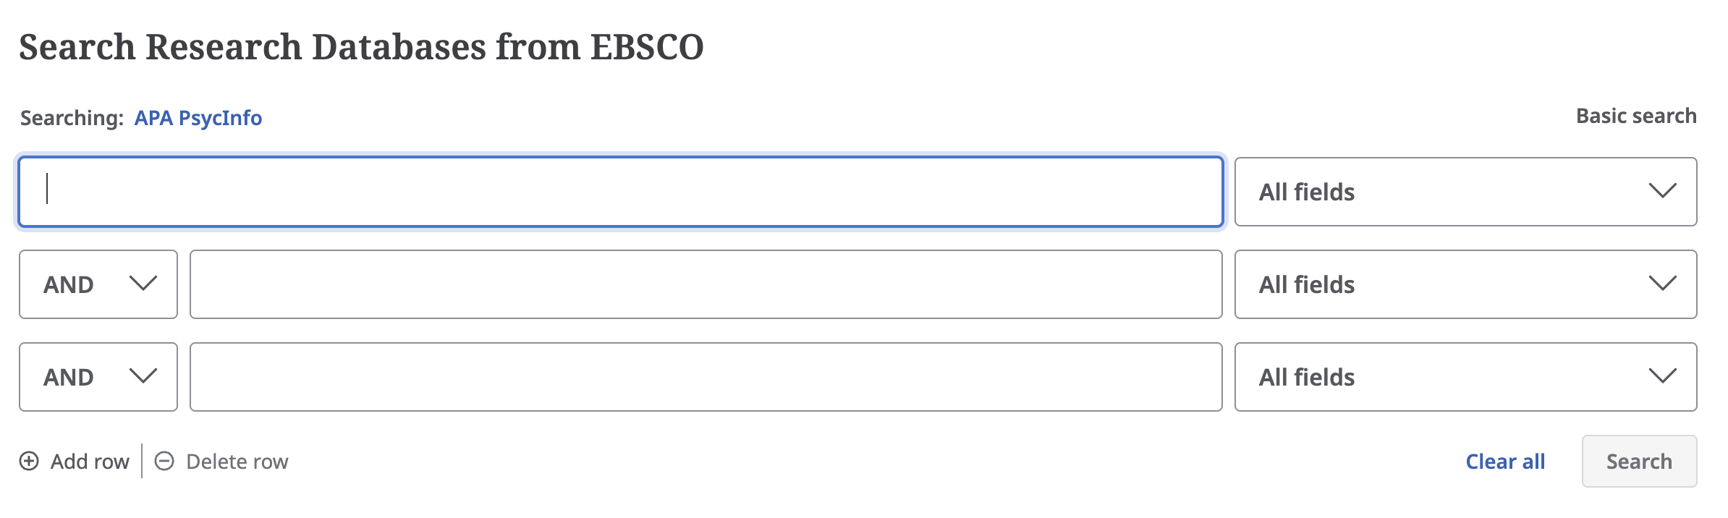
What does PsycInfo look like?

Slide 5
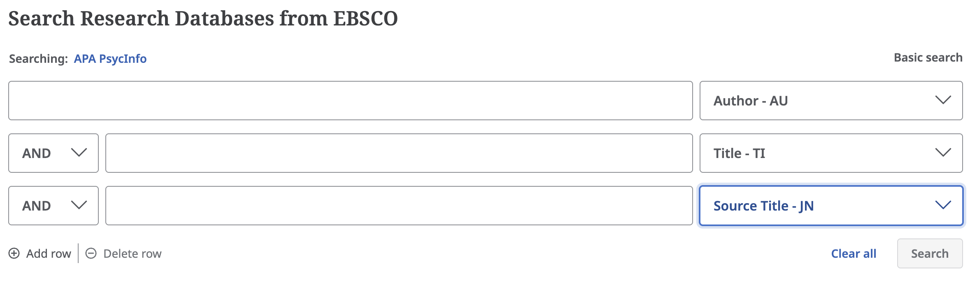
What does PsycInfo look like?

Slide 6
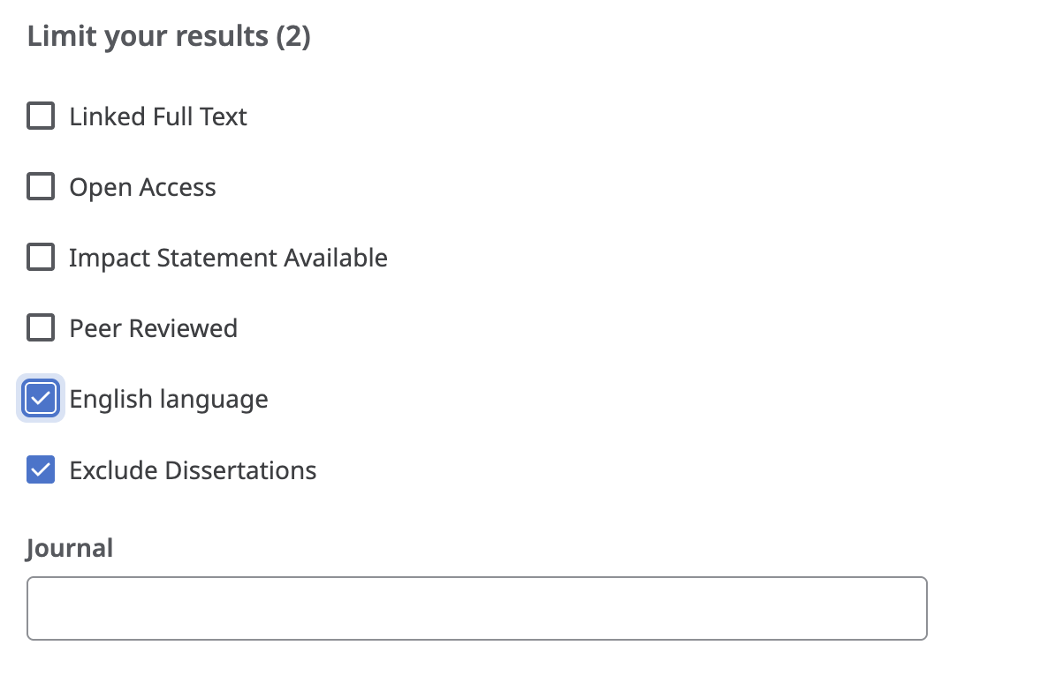
Usefuil filters

Slide 7
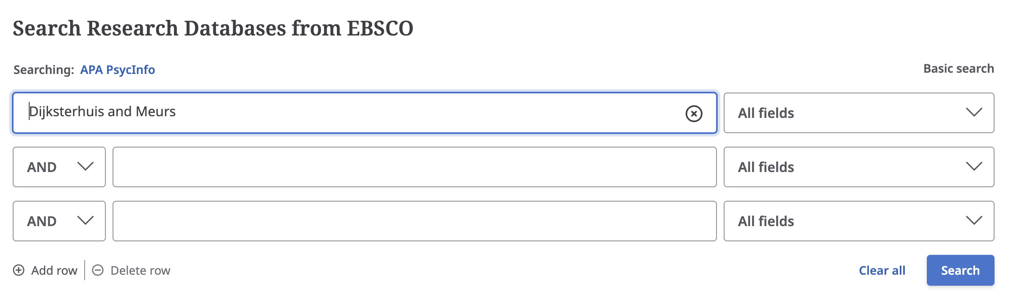
Let’s do a search…

Slide 8
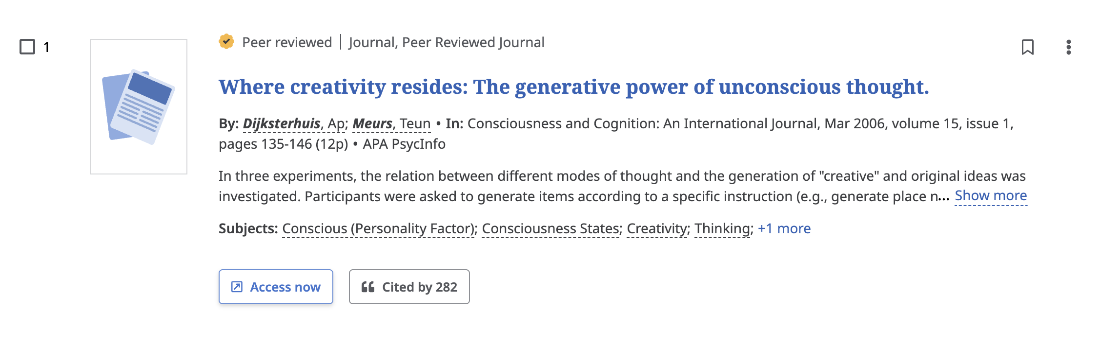
Let’s do a search…

Slide 9
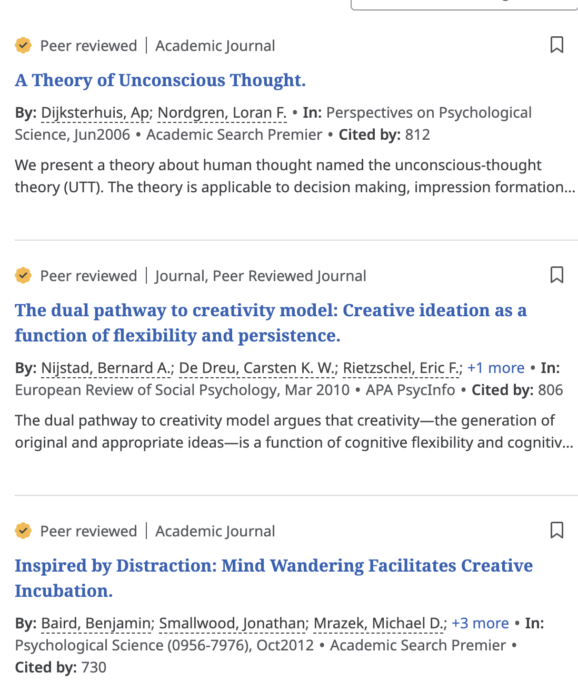
Let’s do a search…

Slide 10
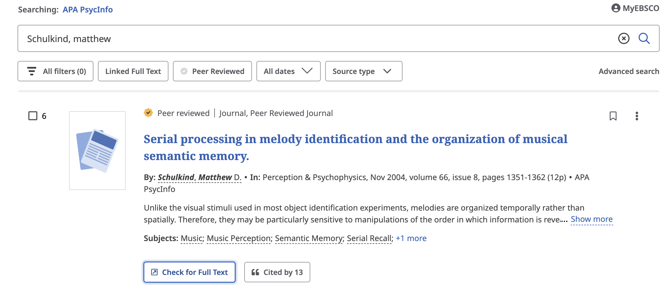
Let’s do another search…
Notes:
If you think John Irving is bad….you do NOT want to read this!!!!

Slide 11
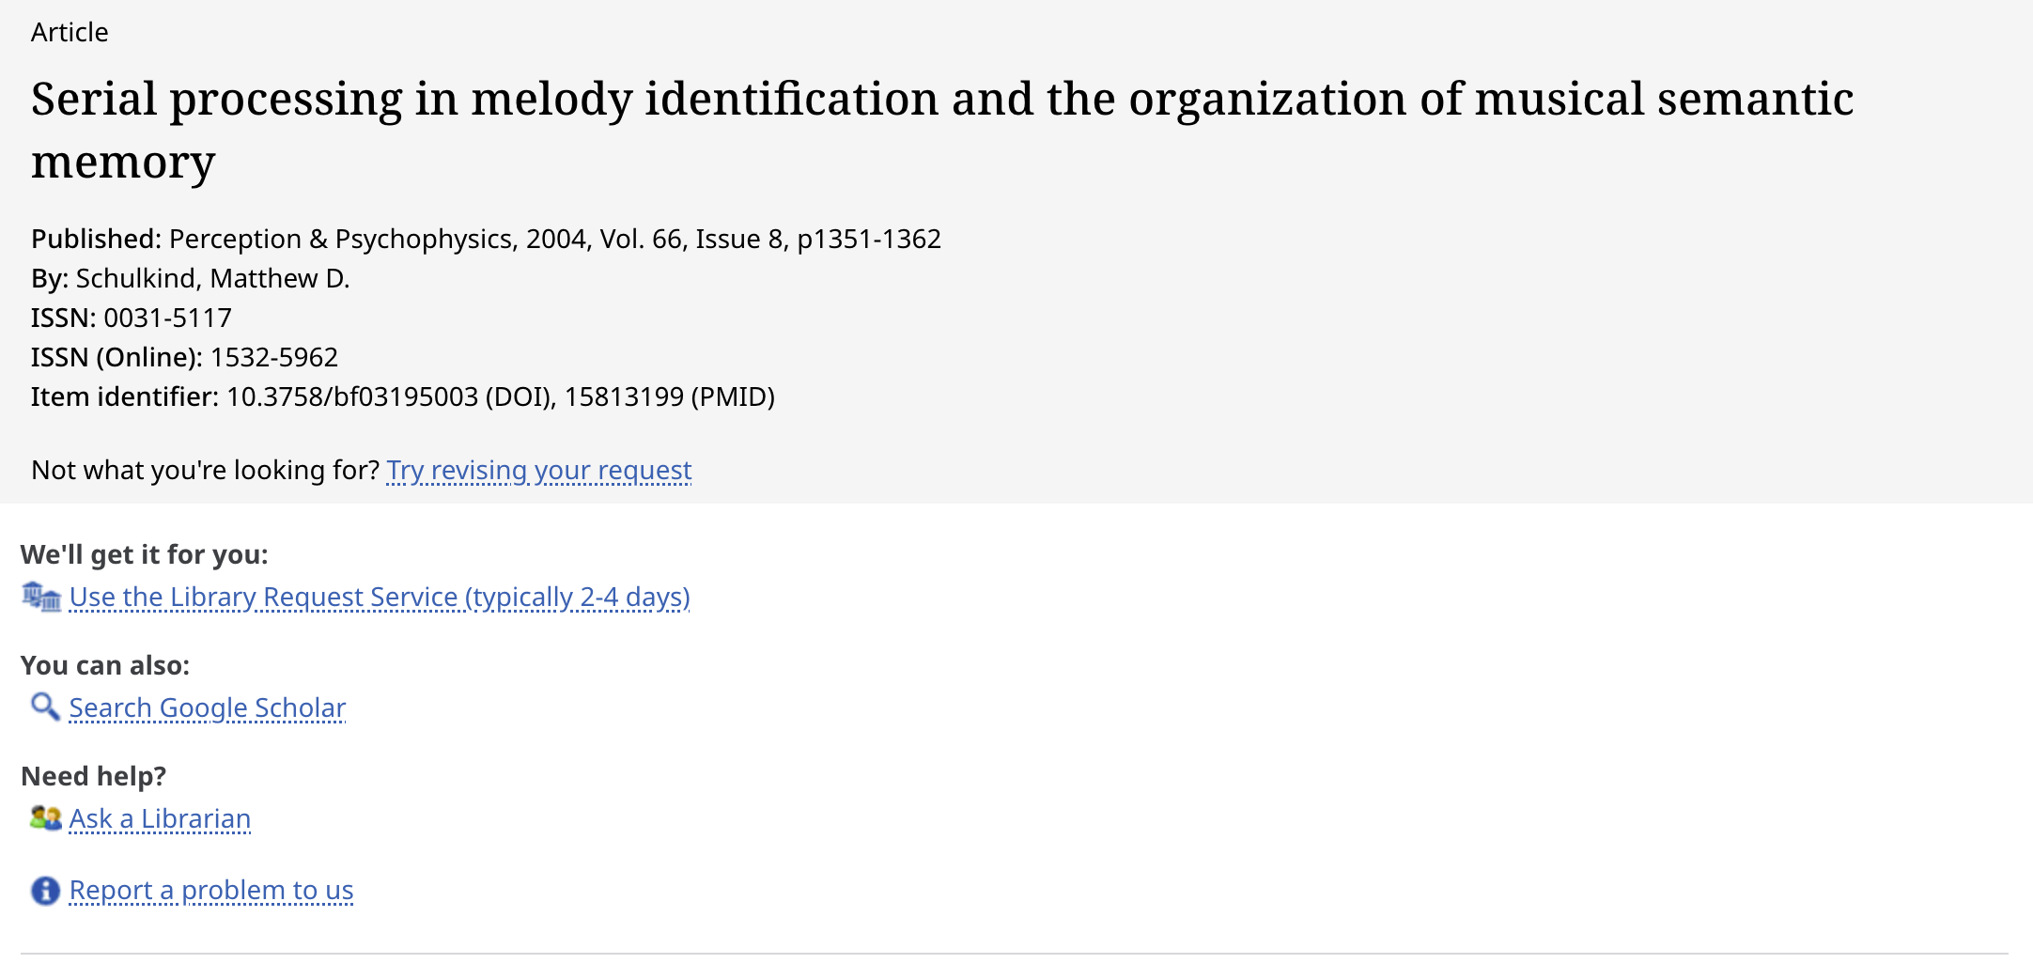
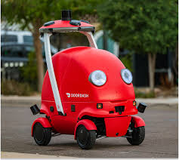
Interlibrary Loan: Dead Useful!
Notes:
The Magic Internet Bunnies populate the information and all you have to do is click submit.

Slide 12



Lit search: things to avoid
Dissertations
Journals with lots of adjectives
Online only sources
Open Access (generally a good thing)
Notes:
If dissertations are not subsequently published…there is usually a reason. AVOID!
More adjectives generally means less prestigious…less rigorous
Online only sources….AVOID. No vetting. No peer review. AVOID!

Slide 13
Lit Search: Hunger Games
Dissertations
Journals with lots of adjectives
Online only sources
Open Access (generally a good thing)
Notes:
If dissertations are not subsequently published…there is usually a reason. AVOID!
More adjectives generally means less prestigious…less rigorous
Online only sources….AVOID. No vetting. No peer review. AVOID!

Slide 14

PsycInfo Tutorial

Slide 15
Citing Authors Works
When you talk about the work of other people, it is imperative that you cite their contribution to your paper, both in the text and in the reference section.
There are two different sets of rules for doing so.

Slide 16
Citing Authors Works in the TExt
Use the word “and” between author names in a sentence, but use the ampersand symbol (“&”) when listing authors inside parentheses.
Include the year of publication.
Follow these examples:
Smith and Jones (1998) surveyed college students and found that....
Other researchers (Reddy, & Smits, 1970; Zucher & Bates, 1968) found...

Slide 17
Citing Authors Works in the TExt
If you cite a paper with three or more authors use only the last name of the first author, followed by et al. and the year of publication (e.g.: Doe et al., 1970).
When listing multiple citations in parentheses, list them in alphabetical order by 1st author.
Other researchers (Reddy, & Smits, 1970; Zucher & Bates, 1968) found...

Slide 18
Citing Authors Works in the TExt
DO NOT INCLUDE ANY INFORMATION OTHER THAN THE AUTHORS’ LAST NAMES AND the YEAR OF PUBLICATION IN THE TEXT. That means:
No first names
No titles
No college or university affiliation
What NOT to do: In 1970, Jane Doe and some of her buddies at Harvard wrote a paper called, ‘My friends and I did an experiment: gotta get paid’ that examined the question of…

Slide 19
Citing Authors Works in the TExt
DO NOT INCLUDE ANY INFORMATION OTHER THAN THE AUTHORS’ LAST NAMES AND the YEAR OF PUBLICATION IN THE TEXT. That means:
No first names
No titles
No college or university affiliation
Instead: In 1970, Jane Doe (1970) and some of her buddies at Harvard wrote a paper called, ‘My friends and I did an experiment: gotta get paid’ that examined whether…

Slide 20
References Format: Journal Article
Journal article: authors, year, title, journal, journal number, pages
Peretz, I., Kolinsky, R., Tramo, M., Labrecque, R. Hublet, C., Demeurisse, G., & Belleville, S. (1994). Functional dissociation following bilateral lesion of auditory cortex. Brain, 117, 1283-1301.

Slide 21
References Format: Book
Book: authors, year, title, publication location: publishing company
Willingham, W.W., & Cole, N.S. (1997). Gender and Fair Assessment. NJ: Lawrence Erlbaum Associates.

Slide 22
References Format: Book Chapter
Book chapter : authors, year, chapter title, book editors, book title, publication location: publishing company
Sternberg, R. J. & Kaufman, J.C. (2018). The big questions in the field of creativity: now and tomorrow. In R. Sternberg and J. Kaufman (Eds.), The nature of Human Creativity. Cambridge University Press: Cambridge, UK.

Slide 23
References format: Online Source
<AVOID>
Online material: Online material is difficult because there are so many variables depending on what is available. Here is a helpful blog post. If possible, provide: the author of the piece, the year of publication, the organization that published the piece, and the URL.
Lee, C. (2010). How to cite something you found on a website in APA style. American Psychological Association. Retrieved from https://blog.apastyle.org/apastyle/2010/11/how-to-cite-something-you-found-on-a-website-in-apa-style.html?_ga=2.225101402.1781300626.1557329041-500936420.1557329041.
<AVOID>

