Slide 1

What does this tell us about creativity?
Very, very important!!

Slide 2


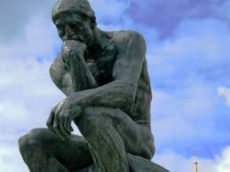
Why are we tackling this question now?
Notes:
Consistent issue last semester; couldn’t seem to solve it.
So, I decided to focus early and offer some practice.

Slide 3
What is the goal of doing research?
We are trying to identify some larger truth.
Three things can stand in the way of us discovering larger truths.
  Failure to find regularity in our data
  Fraud
  Regularities in our data defy theoretical explanation
Notes:
Replication crisis would be a good example. And that does not mean fraud. Fraud in some ways would be preferable becaue we would know that the initial results would be meaningless.

Slide 4
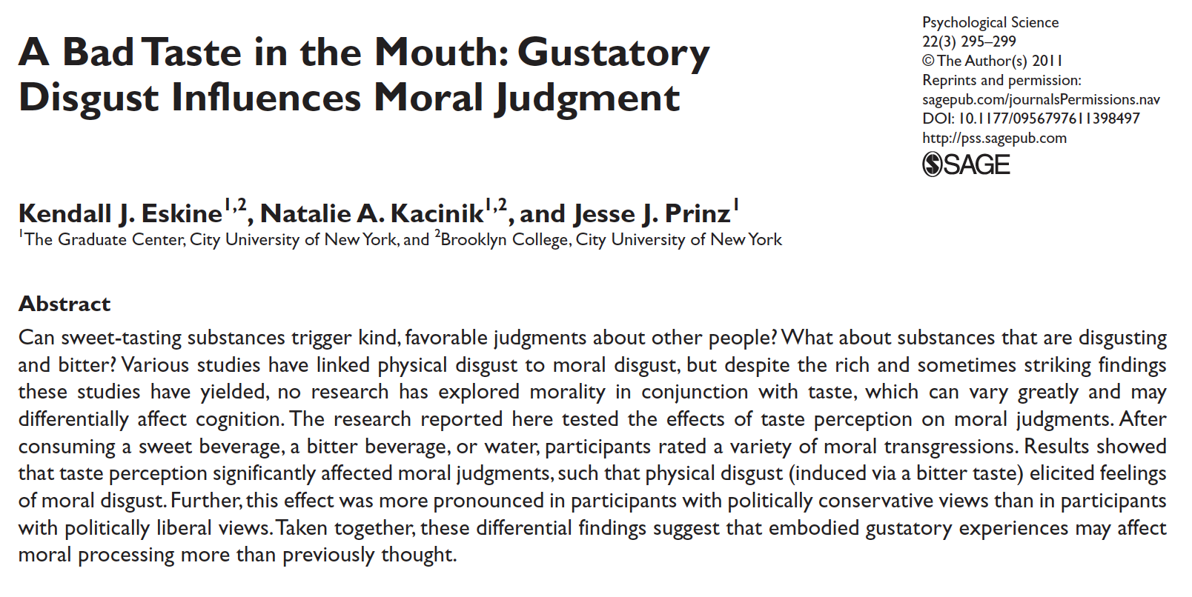
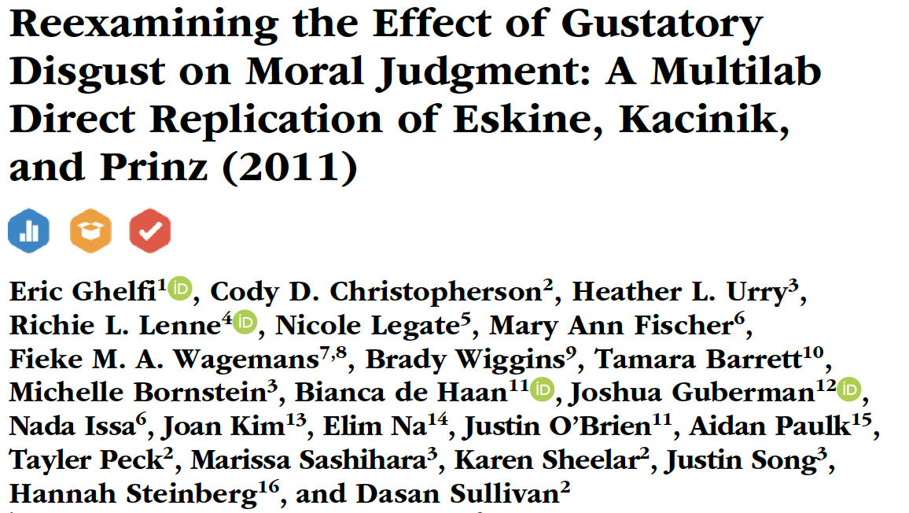
What is the goal of doing research?
Can anyone generate an example of failing to find regularity in the data?
  Not the same thing as ‘fraud’
  Fraud, in some limited ways, is probably preferable to failing to find regularity in the data
Notes:
Replication crisis would be a good example. And that does not mean fraud. Fraud in some ways would be preferable becaue we would know that the initial results would be meaningless.

Slide 5

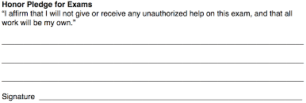

What is the goal of doing research?
Can anyone generate an example of research fraud?
  Fraud, in some limited ways, is probably preferable to failing to find regularity in the data
Notes:
Dan Ariely and Francesca Gino

Slide 6
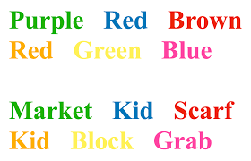
What is the goal of doing research?
Can anyone think of an example of regularity in the data defying explanation?
  Stroop Effect
  First published in 1935
  THOUSANDS of replications
  No consensus as to why it occurs
Notes:
1000s and 1000s of studies on the Stroop effect.
No consensus on why it occurs.

Slide 7

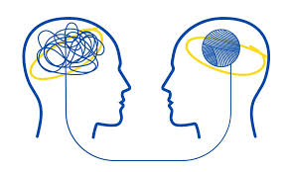
Two approaches to doing research
Be like astrophysics – gather centuries of data and only after having huge, huge sets of data, go about trying to make sense of those data
Be like Psychology – collect data and try to explain it, then collect some more data to evaluate our initial explanations.
Notes:
The ‘Psychology’ way is a little bit of the Fire…Aim…Ready problem that we talked about last week.
Astrophysics is actually super easy…if you can handle the math.

Slide 8

We are going to be Psychologists
Job 1: Choose one of the articles that we read thus far and try to figure out what it tells us about Creativity.
  That does not mean report back on the difference between the experimental groups
  Rather, report back what those differences mean!

Slide 9

We are going to be Psychologists
People who drank a bitter substance gave harsher morality ratings.
Morality judgments are not logical/cognitive. They are emotional
Notes:
Not just the people who drank a bitter substances gave harsher judgments of morality.
Important point is that it suggests that morality is not a cognitive judgment; it’s more emotional.

Slide 10
We are going to be Psychologists
People who drank a bitter substance gave harsher morality ratings.
Morality judgments are not logical/cognitive. They are emotional
Notes:
Not just the people who drank a bitter substances gave harsher judgments of morality.
Important point is that it suggests that morality is not a cognitive judgment; it’s more emotional.

Slide 11
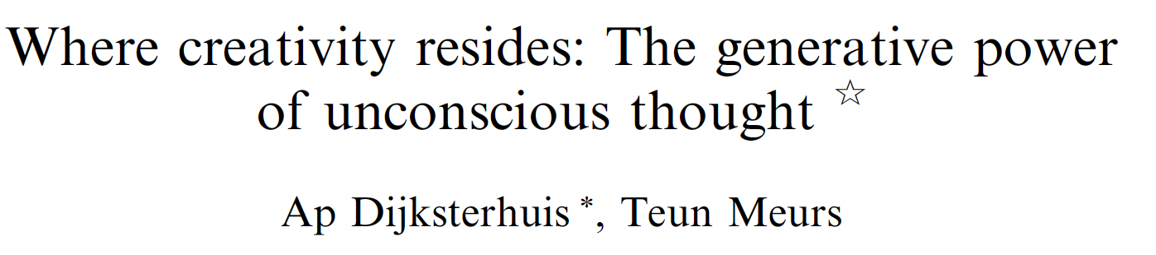
We are going to be Psychologists
Job 1: Choose one of the articles that we read thus far and try to figure out what it tells us about Creativity.
  That does not mean report back on the difference between the experimental groups
  Rather, report back what those differences mean!
Conscious thought yielded less creative responses than unconscious thought
What can we conclude from the difference between conscious and unconscious thought?

Slide 12


We are going to be Psychologists
Job 2: Sketch out an experiment that you think will build upon the results of the paper you chose.
  Again…it’s not about the groups in the experiment. It’s not about the methodology; that is secondary.
  What was the conclusion the authors drew and how can you design an experiment that would support or refute that interpretation.
Notes:
Athletes vs. NARPS.

Slide 13
Y’ALL are going to be Psychologists
Job 3: Sketch out a preliminary research hypothesis.
  Use your annotated bibliography as a starting point.
  What is an unanswered question / mystery that your review of the literature suggests.
  Your research hypothesis should include:
    The hypothesis, itself.
    The rationale for your hypothesis.
    An explanation of what examining your hypothesis will tell us about creativity.
Notes:
Athletes vs. NARPS.

Slide 14
Y’ALL are going to be Psychologists
Notes:
Athletes vs. NARPS.

Slide 15


Y’ALL are going to be Psychologists
Notes:
Athletes vs. NARPS.

Slide 16
Y’ALL are going to be Psychologists
Not enough to say
  Nature matters…..or
  Nurture matters…..or
  It’s a little of both.
Notes:
It’s not terrible, but we already know that.

Slide 17
Y’ALL are going to be Psychologists
Instead:
  Because the data are consistent with nurture, then X must be true about creativity.
  Because bitter drinks increased the harshness of morality judgments, morality judgments are more about emotion than cognition.
Notes:
I recognize that the form of the conclusion is similar for bitter drinks and nature vs. nurture. But bitter drinks digs a little deeper. Again, it's both nature and nurture are a platitude. Which aspects of cognition are tied to nature or nurture. and does that tell us something about the fundamental nature of creativity.

Slide 18
Research Hypothesis
In general, a research hypothesis can be thought of as a statement about the (expected) relationship between two variables: an independent or predictor variable and a dependent variable.
Will relevant domain knowledge increase or decrease creativity?
Will getting baked increase creativity via increased mood or will it only affect perceptions of creativity?
Will focused or diffuse attention influence creativity?
Notes:
What are the IVs and DVs in each of these examples?

Slide 19
Research Hypothesis
For this assignment, I am going to ask you to create a research hypothesis that you think has the potential to form the basis for the experimental project that you conduct across the semester.

Slide 20
Research Hypothesis: From whence?
Two sources:
  Experience of the world

Slide 21
Research Hypothesis: From whence?
Two sources:
  Experience of the world
  Careful read of the Literature
    Draw on your annotated bibliography
    What were the hypotheses of the papers you read?
    Can you identify disagreements or inconsistencies that you can resolve?
    Mechanism is an important consideration

Slide 22
Research Hypothesis: Key parts
The assignment should include the following components:
  The hypothesis itself; that is a statement of the sets of variables (independent and dependent) and how they will relate to each other.
  The rationale for your hypothesis. What is the basis for your predicted results? What is the mechanism? Must be based on what you have learned from the literature.
  An explanation for what examining your hypothesis will tell us about creativity

