Slide 1

Article Summaries
What’s that all about?

Slide 2

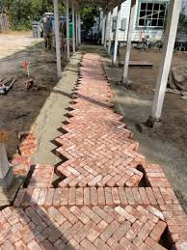
Why are article summaries important?
They are the basic building block of your Introduction.
Notes:
Big difference between introduction of your papers and introductions in journal articles that you read.

Slide 3



Can I just mimic journal articles?
They communicate your understanding of the literature.
Not just the conclusions drawn from the literature.
But what is the justification for those conclusions.
You demonstrating that you understand connection between methods, data, and the interpretation of those data.
Notes:
Big difference between introduction of your papers and introductions in journal articles that you read is that we trust Amabile and Dijksterhuis to know what they are talkinga bout. Lots of experience. You on the other hand, are a little green.

Slide 4

What do I want to avoid?
Notes:
Big difference between introduction of your papers and introductions in journal articles that you read.

Slide 5

Not Enough vs. Too Much
T
D
Notes:
Big difference between introduction of your papers and introductions in journal articles that you read.

Slide 6
4 Components of an article summary
Order | Critical Component | Typical Location
1 | What was the main research question? | Introduction
2 | What were the important elements of the experimental design? | Method
3 | What were the key findings of the experiment? | Results
4 | What do the results tell us about the research question that motivated the experiment? | Discussion
Notes:
Big difference between introduction of your papers and introductions in journal articles that you read.

Slide 7

Main Research question / Intro
Order | Critical Component | Typical Location
1 | What was the main research question? | Introduction
2 | What were the important elements of the experimental design? | Method
3 | What were the key findings of the experiment? | Results
4 | What do the results tell us about the research question that motivated the experiment? | Discussion
Notes:
Big difference between introduction of your papers and introductions in journal articles that you read.

Slide 8
Main Research Question / Intro
What was the question that motivated the experiment?
Empirical question
Theoretical question
Notes:
What does it tell us about creativity?
How will the experimental group perform vis a vis the control group?

Slide 9
Main Research Question / Intro
What was the question that motivated the experiment?
Empirical question – what are the differences between the groups?
Theoretical question – what are we trying to learn about creativity?
You are trying to present the latter more than the former.
Notes:
What does it tell us about creativity?
How will the experimental group perform vis a vis the control group?

Slide 10

Main Research Question / Intro
What was the question that motivated the experiment?
Notes:
Are creative / unusual responses more likely if attention is diffuse rather than concentrated?
Does unconscious thought promote creativity?

Slide 11
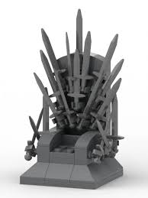
Experimental Design / Method
Order | Critical Component | Typical Location
1 | What was the main research question? | Introduction
2 | What were the important elements of the experimental design? | Method
3 | What were the key findings of the experiment? | Results
4 | What do the results tell us about the research question that motivated the experiment? | Discussion
Notes:
Big difference between introduction of your papers and introductions in journal articles that you read.

Slide 12
Experimental Design / Method
What were the important elements of the experimental design?
Notes:
What does it tell us about creativity?
How will the experimental group perform vis a vis the control group?

Slide 13
Experimental Design / Method
What were the important elements of the experimental design?
Not all of the elements.
You do not have to list the IVs and DVs, explicitly.
Rather, what distinguished the main groups of the experiment (IV)? (Physical Setting)
How was performance measured (DV)? (AUT)
Notes:
What does it tell us about creativity?
How will the experimental group perform vis a vis the control group?

Slide 14
Experimental Design / Method
What were the important elements of the experimental design?
Notes:
Two groups: one prompted and completed the task immediately.
One prompted and completely the task after generating potential responses.
One prompted but only responded after a distractor task.

Slide 15

Key Findings / Results
Order | Critical Component | Typical Location
1 | What was the main research question? | Introduction
2 | What were the important elements of the experimental design? | Method
3 | What were the key findings of the experiment? | Results
4 | What do the results tell us about the research question that motivated the experiment? | Discussion
Notes:
Big difference between introduction of your papers and introductions in journal articles that you read.

Slide 16
Key Findings / Results
What were the key findings of the experiment?
Notes:
What does it tell us about creativity?
How will the experimental group perform vis a vis the control group?

Slide 17
Key Findings / Results
What were the key findings of the experiment?
You don’t have to report every result.
Only those relevant to YOUR argument (not necessarily the authors’)
But…you can’t ignore relevant findings that are inconsistent with your argument. Be HONEST!!!
Notes:
Maybe the authors report on sex differences, but those sex differences are not relevant to your research question…you can leave that out.
But, you can’t

Slide 18
Key Findings / Results
What were the key findings of the experiment?
Notes:
More obscure city names were provided by the group that responded after the distractor task.
Fewer pasta names that ended in ‘I’, as well.

Slide 19

What it all means / Discussion
Order | Critical Component | Typical Location
1 | What was the main research question? | Introduction
2 | What were the important elements of the experimental design? | Method
3 | What were the key findings of the experiment? | Results
4 | What do the results tell us about the research question that motivated the experiment? | Discussion
Notes:
Big difference between introduction of your papers and introductions in journal articles that you read.

Slide 20
What it all means / Discussion
What do the results tell us about the research question that motivated the experiment?
Circling back to the Intro / opening sentences of the paragraph
There should have been an unsolved mystery in the opening sentences
How do the authors’ data address that question?
Could provide a similar answer as previous work
Could provide a different answer than previous work
Could fail to adequately address the question
Notes:
Maybe the authors report on sex differences, but those sex differences are not relevant to your research question…you can leave that out.
But, you can’t

Slide 21
What it all means / Discussion
What do the results tell us about the research question that motivated the experiment?
Notes:
These data are consistent with the idea that diffuse attention and/or incubation promote original ideas.

Slide 22

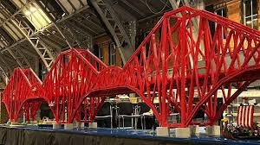
The next step:
Notes:
Big difference between introduction of your papers and introductions in journal articles that you read.

Slide 23

The next step: Building bridges between paragraphs
Notes:
Big difference between introduction of your papers and introductions in journal articles that you read.

Slide 24
The next step: What does a bridge actually look like?
These data are consistent with the idea that diffuse attention and/or incubation promote original ideas.
Crowley, et al. (2025) also found that diffuse attention also increased creative output.
However, not all researchers have reported similar findings regarding the relationship between diffuse attention and creativity. Donovan, et al. (2025) reported that…
Notes:
Big difference between introduction of your papers and introductions in journal articles that you read.

Slide 25

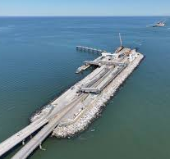



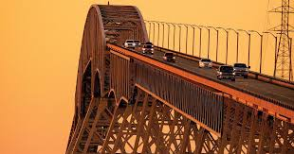
The next step: Warning: Dangerous Bridge
These data are consistent with the idea that diffuse attention and/or incubation promote original ideas.
Building off Dijksterhuis and Meurs (2016), Harrison, et al. (2025) conducted a study looking at…
Notes:
Big difference between introduction of your papers and introductions in journal articles that you read.

Slide 26


Sleep well, citizens of Amherst, TD will keep you safe
Notes:
Big difference between introduction of your papers and introductions in journal articles that you read.

Slide 27
I’m not the Professor y’all need. Nor the professor, y’all want. I’m the professor y’all deserve.
Notes:
Big difference between introduction of your papers and introductions in journal articles that you read.

